Slide 1

The Who, What, Where, Why, and How of the Long-Term Care Ombudsman Program
Notes:
This presentation provides a general overview of the Long-Term Care Ombudsman Program (LTCOP) highlighting the history, role and responsibilities of the program. Every state has a LTCOP, but each state operates their program differently. Therefore, this presentation will only address the program responsibilities required by federal law so the information is applicable in every state. At the conclusion of this presentation you should have an understanding about what the LTCOP does, who the program serves, and how to contact the program.

Slide 2
What is NORC?
Funded by the Administration on Aging/Administration for Community Living grant
Operated by the National Consumer Voice for Quality Long-Term Care (Consumer Voice) in cooperation with the National Association of States United for Aging and Disabilities (NASUAD)
Provides support, technical assistance, and training for state long-term care ombudsman programs and their program representatives:
  Information, consultation, and referral for Ombudsman programs
  Training and resources for state ombudsman programs and program representatives
  Promotes awareness of the role of the Ombudsman program
  Works to improve ombudsman skills, knowledge, and effectiveness in both program management and advocacy

Slide 3
What is the Long-Term Care Ombudsman Program (LTCOP)?
LTCOP representatives are resident-directed advocates.
LTCOPs advocate for quality of care and quality of life of residents in long-term care (nursing homes, board and care/assisted living, other similar adult care facilities).
LTCOP provisions in the Older Americans Act (OAA) include:
  Investigate and resolve complaints
  Provide information to residents, families, staff (e.g. residents’ rights)
  Advocate for systemic changes to improve residents’ care and quality of life.
Notes:
First and foremost, the LTCOP advocates for the quality of life and care of residents in nursing homes, board and care/assisted living, and other similar adult care homes, and is a resident advocate.

Slide 4
History of the LTCOP
1978
Older Americans Act (OAA) amendments required all states to establish an Ombudsman Program
1981
Duties expanded to board and care homes (e.g., Assisted Living Facilities)
1987
LTCOP access to resident records (with resident consent)
2015
Final Regulations for the LTCOP were published in the Federal Register on February 11, 2015
2016
Program designed to be a local, community program utilizing volunteers
Name changed from Nursing Home Ombudsman Program to Long-Term Care Ombudsman Program (LTCOP)
States must prohibit willful interference of official LTCOP duties and/or retaliation against a LTCOP representative, resident or other individual related to LTCOP duties
LTCOP Rule was effective July 1, 2016
Older Americans Act was reauthorized
1972
Five Nursing Home Ombudsman Demonstration programs established to focus on nursing home resident complaint resolution
Notes:
The nursing home industry experienced rapid growth after the introduction of Medicare and Medicaid in 1965. Complaints about substandard care lead to the realization that the systems in place to protect individuals had failed and improvements in quality of care were needed. In addition to increasing the number of state regulatory inspectors, enhancing the federal enforcement standards and process, the federal government also established the Nursing Home Ombudsman Demonstration grants in 1972. Through amendments in the Older Americans Act the responsibilities of the LTCOP continue to expand.
Since 1978, the functions of the State Long-Term Ombudsman program have been delineated in the Older Americans Act; however, regulations have not been promulgated. In the absence of regulatory guidance, there has been significant variation in the interpretation and implementation of the program among States. Final regulations for the LTCOP were published in the Federal Register on February 11, 2015 and were effective July 1, 2016. Implementation of the rule should ensure consumers and other complainants across the country receive services from Ombudsman programs with more consistent quality and efficiency of service delivery.

Slide 5
What Does the LTCOP Do?
Identify, investigate, and resolve complaints made by or on behalf of residents.
Provide information to residents about long-term care services.
Provide technical support for the development of resident and family councils.
Advocate for changes to improve residents’ quality of life and care.
Represent resident interests before governmental agencies.
Seek legal, administrative, and other remedies to protect residents.
Ensure residents have regular and timely access to the LTCOP.
Notes:
According to the Older Americans Act and new LTCOP regulations, responsibilities of the program include:
Identifying, investigating, and resolving complaints made by or on behalf of residents.
Educating consumers about residents’ rights, good care practices, and other related topics.
Providing information to the public regarding long-term care facilities and services, residents’ rights, and legislative and policy issues.
Educating providers about residents’ rights, good care practices, preventing abuse and neglect and other issues regarding quality of life and quality of care.
Helping develop and support resident and family councils by providing information and assistance in starting or strengthening a council.
Advocating for improvements in the long-term care system that will benefit residents of long-term care facilities, including representing resident interest before governmental agencies and seeking legal, administrative, and other remedies to protect residents.

Slide 6
Role of the LTCOP: Long-Term Care Ombudsman Program Representatives
Do not conduct licensing and regulatory inspections or investigations | LTCOP representatives are knowledgeable of federal and state regulations and will refer to relevant regulations as they advocate for the highest quality of care and life for residents. If necessary, with resident consent, a LTCOP representative will file a complaint with licensing and regulatory.
Are not Adult Protective Services (APS) investigators | LTCOPs provide information regarding preventing and reporting abuse, neglect, and exploitation. LTCOPs do not have the same standard of evidence requirement as APS and are not the “official finder of fact.” LTCOPs attempt to resolve complaints to the residents’ satisfaction (including those regarding abuse), not gather evidence to substantiate that abuse occurred. If necessary, with resident consent or permission of the State LTCO if the resident can’t consent and does not have a legal representative, the LTCOP representative will file a complaint about alleged abuse.
Do not provide direct care for residents | LTCOPs share information about quality care practices and ways to enhance the quality of life for residents. LTCOPs are a resource for staff training and provide information for community resources.
Notes:
Per the OAA, the program “identifies, investigates, and resolves complaints” regarding “action, inaction, or decisions that may adversely affect the health, safety, welfare or rights of the residents” made by, or on behalf of, residents, including allegations of abuse, neglect, and exploitation.
LTCOPs are resident-centered advocates, directed by resident goals for complaint resolution and federal disclosure requirements; therefore, the LTCO role in investigating allegations of abuse is unique and differs from other entities such as, adult protective services and state licensing and certification agencies.
Long-Term Care Ombudsman Program representatives need resident permission prior to investigating a complaint and referring a complaint to another agency.
This chart will give you a better understanding of the LTCOP role compared to other agencies and programs.

Slide 7
Who Does the LTCOP Serve?
Individuals, regardless of age, living in long-term care facilities (e.g., nursing homes, assisted living/board and care, similar adult care facilities).
  In accordance with federal law, facilities must provide the LTCOP with access to residents.
  In a small number of states, LTCOPs also visit individuals that receive long-term care services in their own home.
As resident advocates:
  The resident guides LTCOP action.
  The LTCOP needs resident consent prior to taking any action on a complaint or sharing resident information.
  The LTCOP seeks to resolve complaints to the residents’ satisfaction.
  The LTCOP represents residents’ interests, both individually and systemically.
  The LTCOP empowers residents and promotes self-advocacy.
*If the resident cannot provide consent, the LTCOP representative will work with the resident’s legal representative or follow their state procedure if the resident doesn’t have a legal representative.
Notes:
The primary responsibility of the LTCOP is to serve as the resident advocate. The LTCOP supports resident-centered care and residents guide all LTCOP representative work.
For example, if the complaint is from someone other than the resident, the LTCOP representative will visit the resident in order to understand the resident’s capacity to make decisions. If the resident cannot provide consent, the LTCO will work with the resident’s legal representative or follow their state procedure if the resident doesn’t have a legal representative.
Federal law grants LTCOP access to resident information (with resident permission) and LTCOP representatives are required to keep that information confidential.
In accordance with federal law, facilities must provide the LTCOP with immediate access to residents.

Slide 8

Who Represents the LTCOP?*
53 State Long-Term Care Ombudsman Programs
  Each state, Guam, Puerto Rico, and Washington D.C.
  Program structure varies (e.g., centralized, decentralized)
524 local Ombudsman entities
1,320 full-time staff
7,331 certified volunteers donated 609,843 hours of service
  All designated representatives of the Office receive training, including volunteers
  Not all programs utilize volunteers
*2016 National Ombudsman Reporting System (NORS) data http://ltcombudsman.org/omb_support/training/nors#Data
Notes:
Each state has an Office of the State Long-Term Care Ombudsman (Office), headed by a full-time State Long-Term Care Ombudsman (Ombudsman) who directs the program statewide.
Across the nation, staff and thousands of volunteers are designated by State Ombudsmen as representatives to directly serve residents.

Slide 9






LTCOP Activity Highlights (2016)
Visited 28,473 long-term care facilities at least quarterly
Attended 22,205 Resident Council Meetings and 1,974 Family Council Meetings
10,690 community education sessions
4,702 trainings for LTC facility staff
115,708 consultations to LTC facility staff
378,526 information and consultation to individuals (residents, family members, others)
Notes:
Data from 2016 National Ombudsman Reporting System (NORS) data http://ltcombudsman.org/omb_support/training/nors#Data

Slide 10
LTCOP Complaint Investigations
LTCOP representatives:
  Investigate individual complaints and address concerns that impact several or all residents in a facility.
  Can address general concerns they personally observe during a visit (e.g. odors, concerns about the environment, staff not knocking on resident doors before entering).
  Cannot share information without resident consent.
  Investigate to gather the facts, but the main goal is to resolve the issue to the residents’ satisfaction.
  Call upon others to fulfill their responsibilities to residents.
  Represent resident needs by working for legislative and regulatory changes (e.g., coordinated systems advocacy lead by the State Ombudsman).

Slide 11
National Ombudsman Reporting System (NORS)
Complaint Data (2016)
Nationwide, in 2016 the LTCOP investigated and worked to resolve 199,493 complaints.
LTCOPs handle a variety of complaints about quality of life and care.
Not all complaints are about the care provided by a facility, some complaints are about outside agencies, services, or individuals.
LTCOPs can receive and respond to complaints from individuals other than the resident (e.g., family member), but LTCOP representatives still need resident permission to investigate or share information.*
*If the resident cannot provide consent, the LTCOP representative will work with the resident’s legal representative or follow their state procedure if the resident doesn’t have a legal representative.
Notes:
LTCOPs handle a variety of complaints about quality of life and care. The most frequent complaints usually include: complaints about the discharge/eviction process, failure to respond to calls for assistance or call lights, residents not treated with dignity and respect, medication errors, accidents, resident conflict, care planning process, food complaints.
Not all complaints are about the care provided by a facility, some complaints are about outside agencies, services or individuals (e.g. Medicaid or Medicare benefits).

Slide 12
Top 10 Nursing Home Complaints (2016)
1 | Discharge/eviction-planning, notice, procedure, implementation, including abandonment
2 | Failure to respond to requests for assistance
3 | Dignity, respect - staff attitudes
4 | Medications - administration, organization
5 | Resident conflict, including roommates
6 | Food service - quantity, quality, variation, choice, condiments, utensils, menu
7 | Personal hygiene (includes nail care and oral hygiene) and adequacy of dressing & grooming
8 | Care plan/resident assessment - inadequate, failure to follow plan or physician orders
9 | Symptoms unattended, including pain, pain not managed, no notice to others of changes in condition
10 | Accident or injury of unknown origin, falls, improper handling

Slide 13
Top 10 Board & Care/Assisted Living Complaints (2016)
1 | Discharge/eviction-planning, notice, procedure, implementation, including abandonment
2 | Medications - administration, organization
3 | Food service - quantity, quality, variation, choice, condiments, utensils, menu
4 | Dignity, respect - staff attitudes
5 | Equipment/building - disrepair, hazard, poor lighting, fire safety, not secure
6 | Resident conflict, including roommates
7 | Cleanliness, pests, general housekeeping
8 | Accident or injury of unknown origin, falls, improper handling
9 | Care plan/resident assessment - inadequate, failure to follow plan or physician orders
10 | Personal property lost, stolen, used by others, destroyed, withheld

Slide 14
Get to Know the LTCOP
Contact the LTCOP if you know a resident that may benefit from a visit with a LTCOP representative.
Contact the LTCOP if you, or someone you know, needs information about long-term care services and supports.
Share information about the LTCOP with residents, family members, and your colleagues.
Visit the NORC website for information to share with residents: http://www.ltcombudsman.org/.

Slide 15
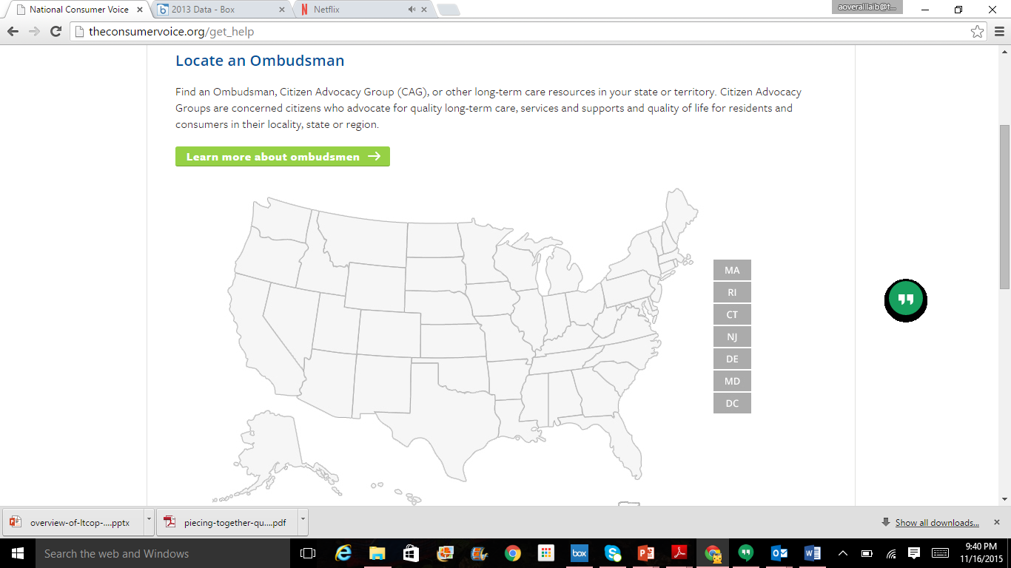
How to Contact the LTCOP
Nursing homes are required to post contact information for the LTCOP and some states require assisted living facilities/board and care facilities to post information about the LTCOP.
Visit the NORC website to locate your state LTCOP: http://www.ltcombudsman.org/
Notes:
As you can see the LTCOP handles a variety of concerns and are resident advocates in all aspects of their work. To get more information about the LTCOP or find out how to contact your state or local program, visit the website. Using the map you can search for your state and local LTCOPs, state survey agency, APS, Medicaid agency, and other state entities.

Slide 16
resources

Slide 17
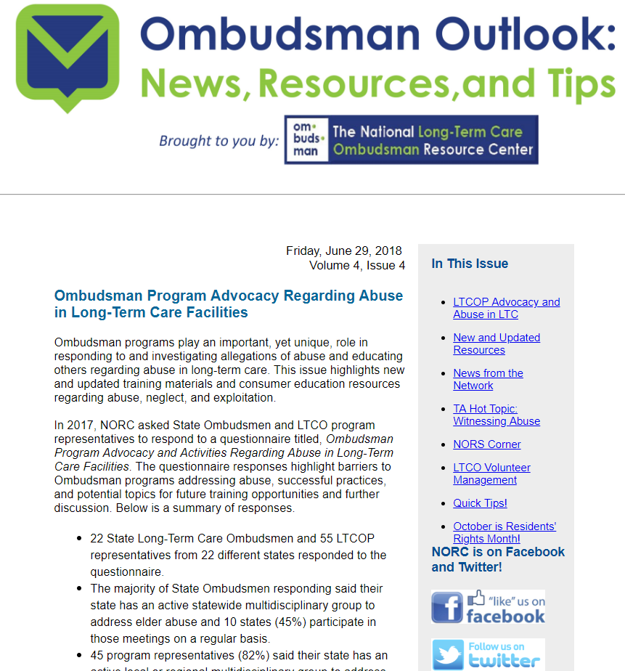
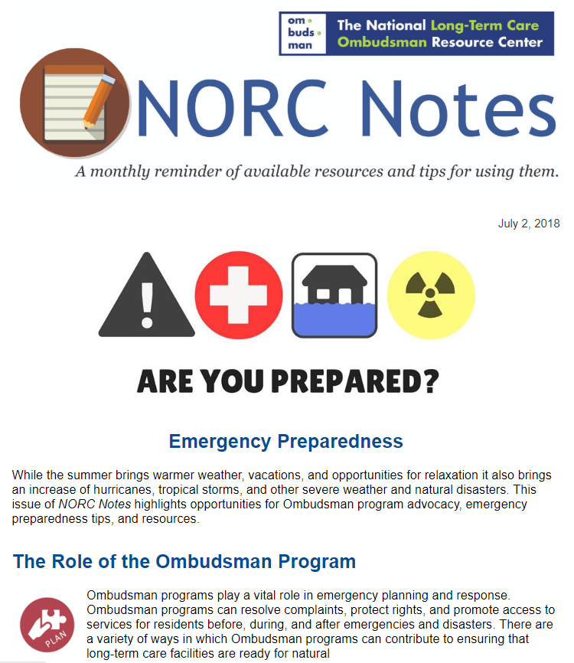
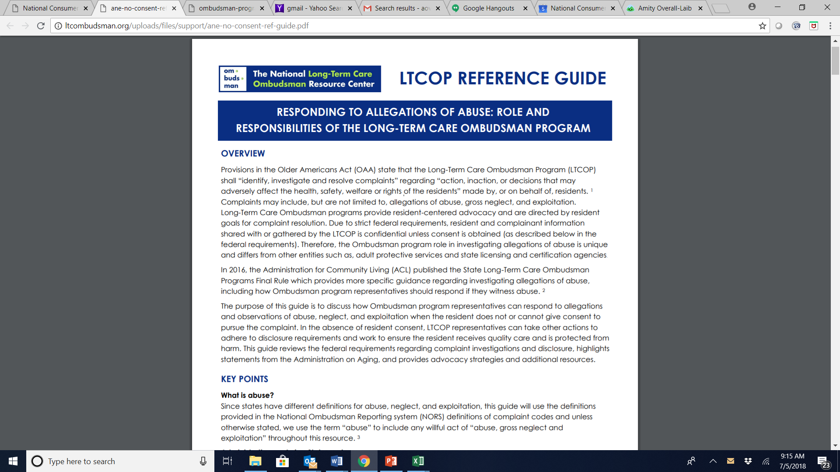
How NORC Supports Ombudsman Programs
Resource Center
  Training (webinars, in-person)
  Resources (quarterly Ombudsman Outlook, monthly NORC Notes)
  Clearinghouse
  Technical assistance (TA) – NEW TA FAQ page http://ltcombudsman.org/omb_support/ta
  Information to share with consumers (e.g., facts sheets regarding financial exploitation, resident-to-resident mistreatment)
Work with LTCOP Associations
Information, not advocacy
  Information regarding policy, regulations and requirements

Slide 18
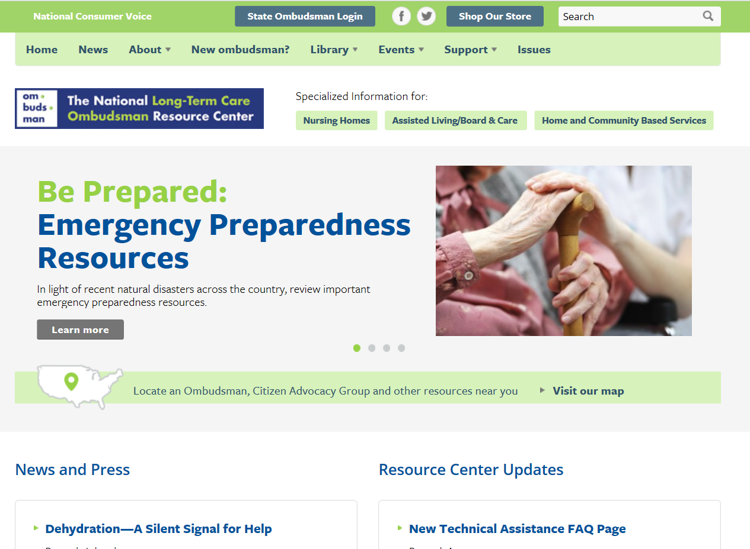
NORC Website www.ltcombudsman.org
New ombudsman?
Library
Government Reports
Federal Laws and Regulations
LTCOP Rule
Events
Support
Program Management
Program Promotion
Training
Systemic Advocacy
Volunteer Management
TA FAQs
Issues
More than 20 issue pages (e.g., abuse, antipsychotic medications, dementia care, emergency preparedness)
Site Map: http://ltcombudsman.org/about/site-map
Notes:
Future NORC work:
Evaluation questionnaire- please respond
NORS Next
NORC Curriculum

Slide 19


The National Long-Term Care
Ombudsman Resource Center (NORC)
www.ltcombudsman.org
Connect with us:
The National LTC Ombudsman Resource Center
@LTCombudcenter
This project was supported, in part, by grant number 90OMRC0001-01-00, from the U.S. Administration for Community Living, Department of Health and Human Services, Washington, D.C. 20201. Grantees undertaking projects under government sponsorship are encouraged to express freely their findings and conclusions. Points of view or opinions do not, therefore, necessarily represent official Administration for Community Living policy.

