Slide 1
b
Responding to Older Adults
Michelle Perry, Kim Kehl
August 17, 2017
Notes:
&

Slide 2
Name and describe your work responsibilities
Share if you have experience with or knowledge about Trauma Informed Care.
The most important thing I want to accomplish or understand as a result of this training is ______________.
Notes:
Acknowledge the reason participants are here today. Could be part of a regularly schedule training or professional development activity. Could be attending due to a recent nursing home closure. Could be attending anticipating a nursing home closure
Option 2
Let’s Stand up and create a circle in the room
Please tell us your name, tell us about the work that you do, and how are you involved in Leadership and management?
Lighting Round / Warm Up: IF YOU…
Have emailed or texted someone at work this morning walk to the other side of the circle
If you supervise more than 5 (five) employees walk to the other side of the circle
Had to a difficult conversation with someone you manage in the past 3 (three) months walk to the other side of the circle

Slide 3
Creating safety
Have a plan for self-care if you should need to take a break
You are free to choose to not participate in any activity
We want to hear from you, participate throughout the program
Silence cell phones
Be respectful of other participants
Notes:
Training Norms:
What said in the room stays in the room
People have the right to their opinion
One person talking at a time
Please leave the room for texting and calls
This is your training and please share your thoughts and experience related to the topic.

Slide 4
Learning objectives
Provide introduction to trauma and trauma-informed approaches in behavioral health, human services and elder services.
Participants will have a shared understanding of trauma.
Participants will be able to identify examples of a traumatic event.
Explain the Six Trauma-Informed Approach Principles.
Learn about how prevalent trauma histories are among the older adults you serve.

Slide 5
Trauma Symptoms = Tension Reducing Behaviors
“How do I understand this person?”
rather than
“How do I understand this problem or symptom?”
Notes:
A trauma-informed approach shifts the focus to the individual and away from some particular and limited aspect of his or her functioning.
A holistic and trauma-focused understanding gives people a structure for organizing and understanding their experience.

Slide 6
Understanding Trauma

Slide 7
What is Trauma?
Individual trauma results from an:
Event, series of events, or set of circumstances that is
Experienced by an individual as physically or emotionally harmful or life threatening and that has lasting adverse
Effects on the individual’s functioning and mental, physical, social, emotional, or spiritual well-being.
Notes:
SAMHSA is the Substance Abuse and Mental Health Services Administration (SAMHSA) agency within the U.S. Department of Health and Human Services that leads public health efforts to advance the behavioral health of the nation.
To arrive at this definition, SAMHSA conducted an environmental scan of trauma definitions and models of trauma informed care.
They convened a group of national experts who had done extensive work in this area. This included trauma survivors who had been recipients of care in multiple service system; practitioners from an array of fields, who had experience in trauma treatment; researchers whose work focused on trauma and the development of trauma-specific interventions; and policymakers in the field of behavioral health.
It is important because it creates a framework for understanding the complex nature of trauma.

Slide 8
The Three E’s in Trauma
Events
Experience
Effects
Effects of trauma include adverse physical, social, emotional, or spiritual consequences.
Events/
circumstances cause trauma.
An individual’s experience of the event determines whether it is traumatic.
Notes:
The focus on events places the cause of trauma in the environment not in some defect of the individual. This is what underlies the basic credo of trauma-informed approaches: “It’s not what’s wrong with you, but what happened to you.”
The focus on experience highlights the fact that not every child or adult will experience the same events as traumatic.
The identification of a broad range of potential effects reminds us that our response must be holistic—it’s not enough to focus on symptoms or behaviors. Our goal is to support a child to learn and grow or an adult to live a satisfying life.

Slide 9
ACE Study
Collaboration between Kaiser Permanente and CDC
17,000 patients undergoing physical exam provided detailed information about childhood experiences of abuse, neglect and family dysfunction (1995-1997)
This study has been replicated and validated numerous times, throughout the world and on culturally diverse populations.
Notes:
The Adverse Childhood Experiences Study (ACE Study) is a research study conducted by Kaiser Permanente health maintenance organization and the Centers for Disease Control and Prevention (CDC).
Participants were recruited to the study between 1995 and 1997 and have been in long-term follow up for health outcomes.
The study has demonstrated an association of adverse childhood experiences (ACEs) with health and social problems as an adult.
The study has been analyzed extensively, is frequently cited as a notable landmark in epidemiological research.
This study has been replicated and validated numerous times, throughout the world and on culturally diverse populations.

Slide 10
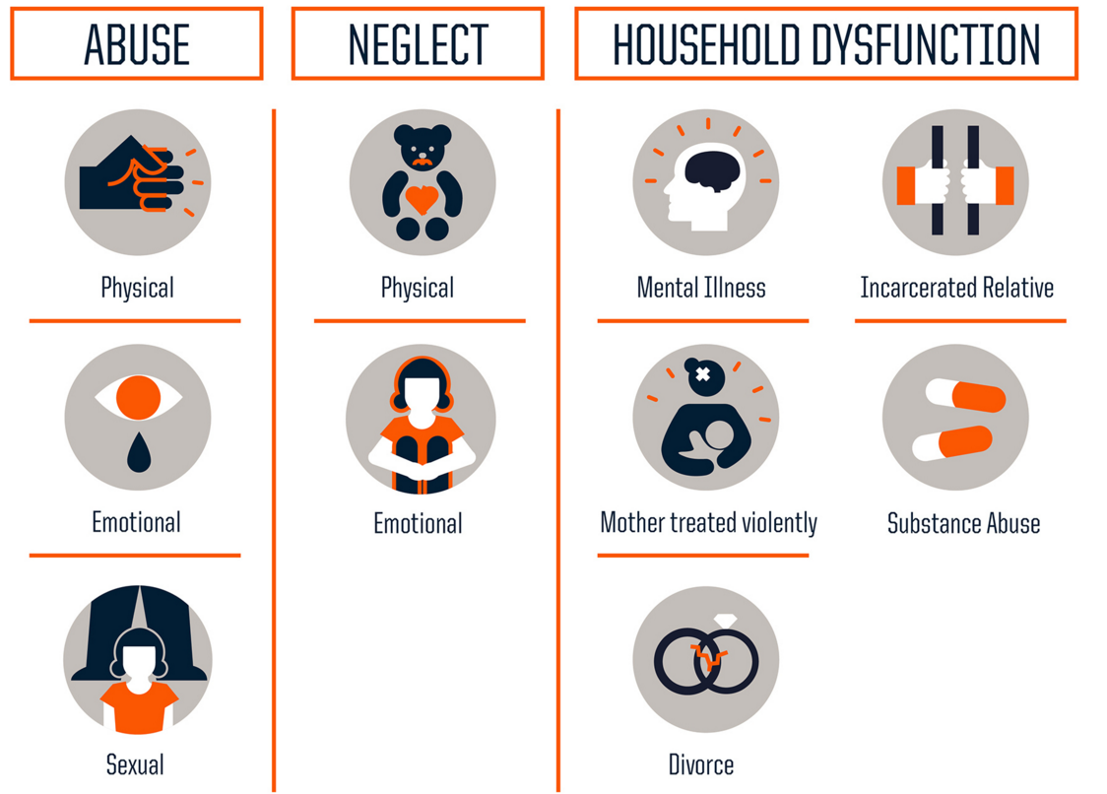
ACEs
http://acestoohigh.com/got-your-ace-score/
/Separation
Notes:
For the purposes of the ACE Study, adverse childhood experiences were defined as emotional, physical, or sexual abuse, emotional or physical neglect, and growing up in a household where someone was an alcoholic, a drug user, mentally ill, suicidal, where the mother was treated violently, or where a household member had been imprisoned during the patient’s childhood.
Additionally, they included contact sexual abuse and serious physical and emotional abuse.

Slide 11
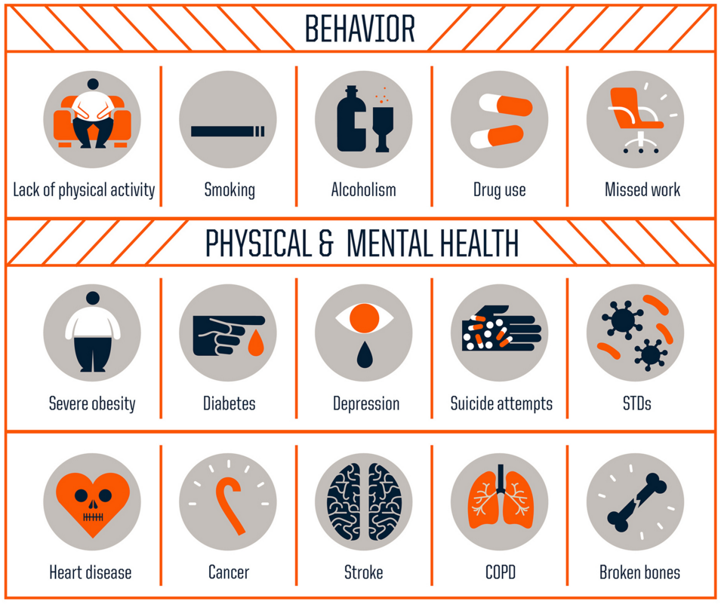
ACE Score and Health Risk
As the ACE score increases, risk for these health problems increases in a strong and graded fashion:
Notes:
Persons with high ACE scores are later at much higher risk for health and medical conditions resulting from their choice of remedies for their pain.
While these approaches are effective in the short term, they often have dire long-term consequences such as serious chronic health and social problems

Slide 12
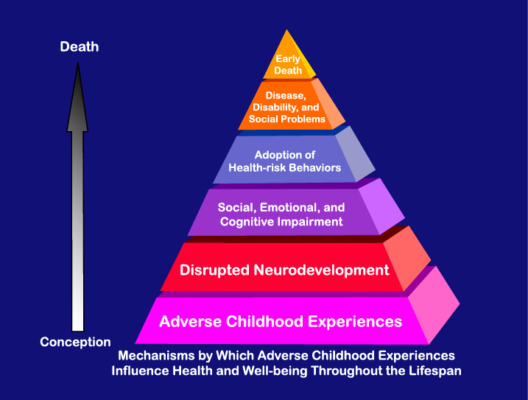
ACE Score and Health Risk
As the ACE score increases, risk for these health problems increases in a strong and graded fashion:
Alcoholism and alcohol abuse
Chronic obstructive pulmonary disease (COPD)
Depression
Hallucinations
Fetal death
Health-related quality of life
Illicit drug use
Ischemic heart disease (IHD)
Liver disease
Risk for intimate partner violence
Multiple sexual partners
Sexually transmitted diseases (STDs)
Smoking
Suicide attempts
Unintended pregnancies
Early initiation of smoking
Early initiation of sexual activity
Adolescent pregnancy
HIV
Notes:
How ACES result in disease and early death (Felitti slide)
Note to trainer: make sure to highlight the top two boxes.

Slide 13
Traumatic Events:
(1) Render victims helpless by overwhelming force;
(2) Involve threats to life or bodily integrity, or close personal encounter with violence and death;
(3) Disrupt a sense of control, connection and meaning;
(4) Confront human beings with the extremities of helplessness and terror; and
(5) Evoke the responses of catastrophe.
(Judy Herman, Trauma and Recovery, (1992))
Notes:
Be sure to highlight bullet #3; Disrupt a sense of control, connection and meaning

Slide 14
Elder-specific Trauma
Loss
Chronic and life-threatening diagnoses
Physiological changes, limitations and disability
Cognitive and memory loss
Increased dependence on caregivers
Retirement
Reduced income
Abuse and neglect
Notes:
Question to class:
What are types or examples of losses?
Spouses, peers, family members
Roles and responsibilities
Social support
Driving and independence
Loss of control
Early unresolved trauma which may be triggered due to any of the elder specific traumas mentioned

Slide 15
Effect
Trauma can…
Cause short and long-term effects
Affect coping responses, relationships, or developmental tasks
Impact physiological responses, well-being, social relationships, and/or spiritual beliefs
Notes:
Trauma can have both short- and long-term effects, and impact may not be immediately recognized.
Trauma can affect an individual’s coping responses or ability to engage in relationships, or it can interfere with mastery of developmental tasks.
Trauma may affect an individual’s physiological responses, psychological well-being, social relationships, and/or spiritual beliefs.
The effects of trauma can be impacted by:
Early occurrence
Being silenced or not believed
Blaming or shaming
Perpetrator is a trusted caregiver

Slide 16
Experience of Trauma
Experience of trauma affected by:
How
When
Where
How Often
Notes:
The individual’s experience of trauma may be profoundly affected by when, how, where and how often it occurs.
Trauma can result from a single devastating event, called single-episode trauma (sometimes called acute trauma), or it can result from multiple traumatic events over time.
Most individuals served in the public system have complex trauma, which comes from experiencing multiple sources of trauma over a lifetime.
Trauma can be totally unintentional, as when an organization does harm through its procedures. For example, the routine practice of undressing for a medical exam can re-traumatize a person.
Systems can also unintentionally replicate the dynamics of an earlier trauma, causing re-traumatization.
Trauma can occur from hearing about, watching, or interacting with others who have had traumatic experiences.

Slide 17
The Brain Matters
• The human brain is the organ responsible for everything we do. It allows us to love, laugh, walk, talk, create or hate
• The brain - one hundred billion nerve cells in a complex net of continuous activity -allows us our humanity
• For each of us, our brain’s functioning is a reflection of our experiences.

Slide 18
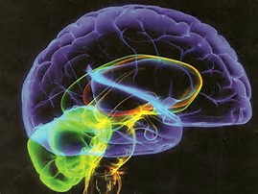
How Trauma Affects the Brain
Many people think that trauma changes you just on an emotional level.
In fact, the changes go all the way down to every tiny cell in the body.
Most importantly, the brain is adaptive and able to change repeatedly over time.
While trauma can change the brain, other experiences can change it again
Notes:
There are many structures in your brain that engage during a traumatic moment, but there are 4 that play critical roles when you’re in survival mode:
Brain stem
Amygdala
Hippocampus
Pre-frontal cortex
How these 4 structures interact and how they function individually affect how you feel during and after trauma. When they over- or under-function they change how you think, process information, sleep and even behave.

Slide 19
How Trauma Affects the Brain
The body and mind are designed to fluctuate between response and repair.
The body knows when to gear up to fight/flight/freeze and when to rest and restore. The brain will increase or decrease several chemicals to activate these responses.
After trauma, however, some of these chemicals can remain high and the brain can remain in a keyed up state ready to protect and defend.
Notes:
Cortisol can cause far-reaching effects on the brain, including the inability to lay down a new memory, or even access an old one.
The presence of cortisol also lessens how effectively brain cells communicate by interfering with the function of neurotransmitters, the way those cells send messages

Slide 20
Complex trauma can over-activate the natural stress response
Survival Responses | Coping Behaviors | Labeled by systems…
Fight | Struggling to regain or hold on to power, especially when feeling coerced. | “Non-compliant” “In denial” “Combative” “Challenges authority” “Treatment resistant”
Flight | Giving in to whoever/whatever is in a position of power | “Passive” “Can’t be helped” “Using the system”
Freeze | Disengaging completely –keeping to oneself, leaving services, abandoning housing, etc. | “Chronic” “Unmotivated”
Notes:
The fight, flight or freeze responses are activated by danger as perceived by the brain. Some common behaviors of trauma survivors—behaviors that are often labeled as “problems” by the aging system—can be directly linked to these responses and to the effects that trauma has on the brain.
This slide lists three sets of “problems” that are often attributed to people in the aging system and shows how the behavior may be a survival mechanism tied to a flight, flight or freeze response.
First is the fight response. In the aging system, someone who struggles too hard to hold onto personal power may be labeled as non-compliant or combative.
Second is the flight response. In the aging, anyone who emotionally withdraws or disengages too much may be labeled as treatment resistant or uncooperative.
Third is the freeze response. In the aging, anyone who gives in too easily to authority may be labeled as passive or unmotivated.
Many of the people we serve have survived circumstances we can hardly imagine. What we often label as pathological may be the very things that helped them to survive.
When we take a trauma-informed approach, we recognize “symptoms” and “problem behaviors” as adaptations to trauma.

Slide 21
Prevalence of Trauma

Slide 22
Trauma in older adults
Approximately one in ten seniors over the age of 60 is abused each year
The majority are older women who live in the community rather than in nursing homes or other senior living facilities.
Elder abuse is grossly underreported
Cognitive decline, even mild , is a pronounced risk factor for financial exploitation
Seniors who have been abused are more likely to be institutionalized in a nursing home or to be hospitalized

Slide 23
Trauma in older adults
About 70% of older men reported lifetime exposure to trauma; older women reported a lower rate, around 41%
Greater lifetime trauma exposure was related to poorer self-rated health, more chronic health problems, and more functional difficulties
Of older women (average age = 70), 72% had experienced at least one type of interpersonal trauma during their lives (e.g., childhood physical or sexual abuse; rape) and higher rates of interpersonal trauma were related to increased psychopathology

Slide 24
Older Adults and Past Abuse
Older adults who have been abused or neglected at the hands of a caregiver or partner found childhood abuse to be a notable risk factor.
Older adults who suffered from physical neglect and abuse in childhood may be more likely to tolerate poor care later in life.
The experience of a prior traumatic event is associated with increased risk of elder mistreatment
Notes:
This is a key slide = the correlation of trauma/neglect in childhood makes them more susceptible as an older adult.
Studies of older adults who have been abuse or neglect at the hands of a caregiver or partner found childhood abuse to be a notable risk factor.
“Older adults who suffered from physical neglect and abuse in childhood may be more likely to tolerate poor care later in life.”
The experience of a prior traumatic event was also associated with increased risk of elder mistreatment, a finding also observed in the literature on younger adult mistreatment.

Slide 25
Trauma effects
Adults with an ACE score of 4 or more were 460% more likely to be suffering from depression.
The likelihood of adult suicide attempts increase 30 fold or 3, 000% with an ACE score of 7 or more.
Childhood and adolescent suicide attempts increase 51-fold or 5,100% with an ACE score of 7 or more.
Notes:
It is important to recognize that Adverse Childhood Experiences are Common. First, The 17,000 HMO members who were interviewed were middle class people, with jobs and medical insurance – not likely to have been exposed to street violence, extreme poverty, malnutrition, dislocation, natural catastrophes or war terror. Of 17,000 HMO members: 72% had attended college 77% were white 62% were 50 or older
They are US.
1 in 4 were exposed to 2 categories of ACE’s –which would equate to 1/4th of this audience
1 in 16 were exposed to 4 categories
22% were sexually abused as children. That’s over 20% of this audience. Over one in every 5 of us.
66% of the women experienced abuse, violence or family strife in childhood. Two-thirds of the women in this audience more than likely had that experience as children.
This is of epidemic proportions and indicates the need to address childhood trauma as a major public health issue.

Slide 26
Trauma effects:
A male child with an ACE of 6 or more has a 4,600 % greater likelihood of becoming an IV drug user.
A child with 6 or more categories or adverse childhood experiences is 250% more likely to become an adult smoker.
A person with 4 categories of adverse childhood experiences is 260% more likely to have Chronic Pulmonary Disease.
2/3rds of all alcoholism can be attributed to adverse childhood experiences.
Notes:
These statistics only demonstrate the generational trauma that impacts Ohioans caught in the throws of opiate addiction and has profound impacts on communities attempting to respond to the current epidemic
ACE study data Suggests the basic cause of addiction is predominantly experience-dependent during childhood and not substance-dependent. ACE study also demonstrates MANY adult conditions may be experience dependent during childhood. This challenge to the usual concept of the cause of addictions – and other disorders - has significant implications for medical practice and for treatment programs.
Existing practice commonly asks “What is wrong with the person?”, vs “What happened to this person?” Existing practice observes symptoms, develops diagnoses, and treats symptoms instead of underlying causes.

Slide 27
Trauma-Informed Approaches

Slide 28
From “What’s Wrong?” To “What’s Happened?”
What’s happened?
What’s wrong?
What is your story? How did you end up here?
How have you coped and adapted?
How can we work together to figure out what helps?
What is your diagnosis?
What are your symptoms?
How can I best help or treat you?

Slide 29
The “What’s Wrong Approach”
He’s having trouble making friends
Because…
Difficulties with relationships
Limited social skills
Difficulty adjusting to new living situation

Slide 30
The TIC Approach
What happened that is affecting his ability to make friend?
Understands …
Adversity can negatively impact a person’s ability to form trusting relationships
Due to truth issues

Slide 31
The “What’s Wrong Approach”
She forgets everything lately, it’s like she’s not listening.
Because…
Not paying attention
Intentionally forgetful
Sick or not listening

Slide 32
The TIC Approach
What happened to affect her memory of attention?
Understands …
Under stress, we perceived threat. Information important or survival is marked.
There may be an underlying medical condition causing the memory loss.

Slide 33
Trauma Symptoms = Tension Reducing Behaviors
“How do I understand this person?”
rather than
“How do I understand this problem or symptom?”
Notes:
A trauma-informed approach shifts the focus to the individual and away from some particular and limited aspect of his or her functioning.
A holistic and trauma-focused understanding gives people a structure for organizing and understanding their experience.

Slide 34
Things to remember
Underlying question =
“What happened to you?”
Symptoms =
Adaptations to traumatic events
Healing happens
In relationships
Notes:
The underlying question is not “What’s wrong with you?” but “What happened to you?”
What are often called symptoms are actually adaptations to traumatic events.
Healing happens in relationships.

Slide 35
Remember:
All behavior has meaning
Symptoms are ADAPTATIONS
We build on success not deficits
Notes:
A individual’s response to traumatic stress may manifest across multiple domains of functioning and developmental processes, including emotional, behavioral, interpersonal, physiological, and cognitive functioning.
Traumatic stress reactions vary widely; often, people engage in behaviors to manage the aftereffects, the intensity of emotions, or the distressing aspects of the traumatic experience.
Some people reduce tension or stress through avoidant, self-medicating (e.g., alcohol abuse),compulsive (e.g., overeating), impulsive (e.g.,high-risk behaviors), and/or self-injurious behaviors. Others may try to gain control over their experiences by being aggressive or subconsciously reenacting aspects of the trauma.
Behavioral reactions are also the consequences of, or learned from, traumatic experiences.
For example, some people act like they can’t control their current environment, thus failing to take action or make decisions long after the trauma (learned helplessness).
Other associate elements of the trauma with current activities, such as by reacting to an intimate moment in a significant relationship as dangerous or unsafe years after a date rape.
Some people readily view their experiences of trauma as being in the past; as a result, they engage in distraction, dissociation, and/or avoidance (as well as adaptation) due to a belief that trauma has little impact on their current lives and presenting problems.
Even individuals who are quite aware of the impact that trauma has had on their lives may still struggle to translate or connect how these events continue to shape their choices, behaviors, and emotions.

Slide 36
OTHER Possible trauma responses
Behavioral
Blowing up when being corrected
Fighting when criticized or teased
Resisting changes
Protective of personal space
Reckless or self-destructive behavior
Seeking attention
Reverting to younger behaviors
Emotional/Physical
Nightmares
Sensitive to noise or touch
Fear of being separated from family
Difficulty trusting
Emotional swings
Unexplained medical problems
Psychological
Confusing what is safe and
what is dangerous
Trouble concentrating
Difficulty imagining the future

Slide 37
The Four R’s
A trauma-informed program, organization, or system:
Realizes
Realizes widespread impact of trauma and understands potential paths for recovery
Recognizes
Recognizes signs and symptoms of trauma in clients, families, staff, and others involved with the system
Responds
Responds by fully integrating knowledge about trauma into policies, procedures, and practices
Resists
Seeks to actively Resist re-traumatization.
Notes:
Trauma-informed approaches reflect a fundamental shift in the culture of an entire organization.
The four R’s highlight basic aspects of culture change that an organization will demonstrate as it becomes trauma-informed.
The Four R’s reflect that it is not enough to simply know about trauma.
To be trauma-informed, people must be able to identify trauma when they see it, and they must know how to respond in a way that doesn’t unintentionally re-traumatize people.
Trauma-Informed approaches can be implemented anywhere, by anyone. Everyone in the organization has a role to play in becoming trauma-informed.

Slide 38
ESSENTIAL ELEMENTS of DIGNITY
What we extend to others and would like for ourselves

Slide 39
Defining Dignity
“An internal state of peace that comes with the recognition and acceptance of the value and vulnerability of all living things…”
“Treat people as they want to be and you help them become what they are capable of being”
“Seeing, hearing, and acknowledging what people have suffered….caring and attending to those who have endured unspeakable atrocities help(s) to recover their sense of worth…”
“…Often a missing link in the understanding of conflicts…”
Notes:
Time does not heal all wounds
To heal, a person must be able to tell their story
When adrenaline starts, we get stupid

Slide 40
Indignities
Unaddressed indignities are at the core of all entrenched conflicts and will block your attempts to resolution, healing and peace…
The wounds of indignities do not go away over time…the person’s story needs to be heard, the person needs to be cared for and attended to…
Most of us when we have violated other’s dignity, have done so accidently and because of not being mindful and understanding of our impact on the other person…

Slide 41
Ten Essential Steps of the Dignity Model
Acceptance of Identity:
Approach people as neither inferior or superior to you.
Give people the freedom to express their authentic selves without fear of being negatively judges
Interact without prejudice or bias
Assume others have integrity

Slide 42
Ten Essential Steps of the Dignity Model
Inclusion: make others feel as if they belong; whatever the relationship, whether they are your family, community, classroom, organization or nation. Making people feel valued and welcomed…
Safety: Put people at ease
Physically so they are safe from bodily harm
Psychologically so they are safe from being humiliated
Help them to speak without fear of retribution
Acknowledging their suffering, acknowledging their strengths…

Slide 43
Ten Essential Steps of the Dignity Model
Acknowledgement:
Give people your full attention by listening, hearing, validating, and responding to their concerns, feelings, and experiences
This can be done simply and can be very powerful…this can be overlooked so easily too…

Slide 44
Ten Essential Steps of the Dignity Model
5. Recognition:
Validate others for their talents, hard work, thoughtfulness, and help.
Be generous with praise and gratitude to others for their contributions and ideas
The importance of leadership being educated on dignity: its power and the cost of indignities
6. Fairness:
Treat people justly with equality in an even-handed way according to agreed upon laws and rules.
People feel their dignity is honored when you treat them without discrimination or injustice.

Slide 45
Ten Essential Steps of the Dignity Model
Benefit of the Doubt:
Treat people as they are trustworthy
Start with the premise that others have good motives and are acting with integrity
8. Understanding:
Believe that what others think matters
Give them the chance to explain and express their points of view
Listen to understand

Slide 46
Ten Essential Steps of the Dignity Model
9. Independence:
Encourage people to act on their own so that they feel in control of their lives and experience a sense of hope and possibility
Accountability:
Take responsibility for your actions.
If you have violated the dignity of another person apologize
Make a commitment to change your hurtful behaviors

Slide 47
Principles of Trauma-Informed Approaches

Slide 48
SAMHSA’s Six Key Principles of a Trauma-Informed Approach
Safety
Trustworthiness and Transparency
Peer Support
Collaboration and Mutuality
Empowerment, Voice, and Choice
Cultural, Historical, and Gender Issues
Notes:
SAMHSA’s principles for trauma-informed approaches emerged from a year-long process involving trauma survivors, family members, practitioners, researchers and policymakers.
During a public comment period, thousands of individuals wrote in with feedback on the definitions and overall approach.
The goal was to develop a common language and framework. As more agencies and organizations work to become trauma-informed—and as more and more claim to BE trauma-informed—there needs to be some standard way to define and assess consistency with the approach.
The principles are value-based. Unlike “manualized” models for specific treatment interventions, these principles can be applied in a wide variety of settings, in many different ways, using whatever resources are available.
Implementing a trauma-informed approach requires constant attention and caring; it’s not about learning a particular technique or checking things off a checklist. Think about something as basic as respect or compassion. Can you do it once, implement a policy, and then check it off as “done”? Trauma-informed approaches are about a way of being, not a specific set of actions or implementation steps.
Becoming trauma informed requires a culture shift.
Expanded bullet text:
Six principles to guide a trauma-informed change process.
Developed by a group of national experts including trauma survivors, with extensive public input
Goal is to establish a common language and framework.
A values-based approach.
A way of being not a checklist or technique.

Slide 49
Principle 1: Safety
Throughout the organization, staff and the people they serve, feel physically and psychologically safe.
Do personal interactions promote a sense of safety?
How do persons served define safety?
What changes need to be made to address safety concerns?
Does the organization work on risk management principles or is the organization risk averse?
Notes:
Discussion points:
Safety throughout the organization, staff and people served
Physical and psychological safety
Physical setting is safe
Interpersonal interactions promote a sense of safety
Question – facilitate large group discussion
How often do you make an assumption about safety without checking it out the people most directly involvd?

Slide 50
Principle 2: Trustworthiness and Transparency
Operations and decisions are conducted with transparency and the goal of building and maintaining trust among clients, family members, staff, and others involved with the organization.
Is the organization constantly building trust?
Do people really understand their options?
Notes:
Discussion points:
Maximizing trustworthiness, making tasks clear, and maintaining appropriate boundaries
Organizational operations and decisions are conducted with transparency
Constantly building trust

Slide 51
Principle 3: Peer Support
Key to establishing safety and hope, building trust, enhancing collaboration, serving as models of recovery and healing, and maximizing a sense of empowerment.
Does the organization practice principles of peer support?
Is there peer support for staff?
Are the staff prepared to accept peer supporters?
Notes:
Discussion points:
In this context, the term “peer” refers to individuals with lived experiences of trauma.
In the case of children this may also refer to family members of children who have experienced traumatic events and are key caregivers in their recovery.
Does your agency offer access to peer support for the older adults you serve, especially those who are trauma victims?
Does your agency offer peer support for your staff?
What barriers are there to implementing peer support in your organization?

Slide 52
Principle 4: Collaboration and Mutuality
Partnering and leveling of power differences between staff and clients and among organizational staff
Demonstrates that healing happens in relationships, and in the meaningful sharing of power and decision-making
Everyone has a role to play; one does not have to be a therapist to be therapeutic
Is there true partnership between people served and staff and between management and staff?
Notes:
Discussion points:
Maximizing collaboration and sharing of power with consumers and families
Leveling of power differences between staff and clients and among organizational staff from direct care staff to administrators
Recognition that healing happens in relationships and meaningful sharing of power and decision-making
Everyone has a role to play in trauma-informed approaches; “one does not have to be a therapist to be therapeutic.”

Slide 53
Principle 5: Empowerment, Voice, and Choice
Individuals’ strengths and experiences are recognized and built upon
The organization fosters a belief in resilience
Clients are supported in developing self-advocacy skill and self-empowerment
How are successes celebrated in the organization?
Notes:
Discussion points:
Strengthens clients and family member’s experience of choice
Recognizes that every person’s experience is unique
Individualized approach

Slide 54
Principle 6: Cultural, Historical, and Gender Issues
The organization actively moves past cultural stereotypes and biases
Offers gender-responsive services
Leverages the healing value of traditional cultural connections
Recognizes and addresses historical trauma
Notes:
Discussion points:
Organization actively moves past cultural stereotypes and biases
Offers gender responsive services
Leverages the healing value of traditional cultural connections
Recognizes and addresses historical trauma

Slide 55
Trauma Informed Organization
What does it look like for staff?
Understands the cumulative impacts of trauma on individuals and organization:
Promotes staff self-care
Supports professional development
Lunch is eaten and not at the one’s desk
Regular supervision
Vacation and sick leave are used regularly
Notes:
Why become trauma informed?
Trauma-informed service settings, with trauma- specific services available, have better outcomes than ‘treatment as usual’ for many symptoms
Trauma-informed, integrated services are cost- effective.
Qualitative results indicate that consumers respond well to TIC..
TIC for adults lead to better outcomes, such as better self-esteem, improved relationships, and increased safety.
Promotes engagement of community, clients and staff.

Slide 56
Healing and
Recovery

Slide 57
What helps healing?
Understand that trauma impacts a wide range human experience, our physical, emotional, intellectual and spiritual well being.
Promote self-assurance by reminding the older adult that they survived a painful experience and that it takes time to heal.
Avoid comparing oneself to how others are handling their experience.
Seek out persons who care for and support the older adult.
Notes:
No part of the human experience is immune from the stress associated with trauma.

Slide 58
What helps healing cont . . .?
Have them share reactions, thoughts and how the experience impacted them.
Know that the reactions to trauma described are normal responses to a very abnormal experience.
Have the older adult consider writing a journal of their experience.
Notes:
Reactions to trauma occur in varying degrees of severity and type for each person.
Help those who care about them become aware of how they might react in certain situations.

Slide 59
What helps healing cont . . .?
Help them gain perspective on the experience.
Trauma places stress on the human body and may result in illnesses that decrease energy and ability to concentrate.
Have the older adult promote their sense of hardiness through healthy nutrition and exercise.
Notes:
Helping older adults gain a perspective on their experience(s)
Is often helped by participation in counseling
Other aids may include meditation, reading, spiritual reflection or involvement in support groups.
If a trauma results in an illness and if needed, seek medical assistance.

Slide 60
Question to the class?
What helps healing?
Notes:
See handout

Slide 61
What does this mean for you?
First ask, “What happened to you?”
Then, support people, in 4 different belief statements:
I believe you.
Thank you for trusting me enough to tell me.
I am sorry that happened to you.
I support you whatever you choose to do.
Notes:
This really about empathy
Empathy fuels connection and traumatic events often disrupts a sense of control, connection and meaning
Empathy is about
Perspective taking
Staying out of judgement
Recognizing emotions in others
Communication

Slide 62
Small Group
Discussions

Slide 63
Questions to consider
What actions should you START doing to integrate today's learning into your daily processes and transitions?
Which actions should you STOP doing to avoid current problems?
What's still working that you should CONTINUE to do?
What needs to CHANGE in order to bring about the desired change?

Slide 64
Group Report Out

Slide 65
CARING FOR YOURSELF IN THE FACE OF DIFFICULT WORK
Our work can be overwhelming. Our challenge is to maintain our resilience so that we can keep doing the work with care, energy, and compassion.
10 things to do for each day
1. Get enough sleep 6. Focus on what you did well
2. Get enough to eat 7. Learn from your mistakes
3. Do some light exercise 8. Share a private joke
4. Vary the work that you do 9. Pray, meditate or relax
5. Do something pleasurable 10. Support a colleague

Slide 66
Only in the presence of compassion will people allow themselves to see the truth.
~ A.H. Almaas

Slide 67
Questions?
THANK YOU!
Kim Kehl
614-644-8442
Kim.kehl@mha.ohio.gov

