Slide 1

Nursing Home QAPI
Webinar
November 14, 2012

Slide 2
Today’s Agenda
Introductions/Opening Remarks
QAPI Demonstration
National Roll-Out of QAPI
Role of Ombudsman Programs
Questions and Dialogue
Wrap-up and Adjourn

Slide 3
Description: What is QAPI?
Quality Assurance (QA) and Performance Improvement (PI) are complementary approaches to quality management. Both involve seeking and using information, but they differ in key ways

Slide 4
Description: What is QAPI?
QA is a process of meeting quality standards and assuring that care reaches an acceptable level. Nursing homes typically set QA thresholds to comply with regulations.
PI is a pro-active and continuous study of processes with the intent to prevent or decrease the likelihood of problems. PI identifies areas of opportunity and tests new approaches to fix underlying causes of persistent/systemic problems.

Slide 5
Description: What is QAPI?
 | Quality Assurance | Performance Improvement
Motivation | Measuring compliance with standards | Continuously improving processes to meet standards
Means | Inspection, review | Prevention, planning
Attitude | Required, defensive | Chosen, proactive
Focus | Outliers, “bad apples,” individuals | Processes, systems
Scope | Individual provider | Systems for patient care
Responsibility | Few | All

Slide 6
QA + PI = QAPI
QA and PI combine to form QAPI, a data-driven, proactive approach to improving the quality of life, care, and services in nursing homes. The activities of QAPI involve members at all levels of the organization to: identify opportunities for improvement; address gaps in systems or processes; develop and implement an improvement or corrective plan; and continuously monitor effectiveness of interventions.

Slide 7
QAPI builds on QA&A
Committee structure
Review complaints and concerns
Conduct audits
QAPI will go beyond QA&A with
  Prospective approach through comprehensive plan and leadership engagement
  Greater involvement of all staff, residents, families
  Focus on performance improvement projects (PIPs) and Systems

Slide 8
The Five Elements
Element 1: Design and Scope
Element 2: Governance and Leadership
Element 3: Feedback, Data Systems and Monitoring
Element 4: Performance Improvement Projects
(PIPs)
Element 5: Systematic Analysis and Systemic Action

Slide 9
Quality Assurance & Performance Improvement in
Nursing Homes
From: Discussion with Stakeholders
September 14, 2012
Thomas E. Hamilton, Director
Survey & Certification Group
Centers for Medicare and Medicaid Certification

Slide 10
Historical Perspective
CMS Expectations + Process
      Aw Maaannnn!

Slide 11
Future Perspective
CMS Expectations + Process
      Aw Maaannnn!
2. Opportunities for ALL Staff in NHs
      Getting to Where there is Yes!

Slide 12
Revisiting CMS Regulations
(Hamilton’s Abridged Version)
BASICS
Do This
Don’t Do That
Examples in Nursing Homes:
Resident Rights (483.10) Admission, Transfer, Discharge (483.12) Quality of Life (488.15) Quality of Care (488.25) Nursing, Dietary, Physician Services (488.30-40) Specialized Rehabilitation (488.45) Pharmacy Services (488.60) Infection Control (488.65) Physical Environment (488.70) Administration (488.75) 180 Tags

Slide 13
Revisiting CMS Regulations
(Hamilton’s Abridged Version)
BASICS (Old Testament) | Beyond the Basics (New Testament)
Do This | Learn
Don’t Do That | Become Even Better Internal Governance Internal Quality Champions
Examples in Nursing Homes:
Resident Rights (483.10) Admission, transfer discharge (483.12) Quality of Life (488.15) Quality of Care (488.25) Nursing, Dietary, Physician Services (488.30-40) Specialized Rehab (488.45) Pharmacy Services (488.60) Infection Control (488.65) Physical Environment (488.70) Administration (488.75) 180 Tags

Slide 14
Revisiting CMS Regulations
(Hamilton’s Abridged Version)
BASICS (Old Testament) | Beyond the Basics (New Testament)
Do This | Learn
Don’t Do That | Become Even Better Internal Governance Internal Quality Champions
Examples in Nursing Homes:
Resident Rights (483.10) Admission, transfer discharge (483.12) Quality of Life (488.15) Quality of Care (488.25) Nursing, Dietary, Physician Services (488.30-40) Specialized Rehab (488.45) Pharmacy Services (488.60) Infection Control (488.65) Physical Environment (488.70) Administration (488.75) 180 Tags | QAPI Requirement Outcomes Expectations

Slide 15
QAPI Requirements in CMS Regulations
Hospitals
Organ Transplant Hospitals
Dialysis Facilities
Ambulatory Surgical Centers
Home Health
Hospice
And coming to …Nursing Homes

Slide 16
Special Opportunities in LTC
Everyone Makes a Difference …
    Democratizing Improvement
        Staff
        Residents, Resident Councils, Families
    Active involvement of residents, staff
    Tools that Everyone Can Use
      Value of Feedback
      Never Worry Alone
      PDSA – Providing the Tools that Everyone Can Use
Culture Change + QAPI: Mutually Reinforcing

Slide 17
Useful Adages
Every System is Perfectly Designed …
    to Achieve the Results it Achieves

Slide 18
Useful Adages
Every System is Perfectly Designed …
    to Achieve the Results it Gets
If we Lose the Patient …
We Don’t Lose the Lesson

Slide 19
Useful Adages
Every System is Perfectly Designed …
    to Achieve the Results it Achieves
If we Lose the Patient …
We Don’t Lose the Lesson
PDSA is the Growth of Knowledge through Making Changes ..
and then Reflecting on the Consequences of those Changes (Don Berwick)

Slide 20
Useful Adages
Every System is Perfectly Designed …
    to Achieve the Results it Achieves
If we Lose the Patient …
We Don’t Lose the Lesson
PDSA is the Growth of Knowledge through Making Changes ..
and then Reflecting on the Consequences of those Changes (Don Berwick)
Measurement is only a Handmaiden to Improvement ..
but Improvement Cannot Happen without it (Don Berwick)

Slide 21

QAPI National Demonstration
Rosalie A. Kane
kanex002@umn.edu
University of Minnesota

Slide 22
Acknowledgement
Contractor team
  University of Minnesota: Rosalie Kane, Robert Kane, Janie Moore, Patricia Schommer, plus other consultants.
  Stratis Health: Jennifer Lundblad, Jane Pederson, Marilyn Reierson, Kelly O’Neill, & Kathie Nichols
Technical Expert Panel (TEP)
  Barbara Baylis, Cornelia Beck, Carol Benner, Nicholas Castle, Mary Tess Crotty, David Farrell, David Gifford, Jill Hreben, Christine Mueller, Mary Ousley, Cheryl Phillips, Sara Singer, & Hollis Turnham
  CMS QAPI team: Alice Bonner, Debra Lyons, Israel Cross, Cathy Lawrence, Kathleen Johnson
  Work performed under contract from CMS to University of Minnesota and Stratis Health; Debra Lyons, CMS Project Officer

Slide 23
QAPI Demo Quick Facts
  17 volunteer nursing homes from 4 states
  2 year project: September 2011 -August 2013
  NHs used CMS 5-element framework
  NHs received technical assistance (TA)
  NHs had access to suggested tools & resources
  NHs were organized as a Learning Collaborative
  Systematic evaluation: first phase focused on early implementation

Slide 24
Demo Nursing Homes
  17 participating homes, selected for variations:
    Large and small; for profit & not-for-profit
    Freestanding or in multi-nursing home corporations
    Levels of previous QA & PI experience
    Rural, suburban, small town & urban homes
    Variation across five star rating spectrum
    Variation in leadership or overall staff turnover
    Varied “culture change” experience
  States (CA, FL, MA, MN) also chosen to vary:
    Structure of industry, labor force, state regulatory & reimbursement policy, use of QIS
  17 NHs illustrate QAPI implementation in a wide range of NH settings, though the sample was too small to generalize results to either state or entire country

Slide 25
General Conclusions
In less than a year, 16 of 17 homes implemented many elements of QAPI to varying degrees:
  Almost all had made progress with QAPI plans
  16 had one or more PIPs completed or in process.
  The NH with the slowest start had undergone many changes in ownership and leadership & experienced quality challenges before a QAPI infrastructure could have been developed.

Slide 26
Factors associated with implementation
    Implementation success was not predicted by:
    Five star rating status
    Degree of culture change & person-centered care. *
    Extent of corporate resources regarding quality. **
* “Culture change NHs” have a head start, with a culture of resident and caregiver involvement & emphasis on quality of life goals. Yet, the culture change NHs in the demo needed to work to develop data-driven systematic QAPI approaches.
** Corporations with participating NHs were often strongly committed to CQI or TQM & some had rich on-line resources, yet corporate materials and dashboards were not readily usable for individual NHs.

Slide 27
Greatest Challenges
  Using data systematically to get a comprehensive overview of performance
  Turning data into meaningful information
  Building in systematic resident and family input without bias
  Structuring PIPs
  Applying root cause analysis
  Using systems thinking in all quality efforts
  Breaking out of silos of disciplines, departments, & shifts to work system-wide.

Slide 28
Completing Pilot
  Final learning collaboratives will be held in 2012-2013
  Research team will analyze data, produce report
  Team will provide feedback from pilot homes to CMS team and groups working on QAPI tools and resources
  Lessons from University of Minnesota QAPI website will be used in deployment of CMS national QAPI website

Slide 29
National QAPI Roll-out
Phase 1 – September 2010
  Planning and Development
Phase 2 – Fall 2011
  Testing and further development of QAPI tools & resources through Demonstration & Nursing Home Quality Improvement Questionnaire (Wave 1)
Phase 3 – Beginning Fall 2012
  Initial Rollout of Foundational Materials
  Nursing Home Quality Improvement Questionnaire (Wave 2)
  Development of Surveyor & Consumer Materials
  Full Rollout of training materials

Slide 30
Phase 2 Roll-Out – NH Quality Improvement Questionnaire (Wave 1)
Administered in 2 waves to a nationally representative sample of 4,200 NHs
  1st Wave (Summer, 2012):
    Obtain baseline info; and
    Identify potential barriers to implementing quality programs
  2nd Wave (Summer, 2013):
    Assess the development of QAPI systems;
    Identify what types of TA to make available to nursing homes in the future;
    Determine potential impact of TA in advancing QAPI in nursing homes

Slide 31
Phase 2 Roll-Out – NH Quality Improvement Questionnaire (Wave 1)
Data collection period ending mid-October 2012
Already have 3,151 completed questionnaires
75%

Slide 32
National Roll-Out Phase 3
Website
  Learn More
    About QAPI
    About Us
    Tools and Resources for Providers
  Featured Videos

Slide 33
Initial Rollout
Sets the groundwork
Helps you see where you are and provides a roadmap for further improvements
“Implementing QAPI is essential – it is not enough simply to understand it.”

Slide 34
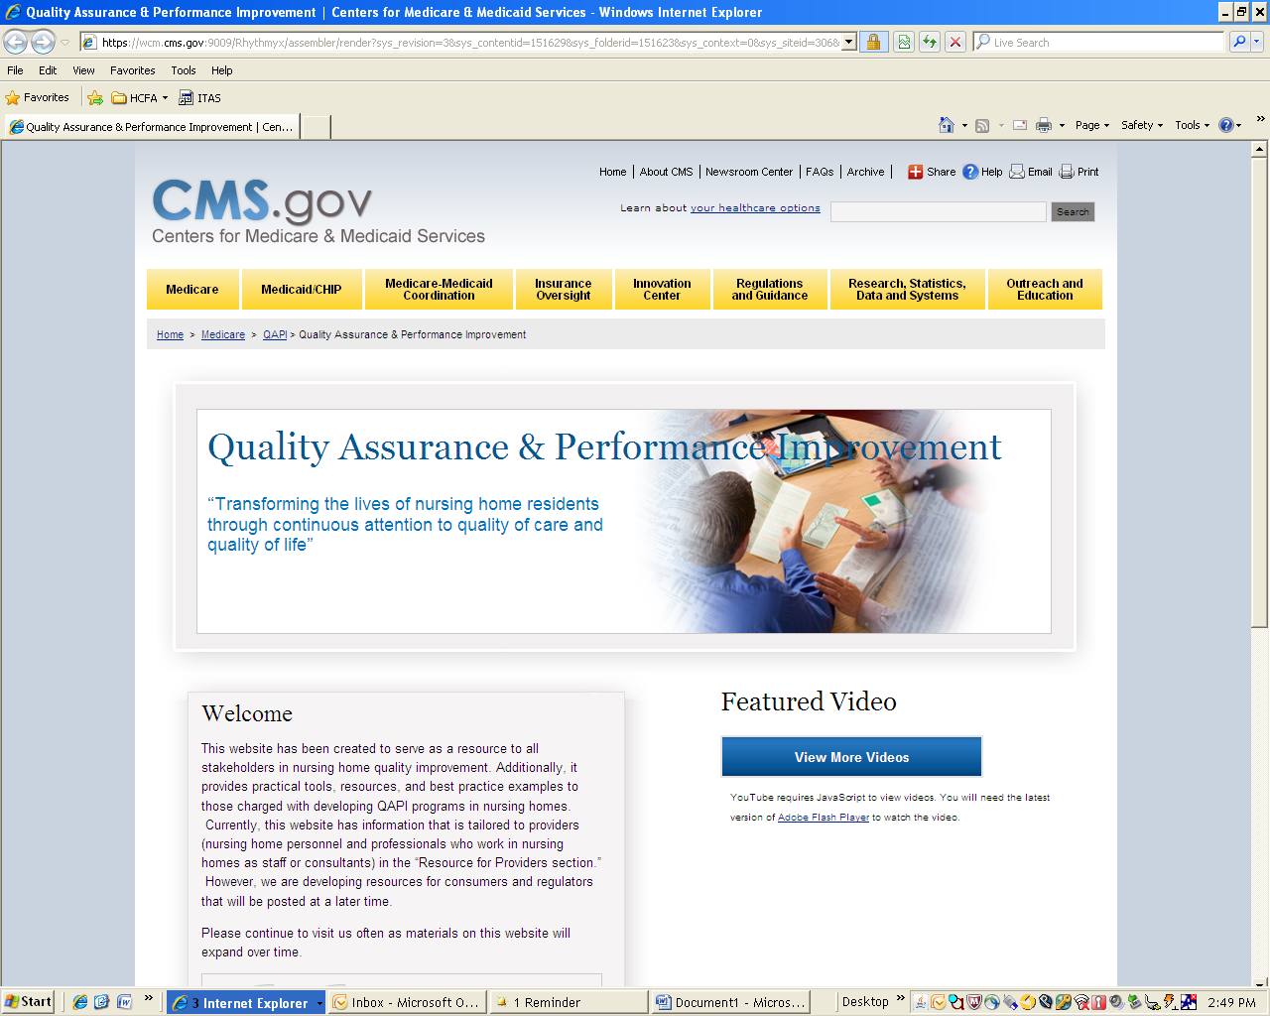

Quality Assurance and Performance Improvement
“Transforming the lives of nursing homes residents with continuous attention to quality of care and quality of life.”

Slide 35
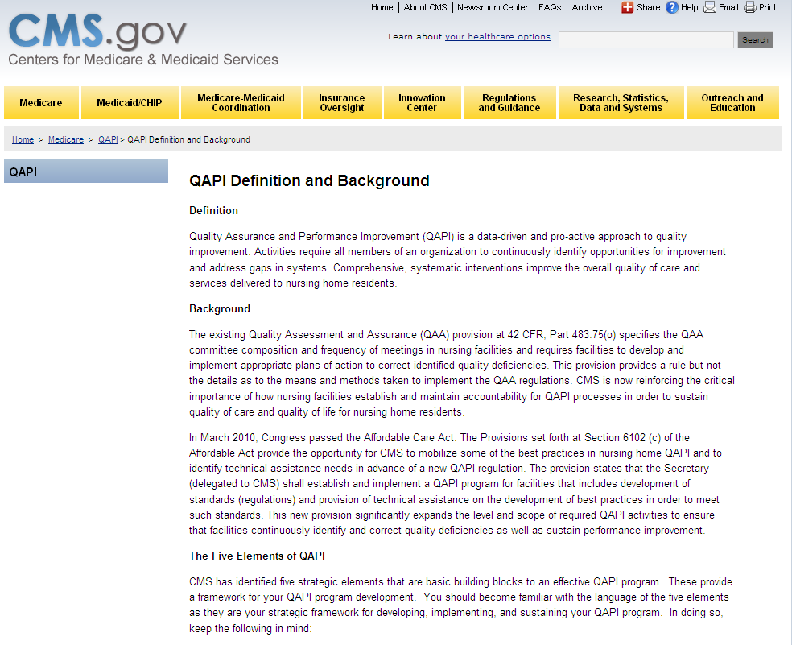

Slide 36


Slide 37
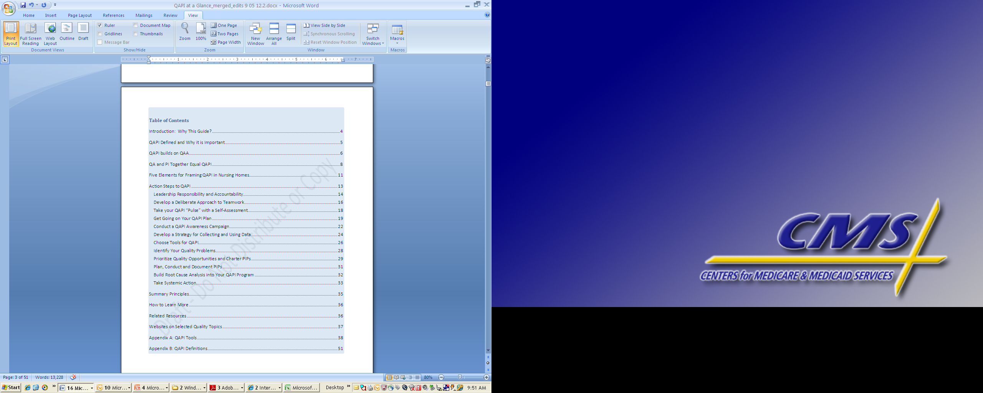

Slide 38


Slide 39
Nursing Home QAPI Purpose & Guiding Principles Worksheet
Guides your organization’s performance improvement efforts
Should reflect input from staff representing all roles and disciplines within your organization
Describe how the program will address:
  Clinical care
  Quality of life
  Resident choice
Guidelines for Performance Improvement Project (PIP) Teams
  Describe the overall plan for conducting PIPs to improve care or services.
  Indicate how potential topics for PIPS will be identified

Slide 40


Slide 41
Nursing Home QAPI Plan Outline
Assists you in achieving what you have identified as the purpose, guiding principles and scope for QAPI
Helps you to understand how QAPI will be used and integrated into your organization
Helps your organization to develop a written QAPI plan

Slide 42


Slide 43
Featured Video
“The Business Case”
Real Residents
  What’s important to me
Perspective of real providers
  What’s in it for me?
  Understanding the value in QAPI

Slide 44
National Roll-Out Phase 3
Phase 3
  Nursing Home Quality Improvement Questionnaire (Wave 2)
  Provider Materials
  Consumer Materials
  Surveyor Materials

Slide 45

Phase 3 Roll-Out – Provider Materials
*Process Tools: Tools that help NHs implement QAPI
*Topic Tools: Tools for specific topics
*CMS not mandating specific tools

Slide 46
Phase 3 Roll-Out – Provider Materials
Online Learning Sessions
Goals:
Provide instruction on basic concepts – 5 Elements
Facilitate early successes & mastery of fundamentals
Audience:
Primary: NH staff serving on QAPI committee, other key staff
Secondary: All NH staff and caregivers
May be used by other audiences (SAs, ROs, Partners, Stakeholders)

Slide 47
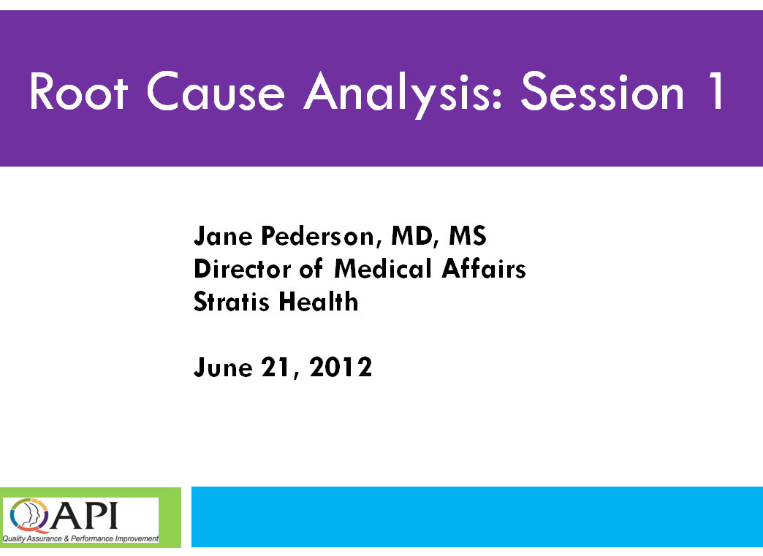
Phase 3 Roll-Out – Provider Materials
Focused Webinars
In-depth study
Complex

Slide 48
Phase 3 Roll-Out – Provider Materials
Provider Materials
Process & Topic Tools
Online Learning Sessions
Focused Webinars
All to go on CMS website
  http://go.cms.gov/Nhqapi

Slide 49
Phase 3 Roll-Out – Surveyor Materials
Surveyor Training Needs:
  Understanding Systems Thinking
  Evaluating Plans of Correction
Surveyor Worksheet
  Prompts surveyors throughout survey process
  Helps identify systems issues to be investigated during QAPI review

Slide 50
Phase 3 Roll-Out – Consumer Materials
Materials that will:
Empower
Engage
Residents, families, agents, ombudsman and advocates

Slide 51
Ombudsman Programs
What role may ombudsman programs play in QAPI implementation?
How may ombudsmen prepare for QAPI and how may they get involved?

Slide 52
Transformation
“Transforming the lives of nursing home residents through continuous attention to quality of care and quality of life”

