Slide 1

National ombudsman reporting system (NORS) training Part I:
Case, Complaint, Complainant, Information and Assistance
February 27, 2019

Slide 2

Agenda
Brief NORS Overview
Part I Training Materials
  Basic Principles
  Quiz
  Quiz Answer Sheet
Resource - Table 1 – NORS Parts A, B, and C – Case and complaint codes, values and definitions
Take Quiz
Questions and Answers
Resources
This Photo by Unknown Author is licensed under CC BY
Notes:
Today’s agenda includes an introduction to NORS, discussion of the basic principles for Case, Complaint, and Consultation and Information and Assistance, review of Table 1 – NORS Parts A, B, and C, audience participation in answering quiz questions and reviewing tips, general Q&A, and a reminder of resources available through the National Ombudsman Resource Center.
For today’s webinar and the rest of this series we are focusing on the basics of NORS reporting. Due to the NORS data collection changing, effective October 1, we updated our training materials to reflect those changes. The purpose of these webinars is to review the new training materials and talk about the basics of reporting to improve reporting consistency. There is often turnover among program leadership, staff, and volunteers, so we want to focus on the basics for now and ensure everyone is on the same page. We are developing FAQs for the revised NORS and will address gray areas of reporting in the FAQs and future training.

Slide 3
ACL’s Perspective
Louise Ryan
Ombudsman Program Specialist
Administration on Aging /Administration for Community Living

Slide 4
National Ombudsman Reporting System (NORS)
In fiscal year 1995, AoA implemented an Ombudsman data collection tool called the National Ombudsman Reporting System (NORS).
NORS fulfills the Older American’s Act requirements to:
collect and analyze data relating to complaints and conditions in long-term care facilities and
requires Ombudsman programs to submit the data, on a regular basis, to ACL and other entities.
Notes:
Hopefully everyone was able to join us for the first Introductory webinar or has had time to listen to the recording and review the materials. I will not go into depth today about what we covered in that webinar, but I do want to take the opportunity to briefly discuss NORS and the revisions to NORS.

Slide 5
National Ombudsman Reporting System (NORS)
ACL, in coordination with Stakeholders, revised NORS in order to achieve the following goals:
  simplify codes and number of data elements,
  increase reliability and accuracy of the data,
  improve our understanding of the problems experienced by residents.
  Parallel to the NORS changes was the development of a new software reporting systems called the Older Americans Act Performance System (OAAPS)
Notes:
As mentioned in the first webinar, AoA/ACL implemented NORS, which provided substantial state and national data on ombudsman cases, complaints and program activities, beginning in 1996. There have been minor improvements since 1996. However in the last few years, Ombudsmen via workgroups, studies, public comment, and test piloting have provided guidance on the revision of NORS.
ACL’s anticipated outcomes are to enhance ACL’s ability to understand and report on: LTCO program operations, and to reflect changes in LTC Ombudsman program operations and long-term supports and services policies, research, and practices

Slide 6
National Ombudsman Reporting System (NORS)
NORS data is used in a variety of ways:
    Inform policy at that state, local and federal level
    Budget justification
    Program management
    Educate the public
Most Important:
NORS is the only data collected that represents the concerns and problems experienced by residents and we thank you for your work!
Notes:
I want to emphasize this last statement. The work that you do and the documentation of cases, complaints and the outcome is not collected elsewhere. The LTCOP is the only program that is solely focused on the health, safety welfare and rights of residents. The resident centered approach to complaint handling means that you truly reflect the problems and needs of residents. This is very valuable information and I want to extend my appreciation for your work and the documentation of your work. I know that it takes time but it is so important; it magnifies the resident voice.

Slide 7
NORS Training Part 1: Case, Complaint, Complainant, and Information and Assistance
The three documents for the revised Part I NORS training materials are:
Basic Principles
Quiz
Quiz Answer Sheet
https://ltcombudsman.org/omb_support/nors/revised-nors-data-collection
Notes:
Similar to the current NORS training materials the documents are: Basic Principles, a Quiz, and the Quiz Answer Sheet for each part. These materials were emailed to registrants last week and available for download in the control panel on your screen. The training materials are also available in black and white and are on the NORC website with the NORS tables from ACL. The slides and recording from today’s webinar will be included on the website with these materials so programs can use them for training months before implementation of the revised NORS.
For today’s webinar our main focus is how to use the revised NORS codes and definitions for a case, complaint, complainant, and information and assistance. We will review the relevant case data components from Table 1 of the revised NORS data collection; however, not all data elements in Table 1 are applicable for responding to the Part I quiz.

Slide 8
Basic Principles
Basic Principles document includes important explanations and reminders.
In these materials, “Ombudsman” is used as a generic term that may mean the state Ombudsman, a representative of the Office, or the Ombudsman program.
Notes:
This is a snapshot of the resource document, NORS Training Part I: Case Complaint, and Complainant AND Information and Assistance – Basic Principles.
Each part of the revised NORS Training includes a Basic Principles resource with important explanations and reminders. During today’s webinar we will highlight the changes in the revised training materials due to the revised NORS data collection, but most of the information for Part I training is similar to the current training materials.
For these materials and the webinar going forward, the term “Ombudsman” is used as a generic term that may mean the state Ombudsman, a representative of the Office, or the Ombudsman program.
We will discuss Case and Complaint and Information and Assistance basic principles and tips in the next several slides.

Slide 9
Basic Principles
A case is comprised of a:
complainant,
complaint(s),
perpetrator for abuse/neglect/exploitation complaints (A codes),
setting,
verification,
resolution, and
information regarding whether a complaint was referred to another agency.
Notes:
As you may have noticed already, the definition of a case in the revised NORS is much more specific than the current NORS. This should help improve consistency in understanding what elements are necessary to have a case.
Today we are discussing the components of a case. A case is comprised of a complainant; one or more complaints; documentation of a perpetrator for cases involving abuse, gross neglect, and exploitation; a setting; verification; resolution; and information regarding any referrals to another agency.

Slide 10
Basic Principles
Each case must have a minimum of one complaint.
A complaint is an expression of dissatisfaction or concern brought to, or initiated by, the Ombudsman program which requires Ombudsman program investigation and resolution on behalf of one or more residents of a long-term care facility.
Notes:
Each case must have at least one complaint.
The definition in the revised NORS for a complaint is very similar to the current NORS in that:
A complaint is an expression of dissatisfaction or concern brought to, or initiated by, the Ombudsman program which requires Ombudsman program investigation and resolution on behalf of one or more residents of a long-term care facility.

Slide 11
Basic Principles
A complainant is an individual (i.e., resident, resident representative*/family/friend, facility staff) who requests Ombudsman program complaint investigation services regarding one or more complaints made by, or on behalf of, residents.
*resident representative as defined in 45 CFR 1324.1
Notes:
A complainant is an individual who requests Ombudsman program complaint investigation services regarding one or more complaints made by, or on behalf of, residents.
In the revised NORS the definition for “resident representative” is from the LTCOP Rule and is (1) an individual chosen by the resident to act on behalf of the resident in order to support the resident in decision-making; access medical, social or other personal information of the resident; manage financial matters; or receive notifications; (2) A person authorized by State or Federal law (such as agents under power of attorney, representative payees, and other fiduciaries) to act on behalf of the resident (3) Legal representative, as used in section 712 of the Act; or (4) The court-appointed guardian or conservator of a resident.
Friend is a non-relative with a personal relationship with the resident as identified by the resident or complainant.
Family is spouse, sibling, other relative or as identified by the resident or complainant.

Slide 12
Basic Principles
Key Changes:
Consultation is now called Information and Assistance.
NORS no longer requires the top three topics for information and assistance.
Information and Assistance is providing information to an individual or facility staff about issues impacting residents (e.g., resident rights, care issues, services) and/or sharing information about accessing services without opening a case and working to resolve a complaint.
Notes:
Consultation is now called Information and Assistance, but the activity defined is very similar to the current NORS.
Also, the revised NORS no longer asks about the topics for information and assistance. However, your state may still want you to document the topics of requests for assistance.
Information and Assistance is providing information to an individual or facility staff about issues impacting residents (e.g., resident rights, care issues, services) and/or sharing information about accessing services without opening a case and working to resolve a complaint.

Slide 13
Basic Principles
Information and assistance may be provided through various means, including but not limited to telephone, by written correspondence such as e-mail, or in person.
It does not involve investigating and working to resolve complaints. The resident (or resident representative, where applicable) has not provided direction and consent to investigate a complaint.
Directing an individual to contact another agency for assistance does not constitute a case.
Notes:
The Basic Principles document provides additional clarification about the difference between a case and information and assistance.
Information and assistance may be provided through various means, including but not limited to telephone, by written correspondence such as e-mail, or in person.
It does not involve investigating and working to resolve complaints. The resident (or resident representative, where applicable) has not provided direction and consent to investigate a complaint.
Directing an individual to contact another agency for assistance does not constitute a case.

Slide 14
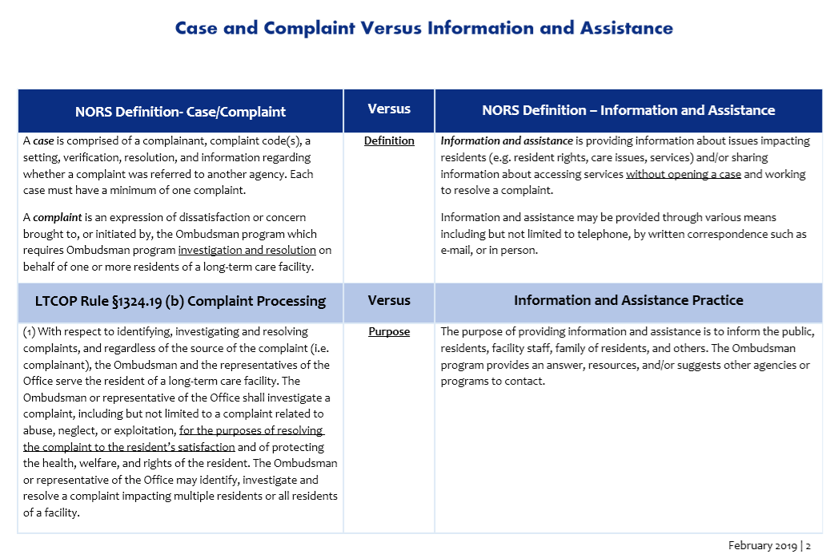
Basic Principles
Case & Complaint vs Information & Assistance
Notes:
The Basic Principles document includes this three-page chart to help you distinguish between what may be a Case with a Complaint and what is Information and Assistance. This will be a helpful tool for training or as a desk reference when you complete your forms or enter your activities in your state system.
As you can see the NORS definitions for a case/complaint and information and assistance are at the top and the rest of the chart outlines the requirements from the LTCOP Final Rule regarding complaint processing compared to providing information and assistance.
The first page clearly establishes the different purposes of a case/complaint versus providing information and assistance. Per the LTCOP Rule the program investigates complaints for the “purposes of resolving the complaint to the resident’s satisfaction,” while the purpose of providing information and assistance is to “inform the public, residents, facility staff, family of residents, and others,” by providing answers, resources, or suggesting other agencies or programs to contact.
The next two slides depict the total of three pages comprising this resource document.

Slide 15
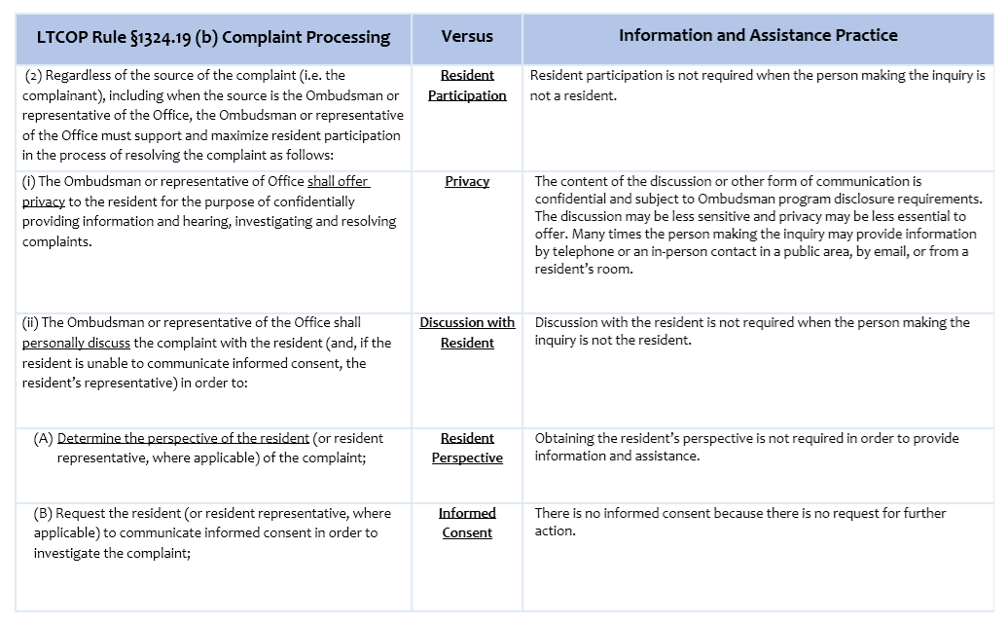
Basic Principles
Case & Complaint vs Information & Assistance
Notes:
We won’t go through every section of this chart as you can do so on your own; however, we do want to highlight an example from each page of the chart.
At the top of the chart, it quotes the LTCOP Rule regarding resident participation stating:
“(2) Regardless of the source of the complaint (i.e. the complainant), including when the source is the Ombudsman or representative of the Office, the Ombudsman or representative of the Office must support and maximize resident participation in the process of resolving the complaint as follows:” and outlines step-by-step how the program must ensure resident participation.
In contrast, resident participation is not required when the person seeking information and assistance is not a resident, since you are only providing information and not taking action to investigate a complaint.

Slide 16
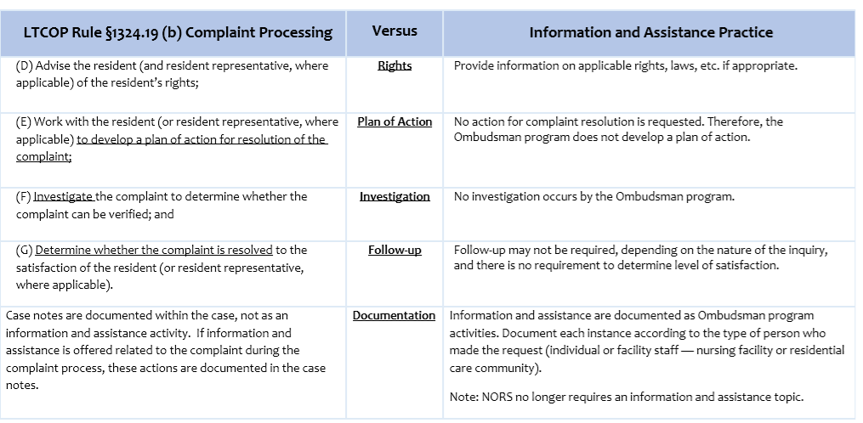
Basic Principles
Case & Complaint vs Information & Assistance
Notes:
As you can see in the last row of the chart, it highlights the difference in documenting your work for cases and information and assistance. It reminds us that case notes documenting your work on a case is included within the case documentation (per your state requirements), not reported as an information and assistance activity.
If information and assistance is provided that relates to the complaint investigation and resolution process, that would be included in the case notes. In other words, don’t count your complaint related communications as information and assistance.
That said, if you provide information and assistance on an issue not related at all to the complaint investigation process, then you would document that as providing information and assistance separate from the case.
Information and assistance is documented as a program activity and you use the code to demonstrate the type of person who made the request (i.e., individual, facility staff).
As we mentioned earlier, the revised NORS does not require the topics of information and assistance requests.

Slide 17
Table 1 – Case Data Components
Parts A, B, and C – Case and Complaint Codes, Values and Definitions
Notes:
Table 1 – Parts A, B, and C - Case and complaint codes, values and definitions is familiar to those of you who attended or listened to the Introductions to Revised NORS webinar earlier this month. Table 1 is 10 pages long and provides pertinent information including definitions and reporting tips and examples.
All resources including Table 1 are available to you in the GoTo meeting Handouts feature and on the National Ombudsman Resource Center website.

Slide 18
Table 1 Highlights
Case Data Components:
  Date case & complaint opened and closed
  Facility or setting
  Complainant
  Complaints (one or more)
  Perpetrator
  Referral agency
  Verification
  Disposition
Notes:
Table 1 explains that cases must have the following components. Reporting most of this information is not new to you.
Currently a case includes one or more complaints brought to, or initiated by, the program. In reporting a case programs have to identify the complainant, complaint code, type of facility, verification, and resolution for complaints.
The changes are in red font. In the revised NORS, programs now have to enter a code for the perpetrator of abuse, neglect, or exploitation, meaning coding whether facility staff, another resident, a family member, resident representative, friend, or other individual is alleged to have caused the abuse, neglect, or exploitation.
Also new in the revised NORS, referring a complaint to another agency is no longer a disposition code. Now, programs will enter a code for what type of agency the complaint was referred as a step toward resolving the complaint.
We encourage you to refer to Table 1 when using the revised NORS training materials and taking the quiz as the table includes the definitions for case, complaint, and complainant. However, the other case data components in Table I that do not pertain to the Part I of the NORS training is not our focus for today.

Slide 19
Part I Quiz
A case must have one or more complaints brought to or initiated by the LTCOP made by or on behalf of one or more residents.
Each complaint requires LTCOP investigation and resolution on behalf of one or more residents of a long-term care facility.
States that have expanded their Ombudsman program services to other settings may choose to report complaints as “other setting.”
Notes:
Now we are going to review the tips provided in the quiz and then work through the quiz together. Here is a snapshot of the Quiz and Quiz Answer Sheet.
As you can see, both documents include tips and directions for the trainee.
The tips remind users that a case must have one or more complaints brought to or initiated by the Ombudsman program by or on behalf of one or more residents.
Each complaint requires Ombudsman program investigation and resolution on behalf of one or more residents of a LTCF. States that have expanded their Ombudsman program services to other settings may choose to report complaints as “other setting”.
The code “other settings” is not a new code as it is called “other” in the current NORS. This code is to be used for complaints Ombudsman programs investigate that are not in a long-term care facility. Use this code for Ombudsman program services provided in other settings such as homecare, adult day care, managed care, and similar types of services or settings.

Slide 20
Part I Quiz Directions
For the following scenarios ask:
Is it a case or an information & assistance?
If it is a case,
  how many complaints are there?
  who is the complainant?
NOTE: Assume you have the consent of the resident, or the resident’s representative as applicable, to take action.
Notes:
The rest of today’s training we will be discussing scenarios. The directions from the training materials will help guide your responses to the poll questions.
Ask yourself is this a Case or the provision of Information and Assistance?
If it’s a Case how many complaints are there and who is the complainant? For all of the hypothetical scenarios assume you have the resident’s consent to take action.
Due to the polling limitations for the webinar, the quiz question and answer format is a bit different for the polls than how you would complete the quiz as a trainee. For this webinar, some of the poll questions will ask you to choose if the scenario is a case, information and assistance, or neither. When some scenarios are determined to be cases there will be an occasional follow-up poll question asking you who the complainant is or the number of complaints.
We will address some questions in between quiz questions and more at the end of the webinar.
We will transition to Katie to assist with the polling feature used today to discuss scenarios, answers, and tips.

Slide 21
Scenario 1
A woman calls asking for information on care planning and how to select a nursing home for her mother. She discusses specific concerns regarding care. The Ombudsman spends an hour talking with the woman and sends additional follow-up information.
Notes:
Read the scenario
A woman calls asking for information on care planning and how to select a nursing home for her mother. She discusses specific concerns regarding care. The Ombudsman spends an hour talking with the woman and sends additional follow-up information.
Choose your answer in the poll:
Case
Information and Assistance
Neither

Slide 22
Scenario 1
Choose the correct answer.
Case
Information and Assistance
Neither
Notes:
The correct answer is Information and Assistance. All of the requests were educational in nature and requests for additional information. Although the Ombudsman spent a lot of time on the call; it did not result in further action rather, the Ombudsman provided information to empower the caller in her search for a nursing home.

Slide 23
Scenario 2
You visit Mrs. Jones, who tells you they are still bringing her pureed food, even though her doctor said she could start eating regular food. You notice her call bell is broken. She indicates she would appreciate your assistance in resolving these problems. You speak to the Director of Nursing (DON) about the call bell, and she promptly fixes the bell. You attempt to talk to the dietician about the pureed food, but she is not available until the next morning. You leave Mrs. Jones but tell her that you will check back with the dietician and will follow-up with her on the results and to ensure that the call bell is still functional.
Notes:
You visit Mrs. Jones, who tells you they are still bringing her pureed food, even though her doctor said she could start eating regular food. You notice her call bell is broken. She indicates she would appreciate your assistance in resolving these problems. You speak to the Director of Nursing (DON) about the call bell, and she promptly fixes the bell. You attempt to talk to the dietician about the pureed food, but she is not available until the next morning. You leave Mrs. Jones but tell her that you will check back with the dietician and will follow-up with her on the results and to ensure that the call bell is still functional.
Choose your answer in the poll:
Case
Information and Assistance
Neither

Slide 24
Scenario 2
Choose the correct answer.
Case
Information and Assistance
Neither
Notes:
It is a case and the complainant is Mrs. Jones, the resident. Although you noticed the call bell, Mrs. Jones gave consent for you to work to get the call bell fixed. Therefore, Mrs. Jones is the complainant because there can be only one complainant for each case.
Is the call bell a complaint or a request? There is a difference between an Ombudsman responding to a concern and an Ombudsman facilitating communication between the resident and the staff. If the Ombudsman is simply the messenger, as in “Would you ask someone to get me some water?” or "Could you tell the aide I'd like to go the dining room now?" then it is not a complaint. Relaying the message does not require investigation, a plan for resolution, and follow-up. However, in this instance, there is a problem which requires action, resolution, and follow-up so it is a complaint. The Ombudsman is doing more than just relaying a message.

Slide 25
Scenario 2
How many complaints are in this case? Choose the correct answer.
One
Two
Three

Slide 26
Scenario 2
How many complaints are in this case? Choose the correct answer.
One
Two
Three
Notes:
This case has two complaints, the complaints are about the broken call light and her food.
The training materials include some training tips in the quiz answer sheet as important reminders for trainers, the tip for this scenario is to remember that since this case has two complaints, the case cannot be closed until both complaints have a final outcome, which we call disposition.

Slide 27
Scenario 3
A certified nurse assistant (CNA) approaches you about the new Director of Nursing (DON). She says that the DON does not listen to staff and is very patronizing when she gives instructions. The staff do not like working with her, several of them are looking for jobs somewhere else. She asks you to intervene with management on behalf of the staff.
Notes:
A certified nurse assistant (CNA) approaches you about the new Director of Nursing (DON). She says that the DON does not listen to staff and is very patronizing when she gives instructions. The staff do not like working with her, several of them are looking for jobs somewhere else. She asks you to intervene with management on behalf of the staff.
Choose your answer in the poll:
Case
Information and Assistance
Neither

Slide 28
Scenario 3
Choose the correct answer.
Case
Information and Assistance
Neither
Notes:
This is not a case, and you should not intervene, because the concern is not made by or on behalf of a resident or residents. If you provide information or suggestions, you may count it as an information and assistance to a facility staff person.
The training tip reminds users to discuss appropriate responses an Ombudsman could provide to the CNA, such as explaining the role of the program as a resident advocate and suggesting that the CNA share her concerns with the facility administrator, human resources, or the facility’s internal complaint process.
If several staff members resign due to treatment of the DON leaving the facility understaffed and negatively impacting the quality of care or life of residents, this could be a case.

Slide 29
Scenario 4
One morning, you receive five notices of discharge from four different nursing homes. The homes are complying with the federal requirement to send copies of these notices to the Ombudsman program.
Notes:
One morning, you receive five notices of discharge from four different nursing homes. The homes are complying with the federal requirement to send copies of these notices to the Ombudsman program.
Choose your answer in the poll:
Case
Information and Assistance
Neither

Slide 30
Scenario 4
Choose the correct answer.
Case
Information and Assistance
Neither
Notes:
Receipt of these notices is neither a case(s) nor an information and assistance. We will talk about why on the next slide.

Slide 31
Scenario 4 – Training Tips
If you follow-up with the residents who received the notices or if one of them or their representative contacts you, you may have a case or an information and assistance.
If the resident or their representative asks you for information or suggestions on how to proceed with the discharge or with an appeal, this would be an information and assistance.
If the resident or their representative asks you to investigate, identify options, and help them either stay in the facility or find another solution, it would be a case with one complaint.
https://ltcombudsman.org/uploads/files/support/NORS_Training_Part_I_Quiz_w_Answers_2019_FINAL.pdf
https://ltcombudsman.org/uploads/files/support/NORS_Training_Part_1_Basic_Principles_2019_FINAL.pdf
Notes:
As a reminder, per the definition of a case, a case is “comprised of a complainant; one or more complaints; documentation of a perpetrator for cases involving abuse, gross neglect, and exploitation; a setting; verification; resolution; and information regarding any referrals to another agency” and a complaint is “an expression of dissatisfaction or concern brought to, or initiated by, the Ombudsman program which requires Ombudsman program investigation and resolution on behalf of one or more residents of a long-term care facility.”
In this scenario, the Ombudsman program is not yet actively involved in investigating and working to resolve the discharges and no one has asked them to on behalf of a resident. Rather, the nursing facilities are sending the notices as part of routine compliance with one of their requirements.
The Training Tips state the following:
If you follow-up with the residents who received the notices or if one of them or their representative contacts you, you may have a case or an information and assistance.
If the resident or their representative asks you for information or suggestions on how to proceed with the discharge or with an appeal, this would be an information and assistance.
If the resident or their representative asks you to investigate, identify options, and help them either stay in the facility or find another solution, it would be a case with one complaint.
We encourage you to refer back to the chart in the Basic Principles for additional information.

Slide 32
Scenario 5
Mrs. Oliver asks you to help her obtain the medical records for her mother, who lives in a nursing home. Mrs. Oliver asked the facility for the records seven days ago and the facility has not responded. She is her mother’s health care durable power of attorney and responsible party.
Notes:
Mrs. Oliver asks you to help her obtain the medical records for her mother, who lives in a nursing home. Mrs. Oliver asked the facility for the records seven days ago and the facility has not responded. She is her mother’s health care durable power of attorney and responsible party.
Choose your answer in the poll:
Case
Information and Assistance
Depends

Slide 33
Scenario 5
Choose the correct answer.
Case
Information and Assistance
Depends
Notes:
This may be a case, with one complaint, or it may not be a case. The difference depends upon how Mrs. Oliver wants you to help. If you conduct an investigation and work to help Mrs. Oliver obtain her mother’s medical records, it is a case. The complainant is Mrs. Oliver, who is the daughter and resident representative.
If you provide information on the process to access resident records to help Mrs. Oliver, it is an information and assistance.

Slide 34
Scenario 6
A facility staff person tells you that Mrs. Smith’s son, who has power of attorney for his mother, is verbally abusing Mrs. Smith, using her income for his own purposes, and has not paid her bill for three months. The staff person requests your involvement in resolving the nonpayment issue.
Notes:
A facility staff person tells you that Mrs. Smith’s son, who has power of attorney for his mother, is verbally abusing Mrs. Smith, using her income for his own purposes, and has not paid her bill for three months. The staff person requests your involvement in resolving the nonpayment issue.
Choose your answer in the poll:
Case
Information and Assistance
Neither

Slide 35
Scenario 6
Choose the correct answer.
Case
Information and Assistance
Neither
Notes:
It is a case.

Slide 36
Scenario 6
How many complaints are in this case? Choose the correct answer.
One
Two
Three

Slide 37
Scenario 6
How many complaints are in this case? Choose the correct answer.
One
Two
Three
Notes:
There are two complaints with facility staff as the complainant. If the resident is at risk of discharge for nonpayment, then you can add a third complaint.

Slide 38
Scenario 7
Mr. Jones calls the Ombudsman program, complaining that his mother has a black eye and the facility can give no explanation for it. He asks you to check on her and cautions you that his mother has Alzheimer’s and does not remember things accurately. You visit his mother and notice light bruises on her face and arms but cannot verify that she had a black eye.
Notes:
Mr. Jones calls the Ombudsman program, complaining that his mother has a black eye and the facility can give no explanation for it. He asks you to check on her and cautions you that his mother has Alzheimer’s and does not remember things accurately. You visit his mother and notice light bruises on her face and arms but cannot verify that she had a black eye.
Choose your answer in the poll:
Case
Information and Assistance
Neither

Slide 39
Scenario 7
Choose the correct answer.
Case
Information and Assistance
Neither
Notes:
It is a case, and there is one complaint. The Ombudsman initiates a complaint investigation, determines if the complaint can be verified, and works to resolve the complaint whether the complaint can be verified or not. The complainant is Mr. Jones, the son, because he is concerned about her black eye and asked you to check on his mother.

Slide 40
Scenario 8
During a facility visit, two residents tell you that they would like to have water available but no one brings it when they ask. They are afraid to ask again and say that it must be an oversight because staff are always rushed. They do not want to complain any more. As you continue your visit, you notice that several other residents who cannot get out of bed do not have water at their bedside tables. Some of the residents cannot communicate with you. You do not see any staff filling containers or distributing water while you are visiting.
Notes:
During a facility visit, two residents tell you that they would like to have water available but no one brings it when they ask. They are afraid to ask again and say that it must be an oversight because staff are always rushed. They do not want to complain any more. As you continue your visits, you notice that several other residents who cannot get out of bed do not have water at their bedside tables. Some of the residents cannot communicate with you. You do not see any staff filling containers or distributing water while you are visiting.
Choose your answer in the poll:
Case
Information and Assistance
Neither

Slide 41
Scenario 8
Choose the correct answer.
Case
Information and Assistance
Neither
Notes:
This is a case with one complaint.

Slide 42
Scenario 8
Who is the complainant? Choose the correct answer.
Resident
Ombudsman program
Facility staff

Slide 43
Scenario 8
Who is the complainant? Choose the correct answer.
Resident
Ombudsman program
Facility staff
Notes:
The Ombudsman program is the complainant. You observed numerous residents who are affected by the problem that two residents discussed with you, but did not give you permission to resolve. Since you observed this on your own and do not have permission, you would address this as the complainant since you noticed and that impacts several residents.

Slide 44
Scenario 9
Mr. Brown’s daughter and guardian, Alice, calls the Ombudsman program, concerned that her father is eating all his meals in his room, instead of in the dining room. You visit Mr. Brown, who seems despondent and is unable to express his wishes. You speak with the Director of Nursing (DON) about Alice’s concern; the DON says staff should be taking Mr. Brown to the dining room and that she will discuss the problem with two new nursing assistants and will put a note in Mr. Brown’s chart. The following week you call Alice, who tells you the nursing assistants are taking her father to the dining room now and he appears much happier.
Notes:
Mr. Brown’s daughter and guardian, Alice, calls the Ombudsman program, concerned that her father is eating all his meals in his room, instead of in the dining room. You visit Mr. Brown, who seems despondent and is unable to express his wishes. You speak with the Director of Nursing (DON) about Alice’s concern; the DON says staff should be taking Mr. Brown to the dining room and that she will discuss the problem with two new nursing assistants and will put a note in Mr. Brown’s chart. The following week you call Alice, who tells you the nursing assistants are taking her father to the dining room now and he appears much happier.
Choose your answer in the poll:
Case
Information and Assistance
Neither

Slide 45
Scenario 9
Choose the correct answer.
Case
Information and Assistance
Neither
Notes:
It is a case. There is one complaint made by Alice, who is the daughter and resident representative.

Slide 46
Scenario 10
Ms. Miller, a resident of Sunny Valley Assisted Living Facility, stops you in the hall and tells you she has a problem: her son, who lives at home, has just lost his Medicaid benefits and she is concerned he won’t be able to pay for his medication. As she rolls away in her wheelchair, you notice that the wheelchair keeps veering to the left and hitting the wall. You ask if she would like your assistance in getting it fixed, or in getting a new chair. She replies, “Yes.”
Notes:
Ms. Miller, a resident of Sunny Valley Assisted Living Facility, stops you in the hall and tells you she has a problem: her son, who lives at home, has just lost his Medicaid benefits and she is concerned he won’t be able to pay for his medication. As she rolls away in her wheelchair, you notice that the wheelchair keeps veering to the left and hitting the wall. You ask if she would like your assistance in getting it fixed, or in getting a new chair. She replies, “Yes.”
Choose your answer in the poll:
Case
Information and Assistance
Neither

Slide 47
Scenario 10
Choose the correct answer.
Case
Information and Assistance
Neither
Notes:
It is a case, with one complaint.

Slide 48
Scenario 10
Who is the complainant? Choose the correct answer.
Resident
Ombudsman program
Facility staff

Slide 49
Scenario 10
Who is the complainant? Choose the correct answer.
Resident
Ombudsman program
Facility staff
Notes:
Ms. Miller, the resident, is the complainant. Once the Ombudsman brings a problem to the resident's attention and the resident acknowledges the problem and gives permission to resolve it, the resident becomes the complainant.
If you tell her how her son can appeal the Medicaid determination, you could document that as an information and assistance to an individual.

Slide 50
Scenario 11
A facility administrator calls you to complain that the volunteer Ombudsman assigned to his home is not doing her job. He explains that he informed her about a problem the facility was having with a resident’s behavior, but she refused to address the facility’s concern. Instead she visited privately with the resident and refused to tell the administrator or the corporation’s lawyer about her visit.
Notes:
A facility administrator calls you to complain that the volunteer Ombudsman assigned to his home is not doing her job. He explains that he informed her about a problem the facility was having with a resident’s behavior, but she refused to address the facility’s concern. Instead she visited privately with the resident and refused to tell the administrator or the corporation’s lawyer about her visit.
Choose your answer in the poll:
Case
Information and Assistance
Neither

Slide 51
Scenario 11
Choose the correct answer.
Case
Information and Assistance
Neither
Notes:
It is not a case because the concern was not made by or on behalf of the resident. If you provide information to the administrator on the role of the Ombudsman, count this as an information and assistance.

Slide 52
Scenario 12 – first part
Mrs. Lee’s daughter called you to complain that her mother would like to take a bath more often than once a week. On December 15th you go to Hilltop Haven to visit Mrs. Lee. On your way to Mrs. Lee's room you notice that there is dirty laundry on the floor in the hall and that the hall is dark because several lights are not working. When you visit Mrs. Lee, she says that she wants to be bathed more often than once a week.
Notes:
Question #12 is presented on two slides.
Mrs. Lee’s daughter called you to complain that her mother would like to take a bath more often than once a week. On December 15th you go to Hilltop Haven to visit Mrs. Lee. On your way to Mrs. Lee's room you notice that there is dirty laundry on the floor in the hall and that the hall is dark because several lights are not working. When you visit Mrs. Lee, she says that she wants to be bathed more often than once a week.

Slide 53
Scenario 12 – second part
After you visit Mrs. Lee, you drop by to see Mrs. James. She tells you that they stopped her physical therapy (PT) and she does not know why. She complains that the sliding track for the privacy curtain is broken, so it does not close all the way. You investigate both complaints. You resolve and close the PT complaint within the week. You learn that the facility has tried to order a new track, but it’s on back order. You keep the complaint open until the new track is installed. You go back to visit Mrs. James in January. She tells you that they are installing the track the next day. She also tells you that she just received a notice from the facility saying that she will have to switch to the facility pharmacy even though it may cost more than the pharmacy she has been using for the past three years. You tell her you'll check into it for her.
Notes:
Second part of Question #12
After you visit Mrs. Lee, you drop by to see Mrs. James. She tells you that they stopped her physical therapy (PT) and she does not know why. She complains that the sliding track for the privacy curtain is broken, so it does not close all the way. You investigate both complaints. You resolve and close the PT complaint within the week. You learn that the facility has tried to order a new track, but it’s on back order. You keep the complaint open until the new track is installed. You go back to visit Mrs. James in January. She tells you that they are installing the track the next day. She also tells you that she just received a notice from the facility saying that she will have to switch to the facility pharmacy even though it may cost more than the pharmacy she has been using for the past three years. You tell her you'll check into it for her.
Choose your answer in the poll:
Case
Information and Assistance
Neither

Slide 54
Scenario 12
Choose the correct answer.
Case
Information and Assistance
Neither
Notes:
Answer: Open three cases.
Case 1: 1 complaint regarding wanting more frequent showers
Case 2: 2 complaints The Ombudsman program can be the complainant when the Ombudsman identifies a problem that affects numerous residents and can address the complaint without disclosing the identity of residents, such as a general environmental concern.
Case 3: Mrs. James, resident – 3 complaints It is possible that Mrs. James’s pharmacy complaint could be a separate case/complaint. Whether you open one or two cases for Mrs. James would depend on your state’s policy and the amount of time between her complaints. For example, if she had one or more complaints in December and January and all the complaints were resolved in February, you would close the case in February. If she then brought one or more complaints forward in March, you would open a new case. However, in the case cited, it is both a judgement call and a state policy decision.

Slide 55
Scenario 12
Who is the complainant for the first case that involved a complaint about additional showers? Choose the correct answer.
Resident
Ombudsman program
Resident’s daughter

Slide 56
Scenario 12
Who is the complainant for the first case that involved a complaint about additional showers? Choose the correct answer.
Resident
Ombudsman program
Resident’s daughter
Notes:
Answer: Mrs. Lee’s daughter – Although you visited the resident and followed her direction, Mrs. Lee’s daughter initiated the complaint. Therefore, the daughter is the complainant.

Slide 57
Summary
NORS Overview
Part I Training Materials
  Basic Principles
  Quiz
  Quiz Answer Sheet
Resource - Table 1 – NORS Parts A, B, and C – Case and complaint codes, values and definitions
Quiz

Slide 58
Questions?

Slide 59
resources

Slide 60
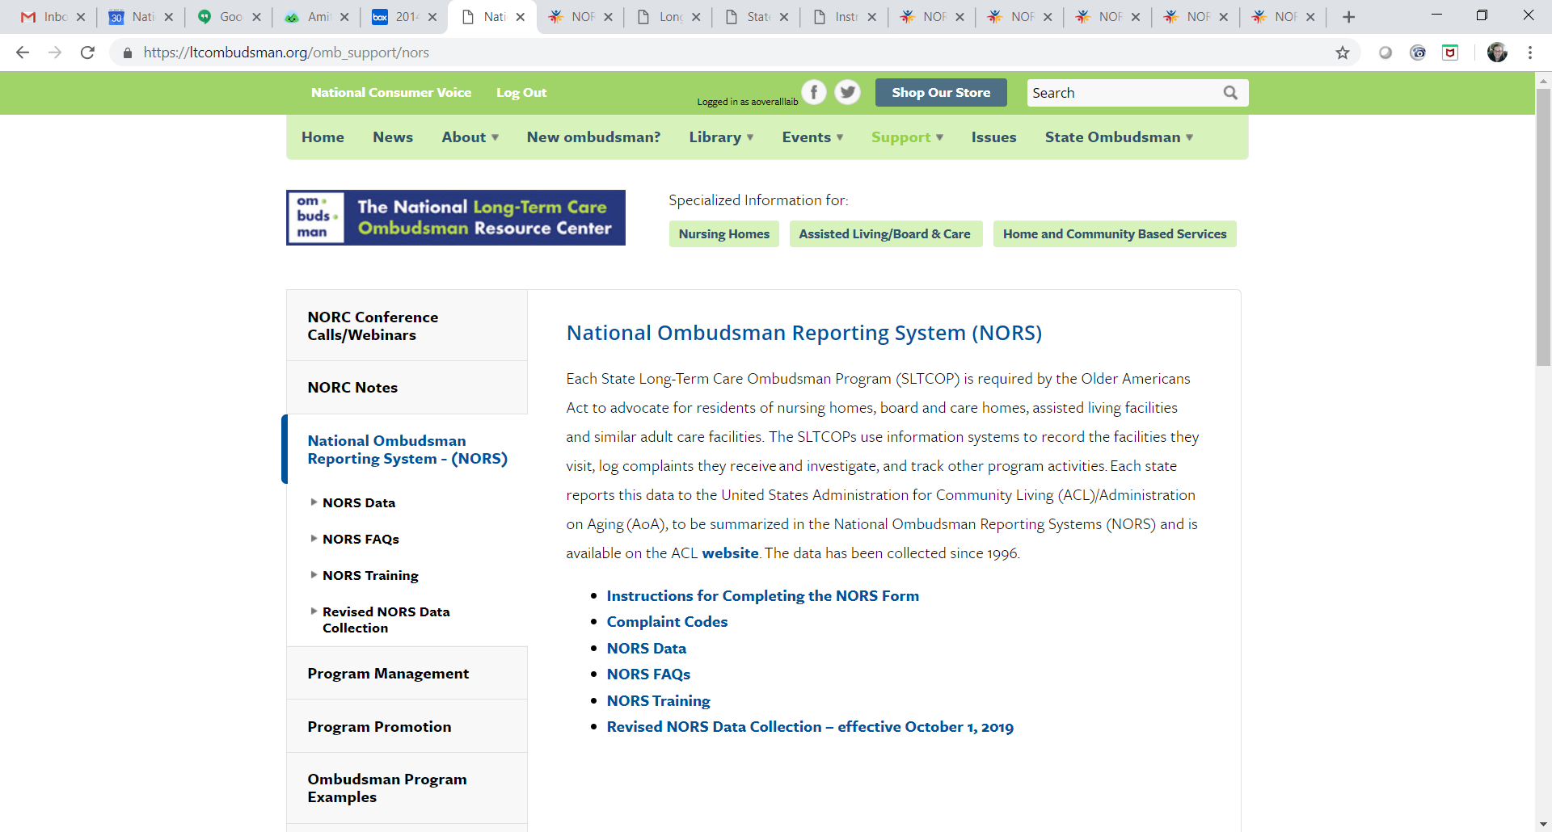
NORS Instructions, Training, and Materials https://ltcombudsman.org/omb_support/nors

Slide 61
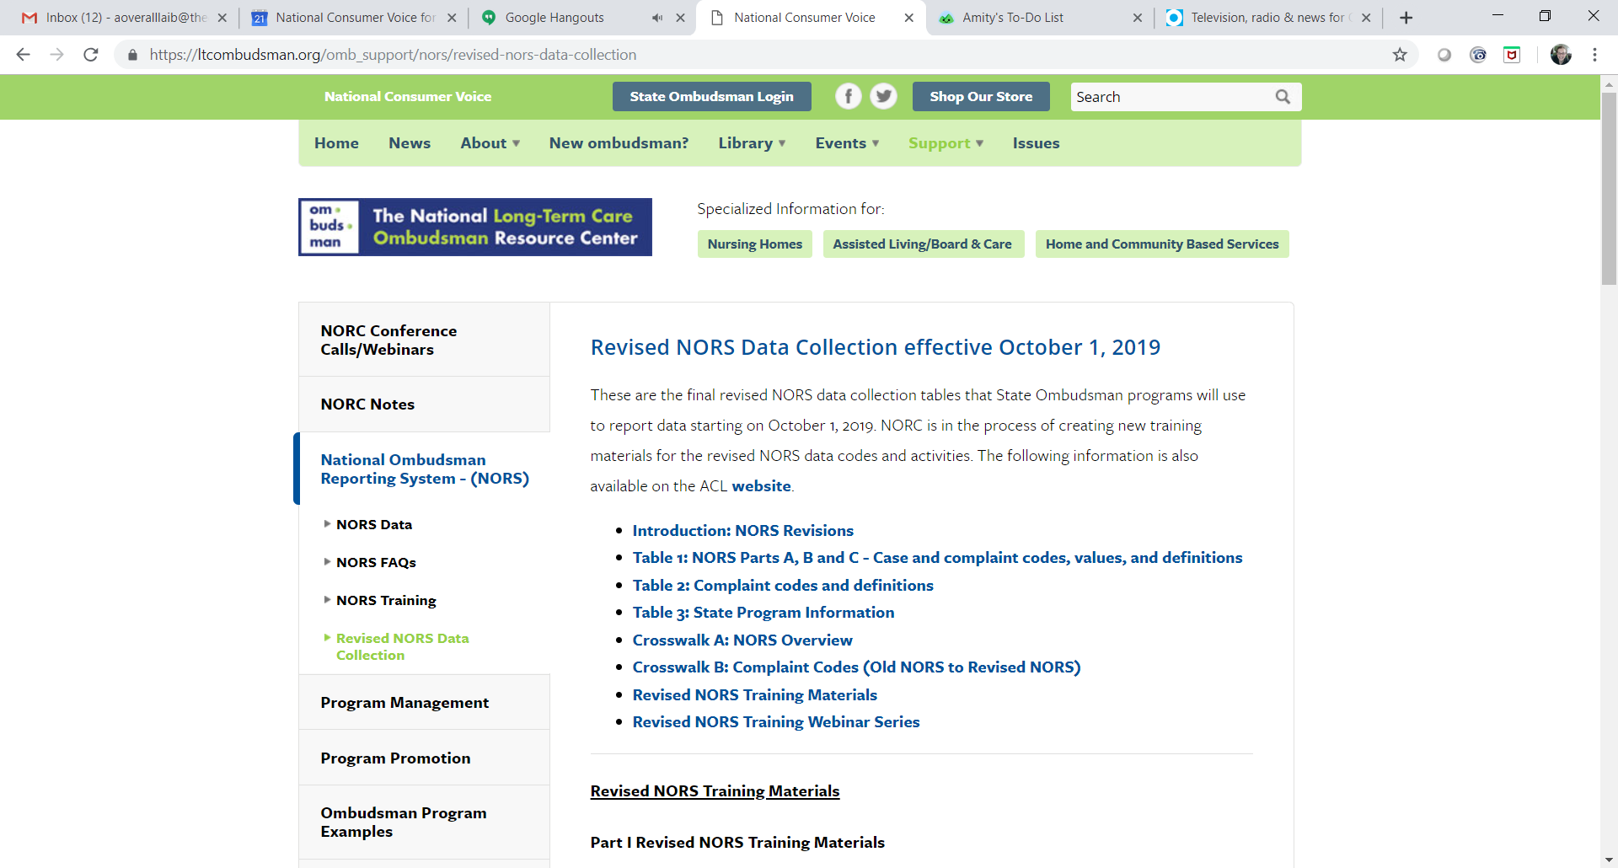
Revised NORS Data Collection https://ltcombudsman.org/omb_support/nors/revised-nors-data-collection

Slide 62

Start Using Revised NORS – October 1, 2019
Notes:
Ombudsman programs will begin using the revised NORS codes, definitions, and activities on October 1, 2019 (Federal Fiscal Year 2020). The Office of the State Ombudsman will submit federal fiscal year 2020 data in January 2021. There are several components of NORS, such as narrative examples of advocacy work, that the Office of the State Ombudsman writes and submits along with data to the Administration for Community Living. This webinar series will highlight areas of the revised NORS that are pertinent to you.
Please remember do not use the new codes or definitions until October 1, 2019.

Slide 63

NORS Training by NORC
Webinars will review the data elements with specific case examples to discuss. Training modules will be released prior to each webinar.
Register for one webinar you are registered for the entire series.
Webinar recordings and materials available here - https://ltcombudsman.org/omb_support/nors/revised-nors-data-collection
NORS Webinars 2019 – 3:00 – 4:30 p.m. ET
  Part II: Coding Complaints – March 19
  Part III: Closing the Case - April 30
  Part IV: Activities – May 29
This Photo by Unknown Author is licensed under CC BY-SA
Notes:
All State Ombudsmen and representatives of the Office are encouraged to attend. If you registered for this webinar then you are automatically registered for all of the NORS webinars. Webinars will be recorded and recordings and materials will be emailed to attendees and available on the NORC website. The next webinar, NORS Part II is scheduled for March 19th, 3:00 – 4:30 p.m. ET.

Slide 64
Contact Information
Amity Overall Laib, NORC Director
aoverallaib@theconsumervoice.org
(202) 332 2275 ext. 207
Louise Ryan, Ombudsman Program Specialist, AoA/ACL
louise.ryan@acl.hhs.gov
206-615-2514
Maria Greene
NORC Consultant
margreene@outlook.com
(770) 668 6366

Slide 65


The National Long-Term Care
Ombudsman Resource Center (NORC)
www.ltcombudsman.org
Connect with us:
The National LTC Ombudsman Resource Center
@LTCombudcenter
This project was supported, in part, by grant number 90OMRC0001-01-00, from the U.S. Administration for Community Living, Department of Health and Human Services, Washington, D.C. 20201. Grantees undertaking projects under government sponsorship are encouraged to express freely their findings and conclusions. Points of view or opinions do not, therefore, necessarily represent official Administration for Community Living policy.

