Slide 1
Ombudsman Advocacy and Culture Change:
Achieving RESIDENT-DIRECTED Care IN DAILY ADVOCACY
January 10, 2012

Slide 2
Your Daily Routine
Think about your morning routine…
What do you do first?
What is your favorite part of your morning?
What do you do on a daily basis that provides you with comfort, joy, a sense of identity, purpose, and/or security?

Slide 3
Underlying Question
How do we organize our systems around the people who live & work in nursing homes to enhance quality of life?

Slide 4
Culture Change: Philosophy and Practice
Culture change is a transformation in philosophy and practice to de-institutionalize care and create a resident-directed approach in all aspects of life in long-term care
Culture change includes changing how Ombudsmen communicate with residents, families and providers
Supporting resident-directed care is important and meaningful at every level including collaboration in coalitions and daily advocacy

Slide 5
Culture Change Practices
Culture Change is more than environment improvements
Environmental
Remove nurses station
Use dinnerware and cloth napkins rather than trays
Introduce plants and pets (including resident pets)
Create smaller neighborhoods of 10-15 residents rather than “wings”
Resident-Directed Care and System Change
Enable resident choice in all aspects of care and facility decisions
Individualized care plans, include resident in hiring process and community dietary decisions, implement consistent staff assignment

Slide 6
Resident-Centered Language (“person-first”)
Institutional Language | Resident-Centered Language
Nourishment | Snack
Bibs | Napkin, Clothing protector
Diapers, Pull-ups | Briefs, Panties, Attends, Brand names
Dietary services, Food service | Dining services
Ward, Unit | Village, Neighborhood
Nurses' station | Work area, Den, Support room, Desk
Patient | Resident, Client, Neighbor, Friend
Residents known by diagnosis | Their name -- Learn it!
Wanderers | People who like to walk
100-bed facility | 100 people live in this home

Slide 7
“Our nation has been conducting investigations, passing new laws and issuing new regulations relative to nursing homes at a rapid rate during the past few years. All of this activity will be of little avail unless our communities are organized in such a manner that new laws and new regulations are utilized to deal with the individual complaints of older persons who are living in nursing homes. The individual in the nursing home is powerless. If the laws and regulations are not being applied to her or to him, they might just as well not have been passed or issued.” Commissioner Flemming (AoA-TAM- 76-24)

Slide 8
Ombudsmen, OBRA and Culture Change
Older Americans Act
Culture Change
Support community efforts to improve long-term care
Advocate for quality care and rights of residents at the individual and systemic level
Resolve problems by representing the interest of the resident
Act on residents’ behalf in response to action or inaction by providers, public agencies and others that may adversely affect the resident
Provide information to residents, families and providers regarding culture change and resident-directed care
Promote resident-directed care and culture change during complaint resolution
Collaborate with others for widespread change and promote culture change as systems advocacy

Slide 9
Ombudsmen, OBRA and Culture Change
OBRA
Culture Change/
Pioneer Principle
Right to the highest practicable physical, mental, and psychosocial well-being of each resident
Right to be treated with consideration, respect and dignity
Right to self-determination and choice
Respond to spirit, as well as mind and body
Know each person
Relationship is the fundamental building block of a transformed culture
All elders are entitled to self-determination wherever they live

Slide 10
Ombudsmen, OBRA and Culture Change
OBRA
Culture Change/
Pioneer Principle
Right to participate in community activities
Right to be informed, participate in care planning and make decisions regarding care
Right to receive appropriate and adequate care
Community is the antidote to institutionalization
Put person before the task
Know each person
Promote the growth and development of all

Slide 11
“Ombudsmen who have embarked on culture change initiatives have found that the effort needs to be comprehensive and long-term and yet needs to be approached in a manageable step by step process.” NORC 2000, Ombudsman Best Practices: Supporting Culture Change to Promote Individualized Care, B. Frank

Slide 12
Case Discussion

Slide 13
Case #1
During a routine visit to Stoneybrook Nursing and Rehab several residents tell you that the food is often cold. You speak with other residents who are also dissatisfied with the food temperatures and would like more than one alternative meal choice. Due to the number of complaints about food, you visit with the Resident Council President, Ms. Jackson. Ms. Jackson says that complaints regarding the food temperature, lack of choice and small servings have been reoccurring complaints in the last few months. Ms. Jackson said the Administrator promises to address their complaints, but it is only better for a week or so and then goes back to normal.

Slide 14
Case #1
Culture Change Practices/Principles
Common Resolution Strategies
Seek permission to attend RC meeting and listen to resident concerns regarding dining
Encourage RC to invite the Dietary Manager to their meetings in order to discuss these issues
Provide information regarding Residents’ Rights
Support resident petition regarding dining
Dining Committee (includes residents and staff)
Discuss different dining styles (e.g. menus, open dining hours, soup and salad buffet, family style)
Formal feedback from residents regarding dining (e.g. survey)
A learning circle to discuss their dining experience
Residents vote on personal recipes for staff to cook
Resident vegetable garden
Incorporate cooking into activities

Slide 15
Case #2
Ms. Young is a 42-year old resident with multiple sclerosis living in Baywater Nursing Home. Prior to needing 24-hour nursing care and moving into Baywater, Ms. Young worked as Physician’s Assistant. The Administrator, Mr. Brooks, calls you to discuss a pending discharge notice for Ms. Young. Mr. Brooks claims Ms. Young is violating the right to privacy of other residents by getting involved in their complaints. Mr. Brooks claims Ms. Young often tells the staff that she is more knowledgeable than they are and they should stop making mistakes. He states that the nursing staff feels threatened by her and do not want to assist her or provide care. Mr. Brooks also says Ms. Young is particularly close to a nurse on staff. Occasionally Ms. Young complains openly about how Mr. Brooks manages the nursing home and treats his staff. Mr. Brooks says he and his staff have spoken with Ms. Young about getting involved in other residents’ complaints, about her relationship with the staff and about her personal complaints, but they cannot meet her needs and have to issue a discharge notice.

Slide 16
Case #2
Common Resolution Strategies
Culture Change Practices/Principles
Provide information regarding residents’ rights and discharge appeal rights
Speak with Administrator regarding resident’s rights and discourage discharge notice
Recommend meeting with staff and resident to discuss resident needs
Identify if the other residents want her involved in their complaints
Identify what is meaningful to the resident and encourage staff to meet those needs
Is the resident involved in the RC? A leadership role in the RC?
PEER Training to be a resident advocate?
Are there other younger residents? If so, do they have shared interests?
Encourage an open dialogue between her and the direct staff
Include her in staff training for a resident perspective
Volunteer in the community? Hospice volunteer in the nursing home?

Slide 17
Complaints and Culture Change
If LTCO focus on culture change activities, who will address the problems in facilities?
Is focusing on culture change the best use
of ombudsman time given the chronic issues
we deal with every day?

Slide 18
Top 10 Complaints (2006-2010)
Code | Complaint
41 | Failure to respond to requests for assistance
19 | Discharge/eviction- planning, notice, procedure, implementation, abandonment
26 | Dignity, respect - staff attitudes
44 | Medications - administration, organization
40 | Accidental or injury of unknown origin, falls, improper handling
42 | Care plan/resident assessment - inadequate, failure to follow plan or orders
71 | Food service - quantity, quality, variation, choice, condiments, utensils, menu
45 | Personal hygiene (includes nail care & oral hygiene) dressing & grooming
Two of the Top 10 Complaints Alternate Between the Three Codes Below:
66 | Resident conflict, including roommates
48 | Symptoms unattended, including pain, pain not managed
79 | Equipment/Buildings - disrepair, hazard, poor lighting, fire safety, not secure

Slide 19
Chronic Issues
NORS: Top 3 Complaints from 2006-2010
1. F-41: Failure to respond to requests for assistance
2. C-19: Discharge/eviction-planning, notice, procedure, implementation, including abandonment
3. D-26: Dignity, respect- staff attitudes

Slide 20
How do you respond to complaints regarding call lights?

Slide 21
Call Lights and Culture Change
What do residents want?
Relationships with staff and other residents
What do caregivers want?
“CNAs defined good caregiving as based on the establishment and maintenance of good relationships with residents…”*
Pioneer Principle
Relationship is the fundamental building block of a transformed culture
*Turnover Reinterpreted: CNAs Talk About Why They Leave, Barbara Bowers

Slide 22
What is the “root cause?”
What is the residents’ routine?
When are call lights used the most?
What is the most common request for help?
Can the staff anticipate the residents’ needs?
Do residents actively participate in their care plans?
Facility schedule or residents’ schedule?
Is there a rigid morning schedule or do residents wake as they wish?
Do shower schedules honor resident preferences?

Slide 23
What is the “root cause?”
Not enough staff? High turnover?
Consistent Assignment
Better understanding of the residents’ routine, better care
Better relationships between the staff and residents
Increased staff and resident satisfaction, less staff turnover
Why are call lights ignored?
Who usually responds to call lights?
“That’s not my job.”
Promote teamwork response and direct care involvement in decisions
Share the residents’ perspective of what call lights mean to them

Slide 24
Culture Change as Systems Advocacy
What are the top 5 complaints in your region/assigned facilities?
How could Culture Change practices address those complaints?
How can you develop a Systems Advocacy plan to respond to those complaints and promote resident-directed care?
In-Service training for staff
Work with Resident and Family Councils

Slide 25
Discussion

Slide 26
In Closing
Seize daily opportunities to incorporate Culture Change principles and encourage resident-directed care in:
Complaint resolution process
Discussions regarding Residents’ Rights
Consultations with facility staff, residents and families
Your language
Systemic advocacy

Slide 27
Resources
The National Long-Term Care Ombudsman Resource Center (NORC) www.ltcombudsman.org
The National Consumer Voice for Quality Long-Term Care www.theconsumervoice.org
Pioneer Network www.pioneernetwork.net
Advancing Excellence in America’s Nursing Homes www.nhqualitycampaign.org
CMS (Centers for Medicare & Medicaid Services) www.cms.gov
CMS: Four Part Series- From Institutionalized to Individualized Care (archived webcasts) http://surveyortraining.cms.hhs.gov
Quality Partners of Rhode Island www.riqualitypartners.org
PHI National www.phinational.org
YOU! Please share your success and activities with NORC.

Slide 28
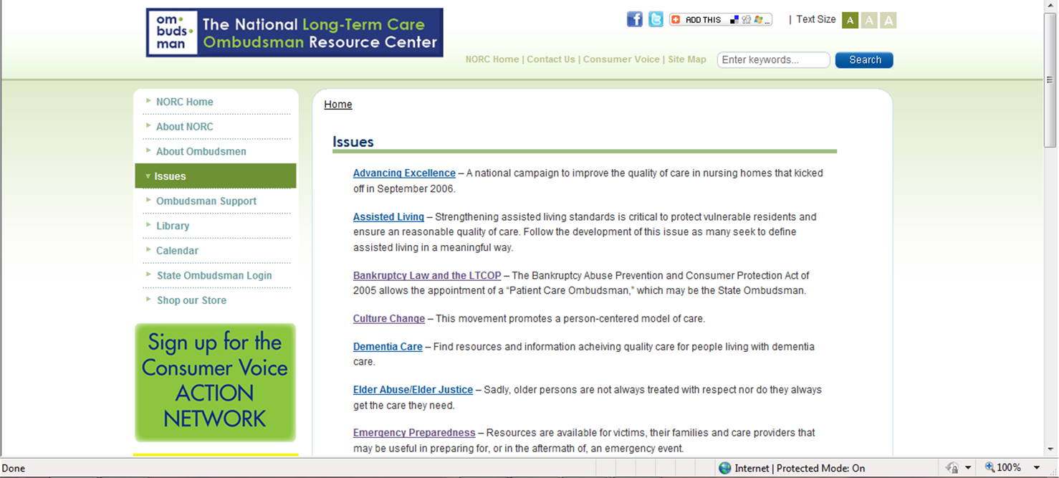

Slide 29
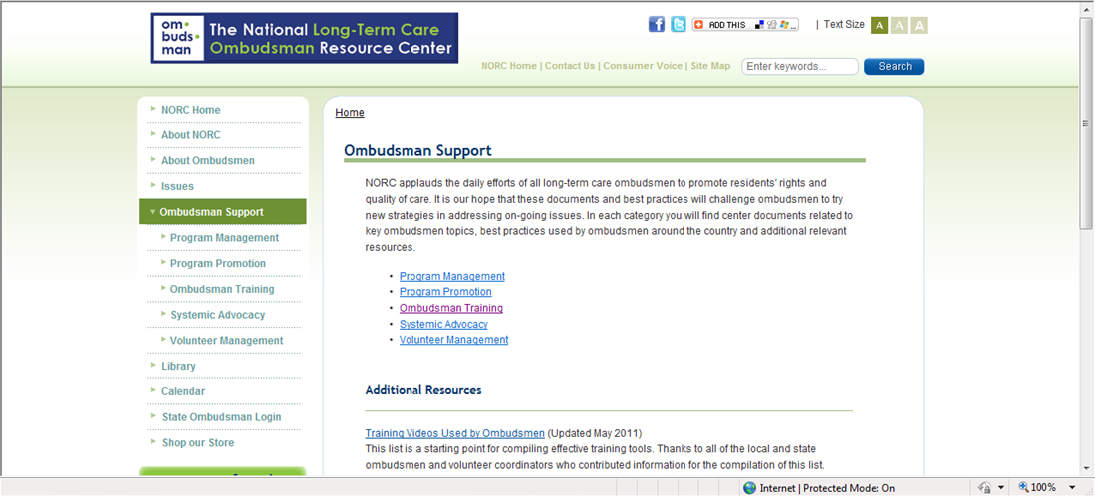

Slide 30
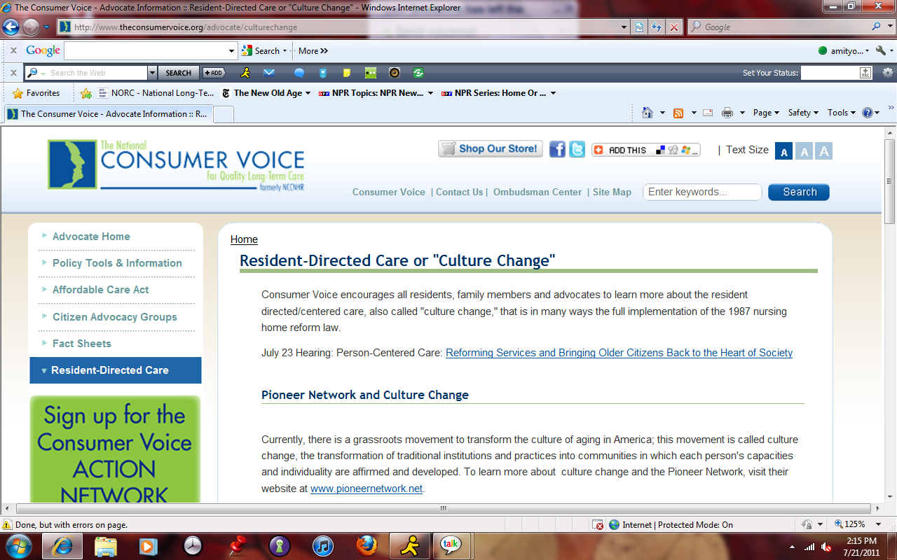

Slide 31
The National Long-Term Care
Ombudsman Resource Center (NORC)
www.ltcombudsman.org
ombudcenter@theconsumervoice.org
The National Consumer Voice for Quality Long-Term Care
(formerly NCCNHR)
http://www.theconsumervoice.org/
This presentation was supported, in part, by a grant from the Administration on Aging, Department of Health and Human Services.

