Slide 1

National Evaluation of the Long-Term Care Ombudsman Program:
Local Data Collection
Kim Nguyen, Ph.D. Emily White, M.A.
NORC at the University of Chicago
May 3, 2018

Slide 2
Agenda
Here are the topics that we will cover today:
Introduction to NORC Evaluation Team
Overview of the LTCOP Evaluation
About the Surveys
Administering the Surveys
Disseminating Evaluation Findings
Question & Answer Session

Slide 3
Introduction to the NORC Evaluation Team
Local Data Collection Team
Kim Nguyen – Project Director
Sarah Downie
Jennifer Satorius
Emily White
Jennifer Scolese

Slide 4
Overview of the Evaluation of the LTCOP
Purpose of the Study
This evaluation is funded by the Administration for Community Living/Administration on Aging (ACL/AoA).
The aim of this evaluation is to better understand how the LTCOP is carried out at the local, state and federal levels, and it’s progress toward reaching program goals.
Information collected will help support program planning and improvement.

Slide 5
Overview of the Evaluation of the LTCOP
Purpose of the Study
The evaluation seeks to describe:
  How the LTCOP is structured and how it operates at the local, State, and Federal levels
  How the LTCOPs use resources to resolve residents’ problems and improve the quality of services
  How LTCOPs coordinate with other entities
  How LTCOPs provide feedback on successful practices and areas for improvement

Slide 6
Overview of the Evaluation of the LTCOP
Phase 1 of Data Collection (Completed in Summer 2017)
Interviews:
  State Ombudsmen
  Federal Staff
  National Stakeholders

Slide 7
Overview of the Evaluation of the LTCOP
Phase 2 of Data Collection (Spring 2018 - underway)
Surveys:
  State Ombudsmen – completed
  Local staff and volunteers (sample of 27 states)
All local/regional staff ombudsmen, and a sample of volunteer ombudsmen from the local programs selected, are invited to complete a survey about their responsibilities and experiences with the program.

Slide 8
Overview of the Evaluation of the LTCOP
Phase 2 of Data Collection (Spring 2018 - underway)
27 Participating States in Local Data Collection
AoA Region
1 | 2 | 3 | 4 | 5 | 6 | 7 | 8 | 9 | 10
ME | NJ | DE | FL | IL | LA | IA | ND | AZ | AK
RI | NY | VA | KY | IN | NM | NE | SD | CA | WA
 |  |  | TN | OH |  |  |  | HI
 |  |  | SC | MN |  |  |  | NV
 |  |  |  | WI

Slide 9
About the Surveys
Respondent Groups
There are three different survey groups:
  Local/Regional Ombudsman – Lead
  Local/Regional Ombudsman – Standard
  Volunteer Ombudsman

Slide 10
About the Surveys
This survey is both voluntary and confidential
Voluntary:
  This survey is voluntary and not part of an audit or a compliance review.
  You may choose to skip any questions that you do not feel comfortable answering, and you may quit the survey at any time.
Confidential:
  Your individual responses will not be shared outside the NORC evaluation team
  Survey results will not identify state or local programs. All results will be pooled across all participating programs and reported out based on respondent group (i.e., ombudsman, volunteer).

Slide 11
About the Surveys
Topics and Administration
The surveys focus on the following areas:
  Background information
  Program structure & resources
  State and local level coordination
  Program activities
  Program quality assurance
  Demographic information
Each survey can be completed in 1 of 2 ways:
  Web-based
  Paper-based

Slide 12
About the Surveys
A note about terms used in the surveys
Local/Regional Ombudsmen =
  Representatives of the office
  Paid staff and volunteers
  Depending on organizational structure, can be located in the state or local office
Office of the State LTCO = Office that is headed by the State Ombudsman
Local programs =
  programs located in decentralized structures in local entities
  state Office in centralized programs
Board and care homes =
  assisted living facilities, residential care facilities, adult congregate living facilities, foster care homes, and other adult care homes (not nursing homes)
In-home services = services provided to older adults in their own home

Slide 13
Administering the Surveys
What to expect
Participants will receive an invitation from NORC, by email, to complete their survey
This email invitation will contain a web link to your personalized survey
If you have questions, need technical assistance, or would like to request a paper-based survey, you may contact the evaluation team by:
  Email at LTCOPsurvey@norc.org
  Phone at 1-877-505-0253

Slide 14
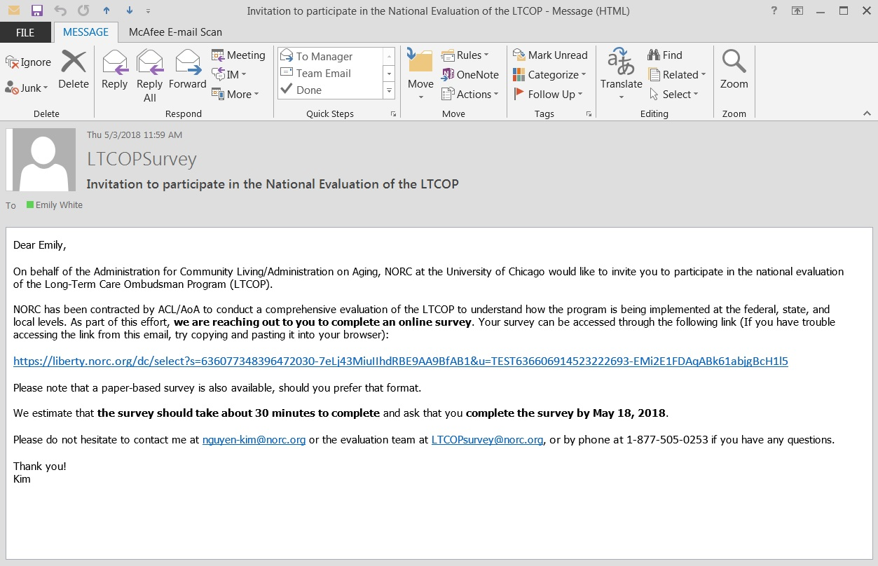
Administering the Surveys – Example Email Invitation
Invitation Email
Notes:
https://liberty.norc.org/dc/select?s=636077348019596145-24AY1EaT7kfIB61if18sD6pAd&u=TEST636582700036376423-8eAmaF4fbea41EmeDbEleAeD2

Slide 15
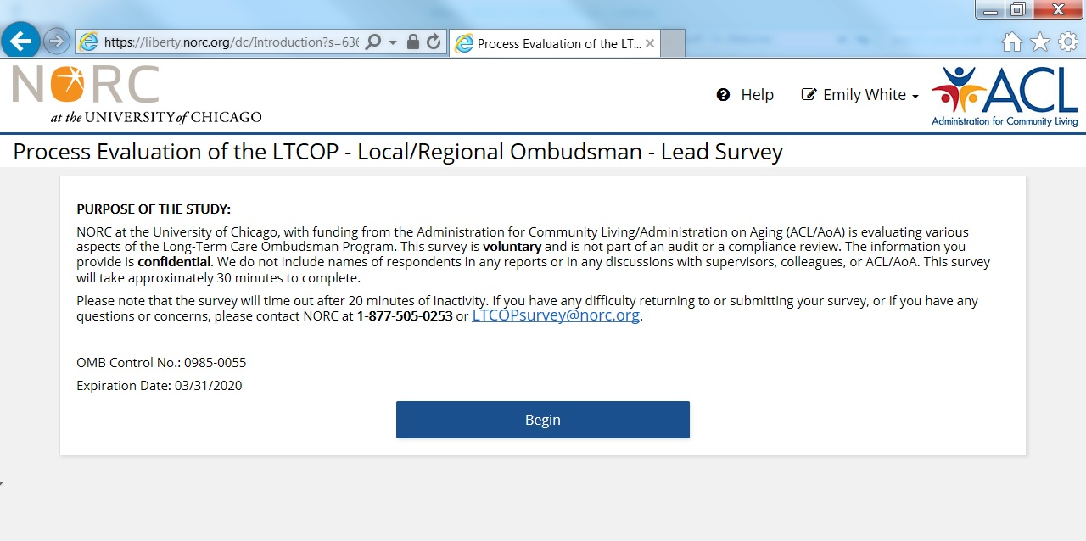
Administering the Surveys – Web Version
Web-based Surveys

Slide 16
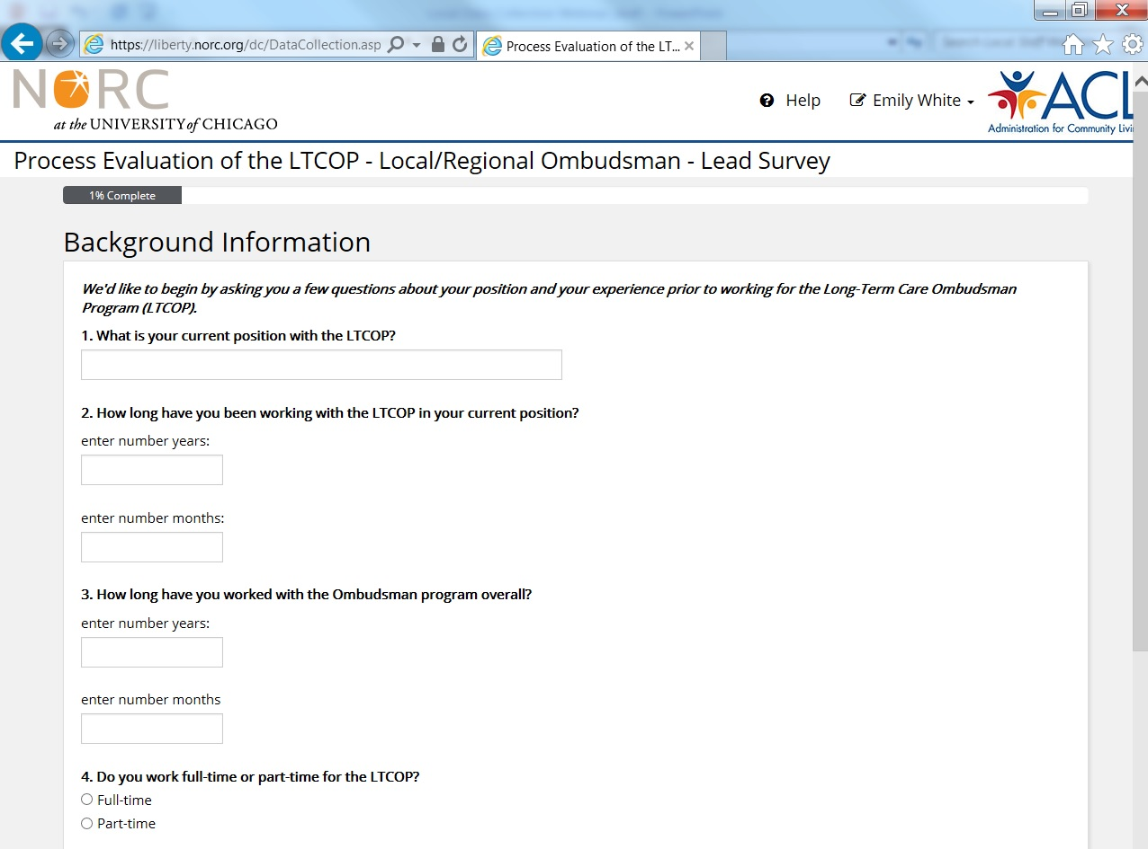
Administering the Surveys – Web Version
Web-based Surveys

Slide 17
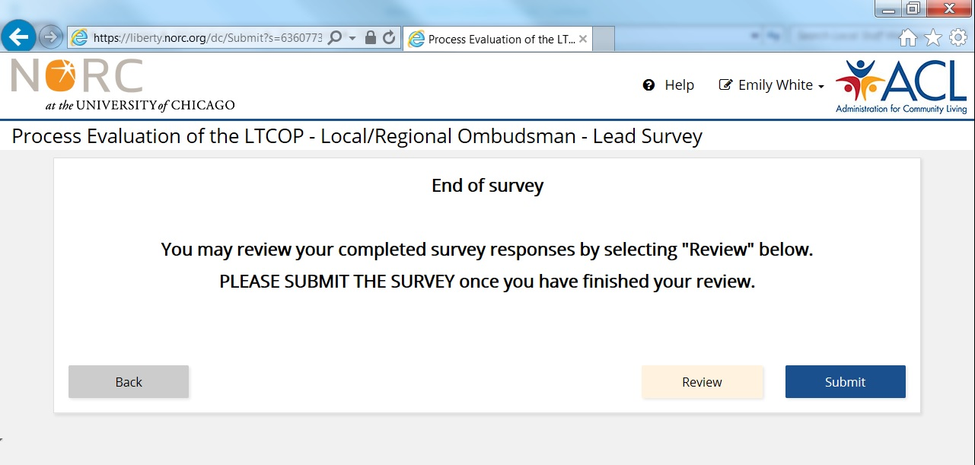
Administering the Surveys – Web Version
Web-based Surveys

Slide 18
Administering the Surveys
Web-based Surveys
Technical tips:
  Chrome is the recommended browser, but the survey can also be accessed and completed Internet Explorer (IE).
  The survey will time out after 20 minutes of inactivity. To access your survey again:
    Close your browser
    Click on, or paste the link into a new browser window
  You may also save your progress, and return to the survey at a later date/time by following the same steps above.

Slide 19
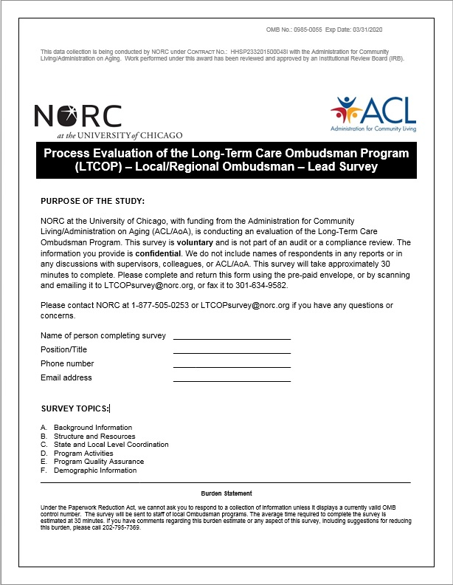
Administering the Surveys – Paper Version
Paper-based Surveys

Slide 20
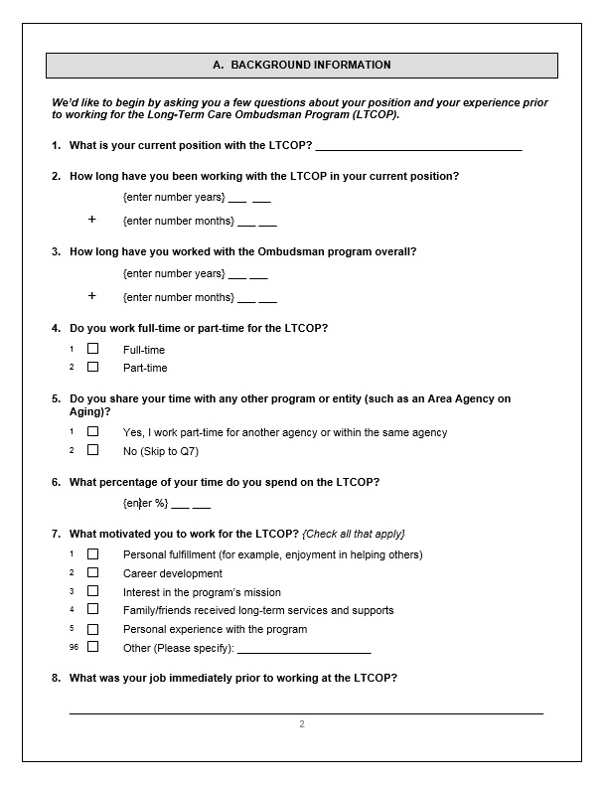
Administering the Surveys – Paper Version
Paper-based Surveys

Slide 21
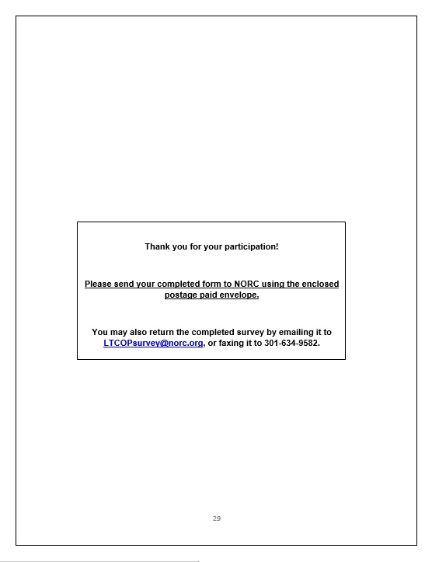
Administering the Surveys – Paper Version
Paper-based Surveys

Slide 22
Administering the Surveys
Paper-based Surveys
Can be completed by either:
  Printing the survey and completing it by hand
  Receiving the survey by mail and completing it by hand
Can be returned to NORC by either:
  Scanning and emailing the survey to the project email address
  Requesting a paid postage stamp or FedEx label, and mailing the survey back to NORC

Slide 23
Disseminating Evaluation Findings
In the Fall of 2018…
NORC will produce a Final Report that includes:
  An overview of the project
  A description of our methodology
  A summary of the results
  Our key findings and conclusions
NORC will also produce a series of topical briefs that highlight the LTCOP and important issues related to the program.
All materials will be accessible to state and local ombudsman staff and volunteers, as well as the aging network and other program stakeholders.

Slide 24
Next Steps
Email invitations go out tomorrow, Friday, May 4th.
The data collection period ends Friday, May 18th.
If you have a schedule conflict during that time, please let us know.

Slide 25
Question & Answer Session
Question & Answer Session

Slide 26
Feel free to contact us at:
1-877-505-0253, or
LTCOPsurvey@norc.org

