Slide 1
Post Acute, Rehabilitative and Convalescent Care (PARCC): A Training for the Local Long Term Care Ombudsman
Authors’ Note: This project was generously supported by The Jacob & Valeria Langeloth Foundation, The Commonwealth Fund (a New York City-based private, independent foundation), the Archstone Foundation, The New York Community Trust, and The California Endowment. The views presented here are those of the authors and should not be attributed to the granting organizations, their directors, officers, or staff. Direct correspondence to Carroll Estes, PhD, Suite 340, Institute for Health and Aging, UCSF, 3333 California Street, San Francisco, CA 94118; phone: (415) 502-5200; e-mail: carroll.estes@ucsf.edu.

Slide 2
Definition of PARCC (Post-Acute, Rehabilitative, and Convalescent Care)
Residents who:
Are expected to stay in a LTC facility less than 100 days or within Medicare Coverage
Are in need to skilled nursing care, rehabilitation, physical therapy, or occupational therapy
Are well enough to leave the hospital, but still too sick to go home
Sometimes referred to as:
Short-stay, post-acute, rehab, skilled nursing, etc.

Slide 3
PARCC Coverage
Who pays for PARCC?
Medicare
Will pay for 100 days of skilled nursing or rehabilitative care in a SNF, per spell of illness
Requires a prior 3-day hospital stay
Private Insurance

Slide 4
Growth in PARCC
Why is PARCC a growing population?
Hospital PPS
The hospital prospective payment system (referred to as “PPS”) was implemented in 1983 as an attempt to control costs
PPS created incentives for hospitals to discharge patients earlier and shortened hospitals stays. (MedPAC, 2005).
This, in turn, has spurred the growth of the post acute care sector. The post acute care sector has been the fastest growing category of Medicare payments in the 1990’s (Buntin et al. 2005).

Slide 5
Nursing Home PPS
Congress implemented a PPS for nursing homes in 1998. Under the nursing home PPS, a case-mix-adjusted and wage-adjusted per diem payment is made to cover the routine, ancillary, and capital costs incurred in treating a skilled nursing facility patient covered by Medicare (MedPAC, 1999).
Created incentives for nursing homes to discharge patients earlier, shorten stays, and minimize treatments/rehabilitation provided.

Slide 6
Why the LLTCOP?
PARCC population comprises residents in Skilled Nursing facilities that the Ombudsmen visit
They, like other nursing home residents may be vulnerable and mistreated.

Slide 7
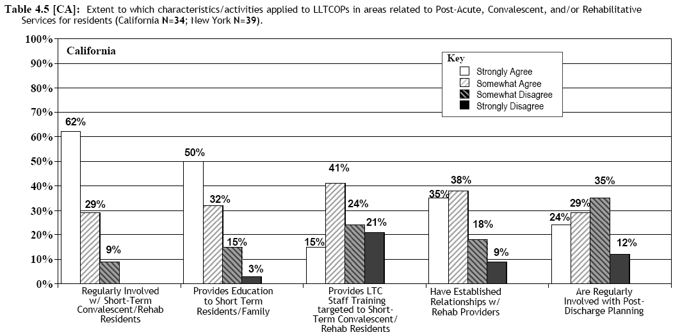
Ombudsman Involvement with PARCC Residents- CA
Estes, C. L., Goldberg, S., Lohrer, S., Nelson, M., Goldstein, C., & Hollister, B. (2005c). Post-acute, rehabilitative, and convalescent care: Pathways to effectiveness for the local long-term care ombudsman. Unpublished manuscript: Institute for Health and Aging, University of California San Francisco.
Notes:
California Description: Self-ratings by California LLTCOP Coordinators of the extent to which issues related to Post Acute, Convalescent, and/or Rehabilitative Services applied to their programs, showed variation across programs and issues. While an overwhelming majority (91%) of coordinators responded affirmatively that their program was ‘Regularly Involved with “Short-Term” Residents Receiving Post Acute, Convalescent, and/or Rehabilitative Services’, nearly half of coordinators disagreed that their programs ‘Are Regularly Involved with Post-Discharge Planning Activities’ (47%) or ‘Provides Long-Term Care Facility Staff Training Targeting Post Acute, Convalescent, and/or Rehabilitative Residents’(45%). Differences were noted in the extent to which CA LLTCOPs were involved in particular activities (differences were significant)*.

Slide 8
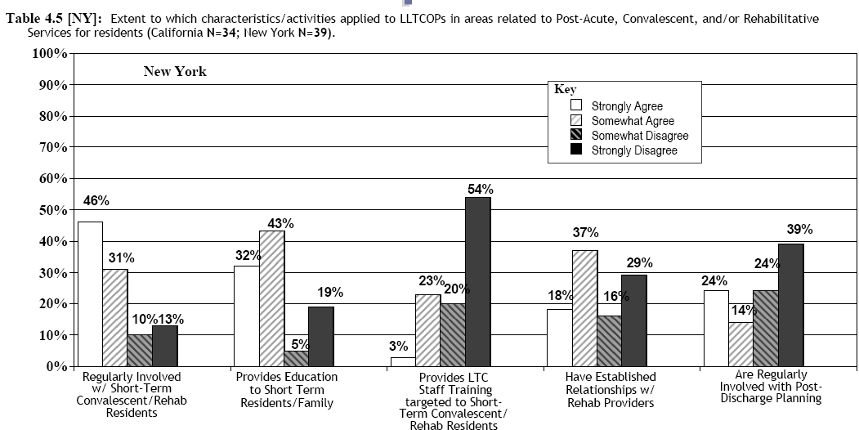
Ombudsman Involvement with PARCC Residents- NY
Estes, C. L., Goldberg, S., Lohrer, S., Nelson, M., Goldstein, C., & Hollister, B. (2005c). Post-acute, rehabilitative, and convalescent care: Pathways to effectiveness for the local long-term care ombudsman. Unpublished manuscript: Institute for Health and Aging, University of California San Francisco.
Notes:
New York Description: Self-ratings by New York LLTCOP Coordinators of the extent to which issues related to Post Acute, Convalescent, and/or Rehabilitative Services applied to their programs, showed variation across programs and issues. While a majority of coordinators responded affirmatively that their program was ‘Regularly Involved with “Short-Term” Residents Receiving Post Acute, Convalescent, and/or Rehabilitative Services’(77%), more than half of coordinators disagreed that their program ‘Provides Long-Term Care Facility Staff Training Targeting Post Acute, Convalescent, and/or Rehabilitative Residents’(74%) or ‘Are Regularly Involved with Post-Discharge Planning Activities’ (63%). Differences were noted in the extent to which NY LLTCOPs were involved in particular activities (differences were significant)*.
California/New York Comparison: Overall, New York LLTCOP Coordinators were less likely than California LLTCOP Coordinators to report involvement in all five aspects of Post-Acute, Convalescent and Rehabilitative Care. Significant differences were found in the areas of ‘Provides LTC Staff Training targeted to Short-Term Convalescent/Rehab Residents,’ ‘Have Established Relationships with Rehab Providers,’ and ‘Are Regularly Involved with Post-Discharge Planning.’ Differences were noted across states concerning involvement in particular activities*.

Slide 9
How are PARCC Residents Different?
Can be younger
Can have higher physical or mental functioning than other residents
They are expected to be discharged
Their stay at a facility is short-term, small window for intervention/resolution
They have different complaints and thus different needs from other residents

Slide 10
What are their complaints
Not receiving Care
Rehabilitation services not being given in a timely and appropriate manner
Inappropriate transfer or discharge
Being told they have “plateau’d”
Being discharged without sufficient reason
Others?

Slide 11
What are the problems facing PARCC residents?
“Quality of care kind of issues. No really effective rehab, not only to improve but to maintain. Not following care plans. Confusion about Medicare, dropping people off Medicare too soon, and making people move from bed to bed.” California LTCO
“The Facilities are not fully informing residents as to their rights – that they can stay longer if needed. We need to tell facilities they need to advocate more for their residents and to let us help them advocate for the residents.” California LTCO
Estes, C. L., Goldberg, S., Lohrer, S., Nelson, M., Goldstein, C., & Hollister, B. (2005c). Post-acute, rehabilitative, and convalescent care: Pathways to effectiveness for the local long-term care ombudsman. Unpublished manuscript: Institute for Health and Aging, University of California San Francisco.

Slide 12
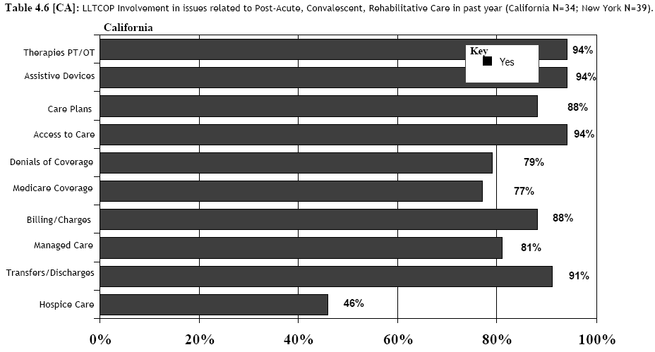
Ombudsman Experiences with PARCC Residents- CA
Estes, C. L., Goldberg, S., Lohrer, S., Nelson, M., Goldstein, C., & Hollister, B. (2005c). Post-acute, rehabilitative, and convalescent care: Pathways to effectiveness for the local long-term care ombudsman. Unpublished manuscript: Institute for Health and Aging, University of California San Francisco.
Notes:
California Description: California LLTCOP Coordinators indicated that their programs engaged in a variety of specified issues related to Post Acute, Convalescent, and Rehabilitative services over the past year. No issues were reported unanimously across programs. Most
coordinators indicated their LLTCOP had been involved with ‘Therapies, such as OT/PT’ (94%), ‘Assistive Devices’ (94%), and ‘Access to Care’ (94%) for post acute, convalescent, and/or rehabilitative residents; whereas most coordinators (54%) reported their programs had no involvement with ‘Hospice Services’ related to post acute, convalescent, and/or rehabilitative residents. Differences were noted in the extent to which CA LLTCOPs were involved in particular activities (differences were significant)*.

Slide 13
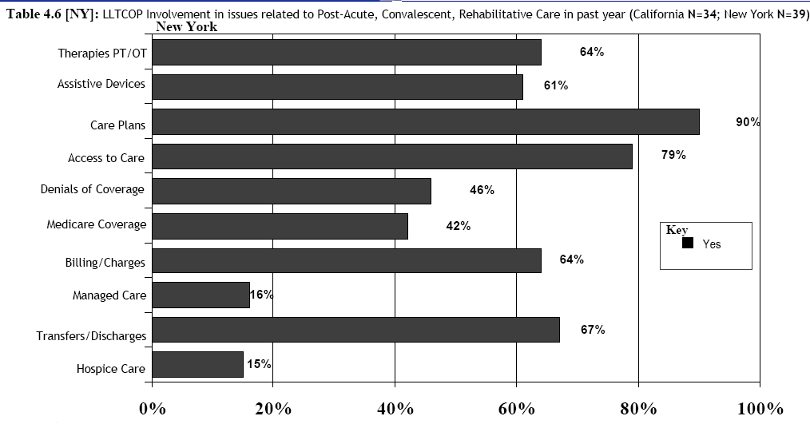
Ombudsman Experiences with PARCC Residents- NY
Estes, C. L., Goldberg, S., Lohrer, S., Nelson, M., Goldstein, C., & Hollister, B. (2005c). Post-acute, rehabilitative, and convalescent care: Pathways to effectiveness for the local long-term care ombudsman. Unpublished manuscript: Institute for Health and Aging, University of California San Francisco.
Notes:
New York Description: New York LLTCOP Coordinators indicated that their programs engaged in a variety of specified issues related to Post Acute, Convalescent, and Rehabilitative services over the past year. No issues were reported unanimously across programs. Most coordinators indicated their LLTCOP had been involved with ‘Care Plans’ (90%) and ‘Access to Care’ (79%) for post acute, convalescent, and/or rehabilitative residents; whereas the majority of coordinators reported their programs had no involvement with ‘Hospice Services’ ( 85%) or ‘Managed Care’ (84%) related to post acute, convalescent, and/or rehabilitative residents. Differences were noted in the extent to which NY LLTCOPs were involved in particular activities (differences were significant)*.
California/New York Comparison: New York LLTCOP Coordinators were more likely to report involvement in issues related to Care Plans and Post Acute, Rehabilitative and Convalescent Care than California LLCTOP Coordinators. They were less likely to report involvement in all other issue areas of Post Acute, Rehabilitative and Convalescent Care, most significantly in issues related to Therapies, Assistive Devices, Denials of Coverage, Medicare Coverage, Billing/Charges, Managed Care, Transfer/Discharges, and Hospice Care. Differences were noted across states concerning involvement in several activities*.

Slide 14
How can LLTCO Help PARCC residents?
Learn more about the residents needs
Encourage residents to ask for second opinions on important medical decisions
Look at care plan and medical record
Talk to the resident about their rights
Talk to the resident about the option of appeal
Help the resident file the appeal

Slide 15
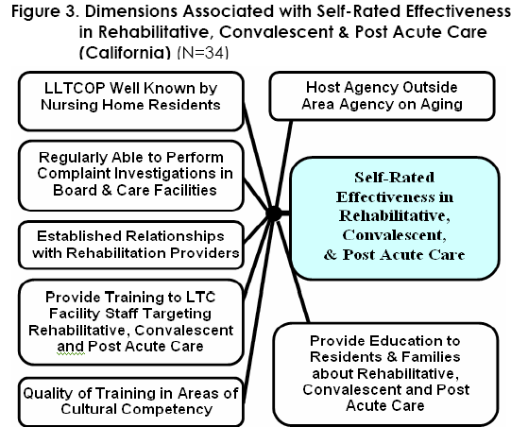
Dimensions Related to Ombudsman Effectiveness with PARCC residents- CA
Estes, C. L., Goldberg, S., Lohrer, S., Nelson, M., Goldstein, C., & Hollister, B. (2005c). Post-acute, rehabilitative, and convalescent care: Pathways to effectiveness for the local long-term care ombudsman. Unpublished manuscript: Institute for Health and Aging, University of California San Francisco.

Slide 16
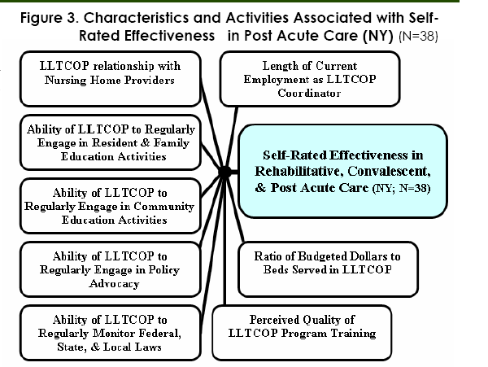
Dimensions Related to Ombudsman Effectiveness with PARCC residents- NY
Estes, C. L., Goldberg, S., Lohrer, S., Nelson, M., Goldstein, C., & Hollister, B. (2005c). Post-acute, rehabilitative, and convalescent care: Pathways to effectiveness for the local long-term care ombudsman. Unpublished manuscript: Institute for Health and Aging, University of California San Francisco.

Slide 17
What about systemic advocacy?
Advance education (resident, community, facility, etc) about PARCC resident needs and complaints
Encourage state offices to develop further training material for LLTCO, and educational materials for residents, families, and facilities
Medicare PPS…. Need better financing of care or monitoring of abuse/fraud
Advocate for increased funding in order to better serve this population

Slide 18
Some Discussion Questions
Is advocating for PARCC residents the LLTCOPs role?
What priority does this take in your other work?
Is more training needed on PARCC resident needs and ways to advocate for this population?
Is more training needed on Medicare laws and regulations and residents’ rights under Medicare?
Is training needed on Medicare Appeals?

Slide 19
PARCC Toolkit Resources
Medicare / PARCC Factsheet
Quick Screen Aid to identify coverable cases
Key resources list for advocates
Reading list
Fax form for improved notification of PARCC resident admission
LLTCO visitation cards for PARCC Resident
PARCC Powerpoint Presentation

Slide 20
Website Resources
Centers for Medicare and Medicaid Services http://www.cms.hhs.gov/
Center for Medicare Advocacy http://www.medicareadvocacy.org/
Center for Medicare Education http://www.medicareed.org/
Medicare Rights Center http://www.medicarerightscenter.org
National Senior Citizen’s Law Center www.nsclc.org

Slide 21
References
Buntin, M. B., Escarce, J. J., Hoverman, C., Paddock, S. M., Totten, M. E., & Wynn, B. O. (2005). Effects of payment changes on trends in access to post acute care. RAND.
Estes, C. L., Goldberg, S., Lohrer, S., Nelson, M., & Hollister, B. (2005c). Post-acute, rehabilitative, and convalescent care: Pathways to effectiveness for the local long-term care ombudsman. Unpublished manuscript: Institute for Health and Aging, University of California San Francisco.
Medicare Payment Advisory Commission (MedPAC)(2005). "Medicare Post Acute Care.” June 16, 2005. Testimony before the Subcommittee on Health, Committee on Ways and Means, U.S. House of Representatives.
Medicare Payment Advisory Commission (MedPAC)(1999). “Medicare Payment Policy: Improving the payment system for skilled nursing facilities.” March 1, 1999. Testimony before Congress.

Slide 22
Enhancing the Performance of the Long-Term Care Ombudsman Program University of California, San Francisco Institute for Health & Aging
Researchers:
Carroll L. Estes, PhD, UCSF Professor and Founding Director, Institute for Health and Aging
Brooke Hollister, BA, UCSF Graduate Student Research Assistant, Institute for Health and Aging
Sheryl Goldberg, PhD, Specialist, Institute for Health and Aging
Steven Lohrer, PhD, Specialist, Institute for Health and Aging
Milena Nelson, BA, Analyst, Institute for Health and Aging
Consultant:
Lenore Gerard, JD, Attorney, Legal Assistance for the Elderly
Advisors:
Patricia Nemore, JD, Senior Policy Attorney, Center for Medicare Advocacy Inc.
Sara Hunt, Consultant, NASOP, NORC
Christian Reitler, Erie County, New York LLTCO Program Coordinator
Benson Nadell, San Francisco County,California LLTCO Program Director
Collaborators:
California Long-Term Care Ombudsman Association (CLTCOA)
New York State Ombudsman Association (NYSOA)
In addition to the above, the research team would like to thank the State Long-Term Care Ombudsman offices of both New York andCalifornia for their cooperation throughout the project.

