Slide 1
compassion fatigue in the Time of COVID-19: A primer for administrators
Sheri Gibson, Ph.D.
sherigibson2@gmail.com
www.DrSheriGibson.com

Slide 2
Introduction
Our work is technically demanding
Our work also places demands on our humanity
Isolation, death, anxiety, grief = the perfect recipe for fatigue and burnout
We must attend to ourselves in order to attend to others
Notes:
[INTRODUCTION]
Our work is technically demanding:
- technical accuracy,
- time schedules
- complex logistics
- (others?)
But it also demands a lot of our humanity:
our minds, our hearts, our spirits are unavoidably challenged
by the fact that we face death and human grief and suffering every day.
If we are not as aware, trained and skillful
about attending to ourselves as we are to our technical duties and our clients,
we risk not only technical and service failures,
but the erosion, even breakdown, of our personal wellbeing and,
indeed, the rest of our lives.
This erosion, of our work efficiency and our whole lives, has come to be called
“compassion stress” and “compassion fatigue.”
ASK: How many of you have heard the terms
“compassion stress” or “compassion fatigue”?
[Solicit answers, comments. Usually, less than half of participants have heard the terms.]

Slide 3
Is there light at the end of the tunnel?

Slide 4
How do we help others with uncertainty?
Normalize anxiety
“It very appropriate to feel anxious right now.”
Focus on coping
“What would be most helpful to you right now?”
“What things are in your control right now?”
Focus on areas of certainty and gratitude
“What are you most certain of?”
“What are the areas of your life around which you have gratitude?”

Slide 5
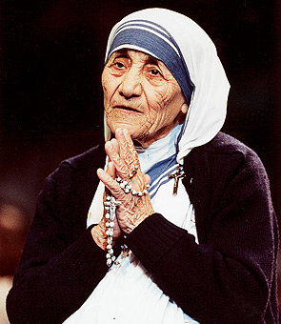
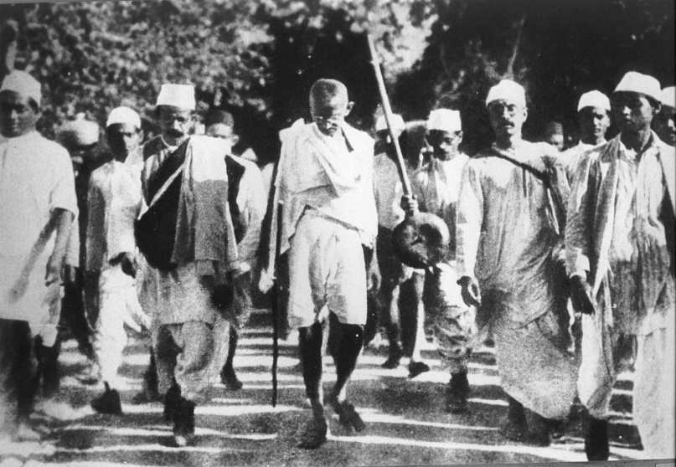
Compassion
What is compassion?
How is compassion different from sympathy and empathy?
Notes:
[Cue “Compassion” photos, title on slide]
ASK: So, what, do you suppose is compassion? How is it different from sympathy and empathy?
[Solicit answers]
[Cue “Compassion, title]
ASK: So, now, what is Compassion? How is it different from both sympathy and empathy?
[Solicit ideas: this will likely be more difficult, for we usually equate empathy and compassion]
This is tough, because we often think
empathy and compassion are the same thing.
And this is exactly why we so often succumb to “compassion fatigue” –
which actually, might more accurately be called “empathy” fatigue.
Because, actually, true compassion has another level of depth and skill
than empathy.

Slide 6
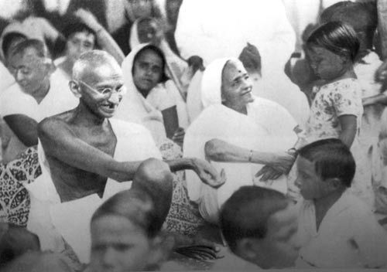
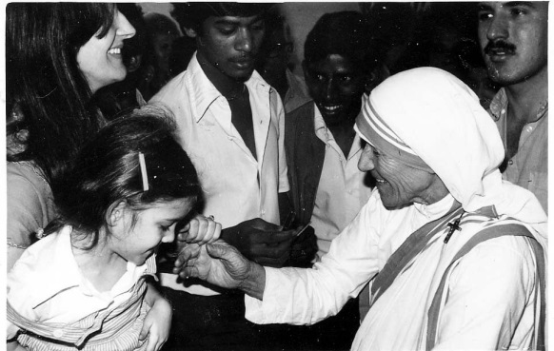
Compassion
An emotional response when perceiving suffering that involves an authentic desire to help.
Derived from Latin and Greek roots “pati” and “pathein” meaning “to suffer” and the Latin root “com” meaning “with.”

Slide 7
Compassion as documented in human history
Christianity: The Good Samaritan
Confucius: Major teacher of the Golden Rule
Judaism: “The 13 Attributes of Compassion”
Buddha: “Loving kindness and compassion is all our practice.”
Dalai Lama: Believed the individual experience of compassion radiates outward and increases harmony for all: “Compassion is a necessity, not a luxury…without it, humanity cannot survive.”
Charles Darwin: Not survival of the fittest, but survival of the kindest. “Communities, which included the greatest number of the most sympathetic members would flourish best, and rear the greatest number of offspring.” (Descent of Man and Selection in Relation to Sex, 1898)

Slide 8
Simply put, Compassion is:
The feeling of sorrow or concern for another coupled by the desire to alleviate the suffering:
“I feel for you” + “I understand you” + “I want to help”

Slide 9
The “Cost of Caring”
Work centered on the relief of suffering involves absorbing information about suffering, thus absorbing that suffering itself:
“secondary victimization”
“vicarious trauma” or “trauma by concern”
“Chiasmal trauma”: an entire system is affected by trauma to even one member
Notes:
And while we may not be as actualized as Mother Theresa or the Dalai Lama,
we have chosen to work in a field of extraordinary service and difficulty.
And we are “strangely” fulfilled by our work for the most part, aren’t we?
it’s enormously rewarding to help redeem something good out of people’s
deaths.
But it also takes a negative toll on us: as empathic beings,
as humans “wired” to connect and cooperate with each other,
if we have any empathy or compassion at all,
we do feel others’ suffering, and there is a “cost to caring” for our psyches,
which effects our bodies, minds, hearts, and souls.
This cost has been called “secondary” or “vicarious” stress or trauma,
now also compassion stress and compassion fatigue.
Even whole groups or organizations can become affected
by the dynamics of compassion fatigue,
and that is called “chiasmal” trauma.
A “chiasm” is an intersection or crossing of two tracts in biology:
in this case, personal and organizational effects intersect.
And what happens, we’ll talk about in a minute, because…
[next slide]

Slide 10
The Study of Compassion Fatigue
Term was introduced by Joinson in 1992 and developed by Figley in 1995.
Figley developed a model for the process by which compassion fatigue develops.
Model has been used to describe development of symptoms across multiple care settings and among persons in different care roles.

Slide 11
Figley’s model of Compassion Fatigue
Notes:
According to figley’s model, the caregiver must have concern and an empathic ability or feel motivated to respond when they perceive that the care recipient is suffering. When caregivers have this empathic response, coupled with an unwillingness or inability to detach from the caregiving situation and the absence of feelings of satisfaction, the caregiver develops compassion stress. Compassion stress results in compassion fatigue if the caregiver prolonged exposure to suffering coupled with traumatic memories and competing life demands.

Slide 12
External Factors
The Work Environment
Societal support
Public policy, regulations
Social acceptance, activism
Work Setting
Physical environment
Employer values, culture
Job tasks, personnel guideline
Management, colleagues

Slide 13
The Effects of External Factors
The “Six Futilities”
Perception of the Suffering
Resident/family demands
Institutional Demands
Communication, treatment errors
Feelings of inadequacy
Sense that the care is not benefitting the resident
Notes:
So, exactly, what are the threats to our empathy and compassion? What things take their toll and erode us in this work?
Let’s take a look at them.
First, let’s look at external factors that can wear us down –
or help buffer us from stress and fatigue, if we experience them as good, positive factors!
[Review slide content]

Slide 14
Also, Internal Factors have an impact
The personal gift and curse of empathy
High empathy helps us understand and can challenge our equanimity
Personal History/Personality
Our temperament
Family/social history
Personal boundaries
Unresolved personal trauma
Over-generalization: thinking others’ experiences are similar to ours
Notes:
What combines with external factors to determine what’s going to erode us
are internal, or personal factors.
Indeed, these significantly effect not only what will “get to us” personally,
but enormously informs our overall level of equanimity.
Firstly, the very empathy that leads us to choose to do this work
can actually make us susceptible to inappropriate, unhealthy actions and responses,
when we don’t train up our equanimity.
This is a bit of a challenging assertion, but it holds true:
- almost all of us who gravitate toward caregiving professions
did not choose this work only by random chance or
fully independent intention.
- our family history and personal experience groomed us for this work,
and that included some tough or tragic experiences.

Slide 15
Internal Factors, cont.
“Pathological Altruism”
A combination of:
An excess of empathy
An inability to self-regulate
Being more focused on relieving one’s own discomfort than another’s

Slide 16
What Happens to Us?
“BURNOUT”
VS.
“COMPASSION FATIGUE”

Slide 17
“Burnout”
Gradual physical, mental, emotional erosion due to long-term involvement in emotionally demanding or unfulfilling situations:
Exhaustion: physically, mentally drained
Depersonalization: feeling hardened or numb
Achievement Void: reduced accomplishment, satisfaction.
Notes:
When too many of these factors, external and personal, are negative,
the “cost” of work starts to overwhelm the satisfaction,
and we end up experiencing stress.
If they progress, we can end up with “compassion fatigue” or “burnout.”
We used to think these terms, like empathy and compassion,
were inter-changeable. But they actually have differences.
“Burnout” can happen in any profession.
It can be the thing that does some in human services in,
rather than the compassion factors.
Burnout stems from a combination of external and internal factors
that are frustrating and not fulfilling one’s professional aspirations or values.

Slide 18
“Compassion Fatigue”
Feels similarly to “burnout” but:
Can emerge suddenly
Existential/spiritual effects: overarching meaninglessness, worthlessness, hopelessness
A sense of isolation from supporters, hyper-vigilance or fear
Symptoms often disconnected from real cause
Notes:
But Compassion Stress/Fatigue are processes directly linked
to being responsible for alleviating the suffering of others.
And the cost of this work is to your heart and spirit, and your total life.
It cannot stay compartmentalized to your work environment.
Compassion fatigue actually erodes your ability
to experience any joy, love, recovery anywhere in your life.
Burnout and Compassion Fatigue are “edge states.”
Often, we deny or try to cope with them with:
- avoidance (substance abuse, other avoidance tactics)
- numbness
- outrage (including “moral outrage” and “justice” fighting)
From a distance, we know that these ways of coping do not help anything.

Slide 19
Signs and Symptoms of Compassion Fatigue
For the Individual:
Difficulty concentrating, pre-occupation, exhaustion
Nightmares/flashbacks
Over-reactions or avoidance of sensory/emotional stimuli
Chronic physical ailments: colds, stomach problems
Apathy, anhedonia
Excessive negativity: blaming others, complaining
Compulsive/avoidant behaviors: substance abuse, over-spending, over-eating, gambling
Problems in personal relationships, intimacy
Denial of difficulties or problems
Notes:
[Review, discuss slide content]
At the end of this session, you’ll be given
a compassion fatigue self-assessment.
Because one of the primary features of compassion fatigue
is an inability to see it in yourself,
We strongly encourage you to make some quiet personal time
to take this assessment and See where you are on it.
Because the sooner you recognize it and attend to it,
the easier it will be to address it
and develop the skills to minimize it in the future.

Slide 20
Signs and Symptoms of Compassion Fatigue
For the Institution:
High absenteeism and/or staff turnover
Increasing difficulty completing routine tasks, assignments
Inability of staff to respect and meet deadlines
Unprofessional outbursts of anger, aggression
Instability, conflict in staff/team relationships
Desire among staff member to break the company rules
Staff inflexibility, increased rigidity, resistance to change
Excessive complaining, negativity towards management
Skepticism or apathy about organizational vision, future
Inability of staff to believe improvement is possible
Notes:
And here’s where we want to issue a difficult but important appeal for compassion for each other.
When a coworker is beginning to exhibit some of these attitudes and behaviors,
our instinctual response is probably NOT compassion is it?
It’s irritation, avoidance, reprimand…but if someone is compassion fatigued –
and, oh by the way, you bet it can be a bereaved family member who was the deceased’s caregiver--
When someone is exhibiting signs of compassion stress and fatigue and being difficult,
it’s important – and amazing – to offer a compassionate approach to them and feedback.
It will help them reconnect to their own humanity, and compassion for themselves.
And here’s the really good news!
There are healthy, positive ways to stave off these edge states:
- to prevent them from developing
- and to heal them when they start.

Slide 21
WHY are we susceptible to Compassion Fatigue?
Sympathetic Nervous System:
Fight, flight, or freeze
Is an adaptive response in real crises, but wilts us day in an day out
Parasympathetic Nervous System:
Restores physiological equanimity
Keeps you rooted, helps you tend and thrive

Slide 22
Critical in a Time of COVID-19
Heightened states of:
Anxiety
Uncertainty
Unknown of the future
Decision-making / Risk assessment
And
Chronicity of the above states
Perception of “no end in sight”

Slide 23
How do we protect ourselves?
The antidote to vicarious trauma, burnout, and compassion fatigue is:
RESILIENCE

Slide 24
Resilience
Defined as:
The ability of something to return to original shape after it has been pulled, stretched, pressed, bent, etc.
The ability to recover from or adjust easily to misfortune or change.
We need to develop skills to stay well for better performance and well-being in high-compassion stress work!
Notes:
The antidote to vicarious trauma, burnout and compassion fatigue is RESILIENCY.
Resiliency is defined as:
1) the ability of something to return to its original shape after it has been pulled, stretched, pressed, bent, etc.
2) an ability to recover from or adjust easily to misfortune or change.
Yes, some resiliency seems to be in-born, but the really exciting news is
that it can also be developed and trained!
Just like those who undertake physical conditioning in athletics,
EMS and protection fields,
We can train and condition our mental and physical reflexes and abilities for better performance and well-being in high-compassion stress work!
And indeed, we should. Because these abilities are just as important to success as our technical training.
The Skill sets we need to develop to stay well in Science Care work include:
- Self-Awareness
- Self-Regulation, and
- Self-Care
Now, if you are not a “touchy-feely” person who loves to share your feelings and explore the deeper meaning of your life,
That’s okay! You do not have to enter psychotherapy or go on a vision quest or sing “Kum Ba Ya” with your colleagues to do this –
- not that there’s anything wrong with that!
But here’s the truth:
the stress of your work has more in common with a military combat medic
than with an investment banker or an engineer.

Slide 25
No Pressure.
Notes:
No pressure.
Your work is nothing short of heroic.
And heroic work requires extra levels of self-awareness, self-discipline, self-care –
Or, well, ever notice how hard heroes fall, when they do?
Or how they can get suddenly weakened or taken advantage of by the most subtle, personal vulnerabilities?
Think of mythic heroes, or superheroes: Superman, Batman…what brings them to their knees?
Would you like to know how to become a hero
that doesn’t have a tragic fall and ruin,
how build your resistance to your “Cryptonite?”

Slide 26
Resiliency Skills #1: Self-Awareness
Self-Awareness
Physical, emotional
Technical
Existential
Self-Awareness Tip: What’s going on in your body, mind, and spirit when you are working is often a clue/barometer of what’s going on in your staff and others.
Notes:
Self Awareness Skills include:
Being consciously attuned to your body, mind, emotions, spirit
- so that you know how you are being and presenting in this moment,
to take care of yourself and others simultaneously.
This is not something that those of us outside athletic,
mental health or protection fields often work on.
In fact, many of us have been taught
that it’s virtuous to ignore, tune OUT of our bodies, emotions and spirits.
But this is dangerous in our work, can greatly affect not only our own wellbeing, but our effectiveness with others.
Knowing how how tired or alert you are, how tense or relaxed
how events or information coming in are impacting you emotionally and existentially
are keys to responding in ways that
will not only further your objectives and ensure the best possible outcome,
but help you take care of yourself now and later.
Just like with athletes, SWAT teams and crisis counselors.
Here’s a tip: what’s going on in your body, mind, and spirit when you are working is often a clue/barometer of what’s going on in your clients, others.
If you are encountering resistance or feeling at a loss to understand others, check into yourself first. As social beings, we are synergistic at the most
subtle but profound levels…..

Slide 27
Resilience Skills: Self-Awareness, cont.
Self-Awareness
Physical, emotional
Technical
Existential
Questions to ask yourself:
What skills and knowledge bases are natural talents for you, and where might you put some effort into developing more?
What are your strengths, growing edges, and blind spots?
Notes:
Self-Awareness also needs to include personal assessment of your professional strengths and growing edges:
What skill and knowledge bases are natural talents for you, and where might you put some effort into developing?
Some examples:
Do you find yourself absolutely committed to the compassionate values of this work,
but quick to interrupt, “soothe” family members so they will stop crying?
-if so, you might want to both:
- do some personal history processing,
- get some practical skills training on how to be present
to suffering and grief.
Or, are you able to be with people’s grief all day long,
but working on your laptop is endlessly cumbersome and frustrating?
- it’s to your credit to admit that you are techno-challenged,
and take a computer skills class.
- It’s important to realize that technology IS part of your care for people,
and your competence there is a caring skill!

Slide 28
Resilience Skills Self-Awareness, cont.
Self-Awareness
Physical, emotional
Technical
Existential
The nature of our work begs all the “big questions”
Spend time consciously exploring your questions about life and death, truth and justice, good, evil
Develop a language and a coping strategy to manage suffering, horror, tragedy, and to help find meaning
Notes:
Lastly, you are working in a heroic field on that edge of life and death.
The nature of this work begs all kinds of “Big Questions,”
Existential and spiritual.
You will do well to have a some kind of practice for processing and coping with those.
In our culture, some people are intentional about religious, spiritual
or ethical practice , and some folks aren’t.
In this line of work, hard research evidence indicates that,
, consciously exploring your questions about
life and death, truth and justice, good, evil,
having some sort of language and practice to cope with:
- existential horror, tragedy, meaning creation and dissolution
help you deal with it better.
And, whatever you believe or understand now?
This work will constantly pose new experiences that
will challenge you and your perceptions, beliefs and understandings
to continually grow.
They won’t do well if they are too fixed, rigid.

Slide 29
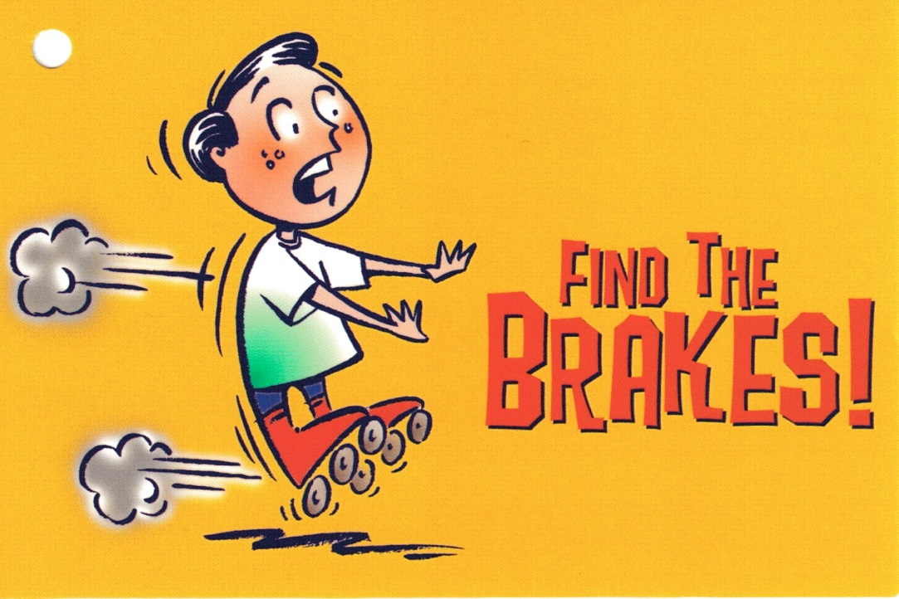
Resilience Skills #2: Self-Regulation
Self-Regulation
Boundaries
Values Clarification
Arousal Management
Notes:
Self-regulation is not something a lot of us have been taught in life,
and it’s not highly valued in our culture, because it’s not very “exciting,” and we LOOOOVE excitement!
But self-regulation is very important in our work, which offers “excitement” overload all the time.
Self-regulation is about how to use your self-awareness
to have more conscious control over your perceptions, communication and behavior.
It’s about being keenly consciously aware of your physical and emotional responses right,
right in this moment and ongoing
so that you can manage how you are being and presenting to others,
to take care of yourself now so that things don’t haunt you so much later.
This is something that athletes, mental health and protection professionals learn,
but not a lot of the rest of us.
In fact, many of us have been taught
that it’s virtuous to ignore, tune OUT of our bodies, emotions and spirits.
But this is dangerous in our work, can greatly affect not only our own wellbeing, but our effectiveness with others.
Knowing how to instantly assess and regulate
your level of awareness and arousal,
Is key to not only achieving your work objectives,
but taking care of yourself—and those you are serving.
And it’s not difficult, or “woo-woo.”

Slide 30
Resilience Skills #3: Self-Care
Self-Care
Eat well, exercise, and sleep
Right for you!
Have fun like your life depends on it
It does!
Get “shallow, simple, and silly” for your health!
Talking really does help
With the right person!
Notes:
Self-Care skills are often more familiar to people considering
Prevention for burnout and compassion fatigue.
But there are some less conventional, but evidence-based
caveats for people in our line of work:
Yes, it is important to eat right, exercise, and get enough rest.
But it needs to be in ways that are sustainably and reasonably enjoyable for you.
If a particular diet and exercise program causes you more frustration
or is just one over-consumption of your time and effort
let it go and try something else!
Moderation tends to be more successful and sustainable than going “militant.”
Have regular fun like your life depends on it – because it does!
In this line of work, you need to “get a life” and keep it!
Spending your working life in the face of death
will sap the life out of you.
When people and the media are carrying on
about superficiality and callousnous of people and society,
They are not talking about you!
Your work is so steeped in depth, pathos, and compassion
That you seriously need to get “shallow, silly and simple” for your health!
Engage with people and activities that literally make you laugh and unself-conscious:
- kids and pets are great for this. Or zany sports, games, activities.
Rest your frontal lobes! Get out of your executive functioning and use other faculties and senses:
- cooking, arts and music, sports
– CONTACT WITH NATURE is one of the most documented
cures for trauma and PTSD

Slide 31
Take a moment:
List one mini-escape or diversion that worked well to restore and renew you.
List one thing that brings you joy.
When was the last time you did it?
What gets in the way of doing it more often?
What are your personal triggers indicating it’s time to “recharge your battery?”

Slide 32
Resilience Skills Self-Care, cont.
TALK IT OUT.
Talking is one of the most effective ways of preventing and healing from compassion fatigue
Who you talk to is important
The person you choose should be someone who:
Can really relate
Can be present without interfering with your process
Doesn’t “one-up” you or switch to their story
Needs to understand and honor confidentiality!
Utilizing your EAP benefits
Notes:
Lastly, one of the most effective ways
of preventing and healing from compassion stress and fatigue
is to be able to talk it through.
There are neuro-biological reasons for why this helps.
But who you talk it through with is of critical importance.
It needs to be someone who:
- really can relate
- can be present without interfering with your process
- doesn’t “one-up” you or switch to their story.
*And they need to understand and honor confidentiality!
So, your significant other may not be the best person!
Or your teammate….
in fact, you may traumatize them, and re-traumatize yourself with them.
Ideas for processing partners:
- periodic work debriefings with an outside facilitator or counselor
- an allied professional you know, trust
- a professional counselor/consultant

Slide 33
Resilience Skills What about those External Factors?
Ask yourself:
Am I (still) committed to:
The agency’s mission, values, culture
The physical environment/resources
The organizational structure
Lines of authority
Style of communication
My colleagues/managers/supervisors
Notes:
A last thought.
Waaaaay back at the beginning of this presentation
We talked about the external factors that contribute to
Or buffer us from –
Compassion stress and fatigue.
It’s important to consider those external factors and
Whether this work is – or is still – right for you and your life.
This work is too stressful to be in if it’s not right for you,
And there’s nothing less or wrong with you
if it doesn’t fulfill you, or costs more than it pays you.
It just means this isn’t your thing.
Or this isn’t the right organization for you to pursue it in.
If it ain’t right for you, don’t do it!
It will suck the life out of you….
Go find what you were born for!

Slide 34
Final Tips on Preventing Compassion Fatigue
“Dig where the ground is soft” – Chinese proverb
Avoid your trickiest area to fix, and pick the issue you can most easily visualize changing/improving.

Slide 35
Prevention tips, cont.
Take stock of what’s on your plate
Make a list of all the demands on your time and energy
Look at your list carefully; what stands out? What factors contribute to overflowing your plate? Brainstorm with a friend.
Start a Self-Care collection
Ask friends what they do for self-care; start making your list – you may learn new things and new ideas!

Slide 36
Prevention tips, cont.
Start a self-care practice with your team:
Start a contest for best self-care idea of the week.
Create a self-care board where people post their favorite ideas.
Initiate “5 minutes of self-care” at each staff meeting, where someone is in charge of bringing new ideas to the group.
Find time for yourself everyday – Rebalance your workload.
Delegate work – at the office AND at home
Create a transition from “work” to “home” (which is one in the same)
Do you walk? Change clothes? Listen to fun music on the commute? Find a way to transition.

Slide 37
Final thoughts
Self-Awareness is key to appreciating your own reactions to stress.
Look for behavioral cues of your staff that indicate trouble areas.
View others through a lens of curiosity and empathy – find the compassion in your own approach.
Utilize key resources to prevent compassion fatigue or intervene when you notice problems.

Slide 38
References
Compassion Fatigue Awareness Project (2013)
http://www.compassionfatigue.org
Davidson, R. and Begley, S. (2013) The Emotional Life of Your Brain: How Its Unique Patterns Affect the Way You Think, Feel an Live – and How You Can Change Them. Plume: the Penguin Group.
Figley, C. (1995) Compassion Fatigue: Coping With Secondary Traumatic Stress Disorders In Those Who Treat The Traumatized. Rutledge.
Halifax, J., Dossey, B. and Rushton, C. (2007, April) Being With Dying: Compassionate End-of-Life Care Training. Conducted at Upaya Zen Center, Santa Fe, New Mexico.

Slide 39
References, cont.
Halifax, J. (2012, May 12) Inside Compassion: Edge States, Contemplative Interventions, Neuroscience. Lecture conducted from the U.S. Library of Congress, Washington, D.C.
Lester, G. Why Stress Management Doesn’t Work for Social Service Professionals and What to Do About It [Audio recording]. United States. Available from https://www.crosscountryeducation.com
Professional Quality of Life Elements Theory and Measurement. http://www.proqol.org
Day, J. R., and Anderson, R. A. (2011). Compassion fatigue: An application of the concept to informal caregivers of family members with dementia, Nursing Research and Practice, Article ID 408024. doi: 10.1155/2011/408024

Slide 40
Thank You

Slide 41
resources

Slide 42
Trauma-Informed, Person-Centered Care Resources
NORC
Trauma-informed care – https://ltcombudsman.org/issues/trauma-informed-care
Person-centered care - https://ltcombudsman.org/issues/person-centered-care
Consumer Voice
Resident-Directed Care/Culture Change https://theconsumervoice.org/issues/for-advocates/resident-directed-care
My Personal Directions for Quality Living - Blank Form & Sample
A tool from Consumer Voice, with edits by SAGE, for individuals to share what matters to them for person-centered care.
Information for LTC consumers - https://theconsumervoice.org/issues/recipients
Information for Family Members - https://theconsumervoice.org/issues/family

Slide 43
Resources
National Long-Term Care Ombudsman Resource Center (NORC) www.ltcombudsman.org
Coronavirus Prevention in Long-Term Care Facilities: Information for Ombudsman Programs https://ltcombudsman.org/omb_support/COVID-19
National Consumer Voice for Quality Long-Term Care (Consumer Voice) www.theconsumervoice.org
Coronavirus in Long-Term Care Facilities: Information for Advocates https://theconsumervoice.org/issues/other-issues-and-resources/covid-19
Coronavirus in Long-Term Care Facilities: Information for Residents and Families https://theconsumervoice.org/issues/other-issues-and-resources/covid-19/residents-families

Slide 44
Connect with us:
www.ltcombudsman.org
ombudcenter@theconsumervoice.org
The National LTC Ombudsman Resource Center
@LTCombudcenter
Get our app! Search for "LTC Ombudsman Resource Center" in the Apple Store or Google Play
This project was supported, in part, by grant number 90OMRC0001-01-00, from the U.S. Administration for Community Living, Department of Health and Human Services, Washington, D.C. 20201. Grantees undertaking projects under government sponsorship are encouraged to express freely their findings and conclusions. Points of view or opinions do not, therefore, necessarily represent official Administration for Community Living policy.

