Slide 1

National ombudsman reporting system (NORS) training Part Ii: Complaint Coding
Open Dialogue
November 20, 2019

Slide 2
Agenda
Comments from the Administration for Community Living
Part II Training Materials
  Complaint Coding Basic Principles
  NORS Table 2: Complaint Codes and Definitions, Examples and Reporting Tips
Open Dialogue
Resources

Slide 3
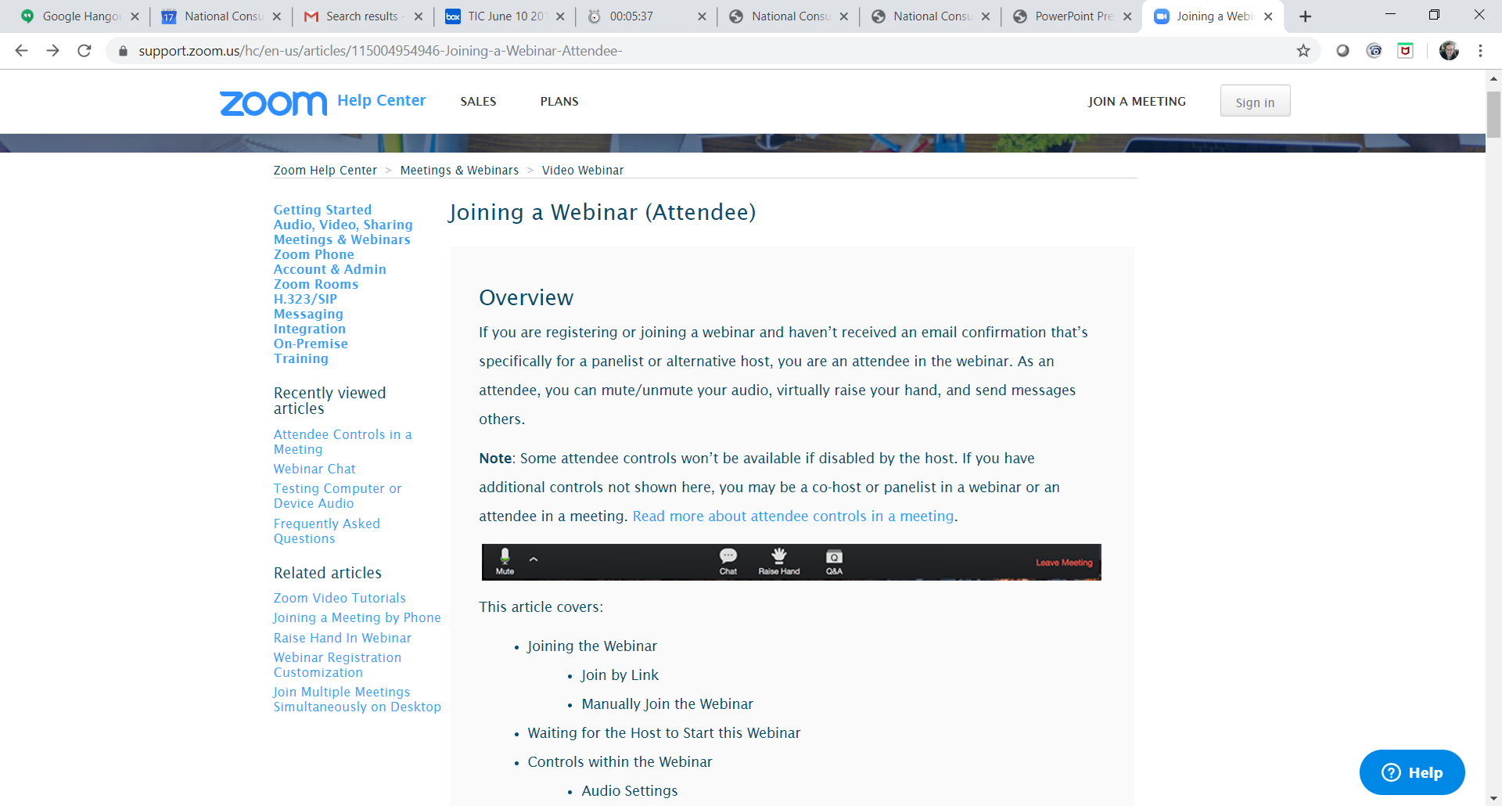
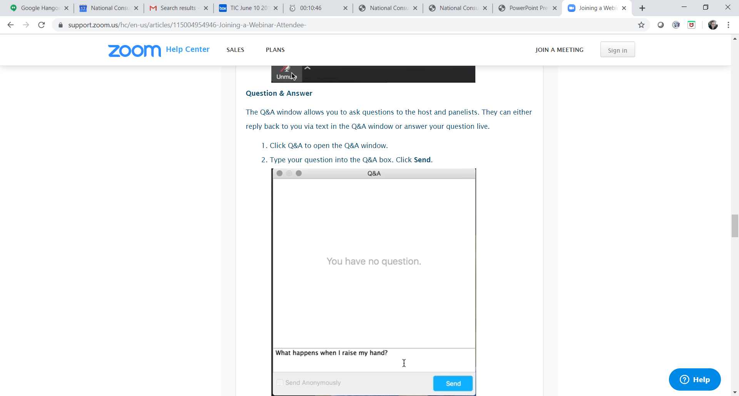
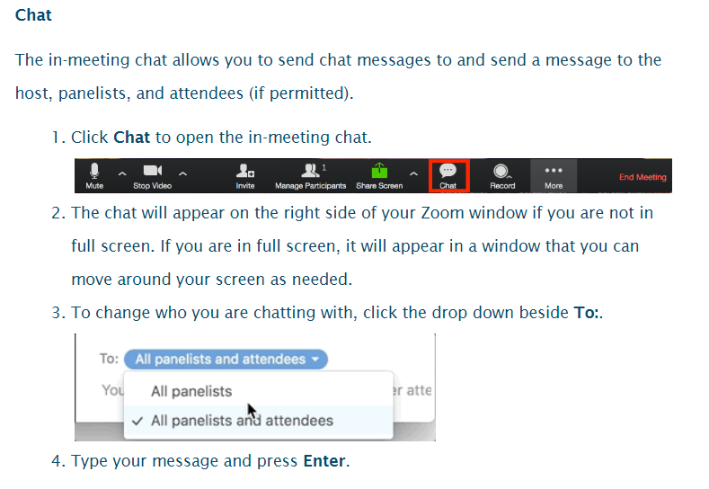
Have a question? Use the Q&A or Chat box.

Slide 4
ACL Greetings
Louise Ryan
Ombudsman Program Specialist
Administration on Aging /Administration for Community Living

Slide 5
NORS Training Part II: Complaint Coding
The five documents for the revised Part II NORS training materials are:
Basic Principles
Quiz
Quiz Answer Sheet
Beyond the Basics Quiz
Beyond the Basics Quiz Answer Sheet
https://ltcombudsman.org/omb_support/nors/revised-nors-data-collection
NOTE: The answer to 4 in the D. Autonomy, Choice, Rights section was revised in September 2019.

Slide 6
Basic Principles
Basic Principles document includes reminders and instructions for coding complaints.
In these materials, “Ombudsman” is used as a generic term that may mean the state Ombudsman, a representative of the Office, or the Ombudsman program.

Slide 7
Basic Principles
There are 59 complaint codes.
Choose the one code which best fits the problem.
Use the NORS, Table 2: Complaint codes and definitions document for all of the complaint codes, examples, and reporting tips.

Slide 8
Basic Principles
Abuse, Gross Neglect, Exploitation Complaints – Code A
Use the applicable perpetrator code.
  (1) facility staff, (2) another resident, (3) resident representative, family, or friend, or (99) other (See Table 1, Part B).
A perpetrator is the person(s) who appears to have caused the abuse, gross neglect, or exploitation.
There may be multiple perpetrators for each complaint.
If the Ombudsman program and another agency (i.e. state survey agency, APS) are both actively involved in complaint investigation and resolution, it still counts as an Ombudsman program case.

Slide 9
NORS Table 2: Complaint Codes and Definitions
ACL Table 2 has complaint codes, definitions, examples & reporting tips https://ltcombudsman.org/uploads/files/support/NORS_Table_2_Complaint_Code_04-30-2021-1.pdf
Crosswalk B: Complaint Codes – Old NORS to Revised NORS https://acl.gov/sites/default/files/programs/2018-05/NORS%20Crosswalk%20B%2004_30_2021.pdf

Slide 10
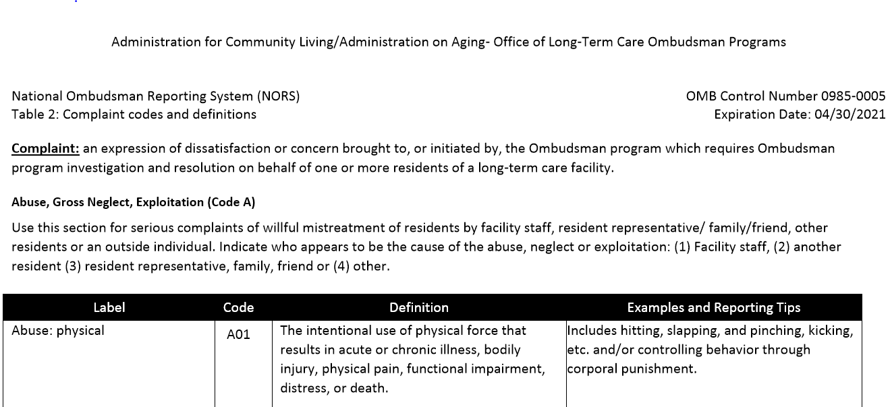
Table 2 – Complaint Codes and Definitions

Slide 11
NEW – Complaint Code Resources
NORS Codes
NORS Codes, Definitions, Examples, and Reporting Tips
https://ltcombudsman.org/uploads/files/support/NORS_Updated_Complaint_Codes_List.pdf
https://ltcombudsman.org/uploads/files/support/NORS_Codes_and_Definitions.pdf

Slide 12
Complaint categories

Slide 13
A Codes – Abuse, Gross Neglect, Exploitation
Use the A codes for complaints of abuse, gross neglect, and exploitation.
Identify a perpetrator for each of the A code complaints.
  (1) facility staff, (2) another resident, (3) resident representative, family, or friend, or (99) other (See Table 1, Part B).
Five A codes, A01 – A05
Notes:
The first group of questions are using A Codes for Abuse, Gross Neglect, and Exploitation. As mentioned earlier NORS now captures information on the perpetrator. The definition for Perpetrator is the person who appears to be the cause of the abuse, gross neglect or exploitation. There can be multiple perpetrators for each complaint. The choices for Perpetrator are Facility Staff, Another Resident, Family/resident representative/friend, or Other.

Slide 14
B Codes – Access to Information
Use this category for complaints against the facility regarding access to information made by or on behalf of the resident.
Use for willful interference with Ombudsman duties.
Three B codes, B01 – B03
Notes:
The second group of questions are using B Codes for Access to Information.. Use the B codes for complaints against the facility regarding access to information made by or on behalf of the resident. Use for willful interference with Ombudsman duties.
There are 3 B codes, B01 – B03

Slide 15
C Codes – Admission, Transfer, Discharge, Eviction
Use this category for complaints against the facility involving issues regarding admission, transfer, discharge, and/or eviction.
Four C codes, C01 – C04.
Notes:
The third group of questions are using C Codes for Admission, Transfer, Discharge, Eviction. Use the c codes for complaints against the facility involving issues regarding admission, transfer, discharge and/or eviction..
There are 4 C Codes, C01 – C04.

Slide 16
D Codes – Autonomy, Choice, Rights
Use this category for complaints involving facility staff failure to honor and promote a resident’s right or preferences.
Nine D codes, D01 – D09.
Notes:
D. Autonomy, Choice, Rights
Use this category for complaints involving facility staff failure to honor and promote a resident’s right or preferences.
There are 9 D codes, D01 – D09.

Slide 17
E Codes – Financial, Property
Use this category for complaints involving facility staff mismanagement of residents’ funds and property or billing problems.
Two E codes, E01 – E02.
Notes:
E. Financial, Property
Use this category for complaints involving facility staff mismanagement of residents’ funds and property or billing problems.
There are 2 E codes, E01 – E02.

Slide 18
F Codes - Care
Use this category for any complaint involving facility staff failure to provide care including poor quality care, planning and delivery.
Twelve F codes, F01 – F12.
Notes:
F. Care
Use this category for any complaint involving facility staff failure to provide care including poor quality care, planning and delivery.
There are 12 F codes, F01 – F12.

Slide 19
G Codes – Activities, Community Integration, and Social Services
Use this category for any complaint involving activities, community integration or social services.
Four G codes, G01 – G04.
Notes:
G. Activities, Community Integration and Social Services
Use this category for any complaint involving activities, community integration or social services.
There are 4 G codes, G01 – G04.

Slide 20
H Codes - Dietary
Use this category for complaints regarding food service, assistance.
Three H codes, H01 – H03.
Notes:
Code H Dietary
Use this category for complaints regarding food service, assistance.
There are 3 H codes, H01 – H03.

Slide 21
I Codes - Environmental
Use this category for complaints involving the physical environment of the facility, including the resident’s space.
Five I codes, I01 – I05.
Notes:
Code I Environmental
Use this category for complaints involving the physical environment of the facility, including the resident’s space.
There are 5 I codes, I01 – I05.

Slide 22
J Codes – Facility Policies, Procedures, and Practices
Use this category for acts of commission or omission by facility leadership/owners including administrators, resident managers, etc.
Three J codes, J01 – J03.
Notes:
Code J. Facility Policies, Procedures and Practices
Use this category for acts of commission or omission by facility leadership/owners including administrators, resident managers, etc.
There are 3 J codes, J01 – J03.

Slide 23
K Codes – Complaints about an Outside Agency (non-facility)
Use this category for complaints involving decisions, policies, actions or inactions by the programs and agencies, including private and public benefits.
Six K codes, K01 – K06.
Notes:
Code K. Complaints about an Outside Agency (non-facility)
Use this category for complaints involving decisions, policies, actions or inactions by the programs and agencies, including private and public benefits.
There are 6 K codes, K01 – K06.

Slide 24
L Codes – System: Others (non-facility)
Use this category for complaints involving decisions, policies, actions or inactions by systems other than the facility or the programs or agencies included in code K.
Three L codes, L01 – L03.
Notes:
Use this category for complaints involving decisions, policies, actions or inactions by systems other than the facility or the programs or agencies included in code K.
There are 3 L codes, L01 – L03.

Slide 25
Open Dialogue

Slide 26
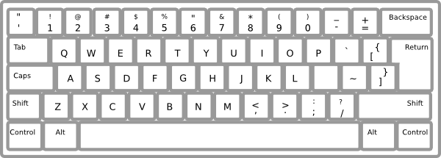
Please type your questions into the Question and Answer box by clicking on the Q&A icon at the bottom of your screen.

Slide 27
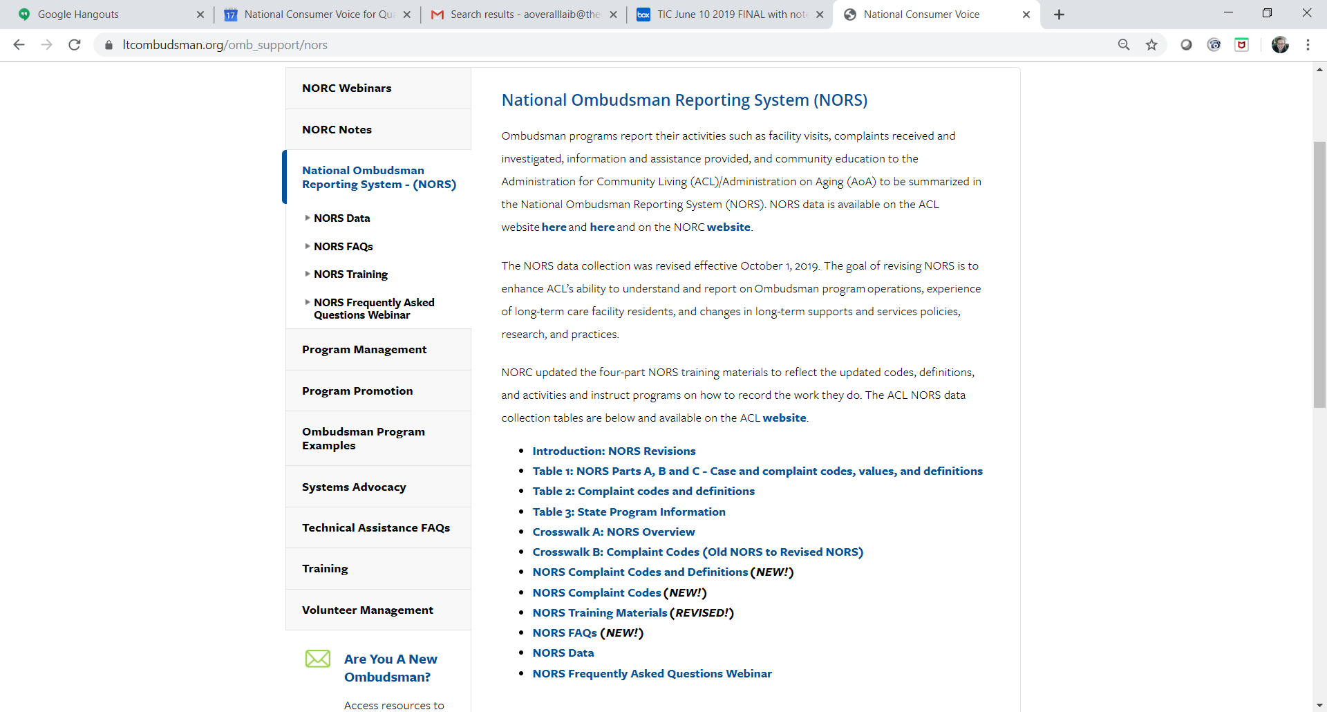
NORS Instructions, Training, and Materials https://ltcombudsman.org/omb_support/nors

Slide 28
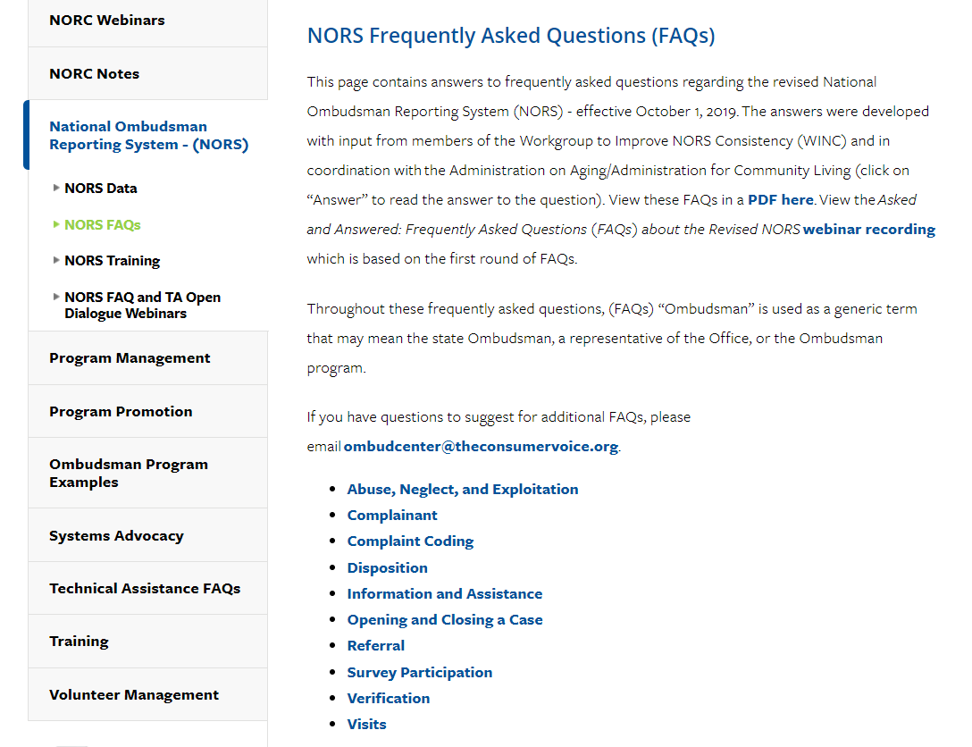
Frequently Asked Questions https://ltcombudsman.org/omb_support/nors/nors-faqs#complaint-coding

Slide 29

NORS Open Dialogue Webinars
Register for one webinar you are registered for the entire series.
  December 17, 3 – 4 ET: Part III and IV Closing the Case and Activities – Open Dialogue
Prior to joining the webinars, please do the following:
  Review the Administration for Community Living (ACL) NORS Tables 1 – 3.
  Review the NORS Training Materials and listen to the NORS Training Webinar series.
  Read the NORS Frequently Asked Questions (FAQs) and listen to the FAQ webinar.
  Keep print and/or digital copies of the ACL Tables and other NORS resources available as a reference during the technical assistance open webinars.
  Write down your questions so you are ready to share.

Slide 30
Contact Information
Amity Overall-Laib, NORC Director
aoveralllaib@theconsumervoice.org
(202) 332 2275 ext. 207
Louise Ryan, Ombudsman Program Specialist, AoA/ACL
louise.ryan@acl.hhs.gov
(202) 795-7355
Maria Greene
NORC Consultant
mgreene@theconsumervoice.org
(770) 668 6366

Slide 31



Connect with us:
www.ltcombudsman.org
ombudcenter@theconsumervoice.org
The National LTC Ombudsman Resource Center
@LTCombudcenter
Get our app! Search for "LTC Ombudsman Resource Center" in the Apple Store or Google Play
This project was supported, in part, by grant number 90OMRC0001-01-00, from the U.S. Administration for Community Living, Department of Health and Human Services, Washington, D.C. 20201. Grantees undertaking projects under government sponsorship are encouraged to express freely their findings and conclusions. Points of view or opinions do not, therefore, necessarily represent official Administration for Community Living policy.

