Slide 1

National ombudsman reporting system (NORS) training Part I: OPEN dialogue
Case, Complaint, Complainant, Information and Assistance
October 30, 2019

Slide 2
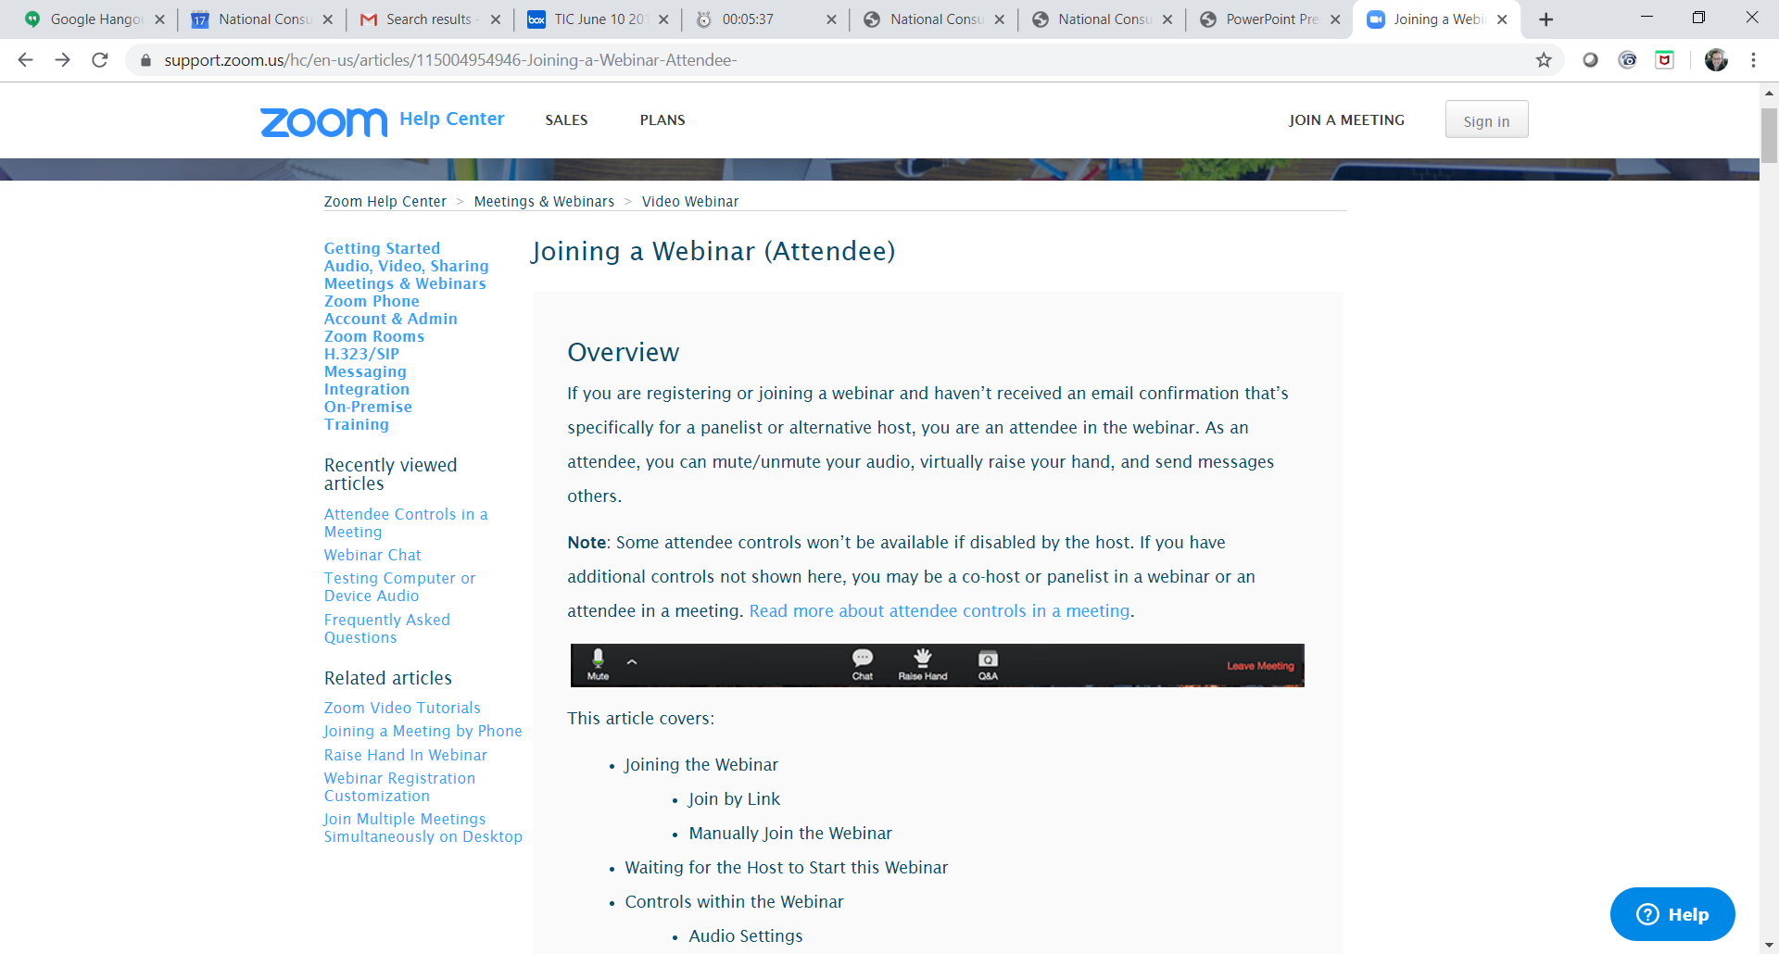
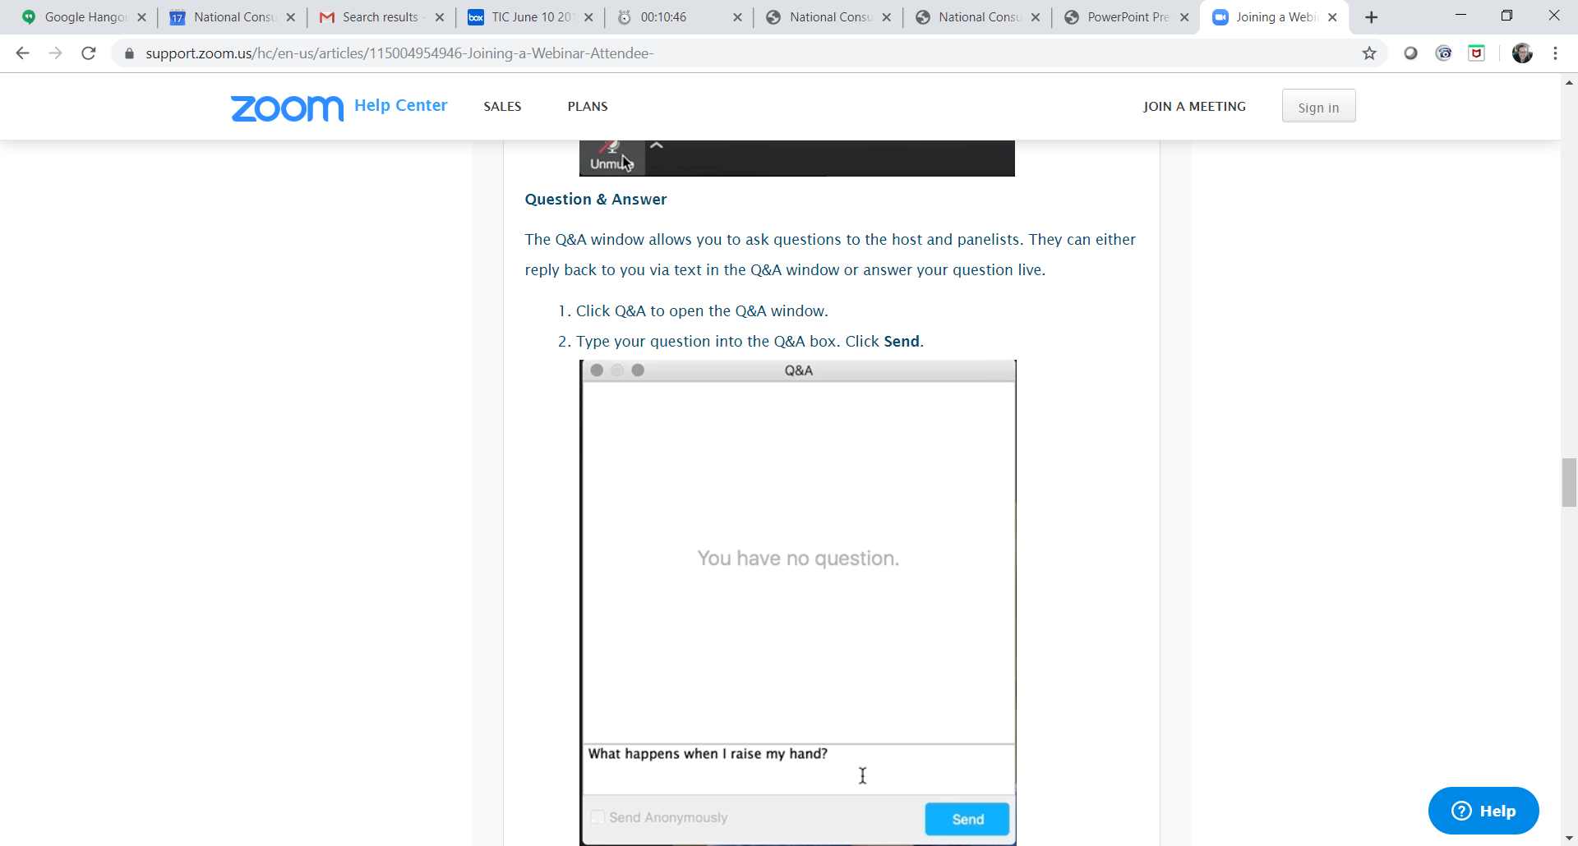
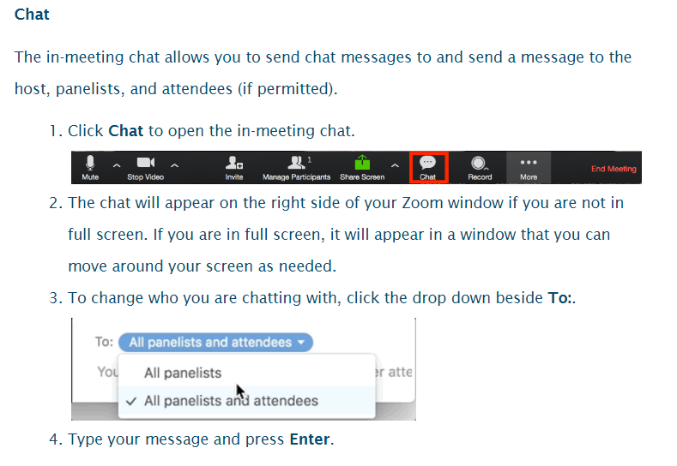
Have a question? Use the Q&A or Chat box.

Slide 3
Agenda
Greetings from ACL
Highlights of Part I Elements
Discussion
Resources

Slide 4
ACL Greetings
Louise Ryan
Ombudsman Program Specialist
Administration on Aging /Administration for Community Living

Slide 5
NORS Training Part 1: Case, Complaint, Complainant, and Information and Assistance
The three documents for the revised Part I NORS training materials are:
Basic Principles
Quiz
Quiz Answer Sheet
https://ltcombudsman.org/omb_support/nors/revised-nors-data-collection

Slide 6
Basic Principles
Basic Principles document includes important explanations and reminders.
In these materials, “Ombudsman” is used as a generic term that may mean the state Ombudsman, a representative of the Office, or the Ombudsman program.

Slide 7
Basic Principles
A case is comprised of a:
complainant,
complaint(s),
perpetrator for abuse/neglect/exploitation complaints (A codes),
setting,
verification,
resolution, and
information regarding whether a complaint was referred to another agency.

Slide 8
Basic Principles
Each case must have a minimum of one complaint.
A complaint is an expression of dissatisfaction or concern brought to, or initiated by, the Ombudsman program which requires Ombudsman program investigation and resolution on behalf of one or more residents of a long-term care facility.

Slide 9
Basic Principles
A complainant is an individual (i.e., resident, resident representative*/family/friend, facility staff) who requests Ombudsman program complaint investigation services regarding one or more complaints made by, or on behalf of, residents.
*resident representative as defined in 45 CFR 1324.1

Slide 10
Basic Principles
Key Changes:
Consultation is now called Information and Assistance.
NORS no longer requires the top three topics for information and assistance.
Information and Assistance is providing information to an individual or facility staff about issues impacting residents (e.g., resident rights, care issues, services) and/or sharing information about accessing services without opening a case and working to resolve a complaint.

Slide 11
Basic Principles
Information and assistance may be provided through various means, including but not limited to telephone, by written correspondence such as e-mail, or in person.
It does not involve investigating and working to resolve complaints. The resident (or resident representative, where applicable) has not provided direction and consent to investigate a complaint.
Directing an individual to contact another agency for assistance does not constitute a case.

Slide 12
Table 1 – Case Data Components
Parts A, B, and C – Case and Complaint Codes, Values and Definitions

Slide 13
Table 1 Highlights
Case Data Components:
  Date case & complaint opened and closed
  Facility or setting
  Complainant
  Complaints (one or more)
  Perpetrator
  Referral agency
  Verification
  Disposition

Slide 14
Open dialogue

Slide 15
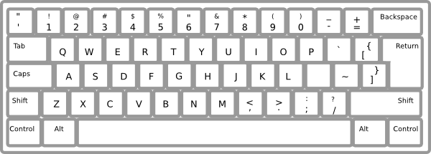
Please type your questions into the Question and Answer box by clicking on the Q&A icon at the bottom of your screen.

Slide 16
resources

Slide 17
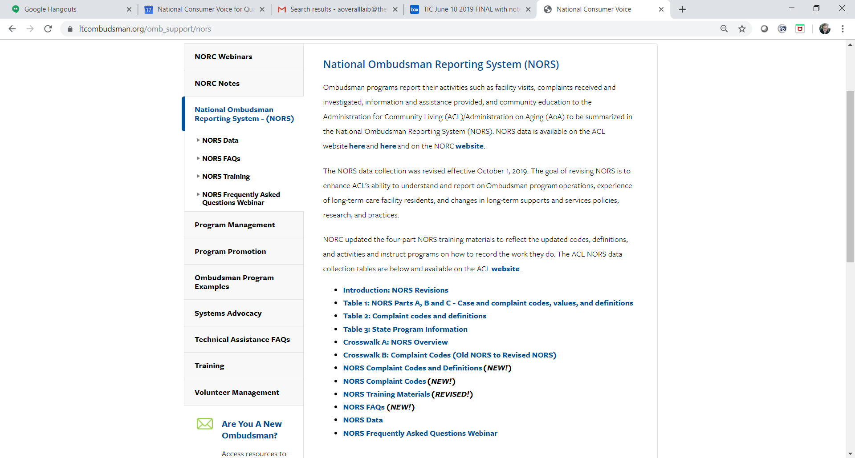
NORS Instructions, Training, and Materials https://ltcombudsman.org/omb_support/nors

Slide 18

NORS Open Dialogue Webinars
Register for one webinar you are registered for the entire series.
  Part II: Coding Complaints – Open Dialogue - November 20, 3 – 4 ET
  Part III and IV Closing the Case and Activities – Open Dialogue - December 17, 3 – 4 ET
Prior to joining the webinars, please do the following:
  Review the Administration for Community Living (ACL) NORS Tables 1 – 3.
  Review the NORS Training Materials and listen to the NORS Training Webinar series.
  Read the NORS Frequently Asked Questions (FAQs) and listen to the FAQ webinar.
  Keep print and/or digital copies of the ACL Tables and other NORS resources available as a reference during the technical assistance open webinars.
  Write down your questions so you are ready to share.

Slide 19
Contact Information
Amity Overall-Laib, NORC Director
aoveralllaib@theconsumervoice.org
(202) 332 2275 ext. 207
Louise Ryan, Ombudsman Program Specialist, AoA/ACL
louise.ryan@acl.hhs.gov
(202) 795-7355
Maria Greene
NORC Consultant
margreene@outlook.com
(770) 668 6366

Slide 20



Connect with us:
www.ltcombudsman.org
ombudcenter@theconsumervoice.org
The National LTC Ombudsman Resource Center
@LTCombudcenter
Get our app! Search for "LTC Ombudsman Resource Center" in the Apple Store or Google Play
This project was supported, in part, by grant number 90OMRC0001-01-00, from the U.S. Administration for Community Living, Department of Health and Human Services, Washington, D.C. 20201. Grantees undertaking projects under government sponsorship are encouraged to express freely their findings and conclusions. Points of view or opinions do not, therefore, necessarily represent official Administration for Community Living policy.

