Slide 1
Person-centered thinking: direct care services
Sheri Gibson, Ph.D.
sherigibson2@gmail.com
www.DrSheriGibson.com

Slide 2
Intent of this Training: Providing Person-Centered Care
Getting back to the basics
Person-Centered thinking during a time of COVID-19
Tools to enhance your knowledge of resident’s needs
Behavioral and nonverbal indicators to raise awareness of what’s working or what’s not working

Slide 3
COVID-19
Notes:
Across the globe and across our nation, a large number of cases have been reported, thousands of people have died and hundreds of thousands have been affected. But, no matter the number, each person is an individual which reinforces the need for person centered care.

Slide 4
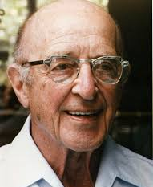
Carl Rogers
Creator of Person-Centered therapy
-Empathy at the core of therapeutic change
-Clients are viewed through the lens of potential
-Therapist exhibits positive, non-judgmental regard

Slide 5
What is Person-Centered Thinking?
Definition- supporting versus dictating or fixing
Strength base approach and build off strengths of the person
Knowing the personal story of the people we serve
Build a culture of learning, partnership and accountability
An approach used to discover meaningful information regarding a person which is later used to create a person-centered plan of supports.
Aims to promote the individual choice, direction, and control of their life and supports they receive.
Helps to ensure individuals are allowed positive control over their desired life, are recognized for their contributions to their community of choice, and are supported through paid and natural supports within their community.

Slide 6
Creating a System and Culture of Person-Centered Care
How are you doing within your organization?
Language- reframe
Perspective- of knowing people and honoring what is important to them while balancing what is important for them.
Listen to how they want to live
Support people in making use of community resources to have the life they want to live.
Provide the support to assist people with making these things happen.

Slide 7
Five Foundational Beliefs
1. Important questions: Who is this person and what is important to them?
2. Person-centeredness aims to change common patterns of community life.
3. Person-centeredness fundamentally challenges practices that separate people and perpetuate controlling relationships.
4. Honest person-centered planning can only come from respect for the dignity and completeness of the whole person.
5. Assisting people to define and pursue a desirable future tests the person’s clarity, commitment and courage.
Notes:
#2: -stimulate community hospitality
-enlist community members in assisting people to define and work toward a desirable future

Slide 8
Quality of Life and Self-Determination
What does quality of life mean to the person?
What does self determination mean to the person?
Autonomy
Dignity of risk – informed choice and importance of documentation
All of which are germane to long term care communities.

Slide 9
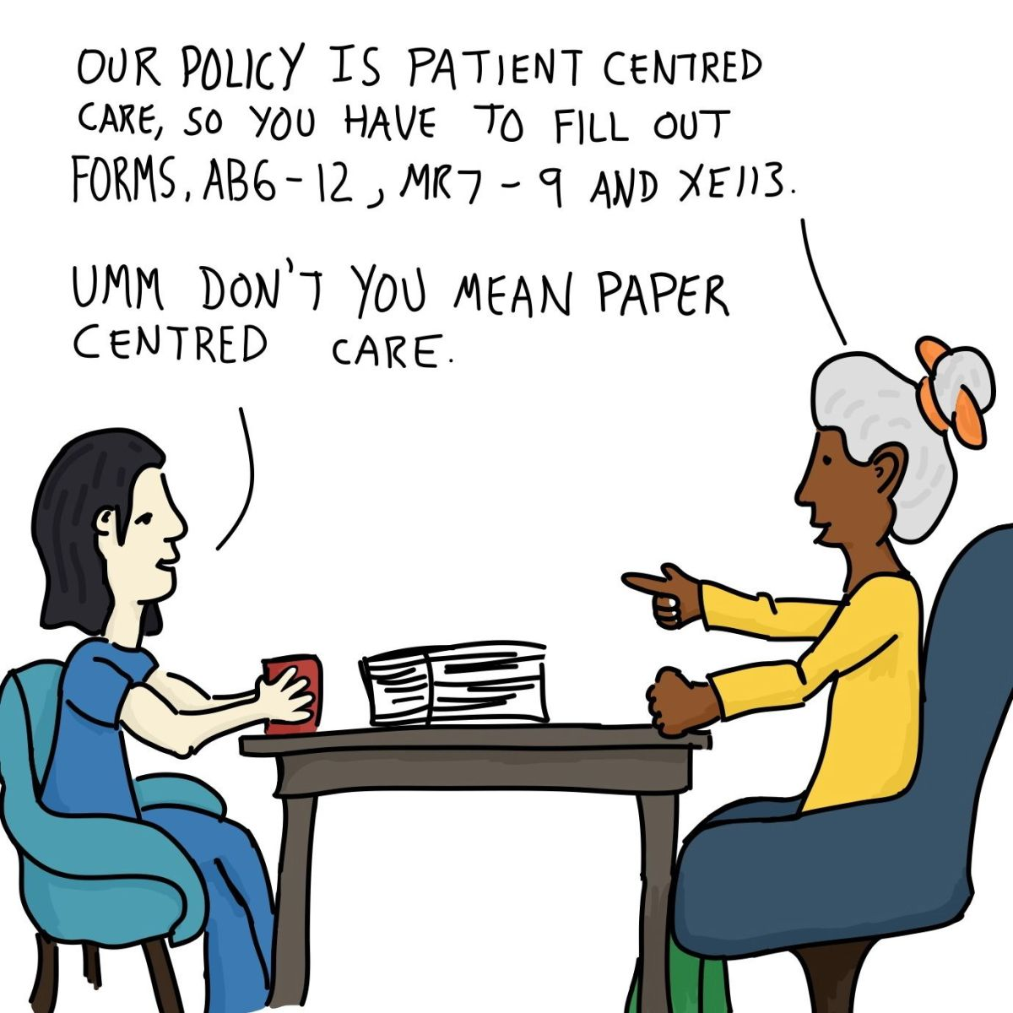
Tools for Analysis and Action

Slide 10
Important to and for
Important To:
Comfort
Happiness
Contentment
Fulfillment
Satisfaction
Important For:
Health and Safety
Being a valued member of the community
Notes:
Being a valued member of the community: How are you regarded by others? How do other people look at you?
If we understand what’s important to the person, then our interventions will support that through what’s important “for” then.

Slide 11
Relationship Maps
Sorting out who to talk to and who to listen to.
Questions to ask of people who can tell you about the person:
What do you like most about him/her?
What do you admire about him/her?
When is the last time you had fun together?
What do the answers reveal? Does they reflect a personal or a working relationship with the individual?
Be persistent in asking “Like, Admire, and Fun”
Listen for the personal connection
Notes:
This helps us build a story to introduce the person – because we typically introduce via paper/documentation
This is more than an assessment, it’s a spark for conversation – follow it wherever it goes.

Slide 12
Working and Not-Working tool
Consider what’s working and not working from different perspectives
The perspective of the person with whom you are working.
Also the perspectives of staff, family, or key stakeholder.
Looking at a particular issue or circumstance.
Core principles of negotiation:
Person feels listened to.
Start with common ground (what can everyone agree on?)
Be unconditionally constructive
Notes:
This exercise is a really simple way of analyzing what is happening in someone’s life from more than one perspective, it can help to identify whether what is important to them is present in their life, and whether they are being support in a way that makes sense to them. Problems surface where there are areas of disagreement in people’s lives. By looking at what is working and what is not working from different perspectives, it is clear where there is agreement and where there is difference.
Being unconditionally constructive: No matter how tempted you are to take sides, you don’t. You don’t criticize people’s perspectives. Solutions will pop up when you facilitate it well.

Slide 13
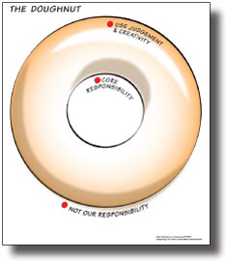
The Doughnut
Notes:
What it does
It is a way to think about and identify specific roles and responsibilities of people in a particular situation, so that people know what has to be done a particular way and where they can experiment and be creative. It also identifies what is not part of someone’s role.
How it helps
It can help to clarify the roles of the different professionals and agencies involved in supporting someone. This can feed into care and support planning, and can be used to sort roles and expectations in a team plan.
d what do you have in mind? What she buys is up to her but if she cannot afford, judgment and creativity is helpful.

Slide 14
The Doughnut
Our core responsibility
What is important to do, as instructed
Judgment and creativity
What is tried to see if it works
Beyond the boundary
Not our responsibility
“Carrie’s story”
Notes:
Charles Handy, The Empty Raincoat (UK)
The Age of Paradox (in the US) read the chapter.
Carrie: Michaels craft store. Going into Michaels is a time to walk out with things for her crafting projects. Doesn’t always have the money. It is your core responsibility to ask Carrie if she has money – is it enough? Do you want to go to Michaels an
What it does
It is a way to think about and identify specific roles and responsibilities of people in a particular situation, so that people know what has to be done a particular way and where they can experiment and be creative. It also identifies what is not part of someone’s role.
How it helps
It can help to clarify the roles of the different professionals and agencies involved in supporting someone. This can feed into care and support planning, and can be used to sort roles and expectations in a team plan.
d what do you have in mind? What she buys is up to her but if she cannot afford, judgment and creativity is helpful.

Slide 15
Four plus 1
What have we tried?
What have we learned?
What are we pleased about?
What are we concerned about?
Where do we go next?

Slide 16
Learning Log
Date
What did the person do?
Who was there?
What did you learn about what worked well?
What did you learn about what didn’t work well?
“Beverly’s story”
Notes:
We are never done learning. Some people change quickly and some people change slowly, but we are always learning.
Reflecting this in our documentation
It gives you a process to help you to record what you are learning while supporting someone. It is more useful when people are trying out new activities or are being supported by a new staff member. By capturing this information and re
What it does?
It gives you a process to help you to record what you are learning whilst supporting someone. It is most useful when people are trying out new activities or are being supported by a new staff member. By capturing this information and reviewing it, the whole team can keep learning how to give the best support.
How it helps
Crucially, learning logs ensure that in-depth knowledge and understanding of a person is shared with the wider team so that they too can support them well. They should be reviewed regularly by team leaders and shared with the people involved in the support.
viewing it, the whole team can keep learning how to give the best support. This can also be shared with the wider team so that they too can support them well.

Slide 17
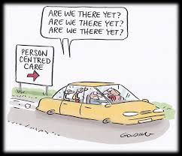
What else can you do?

Slide 18
Listen, Listen, Listen
Relationship is critical in long term care communities;
What is being “said” to you that indicates success or needing a different approach?
Nonverbal communication makes of 85% of all communication.
Embrace the philosophy of “being with” people rather than “doing to” people.

Slide 19
From the Mud, grows the Lotus
Adversity allows opportunity for growth and creativity;
Person-Centered Thinking is a Strength-Based philosophy of being with people, not doing to people;
Person-Centered Thinking is best modeled by YOU to create systemic change that reverberates across all levels of care and, ultimately, affects residents, and families.

Slide 20
resources

Slide 21
Person-Centered Care Resources
NORC
Person-centered care - https://ltcombudsman.org/issues/person-centered-care
Trauma-informed care – https://ltcombudsman.org/issues/trauma-informed-care
Consumer Voice
Resident-Directed Care/Culture Change https://theconsumervoice.org/issues/for-advocates/resident-directed-care
My Personal Directions for Quality Living - Blank Form & Sample
A tool from Consumer Voice, with edits by SAGE, for individuals to share what matters to them for person-centered care.
Information for LTC consumers - https://theconsumervoice.org/issues/recipients
Information for Family Members - https://theconsumervoice.org/issues/family

Slide 22
Resources
National Long-Term Care Ombudsman Resource Center (NORC) www.ltcombudsman.org
Coronavirus Prevention in Long-Term Care Facilities: Information for Ombudsman Programs https://ltcombudsman.org/omb_support/COVID-19
National Consumer Voice for Quality Long-Term Care (Consumer Voice) www.theconsumervoice.org
Coronavirus in Long-Term Care Facilities: Information for Advocates https://theconsumervoice.org/issues/other-issues-and-resources/covid-19
Coronavirus in Long-Term Care Facilities: Information for Residents and Families https://theconsumervoice.org/issues/other-issues-and-resources/covid-19/residents-families

Slide 23
Connect with us:
www.ltcombudsman.org
ombudcenter@theconsumervoice.org
The National LTC Ombudsman Resource Center
@LTCombudcenter
Get our app! Search for "LTC Ombudsman Resource Center" in the Apple Store or Google Play
This project was supported, in part, by grant number 90OMRC0001-01-00, from the U.S. Administration for Community Living, Department of Health and Human Services, Washington, D.C. 20201. Grantees undertaking projects under government sponsorship are encouraged to express freely their findings and conclusions. Points of view or opinions do not, therefore, necessarily represent official Administration for Community Living policy.

Slide 24
Thank you

