Slide 1

Advance care planning for residents
Role and Responsibilities of Long-Term Care Ombudsmen
Charles Sabatino
Director, American Bar Association Commission on Law & Aging
Maria Greene
Consultant, National LTC Ombudsman Resource Center
June 16, 2015

Slide 2
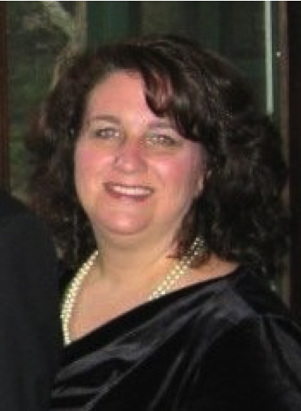
Lori Smetanka, Director
National LTC Ombudsman Resource Center

Slide 3

Charles Sabatino, Director
American Bar Association Commission on Law & Aging

Slide 4

Threshold matter…
What is capacity to make an advance directive?
No well-established legal definition, but…

Slide 5
Capacity to Appoint an Agent
 | Utah§ 75-2a-103 and -105 | Vermont Tit. 18, §9701(4)
Understanding | understands the consequences of appointing a particular person as agent. | has a basic understanding of what it means to have another individual make h.c. decisions for oneself
Appreciation of a relationship | (a) has expressed over time an intent to appoint the same person as agent; | and of who would be an appropriate individual to make those decisions,
 | (b) choice of agent is consistent with past relationships and patterns of behavior between the individual and the prospective agent, or, if inconsistent, whether there is a reasonable justification for the change;
Ability to communicate an intent | (c) expression of the intent to appoint the agent occurs at times when, or in settings where, the individual has the greatest ability to make and communicate decisions. | and can identify whom the individual wants to make health care decisions for the individual.

Slide 6
ADs Have Not Worked as Well as Hoped
A great idea but:
Most people don’t do.
When they do, a standard form doesn’t provide much guidance.
People change their minds.
When they name an agent, they seldom explain their wishes to agent.
Even if they do, health care providers usually don’t know about the directive.
Even if providers know directive exists, it isn’t in medical record.
Even if in the record, it isn’t consulted.

Slide 7
Change of Mind?
2-year study of 189 community-dwelling persons > 60 with advanced chronic conditions. Participants asked about their willingness to risk physical disability in order to avoid death.
    48% changed minds over a 2-year period either + or –
    When asked about willingness to risk cognitive disability, 49% changed their minds.
    Those whose health varied over time were more likely to have inconsistent trajectories.
  Fried, T.R., et al. Inconsistency over Time in the Preferences of Older Persons with Advanced Illness for Life-Sustaining Treatment. 55(7) J. Amer. Geriatrics.Soc. 1007–14. (2007).

Slide 8
What Ads Can’t Do
Can’t provide cookbook directions -- dying is complicated!
Can’t eliminate personal ambivalence.
Can’t be a substitute for Discussion.
Can’t control health care providers.

Slide 9
What ADs Can Do
CAN support a process of advance care planning.
CAN empower/educate a health care agent.
CAN help clarify goals and priorities on a trajectory of increasing specificity.
CAN influence services provided.

Slide 10

Advance Care Planning (ACP)
ACP
It’s all about Conversations

Slide 11

Effective Advance Planning –
A Communications Approach
Three Key Questions
Who can speak for me if I can’t?
What guidance do I want to give?
What’s the best way to communicate all this?

Slide 12

Who can speak
for me if I can’t?
Priority of authority…
The person you appoint under a legally recognized document.
Guardian/conservator with health decisions authority.
Default surrogate under state law, see…
www.americanbar.org/groups/law_aging/resources/health_care_decision_making.html

Slide 13

Selecting an Agent
The ideal health care proxy…
  Meets the legal criteria.
  Willing to speak on your behalf.
  Able to act on your wishes, not his/hers.
  Can be at your side when needed.
  Knows your values, goals, priorities.
  Can handle the responsibility.
  Will talk with you and listen.
  Will live longer than you.
  Can manage conflict.
  Strong advocate.
From: ABA Tool Kit for Health Care Advance Planning

Slide 15

2. What guidance
do I want to give?

Slide 16
Conversations that change over time
People with Chronic Conditions-- Guided planning for long range
Advanced Illness: Specific care plan
(e.g. POLST)
Healthy Adults–
Proxy for emergency care

Slide 17


Slide 18
Consumer Tool Kit for Health Care Advance Planning
www.ambar.org/agingtoolkit
There Are 10 “Tools” in This Tool Kit:
  #1 How to Select Your Health Care Agent
  #2 Are Some Conditions Worse Than Death?
  #3 How Do You Weigh Odds of Survival?
  #4 Personal Priorities and Spiritual Values
  #5 After Death Decisions to Think About Now
  #6 Conversation Scripts: Getting Past the Resistance
  #7 The Proxy Quiz
  #8 What to Do After Signing Your Advance Directive
  #9 Mini-Guide for Health Care Proxies
  #10 Resources (See updated ABA resource list)

Slide 21

www.codaalliance.org

Slide 22
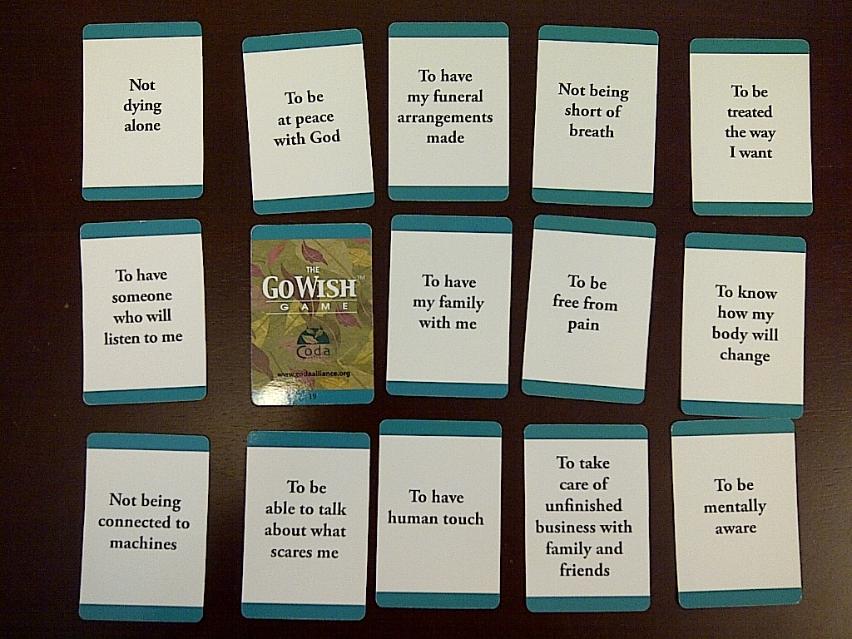

Slide 23
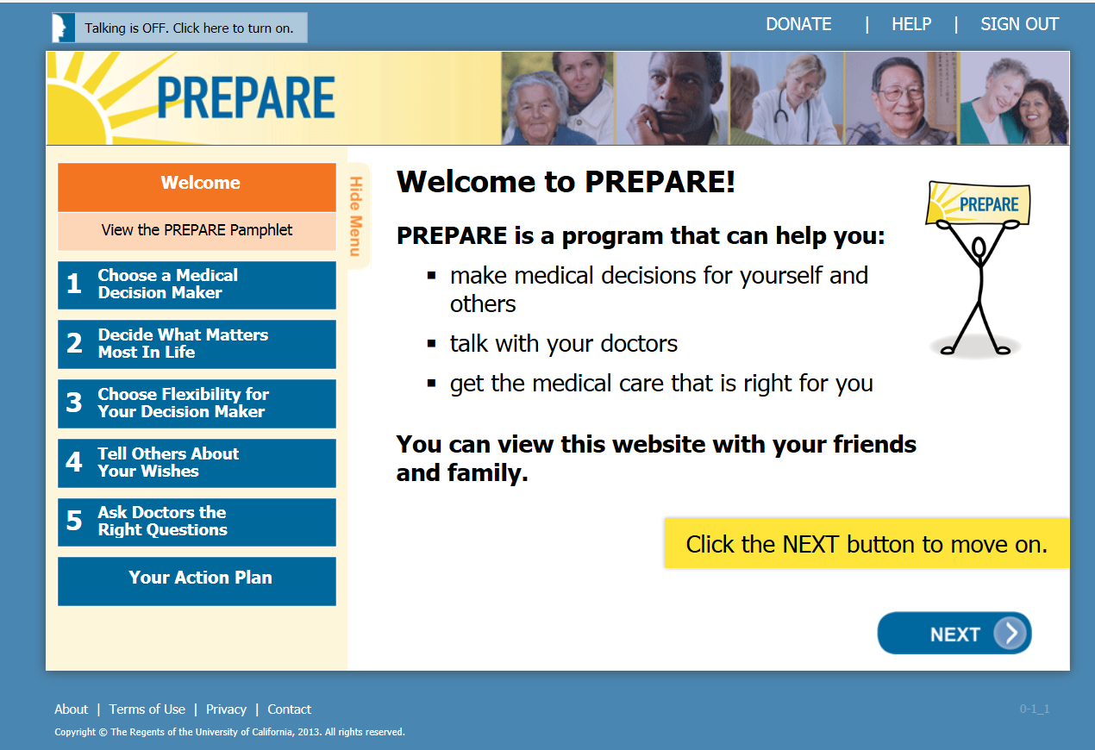

Slide 24
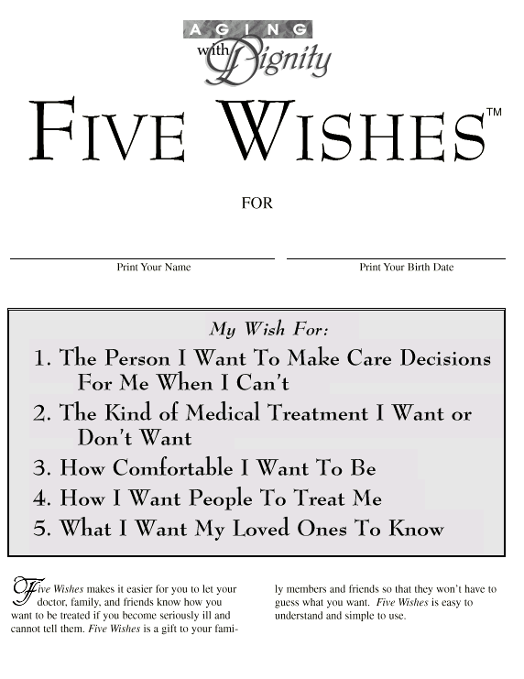
www.agingwithdignity.org

Slide 26
NOTE:
Don’t use this in: IN, NH, OH, TX, WI
www.ambar.org/HealthCarePOA

Slide 27
http://coalitionccc.org/tools-resources/people-with-developmental-disabilities.

Slide 30

Advance Care Planning
3. What’s the best way to communicate all this?

Slide 31
Advance Directive Forms
Health Care Advance Directives – a generic term.
Living will – colloquial, any instructions.
Durable Power of Attorney for Health Care (many names)
Non-statutory documentation: chart notes, worksheets, video, letters, etc.
Physicians Orders for Life Sustaining Treatment (POLST)

Slide 32

Know that an advance directive does not equal a plan of care
+ Standard
Medical
protocols
A
Individual’s Wishes/
Goals of
Care
How do you convert A into B?
B
Rx Orders in Chart

Slide 33
The “POLST” Paradigm
= A systemic step to bridge gap between patient’s goals/preferences and implementation of a plan of care with teeth.
Four actions required:
  Discussion: Find out patient’s goals/wishes re: CPR, care goals (comfort vs. treatment), N&H, etc.
  Translate into doctors orders on visually distinct medical file cover sheet.
  Ensure order set follows patient across care settings.
  Review
It’s not a form, it’s a process.

Slide 34
Advance Directives vs. POLST

Slide 35

Maria Greene, Consultant
National LTC Ombudsman Resource Center

Slide 36
Ombudsman ACP
Roles & Responsibilities
ACP Educator
Advocate to support residents’ requests concerning ACP
ACP complaint resolution
Ensuring resident’s wishes are followed

Slide 37

Roles & Responsibilities
Set Aside Your Own
Opinions
Religious Beliefs
Superstitions
Morals
Fears of Death and Dying

Slide 38

Roles & Responsibilities
Be knowledgeable of states’ ACP documents
Listen to residents’ wishes
Provide information & copies
Make referrals or assist in completing documents
Notes:
Listen to resident wishes regarding their care without telling them what they should think or do and encourage them to document their wishes.
Remain neutral and be respectful of their decisions.
Provide information, copies of advance care planning documents, and/or make referrals, such as to legal counsel, if appropriate.
Inform residents of their rights regarding individualized care, choice, and participating in their care planning- including advance care planning.
Advocate for the resident’s decisions even when family, friends, and facility staff may not agree with the resident’s choices.
Remind facility staff of their responsibility to inform residents of their rights to participate in their own care, choice in their care, and to develop advance care plans.
Share consumer information materials regarding advance care planning and residents’ rights with family members.
Become familiar with advance care planning process in your state as well as the nursing home and assisted living requirements regarding sharing information about advance care planning with residents.

Slide 39

Roles & Responsibilities
  What If ……….
  A resident has questionable or diminished capacity most days but on a “good” day they ask for ACP help?
Notes:
If a resident does not have a guardian/conservator of person appointed by a court of law, they are considered legally competent.
Proceed with seeking assistance to help the resident document his or her wishes
That could include:
Determining if the resident would like to include any family or friends in the advance care planning process
Contacting the social worker in the facility to determine the facility’s policies around assisting the resident in completing advance directives
Making a referral to an appropriate agency or organization – such as a legal services provider or benefits counselor
Sharing information with the resident and/or family members about advance care planning or advance directives
Support the resident being able to have his/her wishes heard and understood by family, friends, or those helping draft their advance directive forms

Slide 40
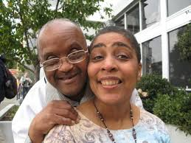
Roles & Responsibilities
What If……….
a resident has an intellectual or
developmental
disability and they express interest in completing ACP documents?
Notes:
As in the above situation, the LTCO would seek to assist the resident in any of the ways mentioned:
Determining if the resident has any family or friends to include in the advance care planning process
Contacting the social worker in the facility to determine the facility’s policies around assisting the resident in completing advance directives
Making a referral to an appropriate agency or organization – such as disability rights or a legal services provider
Sharing information with the resident and/or family members about advance care planning or advance directives
Support the resident being able to have his/her wishes heard and understood by family, friends, or those helping draft their advance directive forms

Slide 41

Roles & Responsibilities
What If……….
a resident completed ACP documents years ago and now they want to change them
Notes:
If a resident is competent and able to express his or her wishes, s/he may change their advance care documents at any time, including changing who is designated as a surrogate decision-maker. Circumstances such as a new health diagnosis may cause a person to re-evaluate what care they do or do not want. Medical or Durable Power of Attorney designees may have died or are no longer capable of carrying out the resident’s wishes thus requiring a new designee.
Even a resident, for example, with a Do Not Resuscitate Order on her chart, may change her mind and request resuscitation if it is necessary, or after any DNR protocol has been activated.
LTCO can support the resident in changing any advance care planning document by helping to assure that the resident is given the opportunity to express her wishes, even in the event of disagreement with those wishes by family, friends, or facility staff.

Slide 42

Roles & Responsibilities
What If……….
I am asked to become a resident’s surrogate decision maker or I’m asked to witness their signing of ACP documents?
Notes:
The act of witnessing someone signing their name is just that. You saw the person sign or make their mark on paper. Unless your state law, rules and regulations or Ombudsman policies and procedures prohibit you in your role of Ombudsman from witnessing a resident sign their name, you may. You may also seek and ask on the resident’s behalf other people to witness the signing. People who may not witness a resident signing legal documents and/or advance care planning documents are facility staff and medical providers . Some states recommend or require witnessing by a notary public. Review your state laws and seek guidance from the Office of the State Long Term Care Ombudsman.

Slide 43

Roles & Responsibilities
What If……….
A resident talks of dying and expresses an interest in ending their life?
Notes:
It could be that the resident wants someone to listen and talk with them about death and dying. Ask the resident if they would like to talk to a hospice counselor or clergy of their choice. You might also ask the resident if they have done advanced care planning and prepared advance directive documents, or named a surrogate decision-maker. Share available resources with them as appropriate.
If you think that the resident may be depressed and suicidal, ask them if there is someone – family, friend, clergy, counselor, staff member – they can turn to for help and ask if you can get or call that person. If they say no, turn the tables – you’ve told me this information and have left me in a difficult situation, so can you help me figure out how to handle this.
If they live in Oregon, Washington, or Vermont – where there are Death with Dignity laws – the resident would have to proactively follow the process set out by state law.
In any of these situations, get the State Ombudsman or supervisor involved as soon as possible.

Slide 44

Roles & Responsibilities
General Guidance
Determine if resident has a legal guardian
Is the surrogate decision maker’s authority in effect?
Read the resident’s ACP documents
Are wishes being followed?
Seek advice from supervisor & SLTCO

Slide 45
ACP Resources
NORC Ombudsman Resources on ACP
TA Briefs
TA Guides
ACP Community Education PowerPoint including group activities
Recorded webinar presentation

Slide 46
Contact Information
Charles Sabatino
charles.sabatino@americanbar.org
Maria Greene
margreene@frontier.net
Lori Smetanka
lsmetanka@theconsumervoice.org

Slide 47
The National Long-Term Care
Ombudsman Resource Center (NORC)
www.ltcombudsman.org
This presentation was supported, in part, by a grant from the Administration on Aging, Administration for Community Living, U.S. Department of Health and
Human Services.

