Slide 1

Identifying, Preventing, and Responding to
Bullying in Long-Term Care Facilities
Tuesday, July 28, 2015

Slide 2
Use the Red Aresidents' rightsow to expand or collapse your control panel.
Audio: Select Mic & Speakers to use your speakers for audio or call-in using your phone. Choose the telephone option to see the call-in information.
Mute: All lines are muted.
Questions: Enter questions in this box and we will respond during the Q&A following the presentation or click the hand icon and we will unmute your line.
Recording: The webinar recording will be available on our website. We will send a link to the recording and materials in a follow-up email soon.

Slide 3

Dr. Robin Bonifas, Associate Professor
School Of Social Work, Arizona State University
Notes:
Dr. Robin Bonifas, is a John A. Hartford Faculty Scholar in Geriatric Social Work and an Associate Professor with the School of Social Work at Arizona State University. She has over 15 years experience working with elders and their families in both long-term care and inpatient psychiatric settings. Her curesidents' rightsent projects examine elder social justice issues such as resident-to-resident aggression in nursing homes, late-life bullying, and other challenges to social relationships in senior care organizations.
To start our webinar, Dr. Bonifas will discuss her recent work regarding bullying among residents in LTC settings, reviewing the prevalence of bullying and how to identify, prevent, and respond to these incidents. There will be time for questions following her presentation.
After her presentation I will share resources regarding resident-to-resident mistreatment, discuss the role and responsibilities of LTCO regarding these incidents, and share some advocacy strategies.

Slide 4

Why Are We Talking About Bullying?
Older Adults Can Be Bullies, Too
It happens, but is often not addressed.
Aggressive behavior is often a symptom of an unmet need.
Bullying negatively impacts all residents involved.
Every resident has the right to individualized care and to be free from mistreatment.
No Age Limit on Bullying
Mean Girls in Assisted Living
Bullying is Ageless: Conflict and Violence Widespread in Nursing Homes, Study Finds
Notes:
We are talking about bullying because it happens. These are just a few examples of headlines in the news about bullying in LTC.
It happens and sometimes no one notices except for the residents involved, or the resident that was bullied doesn’t tell anyone, or the staff and family members downplay the bullying. Bullying, and other forms of aggressive behavior, often occurs due to the unmet needs of residents. Behavior is a form of communication and usually a warning sign that there is an underlying problem.
Bullying has a significant negative impact on all residents involved and each resident has the right to individualized, quality care and to be free from mistreatment.
So we need to learn more about it in order to better support all residents, help ensure their safety and well-being, and promote individualized care.

Slide 5
Resident-to-Resident Abuse and Conflict
2013 NORS Data
Notes:
According to the National Ombudsman Reporting System (NORS) data in 2013, there were 2,140 cases of resident to resident abuse (code A6) in NHs and 642 in ALFs (B&C). Resident-to-resident abuse was the second most frequent complaint in category A, under physical abuse (as most of you know the codes in category A are only for abuse defined as “willful mistreatment of residents.”)
As the bars show on the right-hand side, there were over 5,000 complaints of resident conflict (code I66) in NHs and 1,589 in ALFs. Code I66 is used for any complaint involving conflict between residents, including roommate conflict, and inappropriate behaviors that impact another resident’s quality of life.
Two notable takeaways from this data is that in 2013:
code I66 was among the Top Ten complaints for both NHs and ALFs (#4 in NHs, #6 in ALFs)
there were more complaints of resident conflict (I66) than of any abuse code (in category A) in both NHs and ALFs.
Resident conflict, including bullying, depending on the situation, could escalate to abuse and regardless of whether it is considered willful abuse or not, these conflicts can have a lasting negative impact on resident’s quality of life and care, so this is an important issue that needs to be addressed.

Slide 6
presentation
Dr. Robin Bonifas, Associate Professor
School Of Social Work, Arizona State University

Slide 7

The National Long-Term Care Ombudsman Resource Center
Webinar: Identifying, Preventing, and Responding to Bullying in Long-Term Care Facilities
Robin P. Bonifas, PhD, MSW
July 28th, 2015

Slide 8
Presentation Overview
Characteristics of bullying among older adults
  Definition and example behaviors
  People who bully
  People who are the targets of bullying
The impact of bullying on older adults
Recognizing potential bullying situations
A three-tiered framework for developing interventions to address bullying

Slide 9
Presentation Overview
Minimal research has been completed on bullying among older adults.
This presentation is based on three sources of information:
  A pilot research study in two assisted living facilities
  Practice experience working with individuals and organizations impacted by senior bullying
  Research literature on bullying among other population groups.

Slide 10
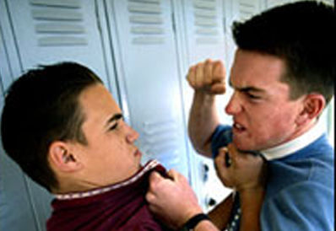

Who here has ever been bullied?
When and where did it occur?
What did it feel like?

Slide 11
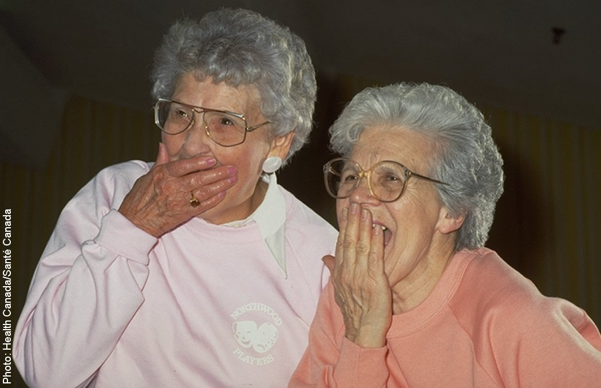
Unfortunately, bullying appears to occur across the lifespan

Slide 12
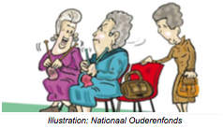
Bullying Definition
First, let’s clarify what bullying is and provide some examples so we all know what it is we are talking about…

Slide 13
Bullying Definition
Intentional repetitive aggressive behavior involving an imbalance of power or strength (Hazelden Foundation, 2008).
  The necessity of repetition is questionable because one-time incidents can have significant negative impact on some individuals.
Relational aggression is a common form of bullying among older adults: non-physical aggression intended to damage peer relationships and social connections (Hawker & Boulton, 2000)

Slide 14
What Does Bullying Look Like?
Bullying includes behaviors and actions that are:
  Verbal
  Physical
  Anti-social or relationship-centered
Here are some specific examples…

Slide 15
Types of Bullying
Verbal: name calling, teasing, insults, taunts, threats, sarcasm, or pointed jokes targeting specific individuals
Physical: pushing, hitting, destroying property, or stealing
Anti-social: shunning/excluding, gossiping, spreading rumors and using negative non-verbal body language (mimicking, offensive gestures)

Slide 16
Most Distressing Behaviors Reported by Research Participants
  Loud arguments in communal areas
  Naming calling/teasing
  Gossiping
  Being bossed around
  Negotiating value differences
  Sharing scarce resources
  Being hounded for money or cigarettes
  Listening to others complain
  Experiencing physical aggression
  Witnessing psychiatric symptoms

Slide 17
Note that some of the behavior listed previously do not meet the definition of bullying
Assisted living residents often consider any behavior that is frightening or disturbing to be “bullying”

Slide 18
Example Bullying Incidents
“There’s one that tries to be the number one tough guy. [He comes up] to me [and says] ‘One of these days, I’m gonna smack you with a hammer.’”
“He calls me “fatso”. He says, “Hey fatso.” Then as he goes down the hall…he would make oinking noises as he went to the elevator.”

Slide 19
How Often Does Bullying Occur?
Incidence noted in my pilot study:
  28 out of 30 residents were able to describe an incident of bullying or negative social interaction that they had experienced since moving into the facility.
  Most had also witnessing others being bullied or involved in similar negative social interactions.
  Given a total of 134 residents in the two facilities, this implies that at least 20 percent of residents experienced one or more episodes of bullying or related behavior.

Slide 20
Where Does Bullying Occur?
My research took place in assisted living facilities, but late-life bullying also occurs in:
  Senior centers
  Adult day health centers
  Senior housing
  Retirement apartments
  Nursing homes

Slide 21
Where Does Bullying Occur?
Engaging in bullying and relationally aggressive behaviors requires a certain level of cognitive and social skills (Walker & Richardson, 1998).
Senior environments with higher functioning residents or participants tend to have more problems with bullying.

Slide 22
Who Bullies?
Some common characteristics of people who bully:
  Seek to control others
  Feel reinforced by:
    Being powerful and controlling
    Making others feel threatened, fearful or hurt
    Causing and observing conflict between people
  Have difficulty tolerating individual differences
  Lack empathy
  Are likely to have few positive social relationships

Slide 23
Who Bullies?
At the same time, bullying among older adults also seems to be associated with loss.
  Loss of valued roles
  Loss of social identity
  Loss of a sense of belonging
Older bullies may be seeking control at a time in their life when they feel powerless.
Some of negative behaviors may be attempts to regain a sense of equilibrium.

Slide 24
Factors Influencing Bullying Situations
“I have problems accepting their problems…that‘s one of the things that is hardest to deal with”
“They go two generations back from me and I don’t know what they’re talking about.”
“For me, the hardest part has been living with people I have never associated with in my life”.

Slide 25
Gender Differences Noted
Women tend to engage in more passive aggressive behavior like gossiping and whispering.
Men are more likely to make negative in-your-face comments.

Slide 26
Bullies Experience Less Lifetime Trauma
Average Differences by Bullying Status
Cognitive impairment | 24.71 (3.62) | 21.27 (5.1) | 1.627
Depression | 6.14 (5.64) | 5.93(3.28) | .091
Self-esteem | 21.14 (8.21) | 19.93 (6.97) | .359
Lifetime trauma | 5.00 (3.32) | 8.33 (3.15) | -2.273**
**p < .05; n = 22

Slide 27
Who Gets Bullied?
Characteristics of people who are bullied:
  Typically have trouble defending themselves.
  Do nothing to “cause” the bullying.
  Often experience a sense of powerlessness because the bullying experiences are unpredictable.

Slide 28

Who Gets Bullied?
Two types of people often targeted with bullying:
  Passive targets
  Provocative targets

Slide 29
Who Gets Bullied?
Passive Targets
  May be highly emotional
  Have difficulty reading social cues
  May be shy and insecure
  May experience anxiety
  May have early stage dementia
  Have racial/ethnic, spiritual beliefs, or sexual orientation perceived as “different.”

Slide 30
Who Gets Bullied?
Provocative Targets
  Can be annoying or iresidents' rightsitating to others
  Quick-tempered
  May unwittingly “egg on” bullies
  Intrusive into others’ space
  May have mid-stage dementia

Slide 31
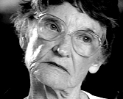
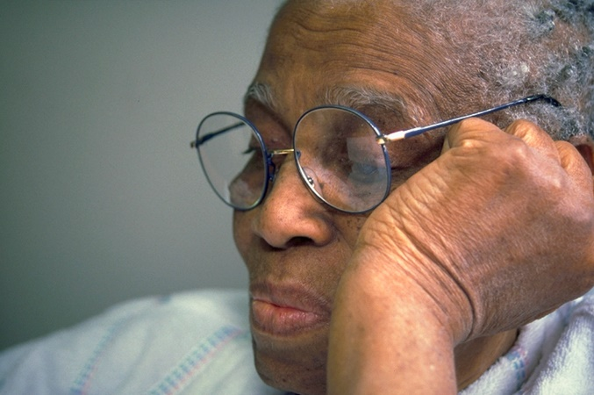
The Impact of Bullying
Common reactions to distressing behaviors and interaction patterns
  Anger
  Annoyance
  Frustration
  Fearfulness
  Anxiety/tension/woresidents' rightsy
  Retaliation followed by shame
  Self isolation
  Exacerbation of mental health conditions

Slide 32
Example Reactions to Bullying
“It makes me burning mad!”
“You can’t get away from that certain person, it’s hard, it’s hard. She won’t change. She does this to everybody, every day. Just aggravates the crap out of me.”
“I just have to dodge him…because he will altercate me. I have to try and avoid being harangued…if he hits me, and I fall, I’ll break a bone.”

Slide 33
Coping with Bullying
Seniors demonstrate extraordinary strategies for coping with challenging social relationships:
  Avoid contact with upsetting individual/ “walk away”
  Engage in positive self-talk
  “Bite their tongue”
  Pursue individual activities
  Just “let it go” or tune it out
  Strive to see the other person’s point of view
  Offer alternatives to problematic behavior
  Work to calm others down
  Spend time with pets
  Relationship with a supportive individual

Slide 34
Some People Have Difficulty Coping
Average Differences by Level of Distress
Cognitive impairment | 22.00 (3.64) | 22.57 (4.99) | -.262
Depression | 3.50 (2.62) | 7.42 (4.07) | -2.442**
Self-esteem | 23.25 (4.20) | 18.64 (8.14) | 1.749*
Lifetime trauma | 7.0 (3.50) | 7.42 (3.63) | -.270
*p < .10; **p < .05 ; n = 22

Slide 35
Bullying Warning Signs
Individuals who are being bullied may exhibit these behaviors:
  Self isolation
  Avoidance of specific areas or activities
  Take long circuitous routes to get to and from communal areas
  Vague complaints “They don’t like me” or “They won’t let me.”
  Depressed mood

Slide 36
Bullying Warning Signs
Individuals who bully their peers may exhibit these behaviors:
  Intimidate staff
  Often tell others what to do using a bossy style
  Criticize others or lack empathy toward them
  Make repeated complaints about others
    Be aware that individuals who complain in a powerful, outraged style about others’ picking on them are often bullies themselves!

Slide 37

We have learned a lot about bullying among older adults…
So what do we do about it?!

Slide 38
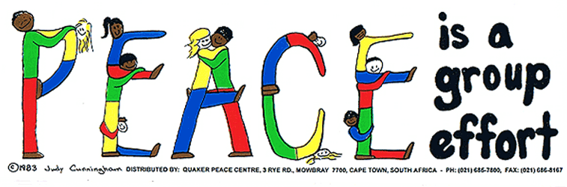
Organizational Level Interventions

Slide 39

Three-tiered Intervention Model
Preventing and minimizing bullying behavior requires intervention at multiple levels:
  Organization
  Bully
  Victim/Target

Slide 40
Organizational Level Intervention
The goal is to create caring communities for residents and staff.
Caring is feeling and exhibiting concern and empathy for others.
Empathy is the capacity to recognize and share feelings that are being experienced by another.
Empathy is the best antidote to bullying!

Slide 41
Organizational Level Interventions
Strive to create an environment that promotes empathy; this requires:
  A culture of respect
  Residents/consumers and staff be held accountable and responsible for their behaviors.
  Everyone is willing to stand up for what is right.
  High level of trust

Slide 42
Organizational Level Interventions: Civility Training
Nine tools for civility
  Pay attention
  Listen
  Be inclusive
  Don’t gossip
  Show respect
  Be agreeable
  Apologize
  Give constructive criticism
  Take responsibility

Slide 43
Organizational Level Interventions
Key Strategies:
  Regular staff and resident trainings and discussions about communal living.
  Staff training and support around recognizing and responding to bullying and aggressive behavior.
  Policies and procedures that guide behavior and encourage reporting of bullying incidents.

Slide 44
Organizational Level Interventions
Other example strategies:
  Acknowledge members of your community that go out of their way to make others welcome.
  Notice acts of kindness and publically reward them.
  Train residents in bystander intervention strategies to help them stop bullying when its observed.

Slide 45
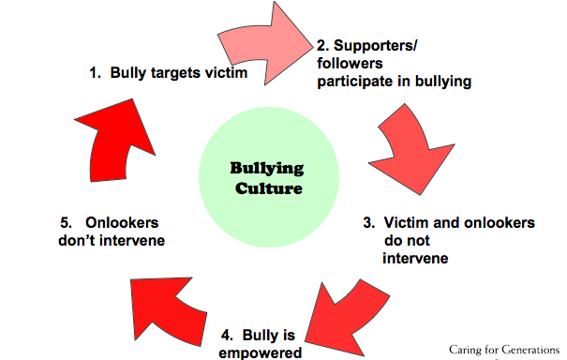
Example Component of Bystander Intervention Training

Slide 46
Interventions for Individuals who Bully
Consistently set limits on bullying behavior
Offer an appropriate outlet to vent frustrations
Help them to:
  Identify alternative methods to feel in control
  Learn positive communication skills
  Develop empathy
  Expand their social network
  Address feeling of loss

Slide 47
Intervention for Individuals who are
Bullied
Foster self worth and dignity; bolster self esteem
Assure an underlying depression is recognized and treated
Focus on skill development to help them avoid being victimized:
  Standing up for one’s rights
  Managing feelings of anger
  Using direct communication strategies

Slide 48
Research Participants’ Intervention Ideas
Offer anger management classes
Set limits with people who pick on others/eviction notices if they don’t improve
Hold regular meetings to promote communication among residents/tenants
Develop rules and expectations for behavior
Create partnerships between residents and facility management

Slide 49
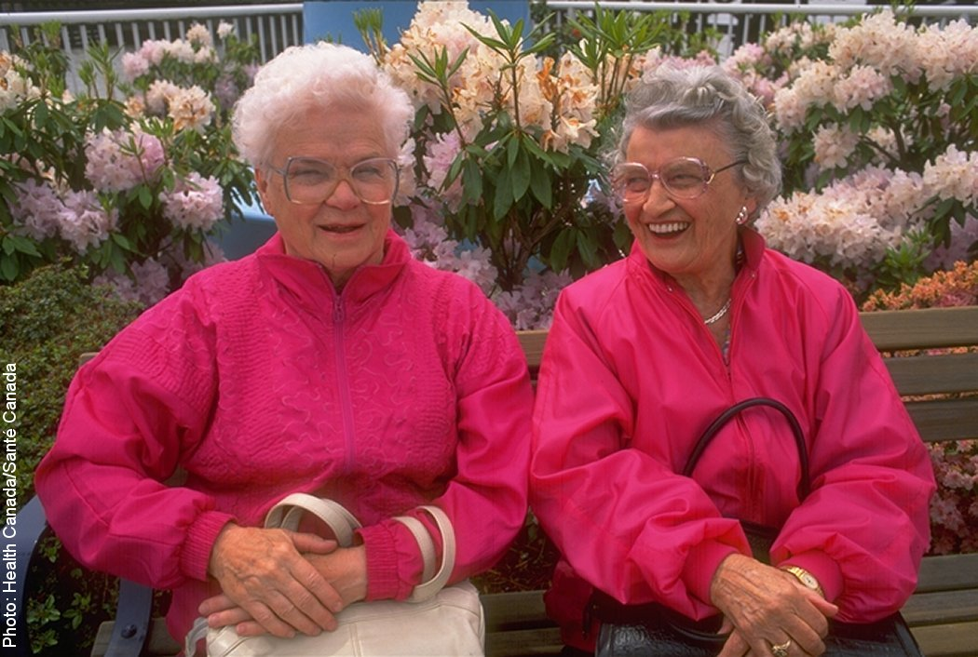
Research Participants’ Intervention Ideas
“We decided to use democratic measures [to deal with problematic resident behaviors] to create a comfortable atmosphere. This is part of our cultural shift.”

Slide 50
Example Intervention Developed with
Assisted Living Residents
Held a Peace Learning Circle
  a group event to help recognize problematic behaviors and present simple strategies to call attention to them when they occur - building on bystander intervention concepts.
Outcome:
  Residents’ attention spans and fatigue interfered with the 30-minute group session.
  The people who really needed it didn’t attend!

Slide 51
Example Intervention Developed by
Assisted Living Residents
Residents and staff revised the Peace Learning Circle concept to better fit the population:
  Incorporating main ideas into the popular weekly religious service
  Maximizing brief teaching moments by Infusing ongoing learning into inspirational “thought of the week” messages

Slide 52
Questions, comments, or discussion?

Slide 53
Questions?

Slide 54
LTCO Advocacy Strategies
Support the resident (as much as they want you involved) and seek direction for their resolution goal.
  If possible, determine whether this has happened before to other residents and if this is a pattern of behavior.
Consult with your supervisor and follow program policies.
Advocate for documentation of the incident and assessment of needs for both residents after the incident.
Discuss facility responsibilities regarding prevention, investigation, and reporting of the incident (if applicable).
  Reminder regarding proper staff supervision and training
Notes:
After receiving permission to pursue a complaint from the resident(s), or legal representative(s), some fundamental LTCO advocacy considerations in response to complaints involving bullying include, but are not limited to, the following:
Support the resident(s), as much as the resident(s) want you involved, during the complaint investigation process. Seek direction from the resident(s) regarding their resolution goal and provide information about available services (e.g. facility social worker, counseling). Provide information regarding residents' rights and communication skills to help empower the resident.
Communicate with your supervisor (e.g. a volunteer LTCO consults with their staff LTCO) and follow applicable state LTCO program policies and procedures regarding consultation, communication, and complaint investigation. For example, in a situation involving two residents consult with your supervisor to determine if you advocate for both residents or if you need the assistance of another LTCO in order for each resident involved to have a separate advocate.
Advocate for documentation of the incident and care planning and assessment for each resident after the incident. Planning should include measures to maintain resident safety, meet their needs after the incident (e.g. counseling), and prevent future incidents (e.g. environmental changes, separation of residents, proper staff supervision). Discuss common characteristics of those that bully and are bullied and if those characteristics apply to the individuals involved, how to address their needs (e.g. sense of loss and needing to regain control, anger, or self confidence for the resident that was bullied)
Share information with the facility Administrator and staff about responding to, and preventing future, incidents of bullying.

Slide 55

Next Steps
Speak with residents and Resident Councils.
Share information with family members and Family Councils.
Talk about bullying with facility staff.
Include information regarding bullying in LTCO training.
Notes:
Now that you’ve learned more about bullying, the characteristics of those that bully and the targets of bullying, the impact of it, and how to recognize it and intervene here are four things you can do now to help ensure the safety and quality of care and life of all long-term care residents.
Residents: Discuss residents' rights, especially their right to be free from mistreatment, including bullying. Share tools for empowerment and open communication. Encourage reporting of incidents and the importance of supporting each other and fostering a bullying free community.
FMs: Discuss residents' rights, signs of bullying, how to support residents, and report incidents.
Facility: Responsibility in preventing mistreatment and responding to incidents (including documenting and possibly reporting it if willful abuse). Stress importance of individualized care.

Slide 56
LTCO Systems Advocacy
Review your complaint data regularly.
Identify areas for education, collaboration, and advocacy.
  Promote bullying free communities and effective communication.
Consult with your supervisor and/or SLTCO to coordinate systems advocacy agendas.
Notes:
In addition to individual advocacy and education, systems advocacy is an effective approach in addressing bullying.
Review your complaint data regularly- how many complaints do you handle regarding resident conflict? Resident-to-resident abuse? Are there any trends? Can you identify any root causes or systemic issues that need to be addressed (e.g. importance of individualized care, meaningful activities, appropriate staffing levels and staff training, etc.)?
Education, Collaboration, and Advocacy
Share information with residents, families, and providers. Create and conduct in-service training for staff and RCs and FCs.
Identify partners to work with regarding abuse and resident to resident mistreatment (e.g. APS, mental health professionals)
Regional/statewide elder abuse task force

Slide 57

Touchstones
Aggressive behavior is often a form of communication- identify the root cause.
Person-centered complaint processing approach.
Resolution goal= resident satisfaction and protection of resident’s health, welfare and rights.
LTCOPs are not the “official finder of fact” to substantiate abuse complaints.
LTCO are not mandatory reporters, but LTCO must support the resident to the extent the resident wants assistance.

Slide 58
resources

Slide 59
Technical Assistance (TA) Brief (DRAFT)
LTCO Advocacy: Resident-to-Resident Aggression
Information regarding resident-to-resident aggression (residents' rightsA)
Tips for LTCO to help prevent and reduce the prevalence of residents' rightsA
LTCO Advocacy Strategies

Slide 60
What is Resident Mistreatment?
Consumer Brochure
Defines ANE
Overview of Residents’ Rights
Defines Resident-to-Resident Mistreatment
Explains how to seek help
http://ltcombudsman.org/issues/elder-abuse-elder-justice#Resources

Slide 61
Technical Assistance Guide
Responding to Allegations of Abuse: Role and Responsibilities of
LTCO
Overview
Key Points
AoA Statements
What Can An Ombudsman Do?
LTCO Advocacy Strategies
Resources
http://ltcombudsman.org/uploads/files/issues/responding-to-allegations-of-abuse_0.pdf

Slide 62
Additional Information…
NORC Resources
  Elder Abuse/Elder Justice Issue page http://ltcombudsman.org/issues/elder-abuse-elder-justice
  LTCO Training (webinar recordings, in-service materials) http://ltcombudsman.org/omb_support/training
  Library (federal regulations) http://ltcombudsman.org/library
  Systems Advocacy (e.g. Quick Reference Guide)
  http://ltcombudsman.org/omb_support/advocacy

Slide 63
Amity Overall-Laib
Manager, LTCO Program & Policy
aoveralllaib@theconsumervoice.org
The National Long-Term Care
Ombudsman Resource Center (NORC)
www.ltcombudsman.org
This project was supported, in part, by grant number 90OM002, from the U.S. Administration for Community Living, Department of Health and Human Services, Washington, D.C. 20201. Grantees undertaking projects under government sponsorship are encouraged to express freely their findings and conclusions. Points of view or opinions do not, therefore, necessarily represent official Administration for Community Living policy.

