Slide 1
Introduction to lgbt aging:
What You Need to Know about Lesbian, Gay, Bisexual and Transgender Older Adults
October 1, 2014
Please call 1-800-768-2983 and use access code 5629525 to join
the audio portion of today’s webinar

Slide 2
Introduction to LGBT Aging: What You Need to Know about Lesbian, Gay, Bisexual and Transgender Older Adults
A product of SAGE’s National Resource Center on LGBT Aging. © SAGE, National Resource Center on LGBT Aging, 2014

Slide 3
Introduction to LGBT Aging: What You Need to Know about Lesbian, Gay, Bisexual and Transgender Older Adults
Developed in collaboration with the LGBT Aging Project

Slide 4
Welcome and Introductions
Tim R. Johnston, PhD
Manager of Education and Training
SAGE‘s National Resource Center on LGBT Aging

Slide 5
SAGE is the country's largest and oldest organization dedicated to improving the lives of lesbian, gay, bisexual and transgender (LGBT) older adults.
Notes:
This presentation was developed by an organization called SAGE in conjunction with the LGBT Aging Project and Fenway Health in Boston. SAGE stands for Services and Advocacy for GLBT Elders. SAGE is the country’s largest and oldest organization dedicated to improving the lives of lesbian, gay, bisexual, and transgender older adults. SAGE offers supportive services and consumer resources to LGBT older adults and their caregivers, advocates for public policy changes that address the needs of LGBT older people, and provides training for aging providers and LGBT organizations.
For more information on SAGE’s programs and services, please visit www.sageusa.org

Slide 6
The National Resource Center on LGBT Aging is the country's first and only technical assistance resource center aimed at improving the quality of services and supports offered to lesbian, gay, bisexual, and transgender (LGBT) older adults.
www.lgbtagingcenter.org
Notes:
SAGE also operates the National Resource Center on LGBT Aging. The Resource Center is the country's first and only technical assistance resource center aimed at improving the quality of services and supports offered to lesbian, gay, bisexual, and transgender (LGBT) older adults.
For more information you can visit www.lgbtagingcenter.org

Slide 7
A basic introduction to:
… some of the unique issues facing LGBT older adults and caregivers.
… the reasons why LGBT older adults are less likely to access health and social services.
… best practices for helping LGBT older adults feel more included in your organization.
Notes:
Our goals for today are to increase your knowledge of what issues are unique for LGBT older adults and caregivers and to enhance your professionals skills working with this population. Many of you have tremendous expertise working with older adults – so today is about taking your A game, adding some new knowledge and skills and making it an A+ game.
Today is a basic introduction to three specific knowledge areas.
Frist, we will look at the unique issues facing LGBT older adults and caregivers. LGBT older adults face many of the same problems as all older adults, but they also have a unique history and set of vulnerabilities that you need to be aware of.
Second, we will talk about how the history of discrimination faced by LGBT older adults make them less likely to access health and social services.
Finally, we will end the presentation by discussing best practices for helping LGBT older adults feel more included in your organization.

Slide 8
Key Terminology
LGBT: Lesbian, Gay, Bisexual & Transgender
Lesbian: A women who is attracted to women
Gay: A man who is attracted to men; also an umbrella term to describe both gay men and women
Bisexual : Individuals who are attracted to both men and women
Notes:
First we’re going to start with some key terminology used to describe the LGBT community.
We will be covering concepts that you may be unfamiliar with or find confusing. The best thing you can do is ask a question. If you have a question, chances are someone else has the same question, so please don’t be shy. At any time feel free to “raise your hand,” use the Chat box, or send me a private message.
LGBT is an acronym that stands for Lesbian, Gay, Bisexual, and Transgender. LGBT, GBLT, BLT – these letters can be used in any combination, don’t worry about “getting it right” while we’re talking.
Many of you may have seen LGBT with additional letters added to the end. Use the chat box to tell us any other letters you’ve seen attached to LGBT, and what you think that letter stands for.
Ex. Q for Queer or Questioning, an I for intersex, or an A for Ally.
All of these are correct, but for today, let’s stick with LGBT which is the most general and common acronym to refer to this community.
Lesbian, Gay and Bisexual all refer to sexual orientation – who one is attracted to or partners with.
Lesbian refers to a woman whose primary emotional, physical, and/or romantic attractions are for other women.
Gay refers to a man whose primary emotional, physical, and/or romantic attractions are for other men. Gay can also be used as an umbrella term that applies to men and women.
Bisexual is someone whose emotional, physical, and/or romantic attractions are for both men and women, although not necessarily in equal proportion.

Slide 9
Key Terminology
Transgender: Individuals whose gender identity or gender expression do not align with their biological or assigned sex.
Cisgender: Individuals whose gender identity or gender expression do align with their biological or assigned sex.
Notes:
First we’re going to start with some key terminology used to describe the LGBT community.
We will be covering concepts that you may be unfamiliar with or find confusing. The best thing you can do is ask a question. If you have a question, chances are someone else has the same question, so please don’t be shy. At any time feel free to “raise your hand,” use the Chat box, or send me a private message.
LGBT is an acronym that stands for Lesbian, Gay, Bisexual, and Transgender. LGBT, GBLT, BLT – these letters can be used in any combination, don’t worry about “getting it right” while we’re talking.
Many of you may have seen LGBT with additional letters added to the end. Use the chat box to tell us any other letters you’ve seen attached to LGBT, and what you think that letter stands for.
Ex. Q for Queer or Questioning, an I for intersex, or an A for Ally.
All of these are correct, but for today, let’s stick with LGBT which is the most general and common acronym to refer to this community.
Lesbian, Gay and Bisexual all refer to sexual orientation – who one is attracted to or partners with.
Lesbian refers to a woman whose primary emotional, physical, and/or romantic attractions are for other women.
Gay refers to a man whose primary emotional, physical, and/or romantic attractions are for other men. Gay can also be used as an umbrella term that applies to men and women.
Bisexual is someone whose emotional, physical, and/or romantic attractions are for both men and women, although not necessarily in equal proportion.

Slide 10
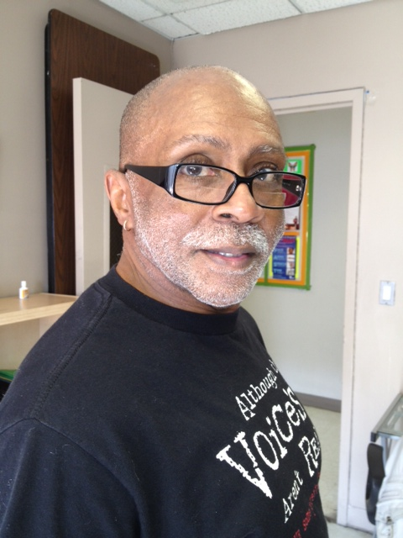
Terms to Avoid
Queer
Homosexual
Lifestyle
Sexual Preference
Notes:
There are some terms that you should avoid when working with LGBT older adults. Let’s look at four of these words now:
Queer: We frequently get questions about the use of the word “Queer.” Historically this has been a very negative term and many LGBT older adults recall having heard this word used with tremendous hate. In recent years it has been reclaimed by a younger generation that has wanted to use it as a more universal term for LGBT and we’ve seen many youth and progressive movements using the term quite freely. This is an interesting intergenerational element in the LGBT community and important to consider. Many LGBT older adults still feel the sting of this word and I defer to that by not using the word queer in my work unless an older adult has used it first.
Homosexual is an outdated term, medical model and very pejorative for many. Gay and Lesbian is much more common. However, some older LGBTs still do use the term themselves.
Lifestyle: Describing LGBT identity as a lifestyle is generally considered offensive. Just as there is no one straight “lifestyle,” there is no one lesbian, gay, bisexual, or transgender lifestyle.
Sexual Preference conveys the suggestion that being gay or lesbian is a choice and therefore can be “cured” or changed.

Slide 11
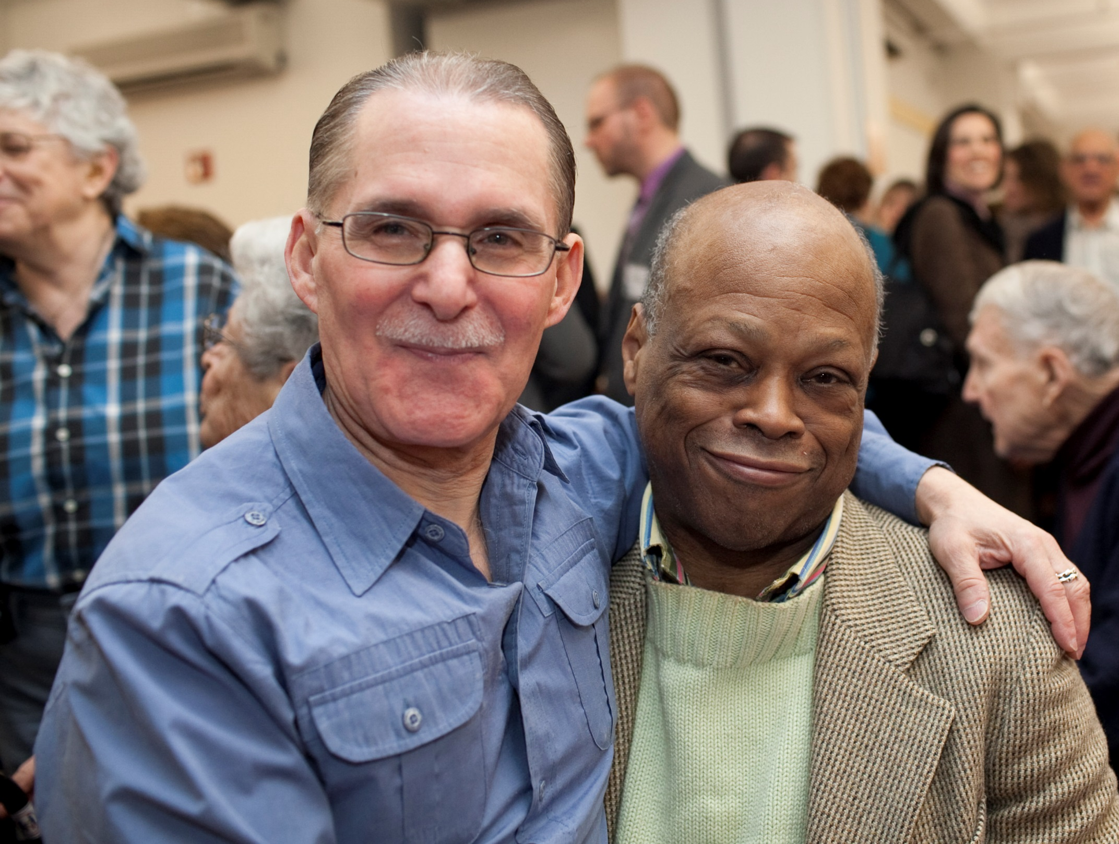
LGBT Older Adults: A Forgotten Population
Notes:
Participant poll:
How many of you know a someone who identifies as LGBT?
How many of you know an older adult (60+) who identifies as LGBT?
Many people know an LGBT person, but not that many know an LGBT older adult. LGBT older adults are an underserved and often forgotten population.
Our work in LGBT Aging grows out of the fact that although the elder service network does provides tremendous care for older adults, LGBT folks have not been on their radar screen. At the same time the LGBT community has focused its energies on HIV/AIDS care, LGBT youth, marriage equality, transgender issues, but not on older adults.
The result is that LGBT older adults have been overlooked and are falling through the cracks.
Next we will look at two questions: How large is this population, and what unique challenges face LGBT older adults?

Slide 12
LGBT Older Adult Population
2010: Between 1.6 and 2.4 million 2030: As many as 7 million
Notes:
One of the frequent questions we hear is how many LGBT older adults are there?
It is estimated that the population of LGBT older adults will more than double between 2010 and 2030. In part this is due to the aging of the Baby Boomers – which will greatly increase the number of all older adults during this time frame. I suspect that during this time it will FEEL like a tremendous growth as well because not only will there be many more older adults in general but LGBT Baby Boomers are more likely to have been out in their younger lives and will continue to be so as older adults. So there will be more out LGBT older adults in the coming years.
That is why we’re having this conversation today.
T/F Question
“Most LGBT people live in major metropolitan areas like New York, San Francisco, and Washington DC”
References
Outing Age: Public Policy Issues Affecting Lesbian, Gay, Bisexual, and Transgender Elders. National Gay and Lesbian Task Force, 2010. http://www.thetaskforce.org/downloads/reports/reports/outingage_final.pdf
http://williamsinstitute.law.ucla.edu/
http://www.aoa.gov/Aging_Statistics/future_growth/future_growth.aspx#hispanic

Slide 13
Same-sex couples per 1,000 households by county (adjusted)
Notes:
The answer is False!
While many LGBT people do live in large urban areas, as this map shows, LGBT people live in nearly every community in the United States. Same-sex couples live in 93% of all United States Counties.
This means that no matter where you live and work, it is important to develop empathy and learn about best practices to make it safe for LGBT elders to seek health and social services. If you believe that you are not currently working with any LGBT older adults, you may be working with people that are in the closet. You almost certainly will work with LGBT older adults in the near future.
References (You do not need to read these aloud. They are included here in case participants ask for more information about these statistics)
http://williamsinstitute.law.ucla.edu/

Slide 14
What makes LGBT older adults unique?
Many LGBT older adults live alone and rely on other older adults for support and caregiving.
A history of discrimination leaves many LGBT older adults with a general distrust of mainstream institutions.
Notes:
Today we will focus on two things that make LGBT older adults unique.
Many LGBT older adults live alone and rely on other older adults for support and caregiving.
A history of discrimination leaves many LGBT older adults with a general distrust of mainstream institutions that many heterosexuals assume are in place to help them.

Slide 15
Health Disparities
Lack of informal or family care
Distrust of professional health and care services
Legal and Financial Disparities
Notes:
We can see how these problems are interlinked. LGBT older adults have higher levels of health issues than their heterosexual counterparts. They also face additional legal and financial barriers to economic security, making them less able to afford care. They lack family or other information care networks, and may distrust the social safety nets and organizations that are intended to help them.

Slide 16
Remember, LGBT older adults may not come out right away, but if you set a tone of respect and acceptance they may feel comfortable coming out later on.

Slide 17
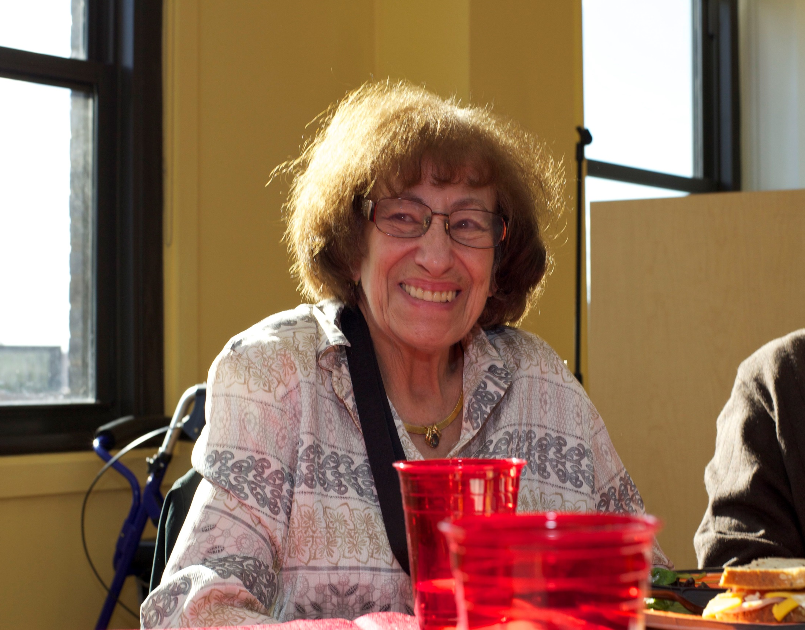
“What is one thing I can start doing differently to better serve LGBT older adults?”
Notes:
I would like for everyone to share their answer to this question: “What is one thing I can start doing differently to be more sensitive to LGBT older adults?”
Tell me your answer through the chat box or private message.

Slide 18
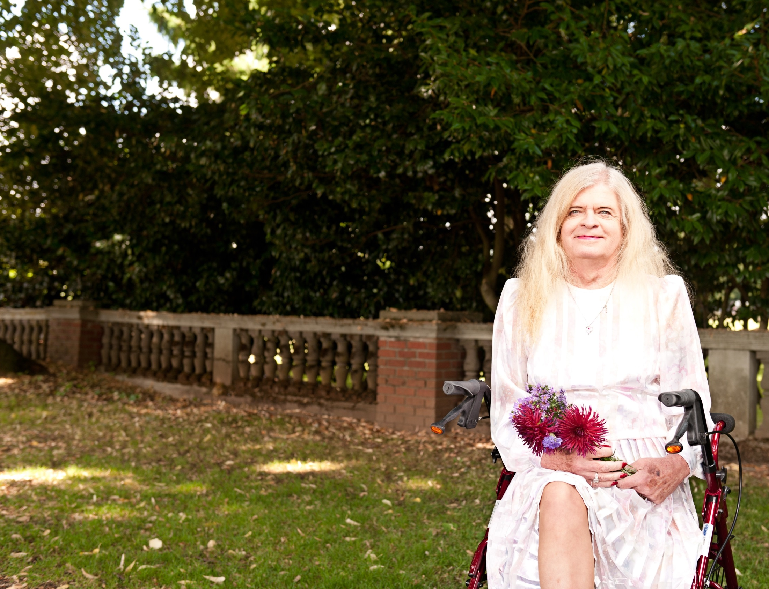
In-Person Trainings
Introduction to LGBT Aging (60 minute highly interactive presentation)
For Aging Service Providers (Intensive 4 or 8 hour workshop)
Our most popular training!
For LGBT Organizations (Intensive 4 or 9 hour workshop)
Request a training and get more information at:
www.lgbtagingcenter.org
Notes:
Are you interested in learning more about LGBT older adults and how you can better serve those who access your services? The National Resource Center on LGBT Aging has developed both in-person and online trainings to support efforts to create a safe and inclusive environment for LGBT older adults.
Please visit www.lgbtagingcenter.org for a full description of our trainings and to schedule a training for your organization.

Slide 19
Thank You!

Slide 20
discussion

Slide 21
Action steps and resources

Slide 22
What can LTCO do?
Learn more about providing inclusive services and being a welcoming agency/program
Incorporate this information into initial certification and continuing education training for staff and volunteer LTCO
Provide in-service training for facility staff
Share information and resources with facility administrators, residents and family members
Share information with Resident and Family Councils
Notes:
As part of your continuing self-evaluation and assessment of your program, learn more about what it means to provide inclusive services and be a welcoming agency to ensure all consumers, families and other individuals are comfortable seeking your assistance.

Slide 23
NEW Consumer Fact Sheet
Residents’ Rights and the LGBT Community: Know YOUR Rights as a Nursing Home Resident
Overview and Context
Residents’ Rights
Advocacy Tips and Contacts
Resources
Notes:
Today is the first day of Residents’ Rights Month. If you are hosting an RR events, conducting in-services or outreach during RRM consider including these fact sheets.
In addition to RRM, distribute these fact sheets during your routine visits, in-services, LTCO training and to start conversations with facility staff, Resident and Family Councils.

Slide 24
Resources and Training
NORC “LGBT Elders” Issue Page
http://www.ltcombudsman.org/issues/LGBT-aging
Residents’ Rights and the LGBT Community: Know Your Rights as a Nursing Home Resident (consumer fact sheet)
Advocating for LGBT Long-Term Care Consumers: Resources for Long-Term Care Ombudsmen (webinar)
Inclusive Services for LGBT Older Adults: A Practical Guide to Creating Welcoming Agencies- National Resource Center on LGBT Aging
Mistreatment of Lesbian, Gay, Bisexual, and Transgender (LGBT) Elders- NCEA
38th Annual Consumer Voice Conference (Arlington, VA)
http://theconsumervoice.org/misc/2014-annual-conference

Slide 25
The National Long-Term Care
Ombudsman Resource Center (NORC)
www.ltcombudsman.org
The National Consumer Voice for Quality Long-Term Care
(formerly NCCNHR)
http://www.theconsumervoice.org/
This presentation was supported, in part, by a grant from the Administration on Aging, Administration for Community Living, U.S. Department of Health and
Human Services.

