Slide 1
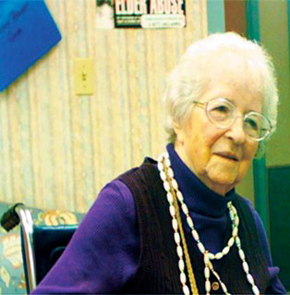
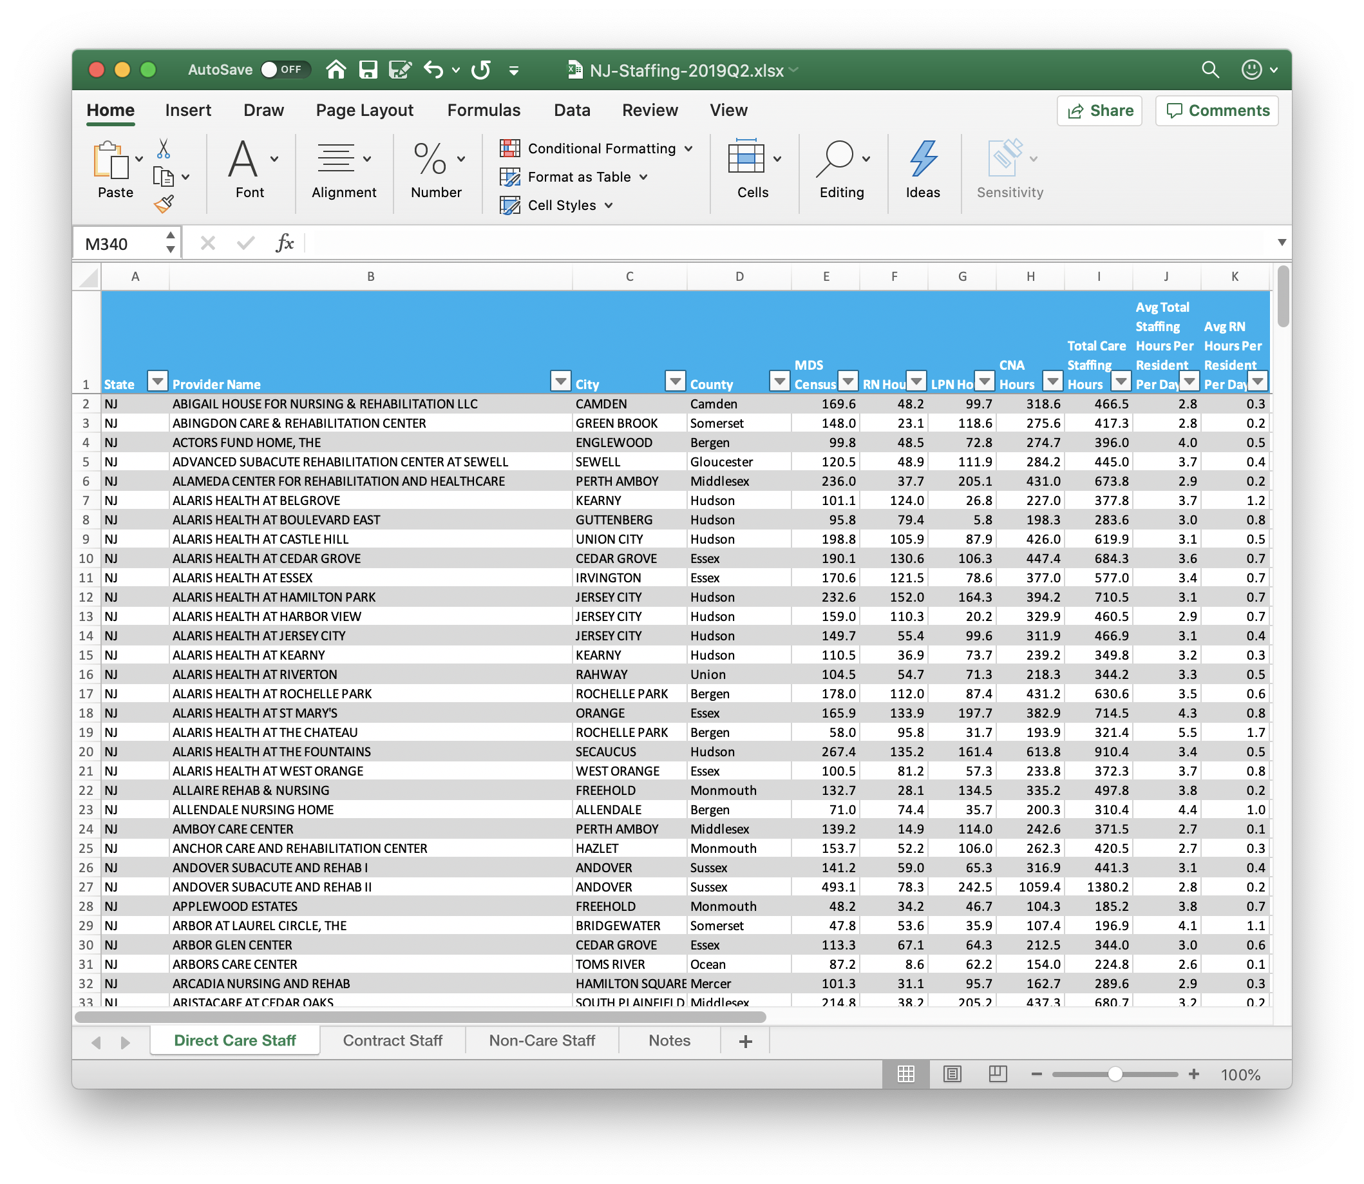
Using Data to Strengthen Your Nursing Home Advocacy
Long Term Care Community Coalition
www.nursinghome411.org

Slide 2
About the Long Term Care Community Coalition?
LTCCC: Nonprofit, nonpartisan organization dedicated to improving care & quality of life for the elderly & adult disabled in long-term care (LTC). Home to two local LTC Ombudsman Programs in NY.
Our focus: People who live in nursing homes & assisted living.
What we do:
State and national policy analysis and systems advocacy;
Education of consumers and families, LTC Ombudsmen, and other stakeholders.
Resources:
www.nursinghome411.org: News, resources, data… all free to use and share;
nursinghome411.org/join/: Sign-up for news and alerts;
Monthly webinars that you can use to offer one-hour LTCO trainings. Email sara@ltccc.org to sign-up your Program.

Slide 3
Why are nursing home data useful?
To Support Advocacy in a Nursing Home
Data can support advocacy about concerns such as antipsychotic drugging, pressure ulcers, falls, etc…
Data enable comparisons between a facility and others in the community or state or nation.
Data can indicate low staffing and support advocacy for improvement.
To Support Broader and Systemic Advocacy
Highlight and substantiate concerns, such as low staffing or high drugging or pressure ulcer rates, with state and federal politicians, news reporters, etc…
Demonstrate and substantiate concerns for state enforcement agencies, Medicaid Fraud Control Units, state auditors, and the public.
Support requests for funding by showing the need of the work you do.

Slide 4
Webinar Agenda
Care Compare: The NEW federal website for nursing home information
Digging Deeper on…
ProPublica’s Nursing Home Inspect
LTCCC’s website, nursinghome411.org
Federal databases: data.medicare.gov & data.cms.gov

Slide 5
Intro to Care Compare

Slide 6
Care Compare & the Five-Star Rating System: www.medicare.gov/care-compare/
Background
Care Compare provides information on every licensed nursing home in the U.S.
While it is not perfect, we consider it to be the most reliable and useful resource for information on a nursing home’s quality.
Staffing
Location
Quality
Oversight

Slide 7
Important to Keep in Mind…
Where Should Momma Go?
Study found that rating systems “are better at identifying problem facilities than potentially good homes.”
https://www.ncbi.nlm.nih.gov/pmc/articles/PMC1920506/

Slide 8
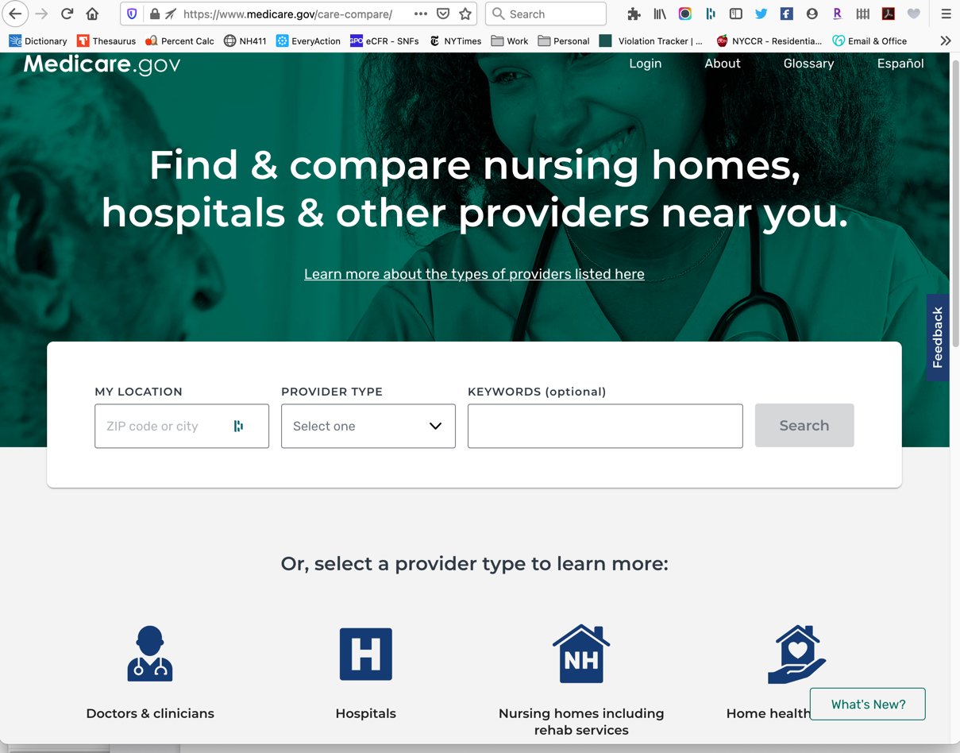
Care Compare: www.medicare.gov/care-compare/
Search by …
Nearest town/city
Zip code

Slide 9
Care Compare Profile

Slide 10
Care Compare Profile

Slide 11
Care Compare Profile

Slide 12
Care Compare Profile

Slide 13
Care Compare Profile

Slide 14
Care Compare Profile
Statements of Deficiencies.
Important Note: Both state nursing home websites and the federal Care Compare website post Statements of Deficiencies. However, Only the state websites are required to post plans of correction.

Slide 15
Digging Deeper
Accessing Data on ProPublica’s Nursing Home Inspect

Slide 16
projects.propublica.org/nursing-homes/

Slide 17
Visit
https://projects.propublica.org/nursing-homes/

Slide 18
Digging Deeper
Accessing Federal Nursing Home Data

Slide 19
Payroll Based Journal Staffing Data: data.cms.gov
What are the PBJ data and why are they so important?
Historically, nursing homes only reported their staffing levels once a year, for the two weeks prior to their annual survey. These data were not audited by either the states or federal government.
Due to concerns that many nursing homes were inflating their staffing numbers (surprise!), the 2010 Affordable Care Act required that nursing homes report their staffing numbers every day of the year, based on their auditable payroll records.
This requirement was implemented in 2016. Public reporting began in 2017.
Data are provided for ever facility for every day, in quarterly (3 month) files.
They include daily hours for: RN, LPN, CNA, nursing staff assigned to provide care or administrative work, nursing staff who are permanent or contract, plus medical directors, pharmacist, activities, and therapy staff.

Slide 20
PBJ Staffing: www.data.cms.gov

Slide 21
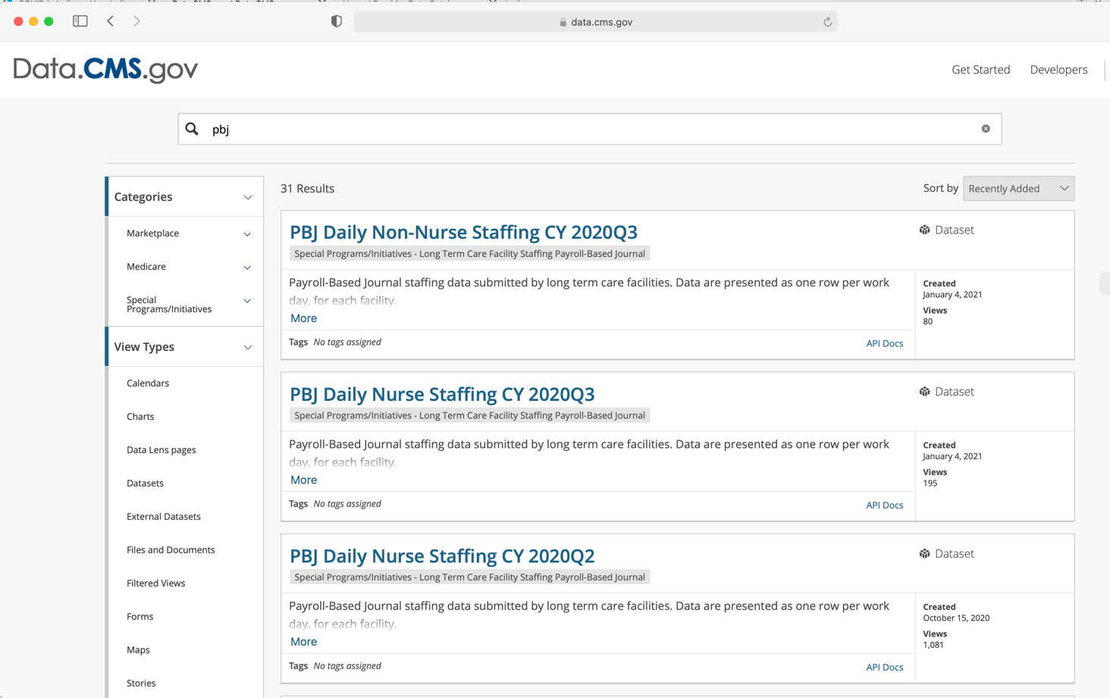
Visit
Data.cms.gov

Slide 22
Other Nursing Home Info: data.medicare.gov
Datasets include information for every nursing home. Topics include:
Health deficiencies
MDS Quality Measures (like antipsychotic drugging rates, pressure ulcers, falls, etc…)
Ownership
Penalty counts
Staffing (risk-adjusted)
Star ratings
Each dataset includes searchable identifying information, such as:
Nursing home name
State
City
County
Address

Slide 23
Other Nursing Home Info: www.data.medicare.gov
Visit
www.data.medicare.gov

Slide 24
Digging Deeper
Accessing Data on www.nursinghome411.org

Slide 25
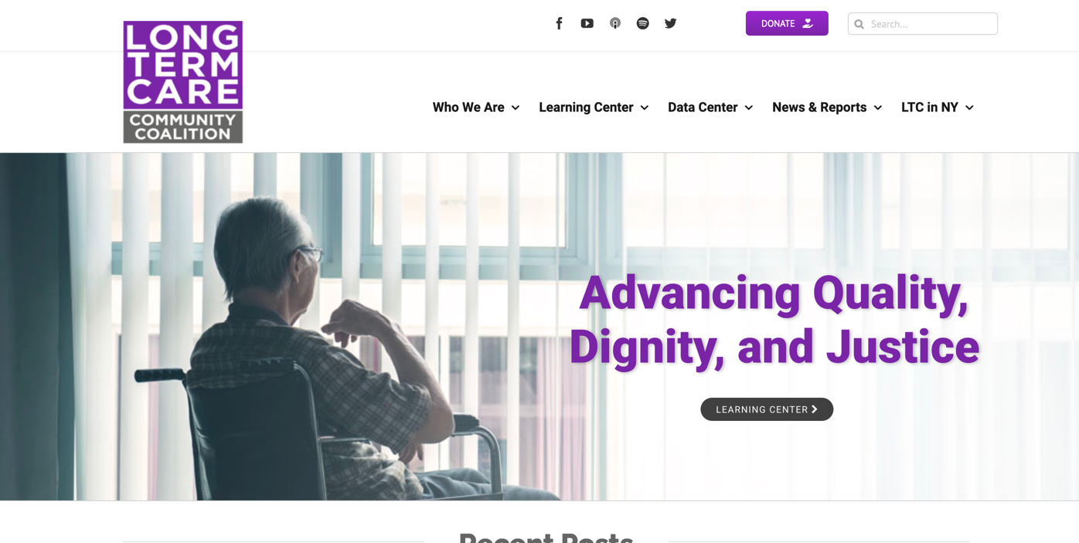
Accessing data on www.nursinghome411.org
NursingHome411.org provides data on:
Staffing
Enforcement
Dementia Care
Antipsychotic Drugging

Slide 26
Citation data on www.nursinghome411.org

Slide 27
Citation data on www.nursinghome411.org
Note: Separate tabs for all citations and citations at harm or immediate jeopardy.
Every file has a Notes tab with information on what data are provided and their original source.

Slide 28
Staffing data on www.nursinghome411.org

Slide 29
Staffing data on www.nursinghome411.org
Sortable facility-level data on staffing based on auditable PBJ data.
NH411 posts new data every quarter, when they are released by CMS, and maintains the historical data files (since 2017) for your reference.
Nurse Staff
Contract Staff
View
Excel file examples
of
State Staffing Data.
Non-Nurse Staff

Slide 30
Additional Resources
Fact sheets, reports, podcasts, etc… to support your advocacy

Slide 31
Learning Center
www.nursinghome411.org/learning-center/

Slide 32
LTCCC Factsheet: Informed Consent
nursinghome411.org/learning-center/fact-sheets/

Slide 33
Family & Ombudsman Resource Center
Sign-up for LTCCC’s Family Council Zoom Meeting Room!
www.nursinghome411.org/families-ombudsmen/

Slide 34
Forms & Tools for Resident-Centered Advocacy
https://nursinghome411.org/forms-tools-resident-centered-advocacy/

Slide 35
Podcasts
Webinars
Available on Spotify, Apple Podcasts, and nursinghome411.org/podcast/.
How Ombudsmen Are a Conduit for Nursing Home Residents
‘It takes a team. A family’: How a Baltimore nursing home has kept out the coronavirus
‘The Eyes, Ears, and Voice’: Why Nursing Home Visitation Saves Lives
Mice, Mold, and Mystery Debris: Journalist Marjie Lundstrom on the Rampant Food Safety Violations in Nursing Homes
LTCCC holds monthly webinars on the 3rd Tuesday of the month @1pm Eastern. All programs are free and we welcome LTCOPs to use these programs for trainings. Email sara@ltccc.org for more info.
To register for a webinar, visit nursinghome411.org/learning-center/webinars-events/.
Coming up on 2/16/21: The Inappropriate Institutionalization of People with Mental Illness

Slide 36
Thank You!
Visit https://nursinghome411.org/join/ or call 212-385-0355 if you would like to…
Receive alerts for future programs or
Sign up for our newsletter and alerts.
You can also…
Join us on Facebook at www.facebook.com/ltccc
Follow us on Twitter at www.twitter.com/LTCconsumer
Visit us on the Web at www.nursinghome411.org.

Slide 37
Questions?
Comments?

