Slide 1
Advocates for residents’ rights
Lori Smetanka
Executive Director

Slide 2
Founded in 1975 as the National Citizens’ Coalition for Nursing Home Reform (NCCNHR) because of public concern about substandard care in nursing homes.
In 2010 expanded focus to advocate for people who need long-term services and supports in any setting, including assisted living and home and community based settings (HCBS).

Slide 3
Our Vision
The Consumer Voice envisions a world in which all consumers of long-term care, services and supports are treated with respect and dignity and have a wide range of affordable, quality options across all care settings. These options will make it possible for individuals to receive care and services in the location and manner of their choice and to attain a high quality of life.
Notes:
Through the Strategic Planning process, we developed the Vision Statement which reads …..
All consumers
Respect & Dignity, individual choice
Affordable, quality options
Essentially, quality care, quality of life, protection of rights

Slide 4
Consumer Voice’s Mission: To represent consumers at the national level for quality long-term care, services, and supports
To carry out our mission, we:
Advocate for public policies that support quality care and quality of life responsive to consumers’ needs in all long-term care settings;
Empower and educate consumers and families with the knowledge and tools they need to advocate for themselves;
Train and support individuals and groups that empower and advocate for consumers of long-term care;
Promote the critical role of direct-care workers and best practices in quality care delivery
Notes:
Our Mission Statement says ………

Slide 5
Consumer Voice Public Policy Agenda
Advocate for public policies that support quality care and quality of life responsive to long-term care consumers’ needs.
To develop, fund, strengthen and preserve programs, laws, and regulations that provide services for and protect long-term care consumers.
To ensure a strong and independent long-term care ombudsman program.
To advocate for the establishment and enforcement of long-term care consumers’ rights.

Slide 6
Consumer Voice Public Policy Priority Areas
Nursing Home Staffing
Reporting of staffing levels through payroll data
24hr RN legislation
4.1 hours of direct care per resident per day
Preserve and strengthen the Nursing Home Reform Law of OBRA ’87 and Requirements of Participation
Assisted Living
Implementation of the new HCBS rules
Improve contract protections for consumers
Establish protections against Medicaid discrimination
Advocate for consumer disclosure statements
Notes:
1). Nursing Home Staffing (Goal #1, 2)
- Seek full and accurate implementation of the Affordable Care Act provision requiring staffing information to be collected through payroll data
- Advocate for passage of federal legislation requiring at least one registered nurse 24 hour a day in Medicare and/or Medicaid certified facilities.
- Develop draft federal legislation to require at least 4.1 hours of direct care nursing (nurse and nursing assistant) time per resident per day in Medicare and/or Medicaid certified facilities; educate the public and policymakers about the need for increased nursing home staffing and minimum standards

Slide 7
The long-term care ombudsman program (LTCOP)
Overview of the History, Role, and Responsibilities
Notes:
This presentation provides a general overview of the Long-Term Care Ombudsman Program (LTCOP) highlighting the history, role and responsibilities of the program. Every state has a LTCOP, but each state operates their program differently. Therefore, this presentation will only address the program responsibilities required by federal law so the information is applicable in every state. At the conclusion of this presentation you should have an understanding about what the LTCOP does, who Long-Term Care Ombudsmen (LTCO) represent and how to work with the LTCO.

Slide 8
What is a Long-Term Care Ombudsman?
A Long-Term Care Ombudsman (LTCO) is a resident advocate.
LTCO advocate for quality of care and quality of life of residents in long-term care (nursing homes, board and care/assisted living, other similar adult care facilities).
LTCO provisions in the Older Americans Act (OAA) include:
Investigate and resolve complaints
Provide information to residents, families, staff (e.g. residents’ rights)
Advocate for systemic changes to improve residents’ care and quality of life.
Notes:
First and foremost, the LTCOP advocates for the quality of life and care of residents in nursing homes, board and care/assisted living, and other similar adult care homes, and is a resident advocate.

Slide 9
History of the Long-Term Care Ombudsman Program (LTCOP)
1972
Five Nursing Home Ombudsman Demonstration programs established to focus on nursing home resident complaint resolution
1978
Older Americans Act (OAA) amendments required all states to establish an Ombudsman Program
1981
Duties expanded to board and care homes (e.g. Assisted Living Facilities)
Name changed from Nursing Home Ombudsman to Long-Term Care Ombudsman (LTCO)
1987
LTCO access to resident records (with resident consent)
States must prohibit willful interference of official LTCO duties and/or retaliation against a LTCO, resident or other individual related to LTCOP duties
Program designed to be a local, community program utilizing volunteers
Notes:
The nursing home industry experienced rapid growth after the introduction of Medicare and Medicaid in 1965. Complaints about substandard care lead to the realization that the systems in place to protect individuals had failed and improvements in quality of care were needed. In addition to increasing the number of state regulatory inspectors, enhancing the federal enforcement standards and process, the federal government also established the Nursing Home Ombudsman Demonstration grants. Through amendments in the Older Americans Act the responsibilities of the LTCOP continue to expand.

Slide 10
LTCOP Responsibilities
Identify, investigate and resolve complaints made by or on behalf of residents.
Provide information to residents about long-term care services.
Provide technical support for the development of resident and family councils.
Advocate for changes to improve residents’ quality of life and care.
Represent resident interests before governmental agencies.
Seek legal, administrative, and other remedies to protect residents.
Ensure residents have regular and timely access to the LTCOP.
Notes:
According to the Older Americans Act and new LTCOP regulations, responsibilities of the program include:
Identifying, investigating, and resolving complaints made by or on behalf of residents.
Educating consumers about residents’ rights, good care practices, and other related topics.
Providing information to the public regarding long-term care facilities and services, residents’ rights, and legislative and policy issues.
Educating providers about residents’ rights, good care practices, preventing abuse and neglect and other issues regarding quality of life and quality of care.
Helping develop and support resident and family councils by providing information and assistance in starting or strengthening a council.
Advocating for improvements in the long-term care system that will benefit residents of long-term care facilities, including representing resident interest before governmental agencies and seeking legal, administrative, and other remedies to protect residents.

Slide 11
LTCO are Resident Advocates
LTCO seek to resolve complaints to the residents’ satisfaction
LTCO represent residents’ interests
LTCO empower residents and promote self-advocacy
The resident guides LTCO action
LTCO need resident consent before sharing information
Notes:
The primary responsibility of the LTCOP is to serve as the resident advocate. LTCO support resident-centered care and residents guide all LTCO work.
For example…

Slide 12
Role of the LTCOP: Long-Term Care Ombudsmen…
Do not conduct licensing and regulatory inspections or investigations | LTCO are knowledgeable of federal and state regulations and will refer to relevant regulations as they advocate for the highest quality of care and life for residents. If necessary, with resident consent, LTCO will file a complaint with licensing and regulatory.
Are not Adult Protective Services (APS) investigators | LTCO provide information regarding preventing and reporting abuse, neglect, and exploitation. LTCOPs do not have the same standard of evidence requirement as APS and are not the “official finder of fact.” LTCOPs attempt to resolve complaints to the residents’ satisfaction (including those regarding abuse), not gather evidence to substantiate that abuse occurred. If necessary, with resident consent or permission of the State LTCO if the resident can’t consent and does not have a legal representative, the LTCO will file a complaint about alleged abuse.
Do not provide direct care for residents | LTCO share information about quality care practices and ways to enhance the quality of life for residents. LTCO are a resource for staff training and provide information for community resources.
Notes:
Long-Term Care Ombudsmen (LTCO) need resident permission prior to investigating a complaint or referring a complaint to another agency. This is due to federal confidentiality requirements of the LTCOP and it is what makes the program so unique and different from other Older Americans Act programs and services.
This chart will give you a better understanding of the LTCO role compared to other agencies and programs.

Slide 13
State LTCO Programs
Who are LTCO?
53 State Long-Term Care Ombudsmen (each state and Guam, Puerto Rico and Washington D.C.)
Local Long-Term Care Ombudsmen (559 local programs)
Volunteer Ombudsmen (8,155 certified volunteers in 2014)
Volunteer Ombudsmen
Not all state and local programs have volunteer LTCO
Volunteer LTCO duties vary depending on the state program
Volunteer LTCO may:
Investigate complaints, provide in-service training, visit residents, and support resident and family councils.
Notes:
The State Long-Term Care Ombudsman is responsible for operating the statewide LTCOP. The LTCOP is designed to be a local, community program utilizing staff and volunteer LTCO to visit residents in their local community. In 2014, there were 559 local programs across the country.

Slide 14
State LTCO Programs
LTCO visit residents in:
Nursing homes and assisted living facilities/board and care homes.
In a small number of states, LTCOPs also visit individuals that receive long-term care services in their own home.
Do LTCO represent all residents, regardless of age?
OAA programs provide services to individuals 60 and older, but the LTCOP will assist residents younger than 60 as advocacy for individuals younger than 60 will also benefit other residents.
How often do LTCO visit?
LTCO regularly visit facilities in order to provide access to the program, but how often depends on the program (e.g. weekly, monthly, quarterly).

Slide 15
LTCO Complaint Investigation
LTCO investigate individual complaints and address concerns that impact several or all residents in a facility.
LTCO can address general concerns they personally observe during a visit (e.g. odors, environmental issues).
During complaint investigations LTCO cannot share information without resident consent. Some residents ask to remain anonymous.
Investigate to gather the facts, but the main goal is to resolve the issue to the residents’ satisfaction.
LTCO call upon others to fulfill their responsibilities to residents.

Slide 16
LTCO Complaint Investigation
If the complaint is from someone other than the resident, the LTCO will visit the resident in order to understand the resident’s capacity to make decisions.
If the resident cannot provide consent, the LTCO will work with the resident’s legal representative or follow their state procedure if the resident doesn’t have a legal representative.
Federal law grants LTCO access to resident information (with resident permission) and LTCO are required to keep that information confidential.
In accordance with federal law, facilities must provide the LTCOP with immediate access to residents.
Notes:
The resident is the ombudsman’s client; therefore, complaint investigation and activities are resident-directed. The OAA requires that LTCO have resident consent prior to investigating a complaint or referring a complaint to another agency. When someone other than the resident files a complaint, the ombudsman must determine, to the extent possible, what the resident wants.
So, after receiving the complaint, the ombudsman will visit the resident in order to understand the resident’s capacity to make decisions before moving forward with the complaint. Many residents, even residents with dementia, are able to express their wishes. If the resident wants the ombudsman to act on the problem the ombudsman will investigate the complaint and continue to communicate with the resident throughout the investigation process. However, even when a resident has limited capacity, it is still important that the resident has the opportunity to participate in decisions regarding their daily life as much as possible. For example, if a resident’s family member has a legal representative, but the resident has capacity and can express their wishes and preferences the LTCO would still work with the resident and follow their wishes.
If the resident cannot indicate to the ombudsman what he or she would like and is not able to provide consent, the ombudsman assumes the resident would want his or her health, safety and welfare protected and the LTCO will work with the resident’s legal representative or follow their state policies and procedures if the resident doesn’t have a legal representative.

Slide 17
Type of Complaints
LTCO handle a variety of complaints about quality of life and care.
Not all complaints are about the care provided by a facility, some complaints are about outside agencies, services or individuals (e.g. Medicaid or Medicare benefits).
LTCO can receive and respond to complaints from individuals other than the resident (e.g. family member), but LTCO still need resident permission to investigate or share information.
Nationwide, in 2014 the LTCOP investigated 191,533 complaints in nursing homes and board and care facilities.
Notes:
LTCO handle a variety of complaints about quality of life and care. The most frequent complaints usually include: complaints about the discharge/eviction process, failure to respond to calls for assistance or call lights, residents not treated with dignity and respect, medication errors, accidents, resident conflict, care planning process, food complaints.
Not all complaints are about the care provided by a facility, some complaints are about outside agencies, services or individuals (e.g. Medicaid or Medicare benefits).
LTCO can receive and respond to complaints from individuals other than the resident (e.g. family member), but LTCO still need resident permission to investigate or share information.
Nationwide, in 2014 the LTCOP investigated 191,533 complaints in nursing homes and board and care facilities.

Slide 18
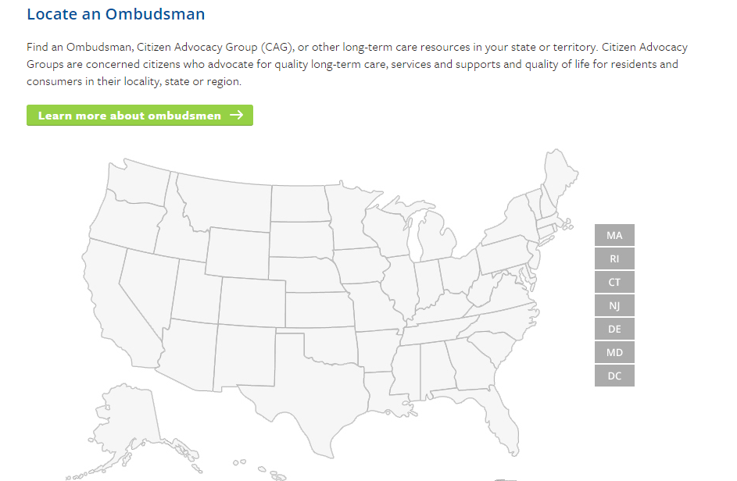
How to Contact the LTCOP
Nursing homes are required to post contact information for the LTCOP and some states require assisted living facilities/board and care facilities to post information about the LTCOP.
Visit the National Long-Term Care Ombudsman Resource Center website to locate your local or state LTCO: http://www.ltcombudsman.org/
Notes:
As you can see LTCO handle a variety of concerns and are resident advocates in all aspects of their work. To get more information about the LTCOP or find out how to contact your state or local program, visit the website. Using the map you can search for your state and local LTCOPs, state survey agency, APS, Medicaid agency, and other state entities.

Slide 19
Residents’ Rights Month
Each October
Materials, Activities, Products
The Resident’s Voice “challenge”

Slide 20
2015

Slide 21
2016 Residents’ Rights Month
… stay tuned!

Slide 22
Lori Smetanka
lsmetanka@theconsumervoice.org
www.theconsumervoice.org
www.ltcombudsman.org

