Slide 1
Initial certification training CURRICULUM for long-term care ombudsman programs
Module 3: Putting the Resident First
Notes:
Trainer’s Note: Before conducting this training, make sure you have read the Trainer’s Guide and are very familiar with the materials. Go over the Trainer’s Tips. Prior to conducting this training, you must add the state-specific information required for this session. You can find the required information in your Trainer’s Guide.
Trainer’s Notes are italicized within the notes. Trainer’s Notes will help you move through the material as intended. The text that is not italicized is information that you should go over with the trainees. Do not read to them, but make sure you deliver the information in a way that the trainees understand.

Slide 2
Welcome and Introduction
Section 1
Notes:
Trainer’s Note: Allow at least 15 minutes for Section 1.

Slide 3
Welcome
Your name
Where you are from
One thing you learned from Module 2
What you hope to learn since the last module
Notes:
Begin the session by welcoming the trainees and thanking them for their interest in the program. Introduce yourself and ask the trainees to introduce themselves by sharing the information on the slide. After introductions, thank the trainees for their information and explain any housekeeping items that need to be addressed including the time-frame of the training day, breaks, location of bathrooms, refreshments, etc.
When conducting the training virtually, make sure all trainees can respond and engage in class discussions via speaker
when possible, or at minimum in writing.
Make sure everyone introduces themselves – even if they come late.
If this is not the first meeting, have everyone reintroduce themselves. For the 3rd bullet point, you can ask them to name one thing they learned from the previous Module – something that really stuck with them or surprised them.

Slide 4
Notes:
Trainer’s Note: If this is the first-time meeting, ask if there are any questions at this point; or, if this is not the first session, ask if any questions have come up for them after the last Module.
If everyone has gone through Module 2, ask them what they learned in Module 2.
Responses may include:
Resident demographics
Why people enter long-term care facilities
Why people stay in long-term care facilities
The impact of loss when residents enter long-term care
Common diagnoses, the effects on residents and the importance to the LTCOP
Common health concerns in long-term care

Slide 5
Today’s Agenda
Section 1: Welcome and Introduction (15 minutes)
Section 2: Person-Centered Care (60 minutes)
Section 3: Decision Making (30 minutes)
Section 4: Advanced Planning and Third-Party Decision-Makers (20 minutes)
-----BREAK----- (10-15 minutes)
Section 5: Empowerment (30 minutes)
Section 6: Resident Assessments and Care Plans (30 minutes)
Section 7: Resident Councils and Family Councils (15 minutes)
Section 8: Conclusion (15 minutes)
Notes:
Trainer’s Note: Go over the agenda with the trainees and refer them to the table of contents in their manual.
Section 1 – 15 mins
Section 2 – 60 mins
Section 3 – 30 mins
Section 4 – 20 mins
Section 5 – 30 mins
Section 6 – 30 mins
Section 7 – 15 mins
Section 8 – 15 mins
Trainer’s Note: The timeframes for each section are approximate. Allow at least 4 hours for this session.

Slide 6
Module 3 Learning Objectives
Person-centered care
Advance planning and decision-making authority
The importance of empowerment
Assessment and care plans
Resident Councils and Family Councils
Notes:
Trainer’s Note: Review the Module 3 objectives saying “by the end of this Module you will be able to understand”: (Review the bullet points.)

Slide 7
Person-Centered care
Section 2
Notes:
Trainer’s Note: Allow 60 minutes to go over Section 2.

Slide 8
Person-Centered Care
Person-centered care is a process for selecting and organizing the services and supports that an older adult or person with a disability may need to live to their fullest potential.
Notes:
Person-centered care is a process for selecting and organizing the services and supports that an older adult or person with a disability may need to live to their fullest potential. Most importantly, the person who receives the services and supports directs and makes decisions about how they receive care.

Slide 9
The Resident Decides
Activities
Bathing
Care
Death and dying
Dining
Dressing
Community involvement
Medication administration
Relationships
Staff assignments
Work
Notes:
Person-centered care places decision-making and self-determination in the hands of individual residents to express choices and preferences about their care and day-to-day activities to the maximum extent possible.
Areas in which person-centered, individualized care can be implemented include, but are not limited to:
(Click to bring up all of the bullet points, reading them as they come on the slide.)
Person-centered practices:
Put residents at the center of decision-making
Recognize residents are experts about their lives
Acknowledge residents have individual interests, needs, and abilities
Emphasize person-first language to eliminate stereotypes and labeling

Slide 10
Person-Centered Care: Person-Centered Language
Notes:
Part of person-centered care is using appropriate language that puts the resident before the diagnosis or disability and is sensitive and respectful to the resident. This type of language is called “person-first.”
Texas Health and Human Services put together a short video to explain person-first language.
Person-first language refers to the person first and then the diagnosis or disability second for example “a resident with dementia” instead of “a confused resident”
Person-first uses neutral language that does not describe the resident as lacking or deficient such as “June had a stroke” as opposed to “June is a victim of a stroke”
Person-first language does not use labels such as “feeders”, “honey” or “sweetie”, but instead calls the resident by their name of choice.
Trainer’s Note: Show the video titled Person-Centered Care: Person-Centered Language by Texas Health and Human Services. This video sets the tone for person-centered care and language that everyone should use. Explain to the trainees that representatives demonstrate appropriate language and behaviors by using person-first language when talking with and about residents.
Ask the trainees: “What takeaways did you get from the video?”
Responses may include: Facilities should partner with a resident when discussing their care. Simple changes such as putting the person first in language can redefine how residents are perceived. Not defining residents by a label such as a “walker” or a “talker” is a more respectful way to talk to or about a resident
Summarize with a quote from the video: “When staff put residents first in their language, they recognize the whole person and don’t let disabilities define a resident.”

Slide 11
Person-Centered Care Based in Law
Nursing Home Reform Act (OBRA)
Federal Requirements for States and Long-Term Care Facilities
Who decides?
The resident!
This Photo by Unknown Author is licensed under CC BY
Notes:
Awareness of and requirements to provide person-centered care or planning are growing. Federal regulations for nursing facilities and for Medicaid-funded long-term services and supports require person-centered care and planning. Brief examples from federal requirements are below. Person-centered care and residents’ rights will be discussed more in the next module.
The first federal law to refer to person-centered care is the Omnibus Budget Reconciliation Act of 1987 (OBRA ’87, also known as the Nursing Home Reform Act). While the primary goals of OBRA ‘87 are to improve the quality of care provided to residents and establish uniform standards for nursing homes, the Act also requires nursing homes to:
• promote the “physical, mental and psychosocial well-being of each resident” and
• promote the quality of life, choice, self-determination, and rights of each resident.
Additionally, OBRA ‘87 required state and federal governments to:
Evaluate whether each resident is receiving care which promotes the highest practicable well-being
Ensure facility compliance with residents’ rights and quality of life
Person-centered care is a requirement of the federal nursing facility regulations. The regulations define resident-centered care as follows:
“…person-centered care means to focus on the resident as the locus of control and support the resident in making their own choices and having control over their daily lives.”
Click to bring up: Who decides?
Who decides when it comes to person-centered care?
Click again to bring up: The resident!
Trainer’s Note: Tell the trainees there are links to several culture change and person-centered care & language in their manuals.

Slide 12
→ Add State-Specific Regulations Regarding Person-Centered Care
Notes:
→ Add state-specific regulations regarding person-centered care in nursing facilities and residential care communities, if applicable.

Slide 13
My Personal Directions for Quality of Life
Notes:
Trainer’s Note: Refer to your Guide to conduct this activity.
Depending on how you conduct the activity, allow 15-30 minutes. Click on the link to the Consumer Voice tool called My Personal Directions for Quality of Life.

Slide 14
Traditional Care
Place to die
Different care staff
Person-Centered Care
Celebrations
Same staff assignments
Residents choose their schedules
Facility sets schedules
Daily activities with purpose
Notes:
Trainer’s Note: Compare some of the differences between a traditional, institutional model of care and person-centered care. Use your experience to share examples of each model.
Facilities that operate using a more institutional care model usually focus on what works best for the facility. Management makes most of the decisions, and daily schedules accommodate staff preferences and facility routines. Facilities that truly practice person-centered care make decisions based on the residents’ preferences, care needs, and routines. The chart below illustrates some of the differences between a traditional, institutional model of care and person-centered care.

Slide 15
How the Ombudsman Program Promotes Resident-Centered Care
Educate and Empower
Model Person-Centered Behavior
Utilize the Care Plan Process
Notes:
Trainer’s Note: Click to bring up each tool.
It is the role of the Ombudsman program to advocate for residents’ rights and person-centered care empowering residents to direct their care and life. How does the LTCOP promote resident-centered care? This is accomplished though educating and empowering residents, modeling person-centered communication, and promoting resident participation in the care plan process.
Educate and Empower
A key responsibility of the Ombudsman program is to inform individuals about residents’ rights. Representatives continually educate residents, family members, staff members, and the public. By providing information about residents’ rights and person-centered care representatives empower residents to voice their concerns and be part of the complaint resolution process to the extent possible or desired.
The Ombudsman program also serves as a resource to staff by sharing promising practices and providing training on residents’ rights and person-centered care. Many Ombudsman programs are involved in local coalitions and initiatives in support of culture change and person-centered care.
Model Person-Centered Behavior
Representatives model how to work and communicate with residents. Representatives always treat residents with dignity and respect. For example, by following the direction of the resident and involving the resident throughout the problem-solving process (to the extent possible or desired), the Ombudsman program models person-centered care to facility staff, family members, and others.
Promote Resident Involvement in the Care Plan Process
Representatives support resident participation during the care plan process to ensure the resident’s needs and preferences are heard, incorporated, and implemented. The care plan process is discussed in more detail later in this Module.

Slide 16
Decision Making
Section 3
Notes:
Trainer’s Note: Allow at least 30 minutes for Section 3.

Slide 17
No Decisional Capacity
Some Decisional Capacity
Decisional Capacity
Notes:
Trainer’s Note: This may be one of the most challenging topics to explain and to work with in the field. Caution the trainees that others may label a resident as “lacking capacity” (believing or suggesting that the resident cannot make any decisions). Direct the trainees to challenge that label by questioning what decisions the resident is unable to make – all decisions or some decisions (e.g., decisions regarding their daily routine, but not financial decisions) and ask for documentation explaining decision-making capacity. Share examples from your work with residents who had diminished capacity. Since this is a complicated topic, it may be helpful to invite an attorney with whom you work closely who understands the Ombudsman program and long-term care to provide training on decision-making capacity for this section and advance care planning and third-party decision makers in Section 4.
Capacity is the ability to make and communicate an informed choice. There is no simple test for capacity. Often, understanding the person’s personal values, preferences, or goals can assist in understanding their capacity to make decisions.
Capacity is issue-specific, a spectrum, and transient. The first question is: “capacity to decide what?” Different types of decisions require varying levels of memory and distinct cognitive skills. The memory needed depends on how relevant past information is to the choice at hand. For example, very little memory is needed to decide what to wear or eat today. Different decisions require different cognitive skills, such as calculation, comparison, or organizing data.
Capacity is a spectrum. The ability to understand and make choices is not an on-off function. Capacity varies in subtle degrees, from no or very low levels of understanding, to the ability to understand and make decisions on very sophisticated and complex issues. Capacity is affected by health, pain, medication, illness, or injury.
Capacity can be developed by learning and experience, and it can decrease with illness or injury. As these factors change, capacity can increase, decease, and return.

Slide 18
Decision-Making Capacity
Does the resident understand the information?
Can the resident relate the information to their situation?
Does the resident understand the possible outcomes of their decision?
Can the resident retain the information long enough to make a decision?
Can the resident communicate their decision in some way?
This Photo by Unknown Author is licensed under CC BY
Notes:
As resident advocates, it is a core program responsibility to empower residents and encourage others to realize the extent of the resident’s decision-making abilities.
When you are unsure of a resident’s decision-making capacity, some questions to consider include:
Does the resident understand the information?
Can the resident relate the information to their situation?
Does the resident understand the possible outcomes of their decision?
Can the resident retain the information long enough to make a decision?
Can the resident communicate their decision in some way?

Slide 19
→ Add State-Specific Policies and Procedures: When Decisional Capacity is Unclear
Notes:
Add state-specific policies and procedures on working with residents when decisional capacity is unclear.

Slide 20
If the resident’s ability to make decisions is still not clear, or the status of the resident’s capacity is uncertain, you may consider the following:
Ask the resident for permission to speak with their representative
Follow your state program policies and procedures
Consult with your supervisor for guidance
Notes:
Representatives empower residents and encourage others to realize the extent of the resident’s decision-making abilities.
If the resident’s ability to make decisions is still not clear, or the status of the resident’s capacity is uncertain, you may consider the following:
Ask the resident for permission to speak with their representative (i.e., decision-maker)
Follow state program policies and procedures for working with residents when capacity is unclear
Consult your supervisor for guidance

Slide 21
Use language and manner the resident can understand
Discuss choices and outcomes fairly and evenly
Let the resident talk to a reliable person
Give the resident enough time
Notes:
Decision-making capacity applies to all areas, including health, legal, financial, daily life, visitors, etc. Regardless of capacity, residents make decisions every day about how they want to spend their time. For example, a resident may not know what year it is, but may be able to communicate whether they want a specific family member or friend to visit them and what activities and food they prefer. Or a resident may not be able to manage their finances but can determine who they want to manage their affairs.
The goal of the Ombudsman program is to focus on the resident and their wishes even if the resident is not able to make all their decisions. For example, a resident may determine their daily routine, go out and visit with friends, or spend “pocket money,” but leave major financial and complex medical decisions up to an individual acting as their representative (e.g., the agent on a Durable Power of Attorney). Communicate with residents and assume they can make their own decisions.
To empower residents to exercise their right to choose and participate in their care (to the greatest extent possible), ensure that:
Information presented to the resident is in a language and manner in which the resident understands
Choices and outcomes are discussed fairly and evenly and without other people influencing the resident
The resident is given the opportunity to talk to anyone they rely upon to make important decisions
The resident is given enough time to consider their options

Slide 22
→ State-Specific Information on Advance Planning
Cardiopulmonary Resuscitation (CPR) Directive
Power of Attorney (POA)
POLST = Portable Medical Orders
Supported Decision-Making
Notes:
Trainer’s Note: Representatives of the Office do not serve as attorneys. However, they may come across advance directives and other health care decision-making documents during their work. This section is intended to provide a basic overview of advance planning options and decision-making authority. The overview includes information about why it is important for representatives to have knowledge of such documents.
Refer to state-specific definitions of relevant advance care planning documents such as a health care advance directive, portable medical order (e.g., POLST/MOLST), CPR (cardiopulmonary resuscitation) directive, or supported decision-making agreement.
Review state-specific laws and/or policies and procedures about communicating with resident representatives.
The Patient Self-Determination Act (PSDA) requires most hospitals, nursing facilities, home health agencies, hospice programs, and HMOs (health management organizations) to provide information on advance directives at the time of admission. The PSDA strengthened residents’ rights to be informed of, and establish, advance directives.
Advance care planning involves learning about the types of decisions that might need to be made, considering those decisions ahead of time, and then letting others know (e.g., family members and health care providers) about their preferences. These preferences are often put into an advance directive, a legal document that goes into effect only if an individual is incapacitated and unable to speak for themself.

Slide 23
Advanced Planning and Third-Party Decision-Makers
Section 4
Notes:
Trainer’s Note: Allow at least 20 minutes for Section 4.

Slide 24
Advance Planning
POLST
Treatments and goals of care
Transfers from setting to setting
Life-limiting condition
State-specific form
Completed by a health care professional & the patient
Also called POST, MOLST, MOST, etc.
CPR Directive
A medical order
Signed by patient & doctor
Instructs providers on resuscitation if the person’s heart or breathing stops
Also called an Out-of-the-Hospital DNR.
Notes:
Per the American Bar Association, a health care advance directive is the primary legal tool for any health care decision made on behalf of an individual should the individual become unable to speak for themself. "Health care advance directive" is the general term for any written statement someone makes while competent concerning their future health care wishes. Formal advance directives include the Living Will and the Healthcare Power of Attorney.
Other types of advance care directives involve discussions with a person’s doctor, and these are written in the form of a medical order.
Trainer’s Note: Go over information on the slide.
DNR = Do not resuscitate
Cardiopulmonary Resuscitation (CPR) Directive
Health care advance directives may also have other terms like, “Cardiopulmonary Resuscitation (CPR) Directive” or “Do Not Resuscitate (DNR) Order.” This type of medical order is signed by the doctor and patient and instructs providers on the patient’s desire about resuscitation if the person’s heart or breathing stops. Some states call this directive an “Out-of-the-Hospital DNR.” The form for this, and who must sign it, varies from state to state.
Portable medical orders are often referred to as POLST. However, states use other names or different acronym definitions [e.g., POLST (Practitioner/Provider/Physician Orders for Life-Sustaining Treatment), POST (Physician Orders for Scope of Treatment), MOLST (Medical Orders for Life-Sustaining Treatment), MOST (Medical Orders for Scope of Treatment)]. A POLST form tells health care providers what treatments the individual wants and the individual’s goals of care, even if transferring from the hospital to a nursing facility, or to hospice or another setting. Points to remember about this type of order:
POLST is for people who are seriously ill or have advanced frailty.
It is a form that is signed by both the patient, or in many states by the health care representative if the patient is unable to do so, and the doctor.
Most important is that it involves a discussion between the doctor and the patient.
Why is this important to the LTCOP? The CPR Directive and the POLST are documents that explain the resident’s wishes. When a resident is unable to communicate their wishes and there is a question about end-of-life decisions, these directives to medical professionals help determine what actions the resident wants or does not want taken. These are one type of medical records a representative of the Office may need to review during complaint investigation* (following relevant policies and procedures).

Slide 25
Supported Decision-Making
What is it?
It is a written arrangement
a list of decisions for which the resident wants assistance
it identifies who will help make those decisions
Allows resident to maintain as much control as possible
Provides for some assistance with making important life, medical or financial decisions
Notes:
The advance directives discussed include information about specific documents and physician’s orders that express an individual’s preferences for health care treatment. Some advance directives allow for individuals to name someone else to make decisions on their behalf.
The Ombudsman program follows the direction of the resident. However, there are residents who lack the ability to communicate their wishes, needs, or preferences. Then whose direction does the program follow? It depends. Some residents have chosen a decision maker, and some have been assigned a decision maker by the courts. Other residents rely upon someone who helps them make medical and financial decisions. In this section, we will explore the different types of decision makers and their authority to make decisions with or on behalf of residents.
Why is this important to the LTCOP? If a resident has a supported decision-maker, the LTCOP still needs permission from the resident to share information with that person.
Trainer’s Note: Tell the trainees there is a link in their manual for more information on supported decision-making.

Slide 26
Third-Party Decision-Makers
Assigned by the Resident
Assigned for the Resident
Power of Attorney (POA)
Appointed by the individual
Does not remove rights
Different types of POAs
Guardianship
Conservatorship
Appointed by the court
Removes the individual’s rights
Deems the individual incapable of administering their own affairs
Notes:
There are two types of decision-makers. Those that are assigned by the resident and those that are assigned for a resident. Decision-makers may only act within the guidelines granted by or for the resident.
A Power of Attorney is a document in which a person appoints another individual(s) to be their decision-maker if/when they are no longer able to do so or earlier in some situations. There are different types of POAs and there are a lot of misconceptions about powers granted in a POA.
The definitions of guardianship and conservatorship vary from state to state. In most states, when a guardian or conservator is appointed, the court removes all or some of the individual’s rights and deems the individual incapable of administering their own affairs. Those affairs may be financial or personal, day-to-day, or both. Guardianships and conservatorships may be limited in scope and in length of time.
Some guardians or conservators are family or friends of residents who know them and their values and goals, and others are court appointed professionals who do not know or may have never met the resident.
The LTCOP advocates that the resident choose who their decision-maker is and what authority they are giving to the person, as opposed to having the court make these decisions. Because guardianships and conservatorships remove individual’s rights, they should be considered as a last resort.

Slide 27
Power of Attorney (POA)
“Power of Attorney” is the document.
“Principal” is the person appointing the decision-maker (agent).
“Agent” is the person who is appointed by the principal.
Agents are required to act with the highest degree of good faith.
An agent’s authority can be revoked by the principle.
Notes:
Trainer’s Note: Go over the information on the slide.
There are different types of POAs. For example, a durable Power of Attorney comes into effect as soon as the document is signed. A springing Power of Attorney “springs” into effect if the principle becomes unable to communicate informed consent. There are POAs specific to health care decisions and some that are specific to finances and property. Every state has their own specific Power of Attorney terminology, forms, and laws.
Tell the trainees there is a link in their manual for more information on POAs.
Why is this important to the LTCOP? In order for a representative to take direction from an agent under a power of attorney, the type of POA and the powers, or authority, granted to the agent must be identified. It is necessary for the Ombudsman program to obtain or review POA papers to determine the extent of the authority granted.
Trainer’s Note: The LTCOP often works in situations where agents try to wield more power than has been granted by the resident. Agents under a POA are normally given the authority to make health care decisions, or in some cases financial decisions, on behalf of the resident. Agents normally DO NOT have the authority to tell the facility who may or may not visit with the resident or restrict the resident from going outside; etc.

Slide 28
→ State-Specific Information: Guardianship/Conservatorship
Notes:
→ Include state-specific laws and/or policies and procedures on communication with a guardian or conservator and with a resident for whom a legal decision-maker has been appointed. Explain any state-specific information necessary for trainees including whether a representative should speak to their supervisor in cases involving a guardian. List each type of guardianship, conservatorship, etc., and provide links to those documents or state resources when applicable.

Slide 29
Representative Payee
Notes:
A representative payee is a person, or an organization appointed to receive Social Security or Supplemental Security Income (SSI) benefits for anyone who can’t manage or direct the management of their benefits. SSI is designed to help people who are aged, blind, or have disabilities and who have little or no income. SSI provides cash to meet basic needs for food, clothing, and shelter.

Slide 30
Resident Representative
Does the resident have:
An advance planning directive?
If so, what kind of directive?
A supported decision-maker?
A guardian or conservator?
Is there evidence of the individual’s authority?
Notes:
Trainer’s Note: This is the first time introducing the term “resident representative.” Explain the definition as defined in Key Words and Terms: An individual chosen by a resident to act on their behalf, or an agent under a power of attorney, or other legally authorized representative, etc., or a court-appointed guardian or conservator of a resident. This term is further defined in the LTCOP Rule and is not intended to include a representative of the Office.
The LTCOP Rule defines “resident representative” as “an individual chosen by the resident to act on their behalf, or a person authorized by federal or state law (e.g., agent under a Power of Attorney, representative payee, and other fiduciaries) to act on behalf of a resident in order to support the resident in decision-making; access medical, social, or other personal information of the resident; manage financial matters; or receive notifications; legal representative (as used in Section 712 of the Act), or a court-appointed guardian or conservator of a resident.” When working with or on behalf of a resident, there are times when the Ombudsman program takes direction from the resident’s representative.
Once the LTCOP has determined the resident is not able to communicate informed consent and before the LTCOP takes direction from someone other than the resident, consider the following questions:
Does the resident have an advance planning directive? If so, what kind of directive?
Does the resident have a supported decision maker?
Does the resident have a guardian or conservator?
Is there evidence of the resident representative’s authority?

Slide 31
Resident Representative Role
Review the forms!
Under what circumstances do you follow the direction of the resident representative?
What authority does the resident representative have?
What decisions can the resident make?
What rights does the resident have?
Notes:
The LTCOP Rule is clear about determining whether to rely upon a resident representative to communicate or make decisions on behalf of residents relating to the complaint process. The LTCOP “shall ascertain the extent of the authority that has been granted to the resident representative under court order (in the case of a guardian or conservator), by power of attorney or other document by which the resident has granted authority to the representative, or under other applicable State or Federal law.”
In order words, this means the LTCOP reviews the relevant documentation to determine under what circumstances they are to follow the direction of the resident representative. The resident representative can only act within the scope of the authority granted. For example, a daughter may say that she has power of attorney to make health care decisions. The Ombudsman program must ask for proof and verify the accuracy and details of decision-making authority. This may also require the Ombudsman program to consult with the program’s legal counsel or local legal services if there are questions or concerns about the form.
Trainer’s Note: Ask why it is important to understand the authority granted to a decision-maker?
Responses may include: The resident representative can only act within the scope of the authority granted. The resident may still have legal rights to make some decisions. The LTCOP reviews the forms to help determine under what circumstances they are to follow the direction of the resident representative. Sometimes resident representatives are confused about what authority has been granted and believe they have more power than they have in reality.

Slide 32
Empowerment
Section 5
Notes:
Trainer’s Note: Allow at least 30 minutes for Section 5.

Slide 33
Empowerment
Imbalance of Power
Becoming stronger
More confident
Controlling one’s life
Claiming one’s rights
Resident
Family
Facility Staff
Notes:
Empowerment is the process of becoming stronger and more confident, especially in controlling one’s life and claiming one’s rights. In an ideal world, when a resident has a concern, they feel confident to approach staff or others for help. However, there are factors that may affect a resident’s sense of empowerment.
The Ombudsman program was created to restore the balance of power between residents and staff, as well as between residents and their family members. Residents tend to be inhibited and constrained due to their health status, their reliance on staff and family members, effects from medication, and lack of opportunity to practice complaint resolution. With this information, the federal government created the LTCOP to ensure residents had someone on their side who would help empower them and, if necessary, be their advocate.

Slide 34
Barriers to Empowerment
I don’t want to get anyone in trouble
I’m afraid
I don’t want them to think I’m difficult
Last time I complained, staff were mean to me
Notes:
Trainer’s Note: Refer trainees to the list titled “Barriers to Empowerment” in their manual and go over some of the obstacles to empowerment. The slide shows common resident responses as to why they may not want to talk to staff about their concerns.

Slide 35
Resident Experiences
Video: Voices Speak out Against Retaliation
1. What reasons are given for not reporting poor treatment or problems within the facility?
2. What concerns or fears are brought up by the residents?
3. What examples of retaliation did you hear from the video?
4. What examples to overcome the fear of retaliation are discussed in the video?
Notes:
Trainer’s Note: Allow 30 minutes to watch and discuss the video.
After viewing the video facilitate a small or large group discussion using the questions on the slide. If breaking the trainees into groups, make sure you tell them they have 10 minutes to discuss the 4 questions and one person from the group will need to report answers back to the entire class. Depending on the time allowed and the size of the class, you may just ask each group to report on one question, even though they should discuss all questions.
If conducting the session virtually, then ask the questions in a large group format.
This 14-minute video was developed by the Connecticut Long-Term Care Ombudsman Program. While the focus of the video is retaliation, the video also portrays other aspects of life in a nursing home from the perspective of five residents.
1. What reasons are given for not reporting poor treatment or problems within the facility?
Possible responses: fear, dependency on staff, not knowing what will happen if problems are reported.
2. What concerns or fears are brought up by the residents?
Possible responses: retaliation, dependency, fear of speaking out, not knowing who to go to for help.
3. What examples of retaliation did you hear from the video?
Possible responses: being treated like a child, being picked on, not answering call lights, dinner tray delivered last, asking for help and staff walk by, being bullied.
4. What examples to overcome the fear of retaliation are discussed in the video?
Possible responses: Find another resident or the Resident Council President, or staff to help confront a problem; call the Ombudsman program; go to resident activities and the Resident Council; create a paper trail for follow-up to problems; know residents’ rights; ask staff to put themselves in the residents’ shoes; create an atmosphere of open communication in the facility.
Trainer’s Note: End the video discussion with the quote in the text box from Ronnie.
“Because when people speak their mind, they become confident and empowered. And when they’re empowered their quality of life improves.”
Ronnie

Slide 36
Retaliation
Call lights not answered or delayed in being answered
Staff ignoring resident requests for help
Nurses withholding pain medication or late when distributing medication
• Rough care
• Abusive treatment
• Eviction
• Withholding food and water
Notes:
Fear of retaliation is one of the most common reasons expressed by residents for not seeking resolution to their concern. Retaliation may be real or perceived, but in either situation, it is frightening to residents. When instances of retaliation occur, they can range from subtle to obvious.
Subtle instances of retaliation include but are not limited to:
• Call lights not answered or are delayed in being answered
• Staff ignoring resident requests for help
• Nurses withholding pain medication or are late when distributing medication
Obvious instances of retaliation include but are not limited to:
• Rough care
• Abusive treatment
• Eviction or attempted eviction
• Withholding food and water

Slide 37
Partnering with Residents for Self-Advocacy
Listen
Educate
Explain options
Encourage
Talk about who can help
Explain how to file a complaint
Notes:
Representatives all have one thing in common: they want to help residents. Often the first thought that comes to mind is to take action for them, but that is not empowering.
Empowerment is the primary way to help a resident and is the first tool representatives use. Explaining resident rights and encouraging residents to have direct communication with other residents, family members, and staff will improve the resident’s ability to resolve concerns.
Empowerment begins with listening to the resident’s concerns, their ideas about resolving their concerns and the actions they have already taken to address the problem. Listening to the resident shows them that their thoughts and feelings are important. Some specific steps the Ombudsman program can take to encourage empowerment for self-advocacy include but are not limited to:
• Educating residents about their rights, including their right to present grievances without fear of retaliation
• Educating family, decision-makers and staff about residents’ rights
• Encouraging residents to participate and address their concern in the care plan meeting
• Encouraging residents to participate and address their concern in the resident council meetings
• Talking about which staff member may most effectively address the problem
• Explaining how to file a complaint with the state survey agency, and the pros and cons of doing so
Trainer’s Note: care plan meeting and resident council meetings are discussed later in this Module.

Slide 38
Resident Rights and Empowerment video
Notes:
When talking to a resident about their concerns, suggest the resident meet with the staff person whom you both have identified as the person most likely to help resolve the problem. When you make this suggestion, it may be helpful to offer to attend the meeting with the resident. The Ombudsman program’s presence may increase the resident’s confidence that their concern will be heard and resolved.
If you attend a meeting with the resident and the staff member, make sure you and the resident have a clear understanding of what will be discussed and who will take the lead in the discussion. Always go with the resident’s preference. Talk to the resident about their desired outcome of the discussion so you understand their goal of the meeting. Remember you are there to promote resident empowerment and advocate for resident rights, not to bring the resident in line with the facility’s preferences.
Trainer’s Notes: Show the 3-minute video titled Residents Rights Month as a summary of the information discussed about empowerment and retaliation. Clarify that Raegan and Teresa are both representatives with the Texas LTCOP. Ask the trainees if they have any questions about the role of the LTCOP and empowering residents. Ask if anyone would like to share their own experience with fear of retaliation in a nursing facility or an RCC.

Slide 39
Resident Assessments and Care Plans
Section 6
Notes:
Trainer’s Note: Allow at least 30 minutes for Section 6.

Slide 40
The Minimum Data Set Assessment (MDS)
Quality of Care
Quality of Life
Highest Practicable Level
Notes:
All nursing facilities are required by federal regulations to provide supports and services necessary to help residents reach or maintain their highest practicable level of well-being. Nursing facilities are required to conduct initial and periodic comprehensive and accurate assessments. An initial assessment evaluates functional capacity and helps staff learn about the resident and their needs. The Resident Assessment Instrument-Minimum Data Set, often referred to as the “MDS” is the required assessment tool used in nursing facilities. It is designed to collect the minimum amount of data to guide care planning and monitoring for residents. It is from this assessment that care plans are developed.
The most important tools for assuring that residents receive adequate care are through resident assessment, care plan development, and the care plan meeting.

Slide 41
How Often are Residents Assessed?
At the time of admission
When readmitted following hospitalization
Quarterly
Annually
After a significant change in condition
When a significant change to a prior assessment needs to be made
At the time of discharge
Notes:
Trainer’s Note: Go over slide.
FYI: When Medicare is paying for the resident’s stay, the facility must complete an assessment at the following intervals: 5-day, 14-day, 30-day, and 90-day mark.

Slide 42
What is Your Role in an Assessment?
Suggest residents prepare
Remind residents that they can make requests
Help residents resolve any issues related
to assessment interview procedures
Notes:
The Ombudsman program can help residents participate in the assessment process to the greatest extent possible by:
Suggesting that residents prepare for the assessment by thinking about daily routines, activity preferences, and goals before staff begin interviews
Reminding residents that they can request activities or daily routines that are not included in the list provided on the MDS assessment
Helping residents work with facility staff to resolve any issues related to assessment interview procedures
Trainer’s Note: Examples include, asking to be assessed at a certain time of day, or with a support person present.

Slide 43
The initial goals of the resident
A summary of the resident’s medications and dietary instructions
Any services and treatments to be administered by the facility
Notes:
Baseline Care Plan
Within forty-eight hours of admission, nursing facilities are required to develop a baseline care plan for each resident that includes the instructions needed to provide effective and person-centered care of the resident that meet professional standards of quality care.
The nursing facility is required to provide the resident and their decision-maker with a summary of the baseline care plan including but not limited to the following information:
• The initial goals of the resident
• A summary of the resident’s medications and dietary instructions
• Any services and treatments to be administered by the facility

Slide 44
Medical
Physical
Mental
Psycho-social
7 Days
Resident-specific
Measurable objectives
Timeframes
Care Plan
Notes:
Federal regulations require facilities to develop and implement a comprehensive person-centered care plan within seven days after completion of the MDS assessment, but not more than 21 days after admission.
The care plan must include resident-specific, measurable objectives and timeframes to meet the resident’s medical, physical, mental, and psychosocial needs that are identified in the MDS. The care plan must also describe services that will be used to help the resident attain or maintain the highest practicable physical, mental, and psychosocial well-being. Care plans must include the resident’s preferences, including the right to refuse treatment and potential for discharge.
The care plan must also describe services that will be used to help the resident attain or maintain the highest practicable physical, mental, and psychosocial well-being. Care plans must include the resident’s preferences, including the right to refuse treatment, and potential for discharge.

Slide 45
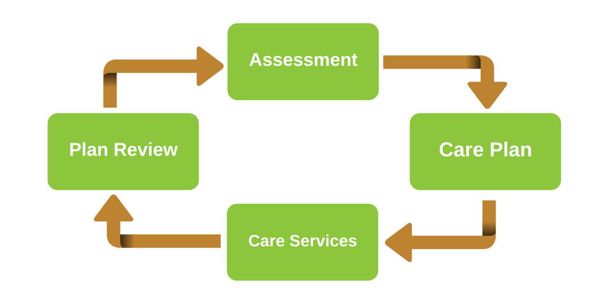
Care Plan
Individualized
Specific
Comprehensive
Written in a language everyone can understand
Reflective of the resident’s concerns, preferences, and goals
Supportive of the resident’s well-being, abilities, and rights
Accessible to staff providing supports and services
Notes:
A thorough care plan is: (Go over the bullet points.)

Slide 46
Care Planning Rights
Participate in the planning process
Identify individuals or roles to be included in the planning process
Request a care plan meeting
Request revisions to the care plan
Participate in establishing goals and outcomes of care
Participate in all factors related to the effectiveness of the care plan
Notes:
Residents’ rights to participate in the development and implementation of the person-centered care plan are clear. The mere existence of the regulations, however, does not guarantee that these planning processes will operate in a person-centered way. Some nursing facilities may be inclined to treat the planning regulations as a bothersome requirement, which makes it essential that residents effectively assert both their right to participate and their preferences for care and discharge. This is where the Ombudsman program can provide an extra voice of knowledge and support to help the resident achieve their goals.
Residents’ Rights Related to Care Planning
•The right to participate in the planning process, including the right to identify individuals or roles to be included in the planning process, the right to request meetings and the right to request revisions to the person-centered plan of care.
•The right to participate in establishing the expected goals and outcomes of care, the type, amount, frequency, and duration of care, and any other factors related to the effectiveness of the plan of care.

Slide 47
Be informed, in advance, of changes to the plan of care
Receive the services and/or items included in the plan of care
See and have a copy of the care plan
Sign the care plan after significant changes have been made
Notes:
Trainer’s Note: Go over the remaining residents’ rights on the slide.
The nursing facility is required to inform the resident of the right to participate in their treatment and must support the resident’s right to do so. The planning process is required to include the resident and/or the resident’s representative, an assessment of the resident’s strengths and needs, and incorporate the resident’s personal and cultural preferences in developing goals of care.
Trainer’s Note: There is a link in the trainee manuals to learn more about assessments and care plans.

Slide 48
Care Plan Meeting
Every 3 months
After a significant change
21 days
Notes:
Once the MDS assessment is complete and a care plan is written, a care plan meeting is held no later than 21 days after admission, every three months, or after a significant change in condition. The care plan meeting is supposed to be scheduled to accommodate the resident and/or the resident’s representative.
The care plan meeting is a conference where staff, the resident, and persons of the resident’s choice go over the care plan. Care plans are a great tool to use when resolving a complaint. Representatives of the Office can participate in a care plan meeting with permission of the resident. It is a good idea to request a copy of the current care plan as well as the proposed care plan (if available) prior to the meeting. Review both care plans with the resident and talk about the resident’s concerns and goals and expectations of the representative’s role during the care plan meeting. While an effective care plan requires the involvement of several individuals, all members of the care plan team may not actually attend the meeting.
Trainer’s Note: Ask the trainees: Who did you see in attendance at Ms. Durham’s care plan meeting?
Answers include: Ms. Durham, her daughter, a nurse, doctor, CNA, & a representative of the Office.

Slide 49
Person-Centered Planning in Home and Community-Based Services (HCBS)
The HCBS Rule applies to all settings in which an HCBS recipient lives or receives the HCBS services, including residential care communities that accept Medicaid coverage for services.
Similar to federal nursing facility requirements for assessment and care planning, the HCBS Rule requires the development of a person-centered service plan that is developed using a person-centered planning process driven by the individual receiving services.
Choices for services and living options are discussed, and the individual can request meetings to update/change their choices. Additionally, the information provided should be in plain language that is accessible to the individual.
Notes:
Trainer’s Note: This is an optional slide. If your state doesn’t utilize HCBS in Residential Care Communities, you can delete this slide. Look in the Trainer’s Manual (Section 6) for more information.
Source: Centers for Medicare & Medicaid Services. Home and Community Based Services. Fact Sheet. January 2014. https://www.medicaid.gov/sites/default/files/2019-12/final-rule-fact-sheet.pdf
HCBS Rule §441,720 and §441.725(a) and the Person-Centered Planning and Home and Community-Based Services fact sheet https://prod.nmhealth.org/publication/view/help/3792/

Slide 50
Person-Centered Care: Care Plans
Notes:
Trainer’s Note: Show the video Person-Centered Care: Care Plans by Texas Health and Human Services to give the trainees an introduction to care plans and the care plan process. Ask trainees to write down specifics they remember about the care plan meeting. Mention to trainees that as an example of person-first language and person-centered care, although the video says the facility develops a care plan for the resident the facility is required to develop a care plan with the resident. The LTCOP advocates to ensure residents are involved in their care (to the extent possible).
Ask the trainees: “What are the key points the video explained?”
Answers: A care plan must be individualized; residents are partners in the planning process; a resident’s social and emotional life are just as important as physical health; and problem solving is a key part of care plan meetings.
Ask the trainees: “Who has participated in a care plan meeting? Tell us about your experience.”
Answers will vary. Some may not have attended one. Be prepared to share some thoughts about your experiences to help the trainees get insight into care plan meetings to support residents.

Slide 51
Key Care Plan Meeting Participants
Care Plan Coordinator
Resident
Resident’s representative
Physician(s)
Nursing staff
Dietary staff
Therapy staff
Social services staff
Activities staff
Anyone else invited by the resident (e.g., family members, representative of the Office)
Notes:
Trainer’s Note: Go over bullet points.

Slide 52
What is Discussed at the Care Plan Meeting?
Resident needs & preferences
Supports and services
Staff responsible for providing supports and services
Resident’s preferred daily routines
Dietary preferences, concerns, & needs
Resident’s preferred activities & interests
Medication
Discharge goals
Notes:
Trainer’s Note: Go over the bullet points then ask:
“How was Ms. Durham treated as a partner in the care planning process?”
Answers:
• She was asked who she wanted to invite.
• Staff encouraged Ms. Durham to discuss new things she would like to try.
• They involved Ms. Durham in problem solving and talked with her about why she is reluctant to shower.
• Staff followed up with Ms. Durham to see how the changes to her care plan are working.

Slide 53
Preparing for the Care Plan Meeting
Is the meeting held at a time of day best for the resident?
Did the facility provide sufficient notice?
Does the scheduled meeting accommodate the resident and others the resident wants to attend?
Is there sufficient time to discuss all necessary information?
NO?
Speak up!
Notes:
Ombudsman Program Advocacy Before, During and After the Care Plan Meeting
Preparing for the Care Plan Meeting
Prior to the meeting, many decisions have already been made in terms of care needs, goals and interventions. Meetings tend to be scheduled back-to-back at 15-minute intervals. However, nursing facilities are required to hold care plan meetings at the time of day when a resident is functioning best, provide sufficient notice in advance of the meeting, schedule meetings to accommodate a resident’s representative (such as conducting the meeting in-person, via a conference call, or video conferencing), and plan enough time for information exchange and decision-making.
Trainer’s Note: The LTCOP and the resident may consider the following questions - go over the questions and then click to have the word “NO” appear.
Explain the facility requirements to the resident and the resident’s representative, when applicable, so they can make an informed decision about asking for changes to the scheduled care plan meeting. (Click again to have the words “Speak up!” appear.

Slide 54
Offer to attend the care plan meeting
Discuss the resident’s expectations, concerns, & goals
Discuss the LTCOP’s role
Prepare a list about what is important to the resident
Notes:
The Ombudsman program can empower the resident and/or their decision-maker to speak up if they would like the meeting to be longer than the scheduled timeframe or prefer/need the meeting to be scheduled differently. The LTCOP can also offer to attend the meeting. If the resident would like the LTCOP to attend, talk about the resident’s expectations of the LTCOP’s role in the care plan meeting as well as the resident’s concerns and goals.
The representative can empower the resident by suggesting they prepare a list of the assistance, activities or other preferences that the resident wants to have included in the care plan. Also, ask the resident to think of how those preferences should be explained or presented to the nursing facility staff. Residents and their families likely will be unfamiliar with the care planning process, at least at first, so good preparation is an important way to ensure that the care planning process is properly focused on the resident’s needs, goals, and preferences.

Slide 55
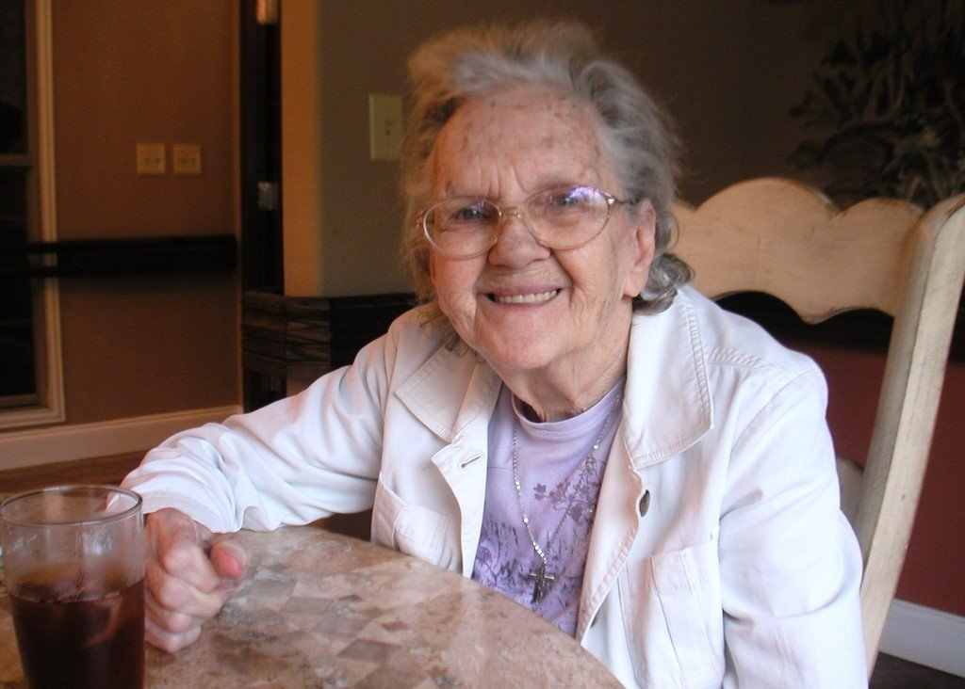
During the Care Plan Meeting
LTCOP advocacy ensures
The resident has an opportunity to speak
Resident’s questions are answered
Preferences are addressed
Supports and services options are discussed
Resident understands and agrees with the care plan
Resident receives a copy of the plan
Knows who to talk to if there are changes to be made to the care plan
Notes:
The LTCOP advocacy during the care plan meeting includes ensuring:
The resident has an opportunity to speak
The resident’s questions are answered
The resident’s preferences are addressed
Supports and services options are discussed
The resident understands and agrees with the care plan
The resident receives a copy of the plan if requested
The resident knows who to talk to if there are changes to be made to the care plan
The resident understands there are options to leave the nursing facility and receive long-term services and supports in the community and how to seek assistance, if applicable (transitioning to the community is discussed more in future modules)
Trainer’s Note: Ask “Why is it important for direct care staff to be involved in resident care planning?”
Answers: Direct care staff / CNAs:
• Know the person
• Understand what is important to the person
• Understand the person’s communication style and may best interpret nonverbal communication
• Have a trusting relationship with the person
• Support the person in different environments
• Can be the person the resident turns to for assistance and support

Slide 56
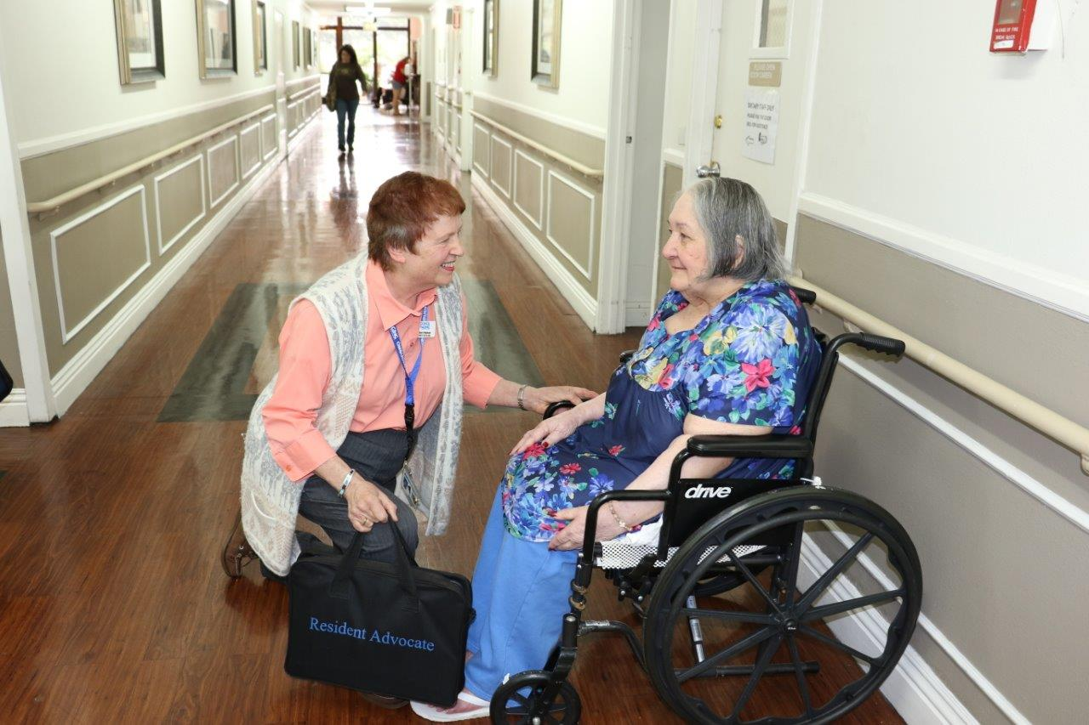
After the Care Plan Meeting
Follow up with the resident
Is the resident satisfied?
Do changes need to be made to the care plan?
Explain right to request a care plan meeting at any time
Notes:
LTCOP actions may include but are not limited to:
• Following up with the resident to find out if the care plan is being followed and asking if the resident is satisfied with the supports and services received.
• Asking the resident if changes need to be made to the care plan.
• Explaining the resident right to request a care plan meeting at any time to make modifications. If the change is not included in the care plan, it will likely not happen.
Trainer’s Note: Ask: “How can residents who are unable to go to the meeting room attend or participate in their care plan meeting?”
Answer: Hold the meeting in their room.
Ask: “How can staff ensure residents, whose ability to make decisions about care and treatment is impaired, participate in their care plan to the best of their ability?”
Answer: Plan enough time for information exchange and decision-making. Ask residents who they would like to attend the meeting to support them in decision-making.
There are links in the trainee manual to learn more about assessments and care planning.

Slide 57
Resident Councils and Family Councils
Section 7
Notes:
Trainer’s Note: Allow at least 15 minutes for Section 7.

Slide 58
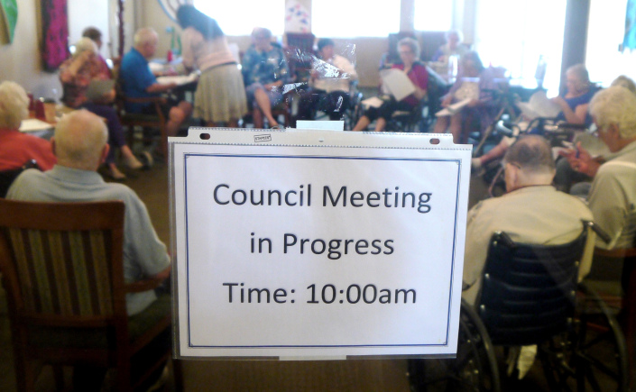
A resident council is an independent group of residents living in the same facility who meet on a regular basis to discuss and seek resolution to concerns, develop suggestions to improve life in the facility, and plan activities to promote socialization with other residents.
Notes:
Trainer’s Note: The following information is related to nursing facilities. However, not all nursing facilities have resident councils.

Slide 59
The nursing facility must:
provide a private space for meetings
make residents aware of upcoming meetings
provide a designated staff person who is approved by the resident council and the facility to provide assistance and respond to written requests from the resident council
Notes:
Some states have regulations pertaining to resident councils in both nursing facilities and RCCs. These state regulations often mirror the federal regulations.
Federal nursing home regulations include the following requirements for resident councils:
• The facility must provide a resident council, if one exists, with a private space for meetings.
• The facility must take reasonable steps, with the approval of the resident council, to make residents aware of upcoming meetings in a timely manner.
• The facility must provide a designated staff person who is approved by the resident council and the facility to provide assistance and respond to written requests from the resident council.

Slide 60
consider the views of a resident council and act promptly upon grievances and recommendations of the resident council concerning issues of resident care and life in the facility
The facility must provide a response and rationale
for their response
The right to a response does not mean facilities are
required to implement every request of the resident council
The resident council meetings are closed to staff, visitors, and other guests, unless invited.
Notes:
The facility must consider the views of a resident council and act promptly upon grievances and recommendations of the resident council concerning issues of resident care and life in the facility.
The facility must be able to demonstrate their response and rationale for their response.
The right to a response does not mean facilities are required to implement every request of the resident council.
The resident council meetings are closed to staff, visitors, and other guests. For staff, visitors, or other guests to attend, the resident council must invite them.

Slide 61
→ State-Specific Resident Council in RCCs
Notes:
→ Add state-specific requirements for resident councils in RCCs, as applicable.

Slide 62
Ombudsman Program and the Resident Council
Required to assist when asked
Encourages the use of resident councils to resolve concerns
Benefits when the LTCOP attend resident councils
Getting to know residents
Being a familiar support to residents
Getting a sense of how the residents are treated
Observing how the facility is managed
Notes:
The Ombudsman program is required to assist with the development of Resident Councils when asked. Representatives often encourage residents to share their concerns during the Resident Council meeting to address concerns that may affect all or some residents, such as call lights not being answered in a timely manner or cold food.
Representatives of the Office must have the approval of the Council Members to attend the meetings. Often, representatives are welcome to attend and do so on a regular basis. There are great benefits in attending the Resident Council meetings, such as getting to know residents, being a familiar support to residents, and getting a sense of how the residents are treated and how the facility is managed.
It is a good idea to check in with the Resident Council President or another Council Member during regular visits to get a sense of what is going on in the facility.

Slide 63
Communication
Action
Support
Education
Notes:
A Family Council is a group of residents’ family members that meets regularly to discuss and offer suggestions about facility policies and procedures affecting residents’ care, treatment, and quality of life; support each other; plan resident and family activities; participate in educational activities; or, for any other purpose.
Members form a united consumer voice which can play a crucial role in voicing concerns, requesting improvements, supporting new family members and residents, and supporting facility efforts to make care and life in the facility the best it can be.
Similar to how parents’ associations work with schools, Family Councils provide a way for concerned persons to actively participate in helping the facility to be the best it can be, through combining and prioritizing shared concerns and then communicating them to facility administrators, making recommendations, and suggesting solutions, sharing answers and information when replies are received, and supplementing staff services via additional actions which enhance residential life.

Slide 64
Strength in numbers
Fosters greater staff accountability
Decreases possible neglect and abuse
Streamlining concerns is efficient
Notes:
A Family Council meets regularly and promotes communication, action, support, and education. The specific activities of the Council depend upon the needs of the residents and the choices made by Council members.
Family Councils operate on the premises that:
There is strength in numbers and that combined voices garner more attention than just one
Increased family involvement fosters greater staff accountability, which in turn decreases possible neglect and abuse
Streamlining concerns is more efficient and reduces the time staff ultimately spends addressing repeat issues

Slide 65
Nursing facilities must:
provide a private meeting space
cooperate with the council’s activities
appoint a staff advisor or liaison to the family council
respond to the group’s concerns
The family council meetings are closed to staff, administrators, and visitors, unless invited by the council.
Notes:
The 1987 Nursing Home Reform Act guarantees the families of nursing facility residents a number of important rights to enhance a loved one’s nursing facility experience and improve facility-wide services and conditions. Key among these rights is the right to form a Family Council and hold regular private meetings.
Nursing facilities must provide a meeting space, cooperate with the Council’s activities, and respond to the group’s concerns. Nursing facilities must appoint a staff advisor or liaison to the Family Council, but staff and administrators have access to Council meetings only by invitation. While the federal law specifically references “families” of residents, close friends of residents are encouraged to play an active role in Family Councils, too.
Specifically, the federal law includes the following requirements on Family Councils:
A resident’s family has the right to meet in the facility with the families of other residents in the facility.
The facility must provide a family group, if one exists, with private space.
Staff or visitors may attend meetings at the group’s invitation.
The facility must provide a designated staff person responsible for providing assistance and responding to written requests that result from group meetings.
When a family group exists, the facility must listen to the views and act upon the grievances and recommendations of residents and families concerning proposed policy and operational decisions affecting resident care and life in the facility.
These federal requirements are often supplemented by State Statutes.

Slide 66
→ State-Specific Family Councils
Notes:
→ Add state-specific information on family councils, as applicable

Slide 67
Ombudsman Program and the Family Council
Required to assist when asked
Encourages the use of family councils to resolve concerns
Provides education, support, and advocacy to family councils when asked
May attend meetings if invited
Notes:
In addition to acting as an advocate for residents, the Ombudsman program can educate residents, families, and friends about residents’ rights, state surveys, and federal and state laws that are applicable to nursing facilities and other long-term care facilities. The LTCOP also provides support and advocacy to Family Councils when asked by the Council.
Successful Family Councils maintain open communications with the LTCOP which is mutually beneficial: the program is kept informed of concerns which reflect multiple residents’ experiences (which often reflect the facility culture) and the Council has a human resource which can help to differentiate fact from fiction when members seek to clarify and correct problematic situations.
There are links to additional information on resident and family councils in the trainee manuals.

Slide 68
Conclusion
Section 8
Notes:
Trainer’s Note: Allow at least 15 minutes for Section 8.

Slide 69
Module 3 Questions
1. Why is it important for a representative to know about advance planning and third-party decision-makers?
2. Explain what “empowerment” means to you.
3. When a resident is hesitant to speak up about a concern, what can you do to help?
4. Name four residents’ rights that are related to care planning.
5. Name two things a facility must do to assist Resident Councils and Family Councils.
Notes:
Why is it important for a representative to know about advance planning and third-party decision makers?
These documents show the resident’s wishes and may also name someone else to make decisions on the resident’s behalf when or if the time comes that the resident is unable to do so.
The LTCOP Rule requires the LTCOP to determine the extent of the authority that has been granted to the resident representative (e.g., agent under a POA, guardian, etc.). Therefore, if/when the LTCOP follows the direction of someone named as the resident’s decision maker, it is crucial to understand the limits of their authority to make such decisions.
Click to show question 2
2. Explain what “empowerment” means to you.
Empowerment is the process of becoming stronger and more confident, especially in controlling one’s life and claiming one’s rights. Empowerment is encouraging others to speak out and resolve their own concerns.
Click to show question 3
3. When a resident is hesitant to speak up about a concern, what can you do to help? Hint: Look at Section 3.
Educate residents about their rights, including their right to present grievances without fear of retaliation
Educate staff about residents’ rights, especially that the resident has the right to bring up concerns or complaints
Encourage residents to participate and address their concern in the care plan meeting
Encourage residents to participate and address their concern in the Resident Council meetings
Talk about which staff member may most effectively address the problem
Explain the pros and cons of speaking up, of asking the LTCOP for help, and of filing a complaint with the state survey agency
Click to show question 4.
4. Name four residents’ rights that are related to care planning.
Participate in the planning process
Identify individuals or roles to be included in the planning process
Request meetings
Request revisions to the person-centered plan of care
Participate in establishing the expected goals and outcomes of care, the type, amount, frequency, and duration of care, and any other factors related to the effectiveness of the plan of care
Be informed, in advance, of changes to the plan of care
Receive the services and/or items included in the plan of care
See the care plan, including the right to sign after significant changes to the plan of care are made False
Click to show question 5
5. Name two things a facility must do to assist Resident Councils and Family Councils.
Possible answers: provide private space for meetings; make residents (or family members) aware of upcoming meetings in a timely manner; designate a staff person to provide assistance; and respond to written requests.

Slide 70
True or False
a. The charge nurse is responsible for assuring the nursing care provided by other nurses and nursing aides meets federal and state requirements.
False
b. The care plan coordinator is a social worker who works with other facility staff, residents, and residents’ family members to conduct assessments and to coordinate individual nursing care.
False
Notes:
Trainer’s Note: Click to show the answer to “a”, click again to show the second question, and finally, click again to show the answer to “b”.
6. True or False:
The charge nurse is responsible for assuring the nursing care provided by other nurses and nursing aides meets federal and state requirements.
False: This is the responsibility of the DON.
b. The care plan coordinator is a social worker who works with other facility staff, residents, and residents’ family members to conduct assessments and to coordinate individual nursing care.
False: The care plan coordinator is a nurse.

Slide 71
Questions?

Slide 72
Additional resources
Refer to your trainee manual for other sources of information related to topics discussed in this module.
Notes:
Trainer’s Note: If you have specific information or resources that you feel trainees need to follow-up on, use this opportunity to direct their attention to those in the trainee manual.

Slide 73
Contact Information
INSERT PRESENTER CONTACT INFORMATION

Slide 74
The National Long-Term Care
Ombudsman Resource Center (NORC)
www.ltcombudsman.org
This project was supported, in part, by grant number 90OMRC0001-01-00, from the U.S. Administration for Community Living, Department of Health and Human Services, Washington, D.C. 20201. Grantees undertaking projects under government sponsorship are encouraged to express freely their findings and conclusions. Points of view or opinions do not, therefore, necessarily represent official Administration for Community Living policy.

