Slide 1

Introduction to the revised National Ombudsman Reporting System (NORS)
February 5, 2019
Speakers –
Louise Ryan, Ombudsman Program Specialist, Administration on Aging (AoA)/Administration for Community Living (ACL)
Maria Greene, NORC Consultant
Amity Overall-Laib, NORC Director
Notes:
Welcome to today’s webinar, an Introduction to the Revised National Ombudsman Reporting System (NORS). My name is Amity Overall-Laib with NORC and we are glad you are here with us.
Attendees of today’s webinar include both State Ombudsmen and Representatives of the Office of the State Long-Term Care Ombudsman. Representatives of the Office, often call local ombudsmen in states, are our target audience today. State Ombudsmen have had other opportunities to learn about the revised NORS but, for many of you this may be your first opportunity to hear details about the revised NORS. Today is the first of five webinars created specifically for those of you in the field who provide direct Ombudsman program services.
You will hear from two other presenters today, Louise Ryan, Ombudsman Program Specialist, with the Administration on Aging/Administration for Community Living, and Maria Greene, a consultant with NORC.

Slide 2
Agenda
NORS background
  What is NORS?
  NORS and the Older Americans Act
  Brief history
NORS significant changes
Overview of NORS Tables
Training outline and dates
Questions
Notes:
Today’s agenda includes a review of NORS background, an overview of the basics and data with a few examples, upcoming training dates, and time for questions. Attendees are muted. If you have questions, please submit those in the control panel on your screen. We will try to address as many questions as possible after the presentations.
The webinar will be recorded and posted with all of the webinar materials shortly after our webinar today. Today’s slides and the tables we discuss are attached in your tool box as handouts.
We will also send a follow-up email to attendees with a Certificate of Attendance that you can share with your supervisor to verify your participation in today’s training.

Slide 3
Poll Question – What is NORS?
Choose the correct answer:
Naturally Occurring Retirement System
National Ombudsman Resource Service
National Ombudsman Reporting System

Slide 4
Poll Question – What is NORS?
The answer is:
Naturally Occurring Retirement System
National Ombudsman Resource Service
National Ombudsman Reporting System
Notes:
Some of you may not have heard of the National Ombudsman Reporting System because in your state the software system that you use to collect NORS data may be called something else. The data entered into your state’s software system is used by the Office of the State Ombudsman to compile the state’s data to submit to the federal agency, Administration for Community Living.
NORS brings consistency in data collection and reporting nationally for the work of the Ombudsman Program. Some of you may provide services, such as home care Ombudsman, managed care Ombudsman services, or other advocacy services beyond what the Older Americans Act (OAA) requires and your state software system captures data also related to those services .
Today we will only be talking about data and codes associated with the OAA requirements of the program. In addition to what you learn today and in future NORS webinars, you may wish to discuss with your State Ombudsman about any state specific data collection required at the state level.
Now I’d like to turn the webinar over to Louise Ryan, Ombudsman Program Specialist, Administration for Community Living, and she will briefly talk about the history of NORS and explain the reasons for the changes.

Slide 5
Older Americans Act Requirements*
The State agency shall establish a statewide uniform reporting system to –
collect and analyze data relating to complaints and conditions in long-term care facilities and to residents for the purpose of identifying and resolving significant problems; and
submit the data, on a regular basis, to— (A) the agency of the State responsible for licensing or certifying long-term care facilities in the State; (B) other State and Federal entities that the Ombudsman determines to be appropriate; (C) the Assistant Secretary; and (D) the National Ombudsman Resource Center established in section 202(a)(21).
*OAA Section 712 (c) Reporting System
Notes:
prepare an annual report—
(c) *REPORTING SYSTEM.—The State agency shall establish a statewide uniform reporting system to—
(1) collect and analyze data relating to complaints and conditions in long-term care facilities and to residents for the purpose of identifying and resolving significant problems; and
(2) submit the data, on a regular basis, to—
(A) the agency of the State responsible for licensing or certifying long-term care facilities in the State;
(B) other State and Federal entities that the Ombudsman determines to be appropriate;
(C) the Assistant Secretary; and
(D) the National Ombudsman Resource Center established in section 202(a)(21).

Slide 6
National Ombudsman Reporting System (NORS)
Data elements that LTC Ombudsmen are required to collect Sec 712(h) (1)-(3)(b)
Cases, Complaints
Types of Complaints and outcome (resolution)
Consultation
Funds Expended and sources
Staff FTE
Numbers of Volunteers and hours
Activities: Training, non-complaint visits, resident and family councils
Systems issues & Legal (narrative)
Notes:
From the OAA guidance we developed NORS. Although we are changing the NORS data collection you will find that most of what is new will be familiar to you because it reflects practice in the field.
ADMINISTRATION.—The State agency shall require the Office to—
(1) prepare an annual report—
(A) describing the activities carried out by the Office in the year for which the report is prepared;
(B) containing and analyzing the data collected under subsection (c);
(C) evaluating the problems experienced by, and the complaints made by or on behalf of, residents;
(D) containing recommendations for—
(i) improving quality of the care and life of the residents; and
(ii) protecting the health, safety, welfare, and rights of the residents;
(E)(i) analyzing the success of the program including success in providing services to residents of board and care facilities and other similar adult care facilities; and
(ii) identifying barriers that prevent the optimal operation of the program; and
(F) providing policy, regulatory, and legislative recommendations to solve identified problems, to resolve the complaints, to improve the quality of care and life of residents, to protect the health, safety, welfare, and rights of residents, and to remove the barriers;
(2) analyze, comment on, and monitor the development and implementation of Federal, State, and local laws, regulations, and other government policies and actions that pertain to long-term care facilities and services, and to the health, safety, welfare, and rights of residents, in the State, and recommend any changes in such laws, regulations, and policies as the Office determines to be appropriate;
(3)(A) provide such information as the Office determines

Slide 7
What is Changing?
The data collection, NORS, is changing. NORS is not going away – it’s just been revised!
The data reporting tool (software) that state Ombudsmen use to report their NORS data is changing and with that comes specific technology requirements in order to complete the report.
Notes:
We have two parallel changes occurring: (1) the revisions to NORS data collection and (2) the reporting tool that State Ombudsmen use to report their annual NORS data. The data collection – NORS (National Ombudsman Reporting System) is changing, which is the focus of this webinar and the next 4 webinars. NORS is not going away – it’s just been revised!
The data reporting tool (software) that state Ombudsmen use to report their NORS data is changing and with that comes specific technology requirements in order to complete the report. Currently state Ombudsmen can manually enter all data. In the revised NORS, the complaint data is extracted from the state software into a separate file and this file is then uploaded to the new software called the Older Americans Act Performance System (OAAPS). No identifying information is released in this process.

Slide 8
Why Revise NORS?
To address past criticisms* regarding inconsistencies across states and implement recommendations to:
  increase reliability and accuracy of the data,
  simplify codes and number of data elements,
  streamline reporting by states and
  reduce manual entry to avoid errors in complaint and activity data.
*Assistant Secretary for Planning & Evaluation, Office of Inspector General, State Ombudsman Stakeholder’s via the “Bader Report,” National Association of State Ombudsmen and National Association of Local LTC Ombudsmen.
Notes:
We’ve revised NORS in order to address past criticisms* regarding inconsistencies across states and implement recommendations to:
increase reliability and accuracy of the data,
simplify codes and number of data elements,
streamline reporting by states and
reduce manual entry to avoid errors in complaint and activity data.

Slide 9
  Revised NORS Goals
Enhance ACL’s ability to understand and report on:
  LTCO program operations,
  experience of long-term care facility residents, and
  changes in long-term supports and services policies, research, and practices.
Notes:
In addition to addressing the criticisms mentioned in the last slide and improving data reliability, the revised NORS data collection should enhance ACL’s ability to understand and report on the LTCO program operations, experience of long-term care facility residents, and changes in long-term supports and services policies, research, and practices.

Slide 10
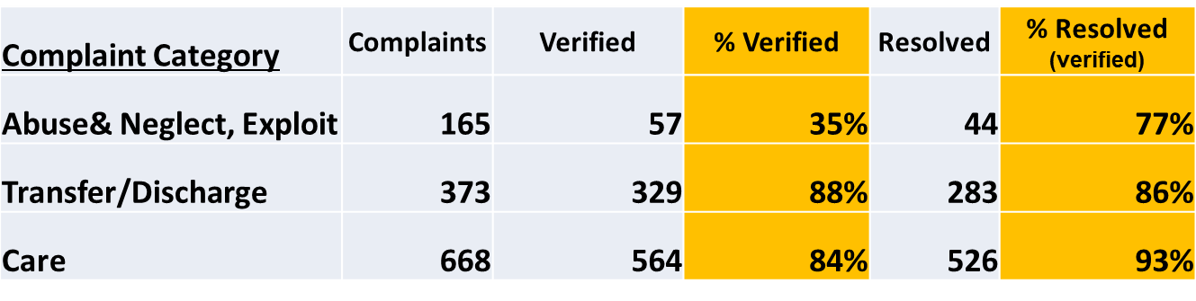
Revised NORS Goals
  Example: ACL would be able to analyze resolution by type of complaint:
Notes:
One example of how the changes will ensure ACL’s ability to understand the data, is that ACL will have access to disaggregated data. This means that ACL can review the data by the type of complaint, number of complaint type verified, number of complaints, resolved etc.

Slide 11

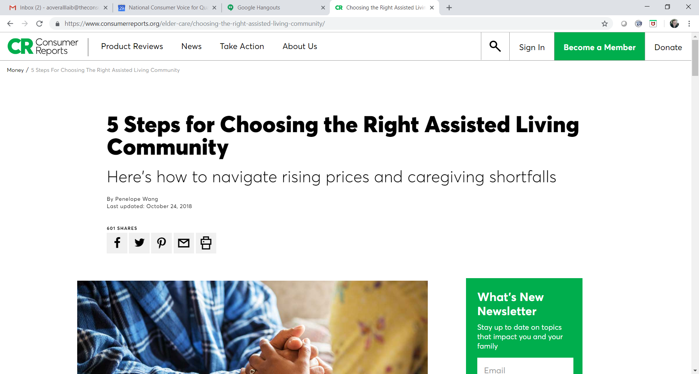

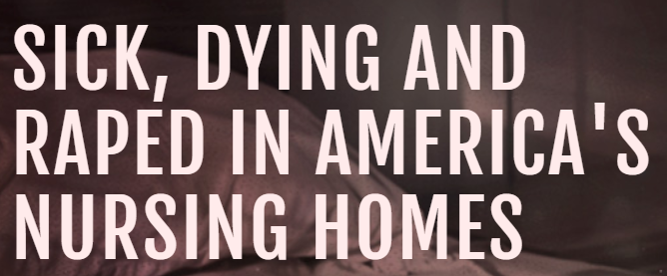

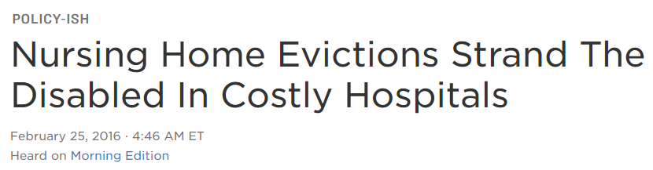
How is NORS Data Used?
Budget justification
To inform policy at the federal, state, and local level.
Respond to media inquiries.
  Consumer Reports - Ombudsman program data show complaints about assisted living have risen 10 percent in recent years (10/2018)
  CNN – sexual assaults in nursing homes cited NORS data (2/2017)
  NPR on inappropriate transfers and evictions (2/2016)
Notes:
We really use the data! It helps to share policy at the federal level – such as when the nursing home regulations were revised. State Ombudsmen use their data at state and local levels to inform the public, raise awareness, and inform policy decisions.
Here are some examples of recent media stories citing NORS data. The NPR story about inappropriate nursing facility transfers and evictions, including the following, “This is not just a California issue. Nationwide, between 8,000 and 9,000 people complain to the government about nursing home evictions every year. It's the leading category of all nursing home complaints, according to the federal Administration for Community Living.”

Slide 12
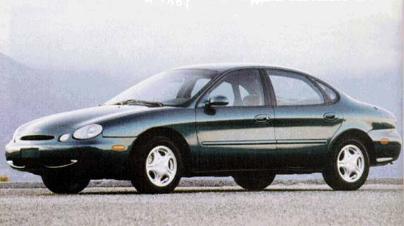
Brief History - Work Involved to Revise NORS
1996 car
NORS Timeline
1996 NORS implemented with minor revisions over the years
Recommendations to improve NORS:
1999 Office of Inspector General report
2002 Bader Foundation report
2003 Workgroup to Improve NORS Consistency (WINC)
Notes:
1995
AoA/ACL implemented NORS, which provided substantial state and national data on ombudsman cases, complaints and program activities, beginning in 1996. There haven’t been significant improvements to NORS since it was implemented in 1996. At times we have struggled with NORS and like some older car models we wished for better days.
1999
Office of Inspector General (OIG, 1999; OEI02-98-00351), study findings support the need to continue to strengthen the LTCOP is reporting system and to develop a standard for measuring outcomes of ombudsman complaint investigation, education, and advocacy efforts.
2002
The National Association of State Ombudsman Programs (NASOP) received a Helen Bader Foundation grant to convene a retreat: The Long-Term Care Ombudsman Program: Rethinking and Retooling for the Future; a report, recommendations and work groups ensued from the retreat.
2003
Based on a Bader Retreat recommendation, the NASOP Data Committee initiated a standing Workgroup to Improve NORS Consistency (WINC). The WINC included representatives from NASOP, NALLTCO, AoA, and NORC. The WINC examined the consistency of the NORS data, developed consensus regarding specific definitions, approaches, and interpretations to provide guidance to Ombudsman programs; and recommended strategies for improving consistency. This workgroup developed the early versions of the NORS training that is in current use.

Slide 13

Brief History – Work Involved to Revise NORS
2019 car
Revised NORS
“NORS Next” workgroup
NORC – Revised NORS Training Workgroup
Pilot testing of Older Americans Act Performance System (OAAPS)
  AK, CA, KS, LA, MS, MN, OH, SC, NORC and ACL
Notes:
There is a long history of state Ombudsman and representatives of the Office involvement in the development and revisions to NORS.
Your assistance to improve and revise NORS has been incredibly helpful and has directly impacted NORS. Like the new cars of today we aim for the new NORS to be efficient, economical, and easy to operate.
ACL convened a “NORS Next” workgroup comprised of state Ombudsmen and representatives of the Office to help develop and give feedback on the revisions to NORS. The proposed data collection then went through two public comment periods and received final approval from the Office of Management and Budget (OMB)
To update the NORS training materials NORC relied on input from the Revised NORS Training Workgroup. The workgroup including representatives from NASOP and NALLTCO and the following states: AK, CA, IA, NC, ND, TX, and PA
In addition to updating the NORS codes, definitions, and activities, ACL created a new reporting software system, the Older Americans Act Performance System (OAAPS), for State Ombudsmen to submit their program data to ACL. We see that the data collection and software go hand in hand and both pieces needed State Ombudsman and representatives of the Office involvement.
Now I going to turn it back over to Amity to administer another poll question.

Slide 14
Poll Question
Do you provide training to representatives of the Office on using NORS codes and definitions?
  Yes
  No

Slide 15
Significant Changes in the Revised NORS
Notes:
Now I’d like to introduce Maria Greene, a consultant with NORC.
Maria is going to walk us through some of the significant changes in the revised NORS.
We understand this is a lot of new information in one webinar, but there will be links to the tables discussed today and we will go into more detail about how to report your work using the new codes and definitions in the upcoming webinars.

Slide 16
Current and Revised NORS
Instructions and Complaint Codes
Revised NORS Tables
https://ltcombudsman.org/omb_support/nors
https://ltcombudsman.org/omb_support/nors/revised-nors-data-collection
Notes:
The instructions and complaint codes on the left should be very familiar as they are the current NORS data collection. These will be obsolete effective October 1, 2019.
The tables on the right are for the revised NORS. The tables, especially Table 2 Complaint Codes and Definitions, and the NORS training materials that will be discussed in detail in upcoming webinars will be your reference points for the revised NORS.

Slide 17
Revised NORS Tables
The revised NORS has three distinct Data Collection Tables.
Table 1 – Case Data Components
Table 2 – Complaint Codes and Definitions
Table 3 – State Program Information
Notes:
The revised NORS data collection has three tables for Ombudsman programs to use when coding. These 3 tables will replace the current NORS instructions effective October 1, 2019. You should throw out those instructions on October 1, 2019 and use the Tables moving forward.
Table 1 pertains to Case Data Components, Table 2 Complaint Codes and Definitions, and Table 3 State Program Information. During the next several slides we will discuss the tables and highlight changes from the current NORS with a focus on what you will most use.
For the vast majority of the states the NORS software will be updated by the State Ombudsman Program’s IT vendor and/or state IT staff. The purpose of this and upcoming NORS webinars is to provide guidance around data collection and recording for Ombudsmen representatives and not about ACL’s NORS reporting software. ACL and the software contractor will provide training to State Ombudsmen on how to use the new Older Americans Act Performance System (OAAPS). ACL is available to answer technical questions that, State Ombudsmen, state IT staff, or vendors have about OAAPS.

Slide 18
Table 1 Case Data Components
Notes:
This is a screenshot of the first page of Table 1. This table is 10 pages long and explains what components each case must have to be reported in NORS. For the purpose of today’s webinar we are only introducing the tables and providing highlights of the content. All tables are available on the NORC website.

Slide 19
Table 1 Highlights
Case Data Components:
  Date case & complaint opened and closed
  Facility or setting
  Complainant
  Complaints (one or more)
  Perpetrator
  Referral agency
  Verification
  Disposition
Notes:
Table 1 explains that cases must have the following components. Reporting most of this information is not new to you.
Currently a case includes one or more complaints brought to, or initiated by, the program. In reporting a case programs have to identify the complainant, complaint code, type of facility, verification, and resolution for complaints.
The changes are in red font. In the revised NORS, programs now have to enter a code for the perpetrator of abuse, neglect, or exploitation, meaning coding whether facility staff, another resident, a family member, resident representative, friend, or other individual is alleged to have caused the abuse, neglect, or exploitation.
Also new in the revised NORS, referring a complaint to another agency is no longer a disposition code. Now, programs will enter a code for what type of agency the complaint was referred as a step toward resolving the complaint.
Each of the Tables will provide code definitions, examples, and reporting tips. We will cover this in more detail in our next webinar.

Slide 20
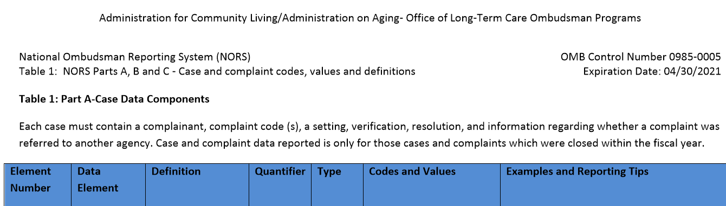
Table 1 – Case Data Components
Notes:
This is a snapshot of the top portion of Table 1 – Case Data Components. We briefly want to discuss how to read the tables. More in depth information will be provided in future webinars.
The arrow highlights the column headers which includes:
Element Number – coding for the software
Data Element – name of the data element. Example: Date Case Opened.
Definition of the data element. Example: Date Case Opened is the Month, Day, and Year that the case was opened
Quantifier – if single or multiple codes are allowed
Type – if it’s an alphanumeric code or a date
Codes and Values – coded elements such as 01resident or 02 resident representative/friend/family, and
Examples and Reporting Tips – such as each case may only have one open case date.
All of the tables are set up with a code, label, definition, codes and values and examples and reporting tips. Some items such as “quantifier” and ”type” are to inform a software developer how this is represented in your state’s software, i.e. – the software cannot allow for more than one facility type or complainant per case, which is true in the current NORS.

Slide 21
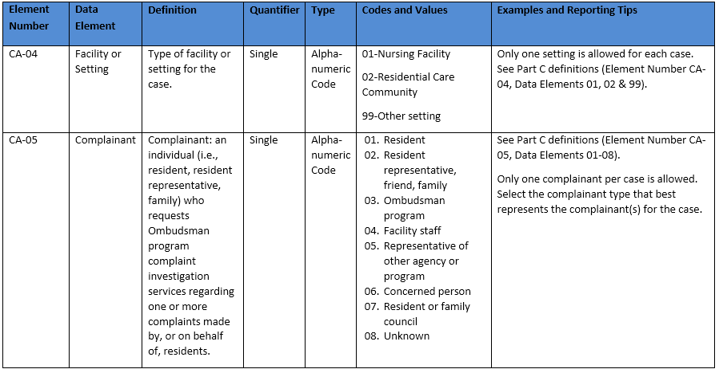
Table 1 – Case Data Example
Notes:
Look closely at the green ovals indicating the codes and values column.
Similar to the current NORS, when reporting a case you will indicate what type of facility or setting the resident resides and the complainant. As you are familiar with, you can only select one facility or setting type and one complainant per case.
01 is a Nursing Facility. 02 is a Residential Care Community which is currently called Board and Care. 99 is Other Setting which is something different than a Nursing Facility or Residential Care Community. Definitions will be provided in training manuals and we will go into more detail in future webinars.
Refer to the list 01 through 08 and choose the complainant type that best represents the complainant for the case. As you can see in the table, there have been minor changes to the types of complainants with the addition of “resident or family council” and merging of other categories from the current NORS.
If you are ever in doubt about which is the right code to choose for any case component or activity, we recommend referring back to the reporting tips, training curriculum, consult your supervisor, and/or contact your State Ombudsman Office.
Although all data elements in the Table have a code and we may refer to those codes during training, your software or forms, may have different codes that map behind the scenes to the NORS codes.

Slide 22
Type of Facility or Setting
Nursing Facility
Residential Care Community (formerly Board & Care)
Other Setting (formerly Other)
Notes:
Starting October 1st, the codes for type of facility or setting will be nursing facility, residential care community, and other setting. The only significant change is the facility type that used to be called “board and care” will be coded as “residential care community.”
In your everyday practice you will not notice a difference. For example, most states have a variety of license types for their residential care settings, such as, Assisted Living, Adult Foster Home, etc. That will not change even though at the federal level we have changed the name from “Board & Care” to “Residential Care Community.”
“Other Settings,” formerly “other,” is an optional code (and many states do not use it) for those states who wish to report other Ombudsman services that the program may provide, i.e. home care Ombudsman, managed care, etc.

Slide 23
Referral Agency and Dispositions
Referral Agency
  The agency (or agencies) to which a complaint was referred to as part of the Ombudsman program’s plan of action for complaint resolution, i.e. state licensing and certification agency, APS, legal, etc.
3 disposition codes:
  Fully or partially resolved
  Withdrawn
  Not resolved
Notes:
As mentioned earlier, referral is no longer a disposition code.
“Referral Agency” is now a component of a case which is defined in Table 1 as “the agency or agencies to which a complaint was referred to as part of the Ombudsman program’s plan of action for complaint resolution” such as referrals to the state licensing and certification agency or APS.
The number of disposition codes, meaning the final outcome of the complaint, were reduced from 7 to only 3 codes: fully or partially resolved, withdrawn, or not resolved.
We will go into more detail about these changes in the next webinar.

Slide 24
Poll Question
I have opened a new case. The resident is in a board and care facility. Which facility code should be used? Choose the correct answer.
01 Nursing Facility
02 Residential Care Community
03 Other Setting
Notes:
I have opened a new case. The resident is in a board and care facility. Which facility code should be used? Choose the correct answer.
01 Nursing Facility
02 Residential Care Community
03 Other Setting

Slide 25
Poll Question - Answer
I have opened a new case. The resident is in a board and care facility. Which facility code should be used? Choose the correct answer.
01 Nursing Facility
02 Residential Care Community
03 Other Setting
Notes:
Residential Care Community is the correct answer. In the revised NORS, Board and Care Facility is now referred to as a Residential Care Community.
As a reminder, states have a variety of names for their residential care communities, such as personal care home, assisted living, or adult foster care, so although board and care is now residential care community in the revised NORS, that doesn’t change the the names at the state level.

Slide 26
Table 2 – Complaint Codes and Definitions
Notes:
This is a screenshot of the first page of Table 2. This table is 21 pages long and explains the complaint codes and definitions for the revised NORS.

Slide 27
Table 2 Highlights
59 complaint codes
Complaint Code Categories A-L
  Category A: complaints about abuse and you must select a perpetrator
  Categories B – J: complaints against the facility
  Category K: complaints against other programs and agencies
  Category L: complaints against others not associated with the facility
Crosswalk B: Complaint Codes – Old NORS to Revised NORS
  https://acl.gov/sites/default/files/programs/2018-05/NORS%20Crosswalk%20B%2004_30_2021.pdf
Notes:
Table 2 includes a label, code, definition, and example and reporting tips for each complaint code.
The most significant change for the complaint codes is that there is a dramatic reduction in the number of complaint codes.
Currently, NORS has 133 complaint codes. Based on recommendations from you, many codes have been merged into the new complaint codes and you will find examples of those old codes in the examples and reporting tips. For instance the old NORS code M96-102 is merged into the complaint code “Staffing.”
The revised NORS has 59 complaint codes. For those of you who have memorized all of the codes, it may take a little time to learn the new codes. We have created resources in simple formats showing side-by-side changes to codes.
Because so many codes were not used in the current NORS they were eliminated or incorporated into other complaint codes. A crosswalk is available if you want to see how the codes changed.
However, we recommend that you start fresh and use Table 2 when selecting complaint codes.
There are also complaint code categories, A – L, Category A is for complaints about abuse in which you must select a perpetrator code; Categories B – J are for complaints against the facility; Category K is for complaints against other programs and agencies; and Category L is for complaints against others not associated with the facility.
The examples and reporting tips will be helpful to help you focus in on the correct code. Your state may choose to have additional codes and that is acceptable as long as they map to an accurate NORS code. (as many states do now)

Slide 28
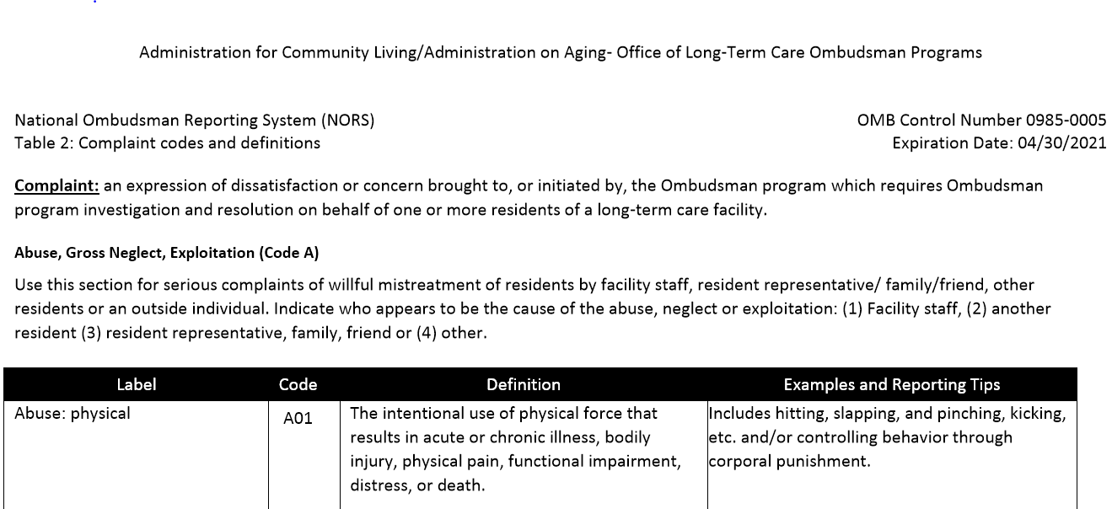
Table 2 – Complaint Codes and Definitions
Notes:
In Table 2 a complaint is defined as “an expression of dissatisfaction or concern brought to, or initiated by, the Ombudsman program which requires Ombudsman program investigation and resolution on behalf of one or more residents of a long-term care facility.” As you see, this definition has not dramatically changed.
Abuse, Gross Neglect, Exploitation (Code A)
Use this section for serious complaints of willful mistreatment of residents by facility staff, resident representative/ family/friend, other residents or an outside individual. Indicate who appears to be the cause of the abuse, neglect or exploitation: (1) Facility staff, (2) another resident (3) resident representative, family, friend or (4) other. This is new in the revised NORS as the current NORS does not ask for the accused perpetrator.

Slide 29
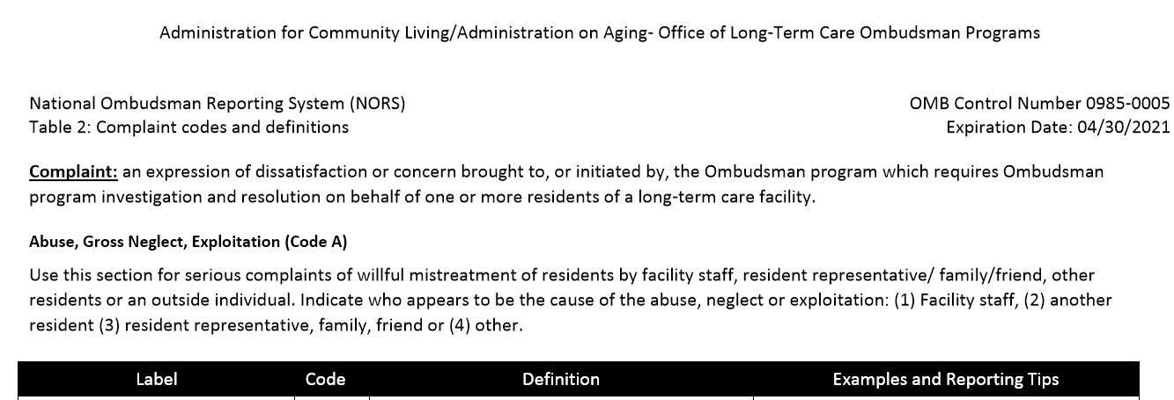
Table 2 – Complaint Codes and Definitions
Notes:
This is a snapshot of the top portion of Table 2 – Complaint Codes and Definitions. The arrow highlights the columns identified as the
Label – data element name such as Abuse Physical
Code – A01 is for the code for Abuse: Physical
Definition – definitions for the complaint codes, such as “the definition of Abuse: Physical is the intentional use of physical force that results in acute or chronic illness, bodily injury, physical pain, functional impairment, distress, or death.
Examples and Tips – Additional information such as “physical abuse Includes hitting, slapping, and pinching, kicking, etc. and/or controlling behavior through corporal punishment”

Slide 30
Table 2 – Complaint Data Example
Abuse, Gross Neglect, Exploitation (Code A) – Revised NORS
A01 Physical Abuse
A02 Sexual Abuse
A03 Psychological Abuse
A04 Financial Exploitation
A05 Gross Neglect
A6 and A7 no longer exist in the revised NORS
A6 Resident-to-resident physical or sexual abuse. (Identify the type of resident to resident abuse by selecting appropriate code(s) A01-A04 with resident as suspected perpetrator.)
A7 Not Used
Notes:
This is one example from Table 2.
Abuse, Gross Neglect, Exploitation (A codes) A01 through A05 remain the same.
A6 and A7 will no longer exist in the revised NORS.
In the revised NORS to report resident-to-resident abuse identify the type of abuse by selecting appropriate code(s) A01-A04 and select resident as the perpetrator, meaning the person who appears to have caused the abuse.
Only use perpetrator(s) for Abuse, Gross Neglect, and Exploitation complaints A01 to A05.
There can be multiple perpetrators for each complaint.
The current NORS P code for System/Others - P117. Abuse/neglect/abandonment by family member/friend/guardian or, while on visit out of facility, any other person will be reported as one of the Abuse, Gross Neglect, Exploitation (A code) and you would select “family, resident representative, or friend” as the perpetrator.

Slide 31
Why has perpetrator been added?
In the current NORS, there is sometimes confusion and miscoding because there are duplicate codes that describe abuse.
This addition will:
  provide ACL with a better understanding of the types of abuse, neglect, and exploitation and the perpetrator;
  increase the information available about abuse; and
  improve the ability to analyze the data.
Notes:
Why has perpetrator been added?
In the current NORS, there is sometimes confusion and miscoding because there are duplicate codes that describe abuse.
This addition will:
provide ACL with a better understanding of the types of abuse, neglect, and exploitation and the perpetrator;
increase the information available about abuse; and
improve the ability to analyze the data.
Requiring a code for perpetrator For example there could be resident to resident financial exploitation but there is not a clear way to reflect that in the current system. Also, the A-Abuse codes have been confused with the P-Systems other abuse codes in the current NORS.

Slide 32
Poll Question
A resident who lives in a nursing facility told a representative of the Office that a staff person hit her while in the shower.
Choose the correct answer for the perpetrator.
01 Facility Staff
02 Another Resident
03 Family, Resident Representative, Friend
04 Other
Notes:
A resident who lives in a nursing facility told a representative of the Office that a staff person hit her while in the shower.
Choose the correct answer for the perpetrator.
01 Facility Staff
02 Another Resident
03 Family, Resident Representative, Friend
04 Other

Slide 33
Poll Question
A resident who lives in a nursing facility told a representative of the Office that a staff person hit her while in the shower.
Choose the correct answer for the perpetrator.
01 Facility Staff
02 Another Resident
03 Family, Resident Representative, Friend
04 Other
Notes:
You would code this as Facility Staff for the perpetrator.

Slide 34
Table 3 – State Program Information
Notes:
This is a screenshot of the first page of Table 3. This table is 35 pages long and explains the elements that Ombudsman programs will use to report their program activities.
The majority of the Program Information is compiled and written by the Office of the State Ombudsman. However, we will provide an overview and share one example of how your work and record keeping is reflected in the program information submitted for Table 3.

Slide 35
Table 3 Highlights
Complaint Example
Systems Issues
Organizational Structure
Staff and volunteers
Conflicts of Interest
Funds expended
Facilities and beds
Ombudsman program activities
Notes:
Here is the list of what is in Table 3. Most of this is the responsibility of the Office of State Long-Term Care Ombudsman and is not significantly different from their current reporting requirements.
There were significant changes to the reporting of Ombudsman program activities so it is in red font and we will describe those changes in a moment.

Slide 36
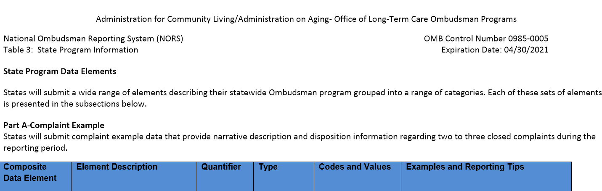
Table 3 – State Program Information
Notes:
This is a snapshot of the top portion of Table 3 – State Program Information.
The arrow is highlights the columns identified as the:
Composite Data Element is the Complaint Example and Data Element (on other pages in Table 3) is the name of the data element.
Element Description or Element Definition (on other pages in Table 3) – name and definition of the data element.
Quantifier – if single or multiple codes are allowed
Type – if it’s an alphanumeric code or numeric
Codes and Values – coded elements such as 01- Nursing Facility 02-Residential Care Community 03-Not specific to a setting
Examples and Reporting Tips – Describe at least two and up to three priority long-term care systems issues identified by the Ombudsman. Describe the leadership and advocacy activities the Office used to address these systems issues.
As you can see, Part A – Complaint Example is a narrative description and disposition information of two to three closed complaints. This information is submitted by Office of State Long-Term Care Ombudsman. In the current NORS submitting a complaint example narrative is optional.

Slide 37
H - Ombudsman program activities
Ombudsman Program Training
Training of Facility Staff (NF and RCC)
Information and Assistance (facility and individuals)
Visits
Survey Participation
Resident Council Participation
Family Council Participation
Community Education
Notes:
These activities probably look familiar as you already report your activities in these categories, but there are changes in the revised NORS for reporting Ombudsman program training and visits.

Slide 38
Changes in Ombudsman Program Activities
Ombudsman program training
  Simplified - though your State Ombudsman may want you to continue to report training.
  Activities
  Reported by facility type (SN or RCC), i.e. facility staff training, survey, work with resident or family councils, information and assistance, etc.
  Visits
      Report both complaint related visits and routine (or non-complaint) visits.
Notes:
Much of how you collect and enter your activity data will not change. Program activities will no longer be reported by state and regional level, but by facility type when applicable.
Reporting of program activities has been simplified.
For example, state Ombudsmen currently report the number of training sessions, hours, and number of trainees for Ombudsman program training. In the revised NORS, states will report the number of certification hours (meaning the total hours of training required to achieve certification for purposes of designation), annual number of continuing education hours, and total number of individuals completing certification training.
Also, states will now report all visits, those that are related to complaints and those that are routine (regular visits not in response to a complaint). While this change may not be new to your state, but it is to NORS.

Slide 39
Table 3 – Program Information Example - Visits
Notes:
This is a screenshot of Table 3 sections regarding visits for nursing facilities and residential care communities.
As you can see, NORS will now collect the following visit data for both nursing facilities and residential care communities:
The total number of facilities that received at least one visit by a representative of the Office;
The total number of visits to facilities no matter the purpose of the visit, both complaint and non-complaint related visits, and;
The total number of facilities visited, not in response to a complaint, in all four quarters of the reporting year.
We will go into more detail about reporting program activities in future webinars, but in regards to visits the most important part to remember is that at the state level all visits need to be entered and the software system will do the math and determine total number of visits for the data elements in these screenshots.
As a reminder, most of the information in Table 3 will be completed by the Office of the State Long-Term Care Ombudsman, but the work you do everyday is invaluable and reported in the program activities.
Now, I am going to turn the webinar back over to Amity to help us wrap up and go to questions.

Slide 40

Start Using Revised NORS – October 1, 2019
Notes:
Ombudsman programs will begin using the revised NORS codes, definitions, and activities on October 1, 2019 (Federal Fiscal Year 2020). The Office of the State Ombudsman will submit federal fiscal year 2020 data in January 2021. There are several components of NORS, such as narrative examples of advocacy work, that the Office of the State Ombudsman writes and submits along with data to the Administration for Community Living. This and other upcoming webinars will highlight areas of the revised NORS that are pertinent to you.
Please remember do not use the new codes or definitions until October 1, 2019.

Slide 41

NORS Training by NORC
Webinars will review the data elements with specific case examples to discuss. Training modules will be released prior to each webinar.
Register for one webinar you are registered for the entire series.
NORS Webinars 2019 – 3:00 – 4:30 p.m. ET
  Part I: Case, Complaint, Complainant, Information and Assistance – February 27
  Part II: Coding Complaints – March 19
  Part III: Closing the Case - April 30
  Part IV: Activities – May 29
^{*image Shutterstock 184663112}
Notes:
All State Ombudsmen and representatives of the Office are encouraged to attend. Webinars will be recorded and available on the NORC website. The next webinar, NORS Part I - Case, Complaint, Complainant, and Information and Assistance is scheduled for February 27th @ 3:00 p.m. ET.

Slide 42
Questions?

Slide 43
resources

Slide 44
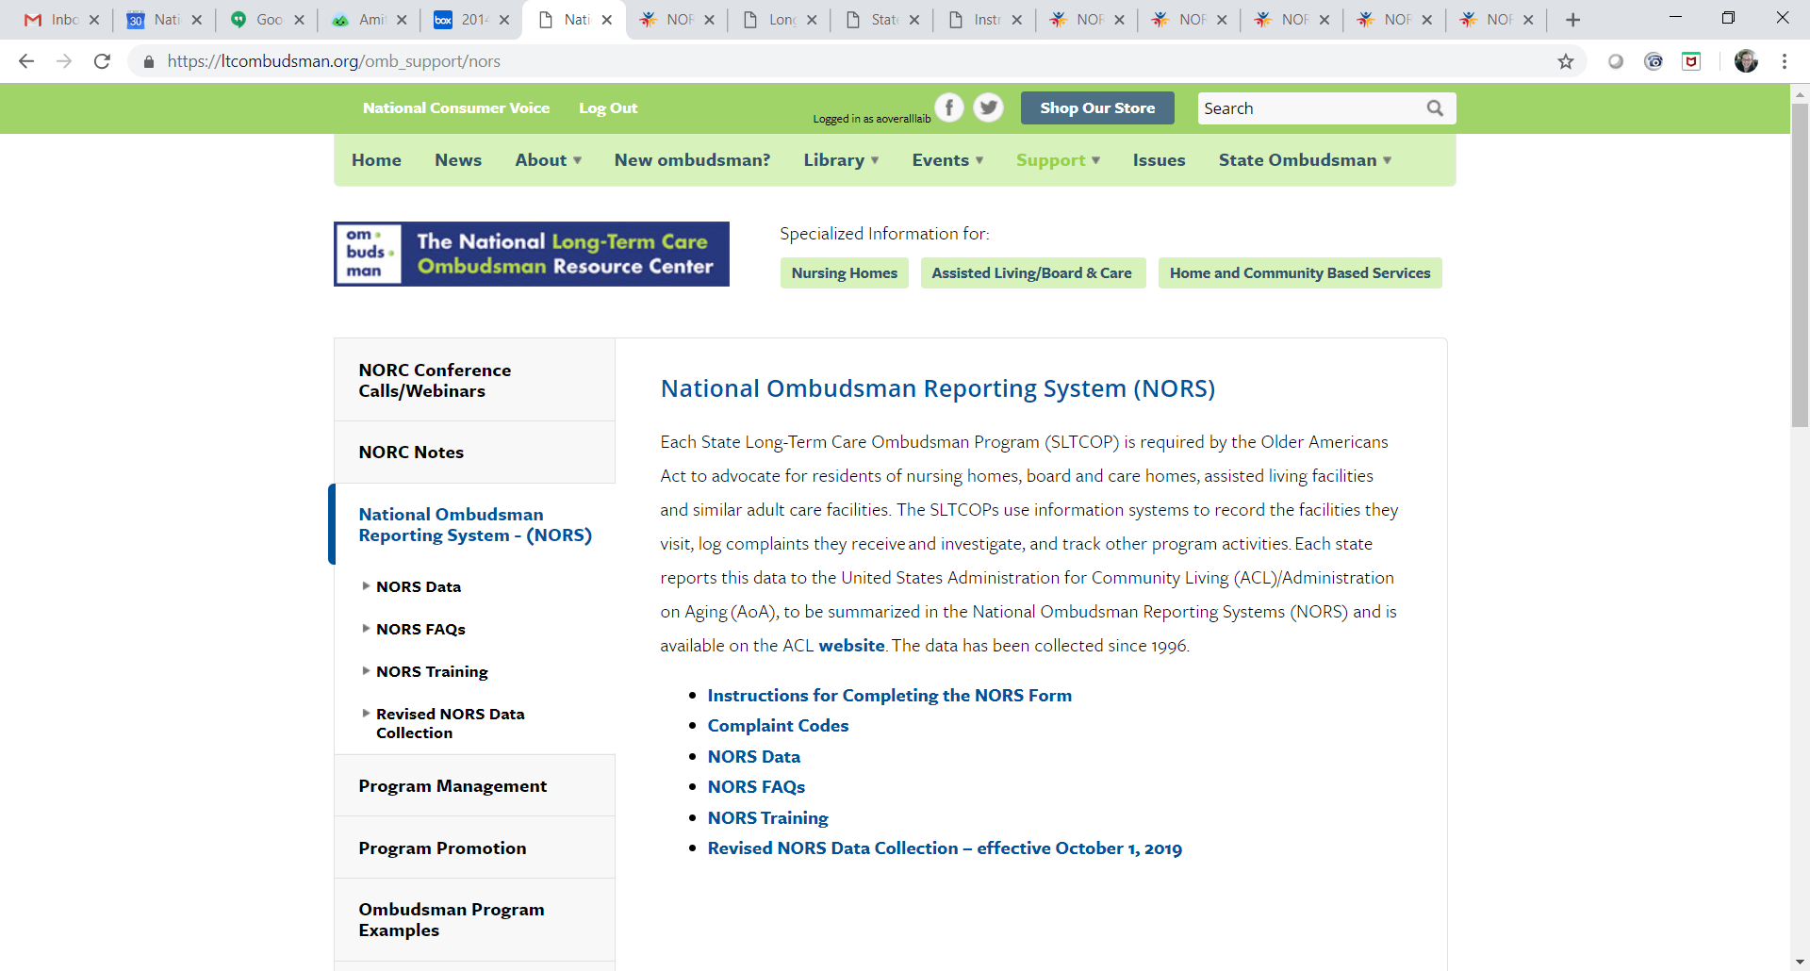
NORS Instructions, Training, and Materials https://ltcombudsman.org/omb_support/nors
Notes:
Here is the landing page for NORS on the NORC website.

Slide 45
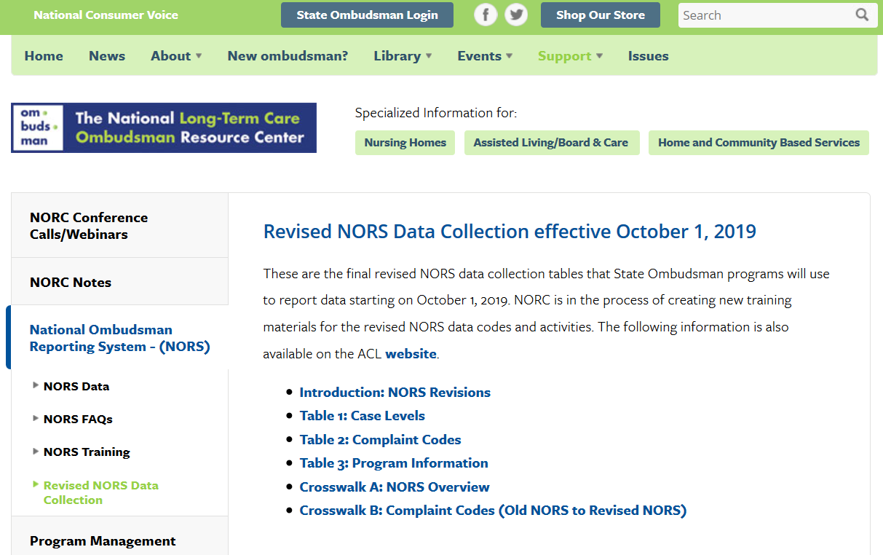
Revised NORS Data Collection https://ltcombudsman.org/omb_support/nors/revised-nors-data-collection
Notes:
In addition to the recording and posting of today’s webinar on the Overview of Revised NORS, you will find these additional resources – Introduction to NORS Revisions, Tables 1,2 and 3, and Crosswalks A and B.

Slide 46
Contact Information
Amity Overall Laib, NORC Director
aoverallaib@theconsumervoice.org
(202) 332 2275 ext. 207
Louise Ryan, Ombudsman Program Specialist, AoA/ACL
louise.ryan@acl.hhs.gov
206-615-2514
Maria Greene
NORC Consultant
margreene@outlook.com
(770) 668 6366

Slide 47
The National Long-Term Care
Ombudsman Resource Center (NORC)
www.ltcombudsman.org
This project was supported, in part, by grant number 90OMRC0001-01-00, from the U.S. Administration for Community Living, Department of Health and Human Services, Washington, D.C. 20201. Grantees undertaking projects under government sponsorship are encouraged to express freely their findings and conclusions. Points of view or opinions do not, therefore, necessarily represent official Administration for Community Living policy.

