Slide 1

Modernizing Your Program to Attract and Retain
Today’s Volunteer
Please call 1-866-740-1260 and use access code
3322275 to join the audio portion of today’s webinar
March 20, 2013
Notes:
Welcome and thank you for joining us for today’s webinar Modernizing Your Program to Attract and Retain Today’s Volunteer.
This is Amity Overall-Laib, Manager, LTCO Program and Policy with the National LTCO Resource Center. We are going to cover a lot of information today, so I would like to review a few housekeeping tips and then get started.
During the webinar all lines are muted. If you have a question, please post your question using the chat feature on the left-side of your screen. We will keep track of incoming questions and do our best to respond after the presentations. When it is time for open discussion we will ask you to raise your hand, and tell you how to unmute your line before speaking.
Also, as you may have heard a moment ago, this webinar is being recorded and will be available on our website with the resources mentioned during this training in the near future.

Slide 2
Overview of Webinar
Review demographics of “today’s” volunteers
Define what it means to “modernize” your program
Why volunteers serve and what they want
How to meet the needs and interests of “today’s” volunteers
Introduce NORC online training modules
Presentations from your peers and Q&A
Discussion questions
Review NORC resources
Notes:
The goal of this webinar is to provide you with an overview of today’s volunteer workforce, tips for modernizing your program and hear from your peers.
We have presenters from a variety of program structures and we believe the information presented today is relevant regardless of program structure and can be adapted to fit your program needs.
Today we will hear from Alia Murphy, Associate LTCO Program & Policy; Laurie Facciarossa Brewer, Chief of Staff, NJ SLTCOP; Greg Shelley, Volunteer Coordinator/Staff Ombudsman, Harris County LTCOP, TX and Gretchen Jordan, Coordinator of Volunteers, OR SLTCOP.

Slide 3
Poll Question #1
Notes:
Before jumping into the agenda, we would like to know if your CVO investigate complaints as we will discuss national LTCO data in the next two slides.
Do your certified volunteer ombudsmen investigate complaints?
Yes
No

Slide 4
Representatives of the LTCOP
Notes:
According to the National Ombudsman Reporting System or NORS data, in the last four years the number of certified volunteer ombudsmen (CVO) has hovered between 8,500 and a little over 9,000; the number of other volunteers ranged between 2,000 and 3,400 and the number of paid staff ranged between 1,100 and just under 1,300. Since 2008, the highest number of paid staff was 1,293 and the highest number of both CVOs and other volunteers was in 2011 with 9,065 CVOs and 3,320 other volunteers.
The NORs definition of a CVO is “an individual who has completed a training course prescribed by the state ombudsman and is approved by the state ombudsman to participate in the statewide ombudsman program.” Therefore, “other volunteers” could include friendly visitors, volunteers that assist with administrative work in the LTCOP office and so on.

Slide 5

Volunteer Time
Total Certified Volunteer Ombudsmen (CVO) Hours NORS 2011
Certified Volunteer Ombudsmen (State) | 64,605
Certified Volunteer Ombudsmen (Local) | 670,806
Total CVO Hours | 735,411
Total Estimated Value of Volunteer Time- $21.79 per hour in 2011* | $16,024,605.69
=
*2011 Value of Volunteer Time: http://www.independentsector.org/release_value_volunteer_time
Notes:
You’ve heard the saying that time is money. Well, determining an estimated value for volunteers is one way to measure the impact of volunteer service and illustrate the importance of a volunteer program. If you want additional information about determining the value and impact of volunteers, there is an article in the first issue of our Volunteer Management e-newsletter titled “What is the Value of a Volunteer Ombudsman?”
In looking at this one way to illustrate the value of CVO time, in 2011…
It is interesting to note that despite there being more volunteers in 2011 than in the last 5 years, 2011 had only the third highest number of CVO hours, falling behind years 2008 and 2009. For example, in 2008 there were nearly 300 fewer volunteers than in 2011, but those CVOs provided 84,000 more hours of service, for a total of 820,259 hours compared to 735,411 hours in 2011. We have not explored the reason for this difference, but it may be due to current volunteers not being able to contribute as much time as they have in the past. We are going to discuss the changing demographics, needs and skills of volunteers in upcoming slides.

Slide 6
Volunteer Ombudsman Programs
(NASUAD 2011)
LTCOP Volunteer Coordinator | Statewide | Local
None | 74% | 69%
Full-Time | 17% | 14%
Part-Time | 9% | 26%
Volunteer Program | Statewide LTCOP | Regional/Local LTCOP | Average (LTCOP, SHIP, SMP)
Program for 10+ years | 68% |  | 45%
Baby Boomer Volunteers (47-65) | 52% |  | 46%
Volunteer Coordinator | 28% | 32% | 38% / 45%
The Use of Volunteers in State Agencies on Aging and Disabilities: Long-Term Care Ombudsman Program. NASUAD. 2011.
Notes:
This slide shows a few of the findings of a 2011 survey regarding volunteerism in the national aging network as part of the Aging Network’s Volunteer Collaborative. State-level directors for the LTCOP, SHIP (State Health Insurance Program), SMP (Senior Medicare Patrol) and ADRCs (Aging and Disability Resource Centers) were sent this questionnaire.
42 statewide LTCOP representatives responded to the questionnaire. The LTCOP had the longest running volunteer program with 68% of statewide programs having a volunteer program that was 10 years or older. The LTCOP also had more baby boomers as volunteers than the other programs.
The LTCOP had the fewest number of volunteer coordinators compared to the other programs. 74% of statewide and 69% of local programs did not have a volunteer coordinator. 15% of the LTCOPs responding to the questionnaire did not have a statewide volunteer program.

Slide 7
Poll Question #2
Notes:
Before describing our definition of “modernizing” your program and getting into the details of generational characteristics of today’s volunteers we would like to know more about your volunteers by taking this poll:
The majority of your volunteers are part of the following generational cohort:
Silent Generation 1922-1945 (68-91 years old)
Baby Boomers 1946- 1964 (49-67 years old)
Generation X 1965-1980 (33-48 years old)
Millennial Generation 1981-2000 (32 years old and younger)

Slide 8
What does “modernize” mean?
“Modernizing” your program means
  Adapting and individualizing your program as much as possible to meet a volunteer’s skills, interests and schedule
    Variety in volunteer function, responsibilities
    Adapt your training process
    Match volunteer’s personality/skills with the facility’s “personality”
“Modernizing” your program is not just about technology, but including technology is one aspect.
  Recruitment
  Training
  Communication
Notes:
So, what does “modernize” mean?
Just like LTCO advocate for individualized care, LTCOP’s need to do their best to individualize their program in order to meet the needs and skills of today’s volunteer. The LTCOP has very clear requirements and responsibilities laid out in the Older Americans Act, so the primary role and responsibilities mandated by federal law are set requirements of the program and you often have state performance measures as well, but you can creatively adjust how you manage and shape your volunteer program to allow for flexibility in the volunteer position in order to recruit and retain “today’s” volunteer.
Naturally, in order to meet your program requirements and have program consistency you will continue to have basic shared requirements (e.g. hours of training, reporting, visits), but you can create flexibility in “how” they accomplish their tasks (e.g. training hours, online and in-person, go to them, phone in reports, submit reports online/email). In the next few slides we will take a look at the expectations and demographics of today’s volunteer, review what the LTCOP has to offer volunteers and how LTCO programs can be “modernized” without losing program consistency, credibility and effectiveness

Slide 9
Current Volunteer Expectations
Before
Now
Recruitment
Org-affiliated
Contribute
Supervised
Unskilled Jobs
Available Long-term
Consistent Schedule
Few Tech Tools
Engagement
Cause-related
Make a Difference
Self-directed
Skilled jobs
Mix of commitment
Flexible Schedule
Many Tech Tools
Recruiting the “Right” Volunteer. SHIP Resource Center Webinar. 2012.
Jill Friedman Fixler.Boomer Volunteer Engagement. 2012
Notes:
Volunteers want to be a part of something BIGGER than themselves and contribute in a meaningful way. The LTCOP gives volunteers an opportunity to connect with and help individual residents as well as participate in advocating for systems change (within one facility, a corporation, laws, rules or regulations).
Volunteers are seeking an organization that shares their world view and today’s volunteer wants to do something specific, time-limited, doable and they want to receive feedback.
Let’s take a look at previous volunteer expectations vs. current volunteer expectations:

Slide 10
Generational Workplace Characteristics
Silent Generation
1922-1945
Dedicated and hard worker
Conforms to rules, laws and order
Baby Boomer
1946-1964
Optimistic
Goal-oriented
Generation X
1965-1980
Appreciates diversity
Strives for balance in work/family life
Millennials (Generation Y)
1981-2000
Sacrifices own needs for cause of the greater good
Values personal growth
Work-oriented
Like to be involved
Health and wellness are priorities
Independent, confident
Loyal
Respects authority
Traditional values
Tech-challenged
Thinks globally
Strong tech skills
Self-reliant, does not like micromanaging
Pragmatic
Informal
Optimistic
Takes pride in civic duty
Confident
Strong stands on issues
Resourceful
Embraces diversity
Social
Part of massive societal changes
Supervision of Intergenerational Dynamics. University of Iowa School of Social Work. 2009. http://www.uiowa.edu/~nrcfcp/training/documents/Participant%20Packet%20Intergen%20Dynamics.pdf
Notes:
This slide goes into a greater detail of the general characteristics of generational cohorts.
Silent Generation (Traditionalists) 1922-1945 (68-91 years old)
Baby Boomers 1946- 1964 (49-67 years old)
Generation X 1965-1980 (33-48 years old)
Millennial Generation 1981-2000 (32 years old and younger)

Slide 11
Poll Question #3
Notes:
Have you noticed differences among your volunteers depending on their generational cohort?
Yes
No

Slide 12
Quick Tips!
Working with an Intergenerational Workforce
Silent Generation (Traditionalists)
Baby Boomers
Introduce changes slowly and announce them early
Highlight your experience and credentials
Provide clear guidelines, expectations and chain of command
Provide classroom training
Recognize their work publicly
Include them in decision-making, treat them as colleagues
Provide transparency in your program’s operations and output (e.g. share results)
Be organized and professional
May like workshop type training (e.g. case studies, manuals and sharing their experiences)
Notes:
We recognize it can be challenging to meet the needs of such a diverse group of individuals, but here are some quick tips for working with volunteers based on their broad generational characteristics. These tips could also help you communicate and work with coworkers, residents, family members and facility staff.

Slide 13
Quick Tips!
Working with an Intergenerational Workforce
Generation X
Millennials (Generation Y)
Don’t micromanage
Show them that you value their skills and encourage them to use them and/or train others (e.g. use of technology)
Provide fun, engaging and interactive training (e.g. role playing, Q&A, discussion)
Provide mentors
Provide challenging work
Let them try new things
Provide instant and frequent feedback
Provide e-learning (e.g. online, videos, blogs, podcasts)

Slide 14
Program Assessment
Self-Evaluation and Continuous Quality Improvement Tool (NORC)
  H. Volunteer Management
    1. General
    2. Recruitment
    3. Training
    4. Supervision and Support
    5. Retention
    6. Recognition
    7. Treatment of Staff
http://www.ltcombudsman.org/ombudsman-support/program-management#Program_Effectiveness___Quality
Notes:
Now that we’ve defined what we mean by “modernizing” your program and given a brief overview of LTCOP volunteer statistics and what today’s volunteers want, I would like to touch on program assessment before moving forward to recruiting, training and communicating with today’s volunteer.
Before revamping your volunteer management program, it is important to understand the baseline of your program so you can build on that foundation. The NORC Self-Evaluation and Continuous Quality Improvement Tool is a tool specifically designed for self-assessment of LTCO programs. The tool has an entire section devoted to volunteer management and addresses the following areas:
There are separate versions for state and local programs, instructional briefs, mini-tools and a webinar recording explaining how to use the tools and sharing LTCO experience with the tools.

Slide 15
Volunteer-Centered | Organization-Centered
We’ll help you grow your skills and increase your impact in your community. | We have mandatory training and certification requirements.
We look forward to learning about your unique talents, skills and interests. | Applicants must have an understanding of long-term care.
We know there’s strength in our diversity. Read about how volunteers from all walks of life have made a difference here. | Advocates needed. Apply today!
We appreciate commitments large and small. Contact us to talk about how we can tailor a volunteer experience that meets your needs. | All volunteers must make a one-year commitment.
Learn more about what we do by visiting our website (or Facebook page, blog, signing up for e-newsletter, etc.). | If you can’t volunteer right now, call us back later.
Recruiting the “Right” Volunteer. SHIP Resource Center Webinar. 2012.
Notes:
I would like to touch on crafting recruitment messages that are volunteer-centered instead of organization-centered that may appeal more to today’s volunteer. Similar to changing language and practices to become resident-centered instead of facility-centered, LTCOPs can change the recruitment and training process to be more volunteer focused.
For example…

Slide 16
Quick Tips!
Information to include on your website
  Automated application form
  Name and photo of contact
  Upcoming training calendar
  Success stories
  Volunteer experiences
Develop standard interview questions
Find out what motivates and interests potential volunteers
The LTCOP is not the best fit for every volunteer
  It is ok to say “no, thank you”
  Refer them to other volunteer opportunities that may be a better fit for their interests and skills
Recruiting the “Right” Volunteer. SHIP Resource Center Webinar. 2012.
Notes:
In addition to the recruitment messages in the previous slide, here are some quick tips about the Interviewing and Screening process.
Learn what motivates and interests them as that will help you keep them engaged on an ongoing basis. That includes finding out what is meaningful to them in regards to recognition for their work as that will help you show your appreciation in ways that mean a lot to them and help with your retention (e.g. some volunteers like public recognition- a press release about their service in their local paper).

Slide 17
Use of Social Media
 | % of internet users who… | The service is especially appealing to…
Use Any Social Networking Site | 67 | Ages 18-29, women
Use Facebook | 67 | Women, ages 18-29
Use Twitter | 16 | Ages 18-29, African-Americans, urban residents
Use Pinterest | 15 | Women, adults under 50, whites, those with some college education
Use Instagram | 13 | Ages 18-29, African-Americans, Latinos, women, urban residents
Use Tumblr | 6 | Ages 18-29
The Demographics of Social Media Users. Pew Research Center. 2012. http://pewinternet.org/~/media/Files/Reports/2013/PIP_SocialMediaUsers.pdf
Notes:
In general, developing on online presence is important for all organizations and agencies, but before dedicating a significant amount of time to outreach and recruiting efforts using social media, you may want to consider the audience you are trying to reach and develop a plan that includes: what are you going to use it for (recruiting, outreach, communication with current volunteers, residents and families) what you are going to say, how much time you will devote to social media, who you are targeting, how will you measure impact.
A recent Pew Research Center report provided statistics of who uses social media stating the following:

Slide 18
Poll Question #4
Notes:
Do you have different roles for your volunteers other than routine visits and complaint investigation? (select all that apply)
Administrative
Marketing/Outreach
Training
Other
No

Slide 19
Redefining the Volunteer Experience
Volunteer Functions
  Team Leader
  Subject Matter Expert
  Consultant
  Outreach and Communications
“How-to” Volunteer
  Volunteer Team/Partnership
  Seasonal
  Flexible Schedule
  Flexible Training
Recruiting the “Right” Volunteer. SHIP Resource Center Webinar. 2012.
Notes:
Reshaping the how a CVO volunteers and what they do can both expand your program’s reach and enhance the volunteer’s experience allowing your program to recruit and retain a more diverse group of volunteers with varying backgrounds, experiences, skills and time to volunteer. As I stated earlier, the core responsibilities, requirements and role of the LTCOP is clearly defined by the OAA, but LTCOPs have flexibility in how a CVO volunteers and what they do within their role as a CVO.

Slide 20
Poll Question #5
Notes:
Do you provide initial certification training or continuing education to your volunteer using (select all that apply):
Webinars
Conference Calls
Online Training

Slide 21
NORC Online Curriculum
Based on the existing NORC curriculum, Equipping Long-Term Care Ombudsmen for Effective Advocacy: A Basic Curriculum.
Introduces potential volunteers to the Long-Term Care Ombudsman Program and basic Ombudsmen thinking and problem solving.
  Enables self-study and self-paced learning
  Allows individuals to spend more time on content as needed
Notes:
This new online curriculum is based on the existing NORC curriculum, Equipping Long-Term Care Ombudsmen for Effective Advocacy: A Basic Curriculum.
All of the content and the basic format and layout in the online training is lifted directly from the NORC curriculum – we have just supplemented it a bit with some training videos, graphics and review quizzes.
The online training allows potential volunteers to work through the modules at their own pace and introduces them to the Ombudsman Program and basic Ombudsmen thinking and problem solving before they get to the classroom – so once they are in any in-person training, they can come prepared with any questions.

Slide 22
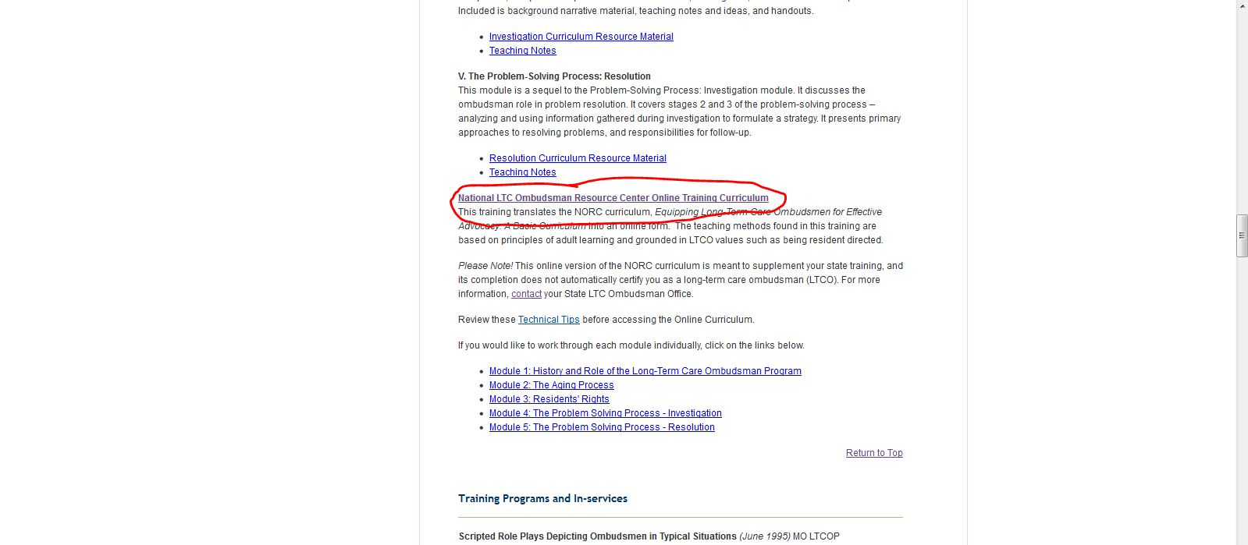
Link to the Online Training
NORC home page -> Ombudsman Support ->
Ombudsman Training -> NORC Curriculum
http://www.ltcombudsman.org/ombudsman-support/training#Curriculum
Notes:
Click on the first link to view all of the modules together.
Click on each individual module.
Be sure to view the technical tips so that all of the components of the online training work correctly.

Slide 23
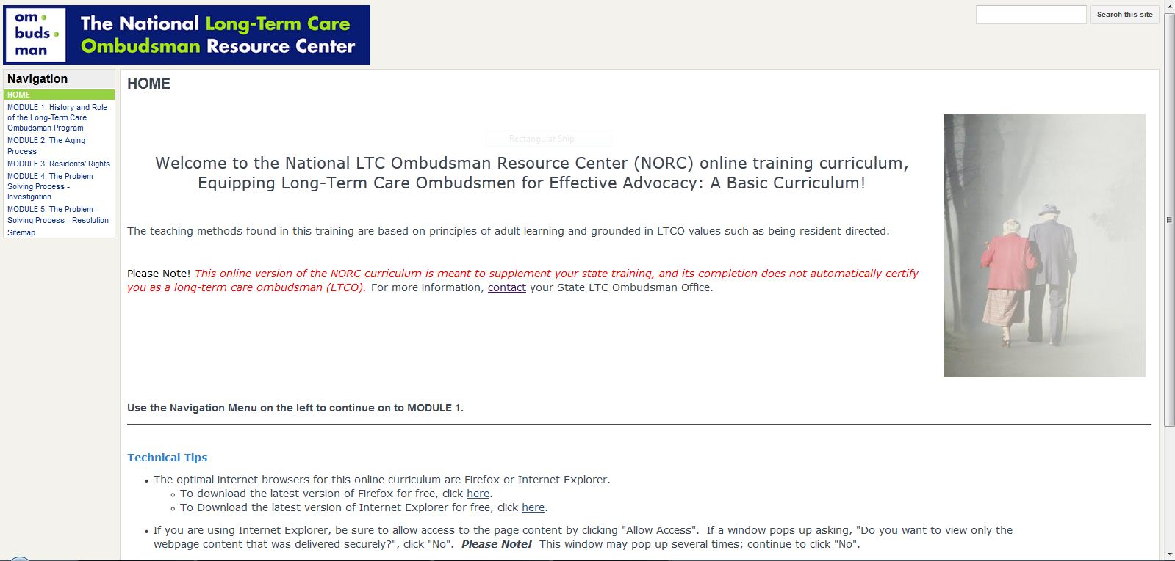
Home Page
Notes:
Home page for the online training
Navigation menu along the side
Technical tips
Link to contact State Ombudsman office for more information.

Slide 24
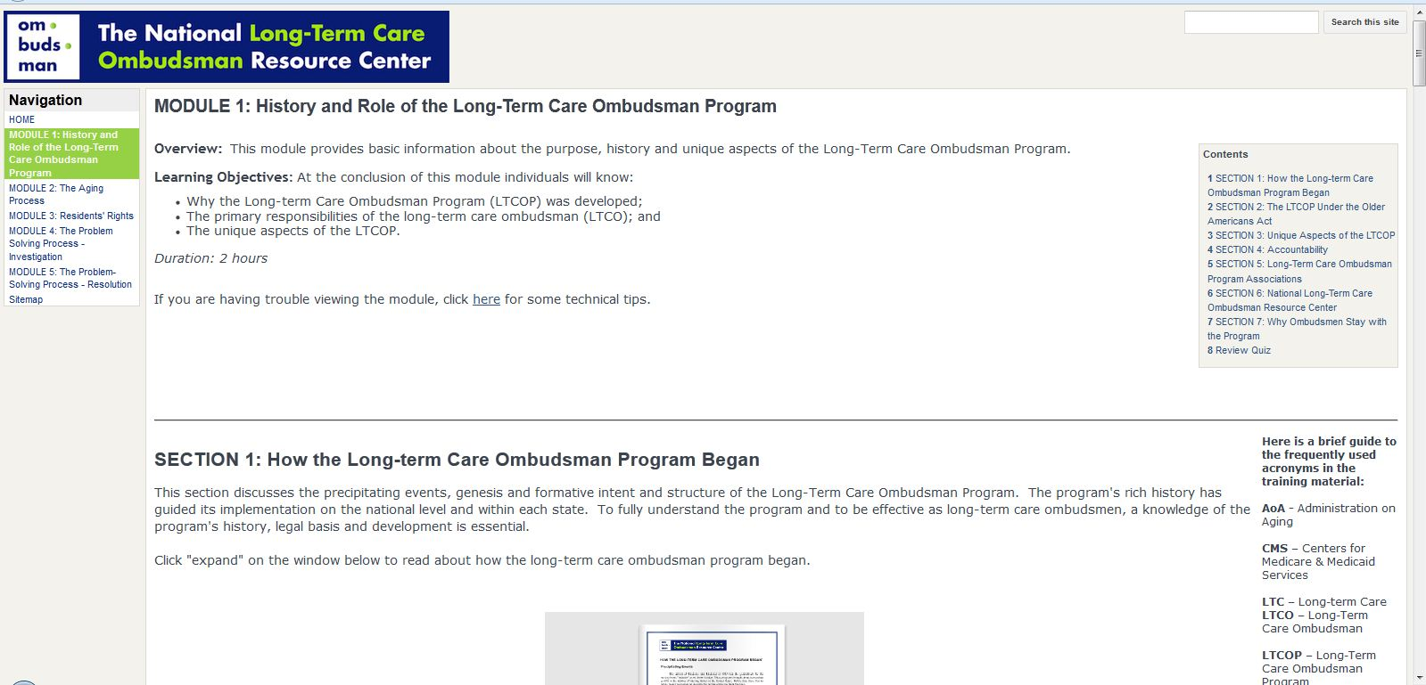
Modules
Notes:
Overview
Learning objectives
Duration
Click through the each section using the table of contents
Guide to acronyms along the side.

Slide 25
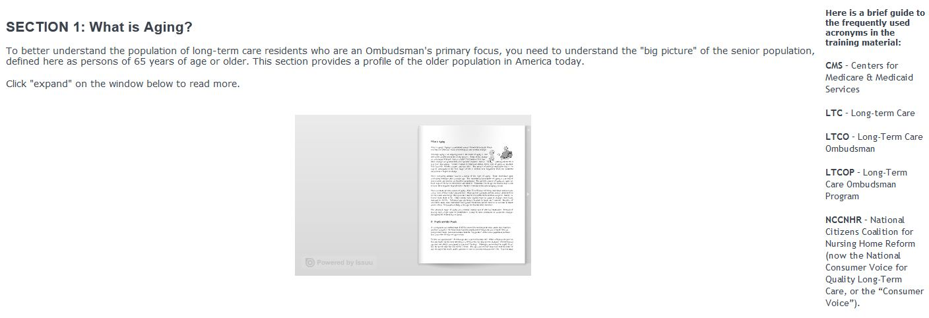
Modules
PDF
Notes:
Content is presented in a variety of formats throughout the modules:
Pdf
Interactive pictures
Video

Slide 26
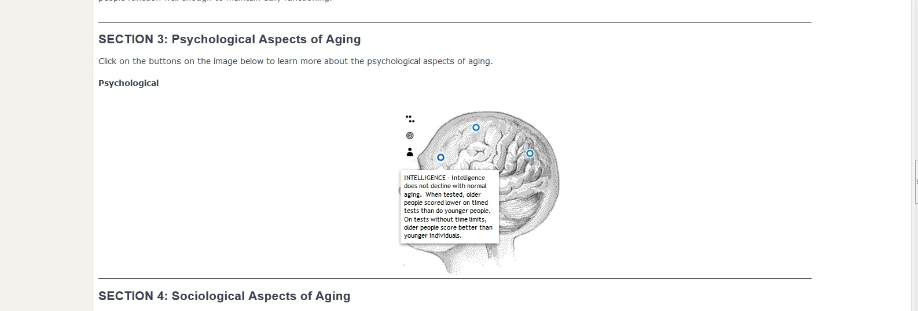
Modules
Interactive pictures

Slide 27
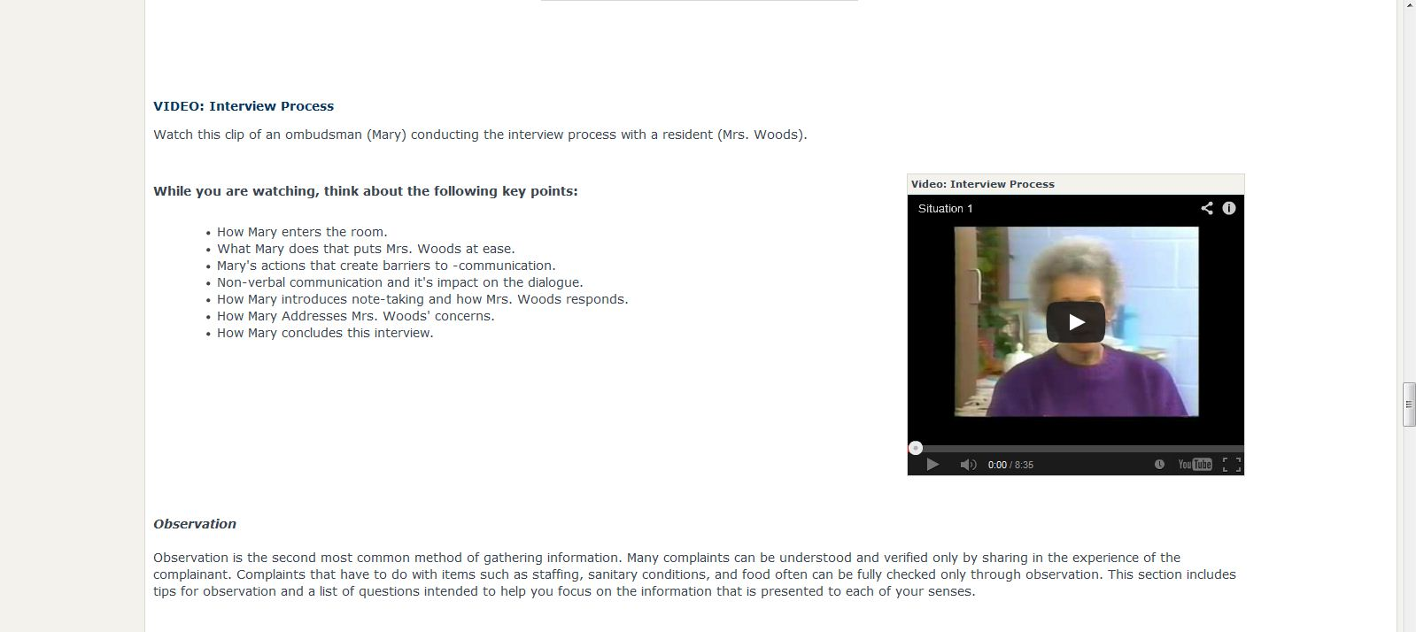
Modules
Videos

Slide 28
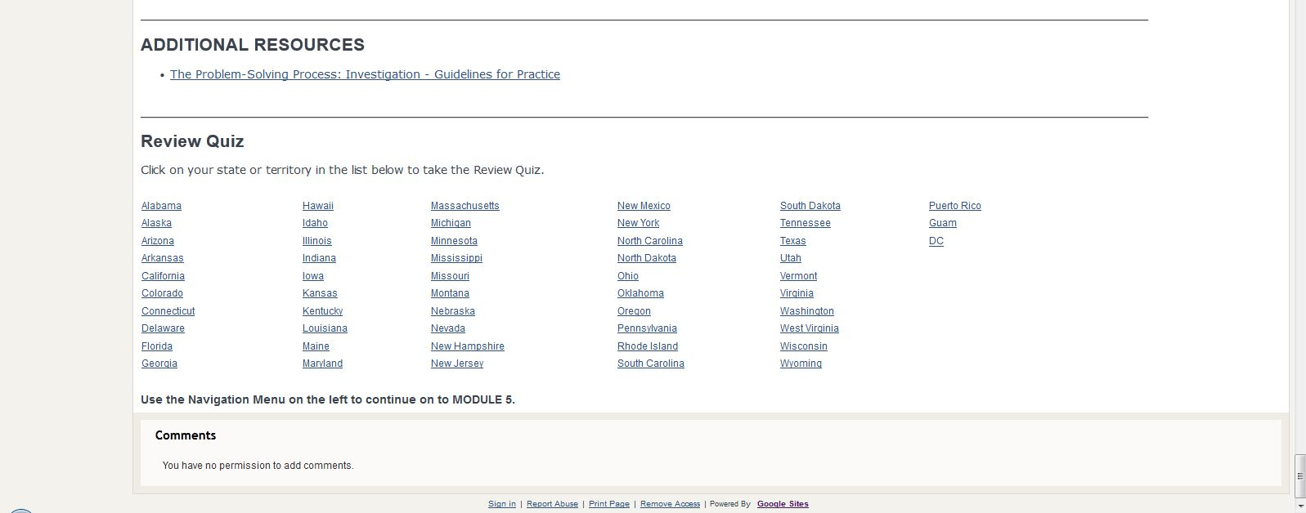
Module Quiz
Notes:
At the end of each module is a review quiz.
Click on your state and you will be redirected to a brief review quiz on the material covered in the module.
The quiz opens in a new tab so that you can refer back to the material as you make your way through.

Slide 29
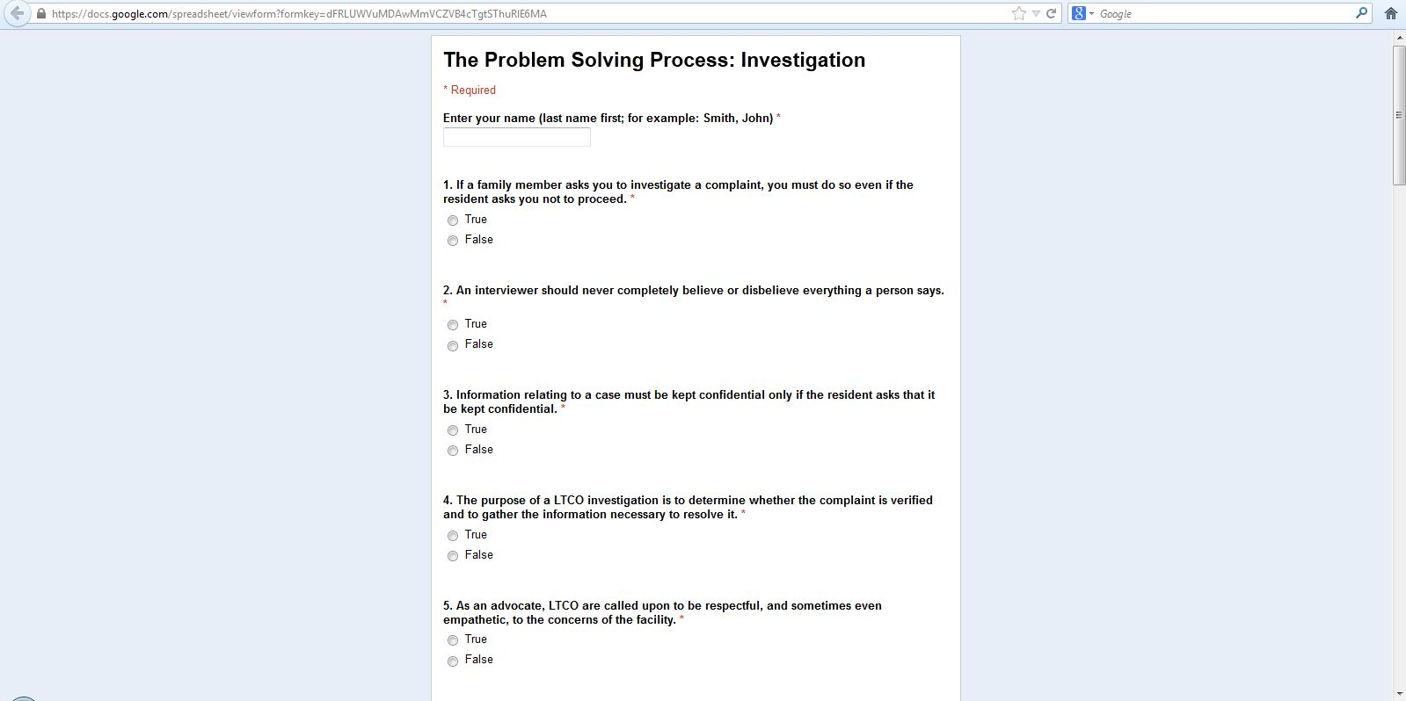
Module Quiz
Notes:
You are instructed to put in your first and last name, and then you can start making your way through.
Questions are either true false or multiple choice.
Once you submit your answers, you can view an answer key so you can see how you did.

Slide 30
Contact Your State Ombudsman Office
Work with your State Ombudsman on incorporating the online training into your training programs.
Note! The online training is meant to supplement state training, and its completion does not automatically certify you as a long-term care ombudsman.
Questions? Contact me at amurphy@theconsumervoice.org or 202-332-2275, ext. 222

Slide 31
Questions?

Slide 32
Discussion Questions

Slide 33
Question #1
Have you noticed a difference in the individuals interested in volunteering for your program now than a few years ago?
  If so, what are the differences?
  Have you made any changes to address those differences?

Slide 34
Question #2
Have you changed your outreach and recruitment strategies to attract specific individuals? If so, what worked best for your program?

Slide 35
Question #3
What trends do you see with your current volunteers?

Slide 36
Application to YOUR work…
What is YOUR next step in modernizing your program?
Did today’s webinar address an issue, best practice or idea that you would like more information about?

Slide 37
Resources and Support
NORC Resources
http://www.ltcombudsman.org/ombudsman-support/volunteer management
  Getting Started
  Program Management
    NORC Compendium on Recruitment, Training and Retention
  Volunteer Training
  Volunteer Recognition
  Volunteer Management Conference Calls/Webinars
  Volunteers in the News
  Volunteer Opportunities
Volunteer Management Network
  Listserv
  Quarterly e-newsletter
  Annual webinar

Slide 38
New Jersey’s Office of the Ombudsman
Modernize Your Volunteer Program to Attract and Retain Today’s Volunteer
Laurie Facciarossa Brewer
Chief of Staff
NJ Office of the Ombudsman for the Institutionalized Elderly

Slide 39
New Jersey Office of the Ombudsman for the Institutionalized Elderly
Located in, but independent of, the NJ Department of Treasury
Authorized under federal law, Older American’s Act, to investigate and resolve complaints made by or on behalf of residents of LTCF
Under NJ state law, OOIE receives and investigates reports of abuse and exploitation of institutionalized elderly from “mandated reporters” -- refers cases to appropriate regulatory and law enforcement agencies where OOIE findings require referral

Slide 40
New Jersey Office of the Ombudsman for the Institutionalized Elderly
Staff of 35 – six part-time
Staff includes:
  The Ombudsman
  General Counsel
  11 Investigators
  5 Money Follows the Person outreach staff
  2 Intake Professionals
  Nurse Consultant
  Director of Policy
  Director of Outreach
  Chief of Staff
  5 administrative support staff
  Statewide Supervisor of Volunteers
  4 Regional Volunteer Coordinators /1 part-time marketing staff person
  210 Volunteers

Slide 41
History of the NJ Volunteer Advocate Program
Piloted in 1993, Volunteer Advocate Program has been recognized as a highly successful program
Originally outsourced to a non-profit service provider
Internal contract manager worked closely with three part-time staff from non-profit agency
Program was effective – but static – the recruitment numbers were flat
Decision made in 2010 to move operation in-house and recommit to jump starting the program and increasing the number of volunteers

Slide 42
History of the NJ Volunteer Advocate Program
Volunteers receive 32 hours of training
Required to spend four hours a week in their assigned facility
Report to a regional volunteer coordinator who is their main link to central office
Required to attend quarterly meetings in their region that are hosted by the regional coordinator

Slide 43
Re-energizing the Volunteer Advocate Program
New leadership -- James W. McCracken joins OOIE in January 2011
Requested assessment of actual number of “active” volunteers -- showed volunteers hovered at about 145
Set a goal to have a volunteer assigned to 80 percent of all 370 nursing homes – or 296 volunteers – by the end of calendar year 2013
Committed to increasing staff resources – adding a staff person to the southern, more rural part of the state and a part-time marketing person
Implemented a marketing plan to promote awareness of the program with key audiences
Good results – we have seen a 45 percent increase in volunteers in the last two years from 145 to 210

Slide 44
Re-energizing the Volunteer Advocate Program
Bringing the program in-house created uniformity and economies of scale in the following areas:
  Administration
  Marketing and promotion program
  Training
Fostered greater integration between the VAP and overall OOIE operation

Slide 45
Re-energizing the Volunteer Advocate Program
Administration
OOIE Trenton/Central office support staff assist with administrative duties once exclusively handled by the part-time regional volunteer coordinators
Criminal History Background Checks, including fingerprinting by the NJ State Police instituted in 2012
Created forms and processes to be used in all regions

Slide 46
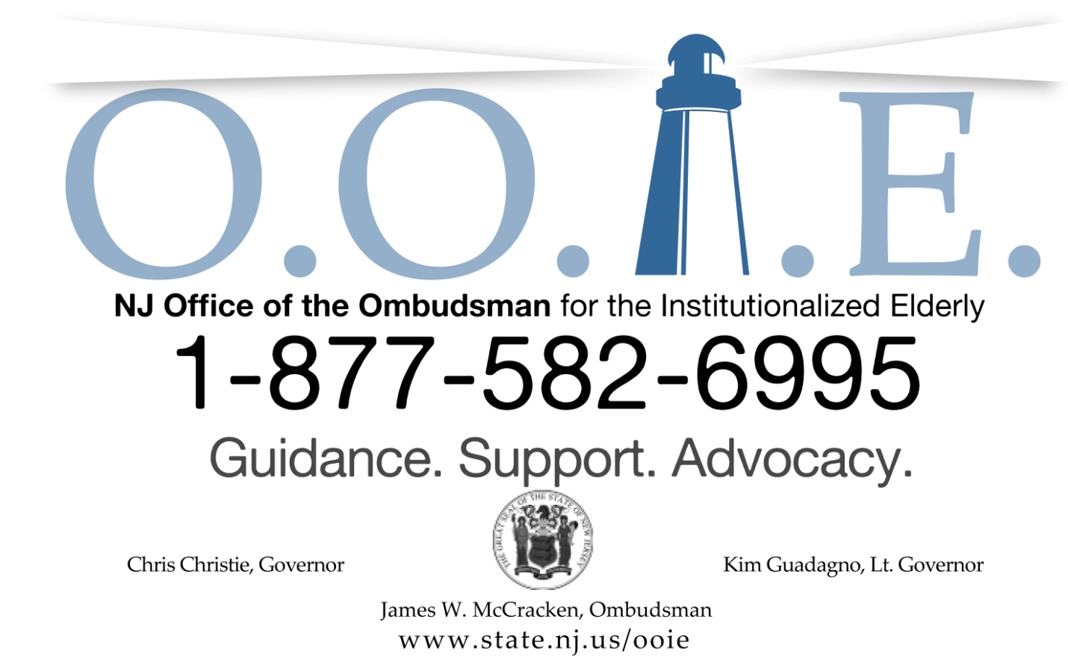

Slide 47

Re-energizing the Volunteer Advocate Program
Marketing
Branding – new logo and marketing materials to be used in every region for all marketing
Successful individual approaches continue – websites, local weeklies
Outreach strategy implemented from Central Office included:
  Print advertising – tailored to different regions
  Mailings – libraries, post offices, senior centers
  Earned media – Letter to the Editor for World Elder Abuse Awareness Day
  Pa

Slide 48
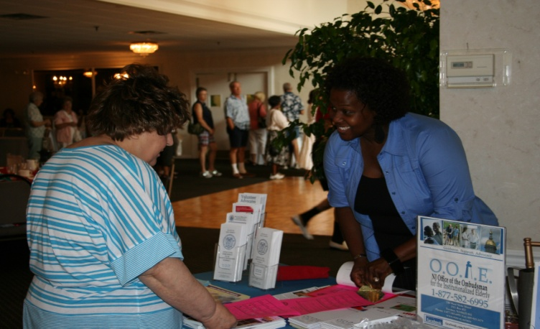
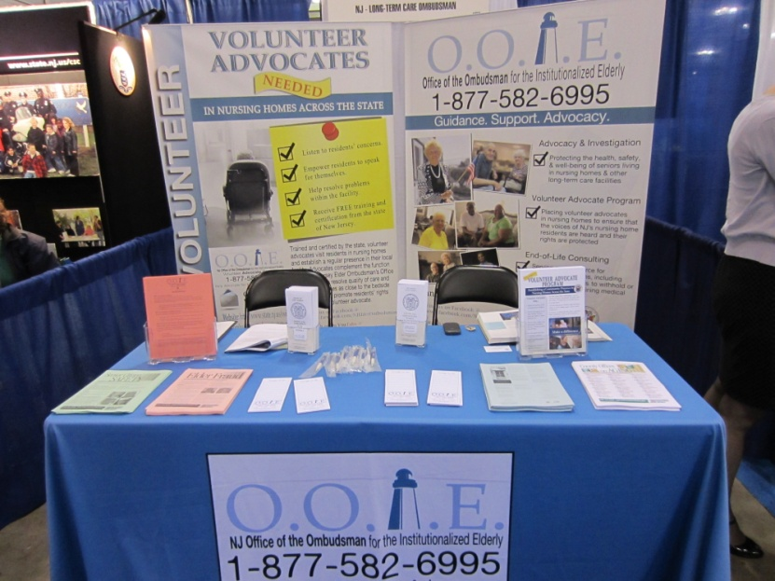
Re-energizing the Volunteer Advocate Program
Marketing
  Outreach events: health fairs, senior expos, senior centers, provider and government conferences, senior picnics, community days
  Partnerships – AARP, RSVP, County Offices on Aging
  No one-size-fits-all in terms of marketing and recruitment

Slide 49
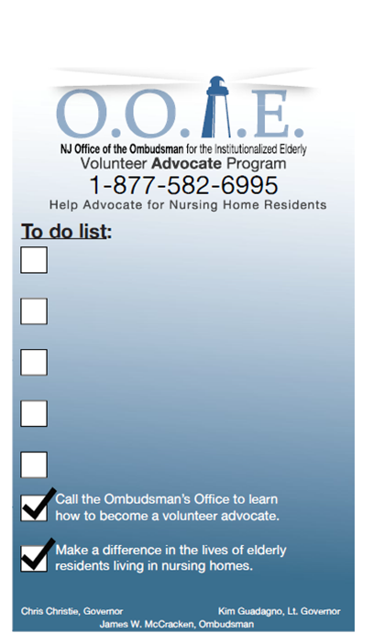

Re-energizing the Volunteer Advocate Program
Marketing
  Collateral materials – pens, magnets, magnetic, erasable
  to-do list

Slide 50
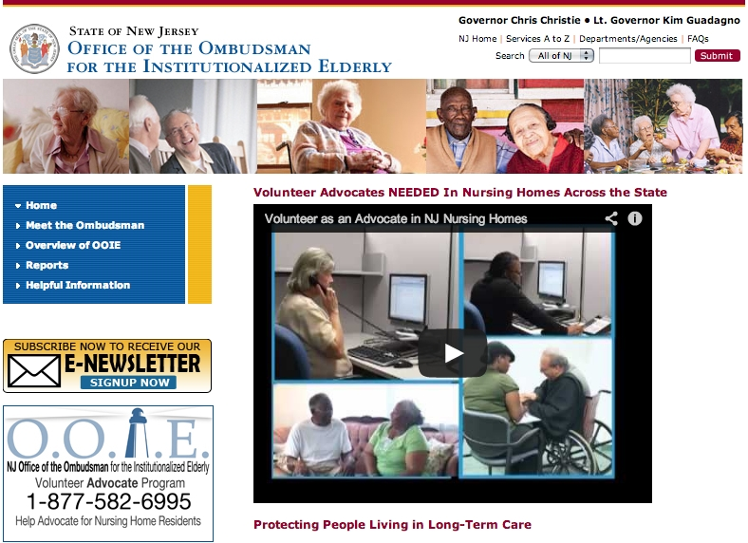
Re-energizing the Volunteer Advocate Program
Marketing
  Built stake-holder mailing list to send quarterly
  E-newsletter and
  distribute video

Slide 51
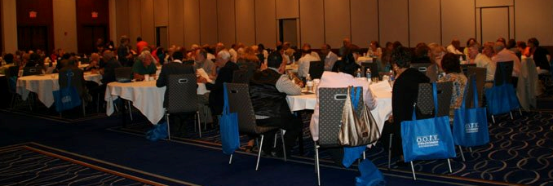
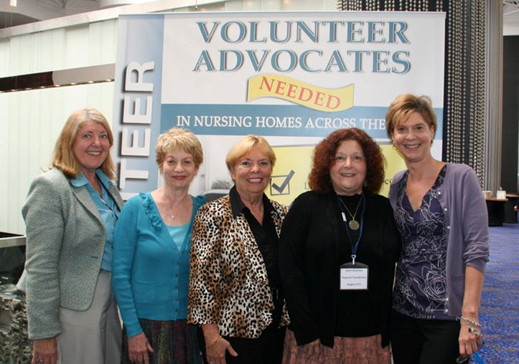
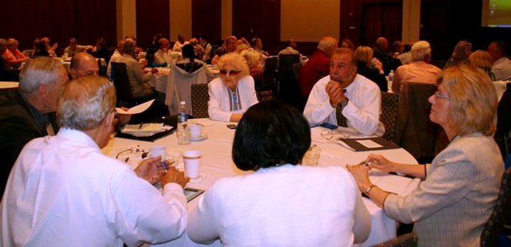
Re-energizing the Volunteer Advocate Program-Training
Transforming quarterly meetings into continuing education sessions – more uniformity of topics.
Senior managers attend regularly
Marketing occurs around scheduled group trainings – central location.
One-on-one trainings for new recruits are still available to people who work and cannot attend group trainings. However, there was an over-reliance on this method
Replace recognition event with state-wide training conference

Slide 52
Re-energizing the Volunteer Advocate Program Office Integration
Transferring in-house telegraphed the importance of the Volunteer Advocate Program
“Volunteers are an extension of our office”
Previously there was a divide between state staff and the regional coordinators/volunteers
Not all investigators attended volunteer quarterly trainings
Investigators are now required to attend quarterly trainings and to work with volunteers on cases, as appropriate
Both staff and volunteers attend the statewide training summit

Slide 53
Re-energizing the Volunteer Advocate Program -- Office Integration
Case practice modifications
Send volunteers out to respond to complaints that investigators may not get to immediately
The Super Storm Sandy experience
Volunteers included as part of a SWAT team approach
Utilize seasoned volunteers for trouble spots or to mentor new volunteers

Slide 54
Volunteer Satisfaction Survey
October 2012, OOIE initiated comprehensive satisfaction study among 200 volunteers
Response rate of 50-percent – in the midst of Super Storm Sandy
Quantitative result and verbatim comments captured
Volunteers had never been surveyed in this way before
Results will be used to improve support for the volunteers and will inform future trainings

Slide 55
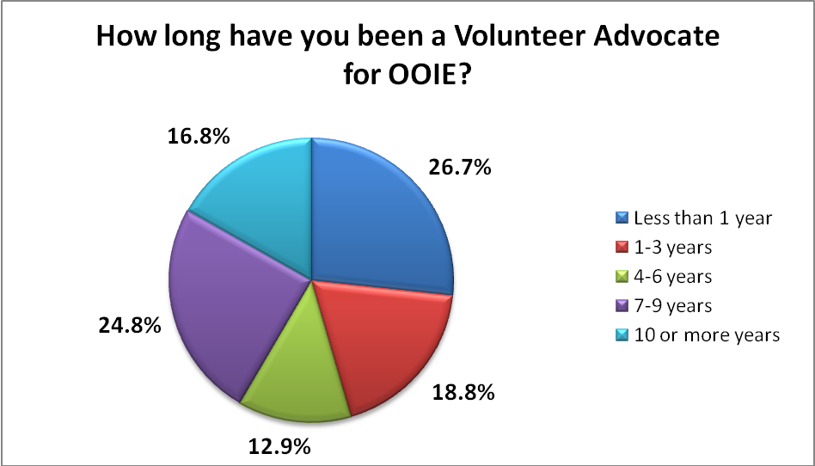
Volunteer Satisfaction Survey
Respondent Demographics
Almost 55 percent have been with the program for more than four years

Slide 56
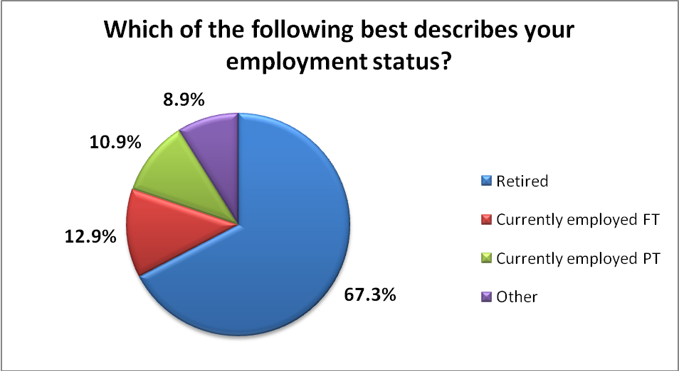
Volunteer Satisfaction Survey
Respondent Demographics
More than 67 percent are retired, about 24 percent work full- or part-time

Slide 57
Volunteer Satisfaction Survey
Training and professional development
With the exception of the interest in webinar-based trainings, the volunteers largely agree with the quality of the trainings
The comment section provided great insight into the training needs of the volunteers. Training topics and/or approaches requested:
  Dealing with residents with Dementia
  Dealing with facility staff
  Greater familiarity with regulations i.e. staffing requirements
  More information/experience sharing among volunteers
This information will be used to inform future trainings including our next statewide training summit

Slide 58
Volunteer Satisfaction Survey
Communication and Support
Nine questions were included to evaluate the communication and support between the volunteers and the OOIE staff.
Average ratings range from a low of 3.91 (facility staff understanding the role of the VAP) to a high of 4.59 for support received from the regional coordinator.
It was very encouraging to see a 4.46 rating in response to the question: I am clear on my roles and responsibilities as a volunteer advocate.
The ratings for getting support from investigators and our legal team in Trenton – while still high – are the only other areas where the ratings dipped below 4.
What we learned is that volunteers seem to appreciate the support they receive from the office, but there is still some work that needs to be done in that area.

Slide 59
Volunteer Satisfaction Survey
Overall Satisfaction
Survey Item | Average Rating | Number of respondents
I am passionate about my work as a volunteer advocate. | 4.47 | 92
I feel I make an impact in the facility. | 4.33 | 91
I feel supported in my efforts within the facility. | 4.09 | 91
I envision continuing as a volunteer advocate for some time. | 4.25 | 92
Overall, I am satisfied with the volunteer advocate experience. | 4.35 | 93
I would recommend others to the OOIE volunteer advocate program. | 4.55 | 94

Slide 60
Re-energizing the Volunteer Advocate Program
Next Steps
Recruit, recruit, recruit
Volunteering portal – exchange of ideas, high value to volunteers
Implementing NORC on-line training to augment current training
Recruit bi-lingual volunteers
Outreach to social work programs, retiree organizations (e.g. NJEA retirees), partner with cities

Slide 61



Digital Information Resources
Greg Shelley
Staff Ombudsman/Volunteer Coordinator
Harris County Long-term Care Ombudsman Program

Slide 62




What We Have
www.facebook.com/LTCOmbudsmen
www.twitter.com/TheLTCOmbudsman
www.YouTube.com/TheLTCOmbudsman

Slide 63



What We Have
http://pinterest.com/gregshelley/harris-county-long-term-care-ombudsman-program/
http://tinyurl.com/armav4b
http://tinyurl.com/b3yxqux

Slide 64
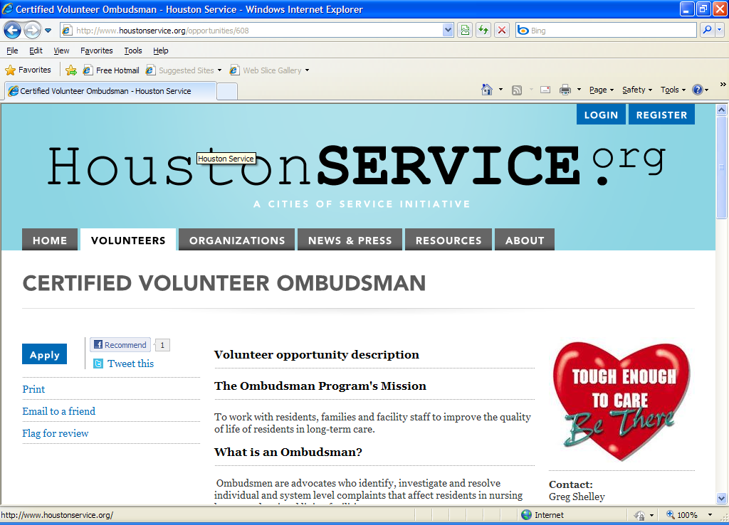
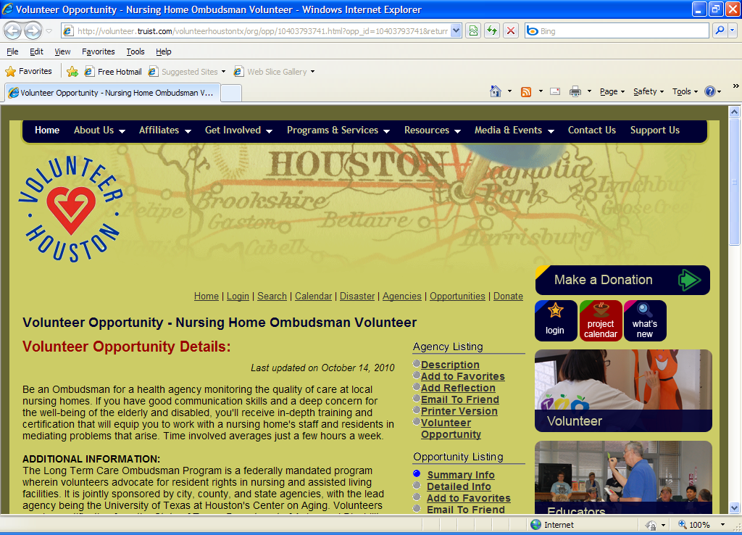
Advertisements
United Way
Idealist.org
Volunteer Houston
Volunteer Match
UTVolunteer.org
AllForgood.org
ServiceNation.org
VolunteerSolutions.org
CharityData.org
Web Presence

Slide 65

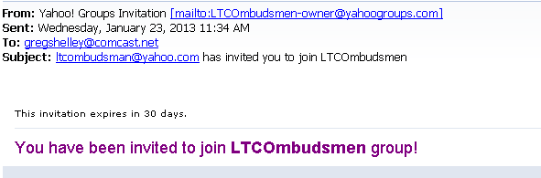
What’s in the Works
Updated email exchange
Yahoo Discussion Group

Slide 66
What Wasn’t Working
Program-Centric Vs. Volunteer-Centric
Post Card Mail Outs
Word of Mouth (By itself)
Student Groups

Slide 67
What’s Changed
Increase in Career Professionals
Communication (Less snail mail and more email)
Greater Interest in Networking
Teams

Slide 68
Oregon Long-Term Care Ombudsman Program
Gretchen Jordan, CVA
  Coordinator of Volunteers
    Responsible for outreach & recruiting volunteers statewide.
    Manages website and social media
    Support to staff on tech issues
    Press releases, news articles & general info about the agency

Slide 69
Using today’s tools when recruiting volunteers
Volunteers are screened on how they’d like communication, information and updates
  On their initial application, phone or email
  A formal form confirming the email address they’d like to use
    It may change after applying (such as lindaltco@gmailcom), as we suggest they get an individual email addres for ombudsman duties

Slide 70
Tech tools for volunteers
Perfect forms
  Online reporting system
  Forms that self-populate based on volunteers assigned ID #
  Document library where they can view & download forms, videos, slideshows, etc.
  Upgrading now to include use for ipad, kindle or tablet

Slide 71
Additional Resources
You-tube – good tutorials
  ‘how to skype’
Techsoup www.techsoup.org
  Glossary, software, discounts
  www.oregon.gov/ltco
  Gretchen.jordan@ltco.state.or.us

Slide 72
The National Long-Term Care
Ombudsman Resource Center (NORC)
www.ltcombudsman.org
The National Consumer Voice for Quality Long-Term Care
(formerly NCCNHR)
http://www.theconsumervoice.org/
This presentation was supported, in part, by a grant from the Administration on Aging, Administration for Community Living, U.S. Department of Health and
Human Services.
Notes:
Thanks again to Laurie, Greg and Gretchen for sharing their volunteer management experiences and to Alia for reviewing the new NORC online training modules. After the webinar ends a link will direct you to a brief SurveyMonkey evaluation, please let us know what you think about today’s training as it is important for us to hear from you in order to develop future training opportunities.
Again, thank you for joining us today and for the important work you do as Ombudsmen and have a great day.

