Slide 1
You Catch More Flies
With Honey
The Customer Service of the Ombudsman Program

Slide 2
In my role as the Ombudsman, how do I stay resident centered and try to create a win/win situation for all?

Slide 3
Group Discussion
How do I…
• Walk the fine line between residents and staff in a way that increases their trust in an ombudsman?
• Present myself, so residents understand I am here to advocate on their behalf?
• Develop relationships with staff that leads to improvement in the quality of life and care for residents without crossing a boundary.

Slide 4
By Developing Appropriate Relationships with…
The Administrator
The Social Worker
The DON & ADON
Nursing staff and CNA’s
And of course…
Residents & Family Members
Notes:
Courteous and respectful
A good listener
Patient and understanding
Trustworthy with confidential information
Helpful

Slide 5
Beware of Appearing
Pro-Facility
If you appear to be Pro-Facility it diminishes…
Trust in relationships with residents and family members
Objectivity in identifying problems
Effectiveness
Goals of the ombudsman program

Slide 6
Be Aware of How You
May be Perceived
Be careful not to bulldoze your way in. It may:
Limit your capacity to achieve results.
Put others on the defensive.
Create a power struggle and go nowhere.

Slide 7
To find the right balance…
Leave the “I’m going to get you for something!” attitude at the door.
At the same time, don’t get desensitized to issues that are present.

Slide 8
It’s not what you say….It’s how you say it.
Be aware of the language you use!!

Slide 9
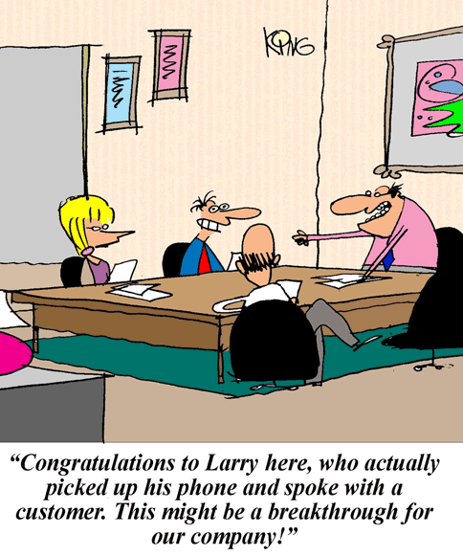

Slide 10
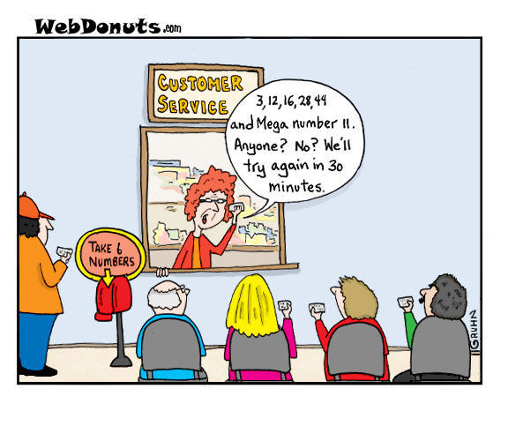

Slide 11
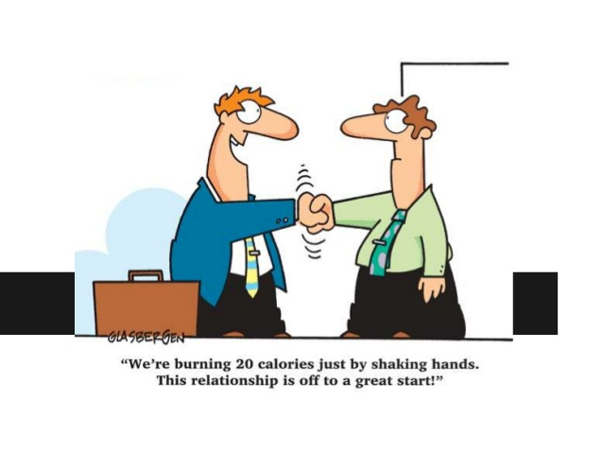
Building Relationships
with Administrators

Slide 12
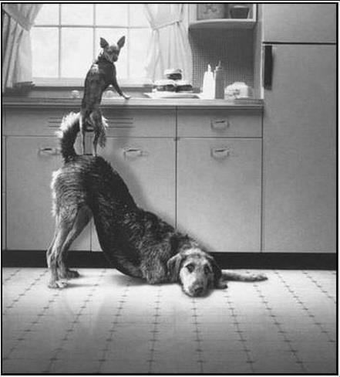
Establish (or Re-establish )Your Role as Ombudsman
Set a meeting if necessary (SLTCO can assist)
Acknowledge the difficulty of their job
Emphasize we have some common goals
Let them know you can:
Help them settle many problems before they go to regulatory, which provides a faster response and a solution for resident concerns.
Help promote a win / win situation for one resident and the whole community of residents.
Be a third party voice to support resident needs and rights.
Provide feedback to help improve residents’ quality of life and care.

Slide 13
Daily Protocol for Visitations
Establish—or reestablish—who your primary point of contact is in the facility
Touch base when you arrive and before you leave — whether you have a concern or not
Praise their “positives!”
Remind you are available to attend care plans, resident councils, provide conflict resolution, etc., with resident permission.
Never pass an opportunity to remind them that you are there to help.

Slide 14
When Reporting a Problem or Concern …
Acknowledge the difficulty of the issue at hand (especially when the issue is particularly challenging)
Be diplomatic, courteous and tactful
Remember to use helpful language.
Accountability: Ask the person to let you know when the issue is resolved so you can verify with the resident that the issue is receiving appropriate attention
Follow up with the resident and the Administrator

Slide 15
Once an Issue is Settled…Acknowledge the Success
Thank the administrator!
For their quick or steadfast response
For their efforts
For allowing you to assist in the problem
For putting the resident first
Let them know how happy the resident or family is with the outcome.
Encourage them to call anytime they need your assistance.

Slide 16
Building Relationships
with Direct Support Staff

Slide 17
Establish Your Role
Ask the administrator if you may speak at their next staff in-service to explain your role as ombudsman.
At the in-service, explain our approach to resolving concerns and identify the ombudsman’s role.
Remind them of ways to bring concerns:
Report problem to the responsible staff or Admin.
Contact the ombudsman at 1-877-236-0013 or give them your local number.

Slide 18
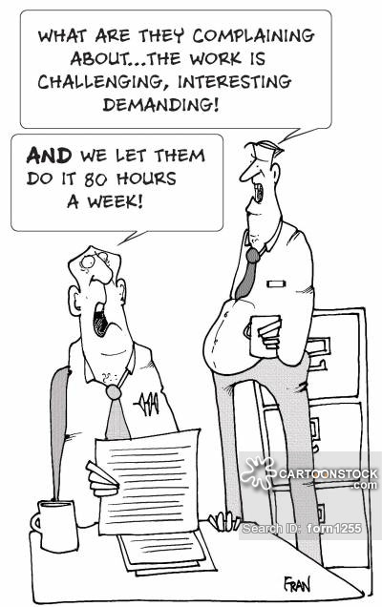
Interaction with Staff
Make time to explain the ombudsman role.
Call staff by their name.
Let them know it is your job to bring resident concerns to their attention.
Focus on resident needs.
Avoid correcting a direct care worker; speak to their supervisor or if a systemic issue, ask to provide in-service training.
Remain courteous, even if staff is rude.

Slide 19
Praise! Praise! Praise!
MOST IMPORTANTLY: Take every opportunity to praise work well done -- directly to staff! Acknowledge how difficult their job is and praise them for their compassion, gentle care, passion, efforts or attentiveness!
Report “Good Works” to Administrators!
Let the worker know you are reporting his/her superior work efforts; so... find out the worker’s name
Report to superiors when residents’ praise the effort of particular staff. Ask the resident if she minds you sharing their praise
Commend the administrator for successfully leading staff to strive for excellence in caring for residents

Slide 20
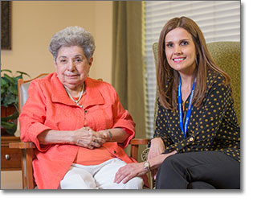
Building Relationships
with the Residents

Slide 21
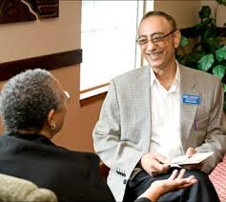
Introductions
Introduce yourself to every resident and family member.
Explain your role as ombudsman – you are there to:
Help solve concerns or problems.
Advocate for residents rights and promote quality care.
Listen, provide information and speak on the resident’s behalf, if needed.
Specifically: Bring resident and family member concerns/complaints (with permission) to the staff’s attention, and to seek resolution; and
Attend care plan meetings and resident/family council meetings, when invited.

Slide 22
Do’s and Don’ts
Do spend time with residents to establish a level of trust.
Do relay to residents their rights and available services.
Do report to residents, the status of their complaints.
Do validate resident’s concerns.
Do support resident’s decisions—even if they are “bad” decisions.
Don’t enter a room without knocking.
Don’t engage in a power struggle or dispute.
Don’t appear Pro-Facility.
Don’t break confidentiality.
Don’t forget that your professional role is not “friendship.”

Slide 23
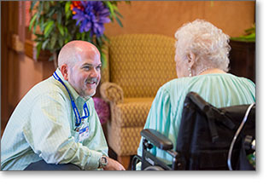
Remind Residents that…
You will check on them often to see if they have any concerns that need attention.
You keep all conversations confidential.
They have the right to contact you, their ombudsman, and to ask staff for help to call.
They can contact you by calling the telephone number on the poster located in the facility, or give them a calling card.

Slide 24
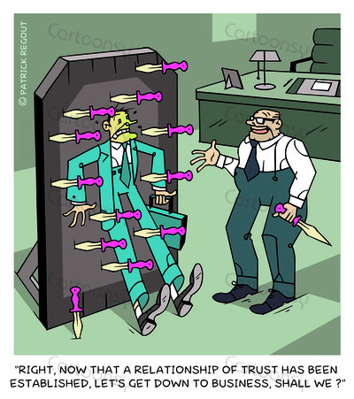
Let’s Practice…

Slide 25
Situation #1
You have received an involuntary discharge where the resident was sent to the hospital and now the facility refuses to take the resident back.

Slide 26
Situation #2
A family member calls you and says that the facility is abusing their father. They tell you that their father has dementia and has limited use of his arms. When you get to the facility you find that the resident’s room has a foul smell and that the resident is soaking wet with urine. The food tray from breakfast is sitting on the table untouched, and it is almost 1130. You try to speak with the resident but he does not engage with you.

