Slide 1
INITIAL CERTIFICATION TRAINING CURRICULUM FOR LONG-TERM CARE OMBUDSMAN PROGRAMS
Module 2: The Resident and the Resident Experience
January 2025
Notes:
Trainer’s Note: Before conducting this training, make sure you have read the Trainer’s Guide and are very familiar with the materials. Go over the Trainer’s Tips. Prior to conducting this training, you must add the state-specific information required for this session. You can find the required information in your Trainer’s Guide.
Trainer’s Notes are Italicized within the notes. Trainer’s Notes will help you move through the material as intended. The text that is not Italicized is information that you should go over with the trainees. Do not read to them, but make sure you deliver the information in a way that the trainees understand.

Slide 2
Welcome and Introduction
Section 1
Notes:
Trainer’s Note: Allow at least 15 minutes for Section 1

Slide 3

Welcome
Your name
Where are you from
One thing you learned from Module 1
What you hope to learn since the last module
Notes:
Trainer’s Note: Begin the session by welcoming the trainees and thanking them for their interest in the program. Introduce yourself and ask the trainees to introduce themselves by sharing the information on the slide. After introductions, thank the trainees for their information and explain any housekeeping items that need to be addressed including the time-frame of the training day, breaks, location of bathrooms, refreshments, etc.
When conducting the training virtually, make sure all trainees can respond and engage in class discussions via speaker if and when possible, or at minimum in writing.
Make sure everyone introduces themselves – even if they come late.
If this is the second time the group is meeting, have everyone reintroduce themselves. Ask them to name one thing they learned from Module 1 – something that really stuck with them or surprised them.

Slide 4

Notes:
Trainer’s Note: If this is the first-time meeting, ask if there are any questions at this point; or, if this is the second time meeting, ask if any questions have come up for them after the last session.
If everyone has gone through Module 1, ask them what they learned about in Module 1
Responses may include:
Training requirements
History of the LTCOP
Laws pertaining to the LTCOP
Program structure
Roles and responsibilities of both the State Ombudsman and representatives of the Office
Program advocacy

Slide 5
Today’s Agenda
Section 1: Welcome and Introduction (15 minutes)
Section 2: Resident Demographics (45 minutes)
Section 3: The Resident Experience (45 minutes)
-------------Scheduled break-------------
Section 4: Common Health Experiences (60 minutes)
Section 5: Conclusion (15 minutes)
Notes:
Trainer’s Note: Go over the agenda with the trainees and refer them to the table of contents on Page 2 in their manual.
The timeframes for each section are approximate. Allow at least 3.25 hours for this session.

Slide 6
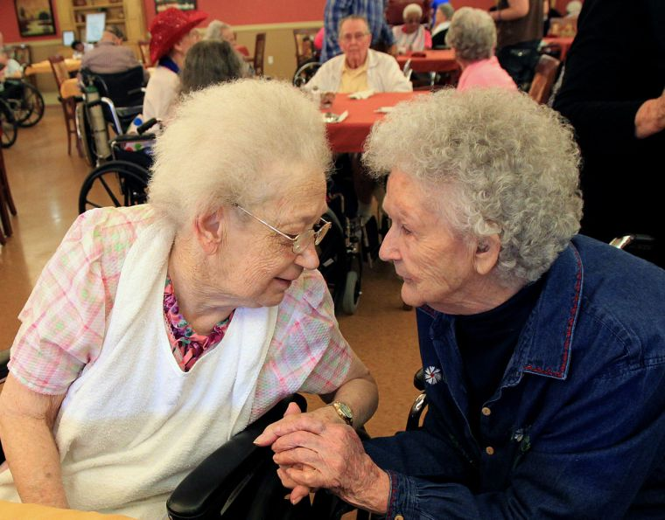
Module 2 Learning Objectives
Who lives in long-term care facilities
Why people enter long-term care
Why people stay in long-term care
The impact of loss when residents enter long-term care
Common diagnoses, the effects on residents, and the importance to the LTCOP
Common health concerns in long-term care
Notes:
Trainer’s Note: Go over the Module 2 learning objectives saying “by the end of this Module you will be able to understand”: (review the bullet points)
Be mindful of the sensitive topics discussed in this Module. The discussion could trigger unexpected emotions from the trainees due to a personal experience. Sometimes when this happens people either shut down or overshare. Pay close attention to the trainees and if you notice someone having a hard time, either take a break or arrange to talk with them after the session or both. If someone begins to overshare and their experiences start to take over the discussion, politely and respectfully express the need to move on with the material and offer them time to speak with you privately after the training. Review the learning objectives with the trainees.

Slide 7
Who lives in Long-Term Care Settings and Why?
Section 2
Notes:
Trainer’s Note: Allow approximately 1 hour to cover Section 2.

Slide 8
If you’re a caregiver, you don’t just insert a hearing aid for a hearing-deprived resident, you don’t just give a shower to a manually disabled resident, you don’t just wipe a totally dependent resident. In short, you do more than assist a resident with performing the Activities of Daily Living: You become the human bridge that carries a trace of dignity to the helpless; that empathizes with their inability and uncertainty. - David
Notes:
Trainer’s Note: Explain that there are resident quotes throughout this Module. The quotes are from actual residents, but the names are fictitious. Read the quote on the slide from David and move to the next slide.

Slide 9

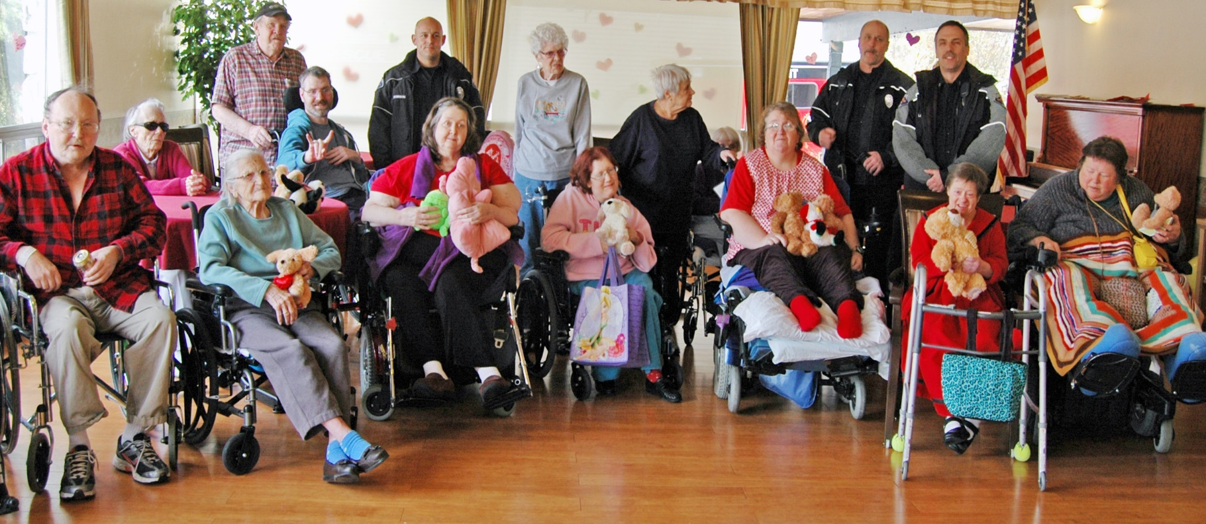
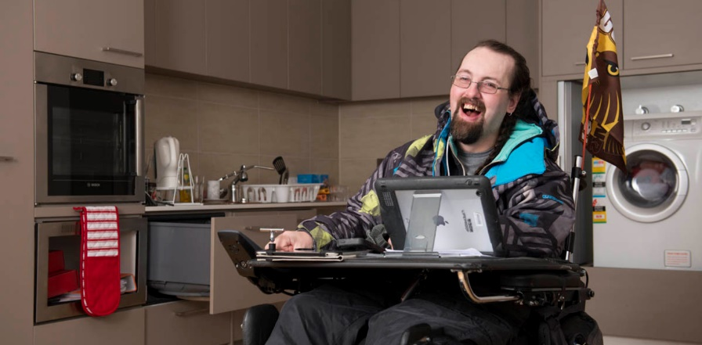
Who Lives in Nursing Facilities and Why?
This Photo by Unknown Author is licensed under CC BY
This Photo by Unknown Author is licensed under CC BY-ND
Notes:
When many people think about residents, they imagine older individuals with a variety of ailments associated with aging, who are bedridden or immobile. Sometimes lost is the realization that residents vary in the same respect as individuals who live in the community. Residents have a variety of backgrounds, life experiences, and roles, such as: mother, father, friend, sibling, son, daughter, teacher, nurse, doctor, engineer, coach, farmer, and social worker. The list goes on and on. Some residents had a hard life, some were abused as a child or an adult. Some residents are veterans, some have seen combat, some are Holocaust survivors, and some marched for civil rights and/or made great contributions to their communities. Each one of us can be found in the face of a resident.

Slide 10
LTC Informational Series Video 9 - Diversity in Long-Term Care Facilities

Slide 11
Myth/Stereotype | Reality
Residents are not connected to what is going on around them. | Residents are interested in meaningful relationships.
Residents are child-like and should be treated as such. | Residents are adults and should be treated with dignity and respect.
Notes:
Trainer’s Note: Allow 10-15 minutes use the chart on the next two slides to explain common myths and stereotypes about people who live in long-term care facilities. Draw from your experiences– but you don’t need an example for each myth/stereotype or reality. Examples are provided here in the notes section if needed.
There are some common myths and stereotypes about older adults and persons living with disabilities in long-term care facilities. In reality, residents are not much different from those living in the community at-large. Residents have desires, abilities, and the need to have a sense of purpose. Residents are from all walks of life, are young and old, with or without disabilities. Just as with other populations, it is damaging to stereotype people who live in long-term care facilities.
Myth - Residents are not connected to what is going on around them. Residents lose interest in life and become more introspective and withdrawn.
Reality - Residents are interested in meaningful relationships. People important to the resident may have died or disengaged from the resident, but that does not mean the resident isn’t interested in connecting with others. Sometimes residents may appear disengaged and that could be due to difficulty hearing, seeing, remembering, or to the side-effects of medications.
EXAMPLE - Ken always appears disinterested in what is going on around him and does not talk to the other residents. During a doctor’s appointment, the doctor finds a great deal of wax build-up in Ken’s ears and cleans them out. Since his appointment, Ken is much more social with the other residents.
Myth - Residents are child-like and should be treated as such.
Reality - Residents are adults and should be treated with dignity and respect.
EXAMPLE - Howard is a former engineer and says he does not appreciate how staff call him “honey” and “sweetie,” or tell him when to go to bed. He says he is not a child and does not want to be treated in that manner.

Slide 12
Myth/Stereotype | Reality
Residents are dependent and want someone to take care of all their needs. People with disabilities always need help. | Most residents maintain abilities and want to care for themselves as much as possible.
Older people don’t participate in sexual activity. Most people with disabilities cannot have sexual relationships. | Need for sexual expression and intimacy continues throughout life. Anyone can have a sexual relationship by adapting sexual activity. Sexuality is a basic human need and the choice to participate in sexual acts belongs to the resident.
Notes:
Myth - Residents are dependent and want someone to take care of all their needs. People with disabilities always need help.
Reality - Most residents maintain abilities and want to care for themselves as much as possible. Most residents do not want to be totally dependent on others to meet their needs. In fact, many residents are not fully dependent and want to be as independent as possible.
EXAMPLE – Many residents do not like having to depend on others. Often, residents help each other and will alert staff if their roommate needs assistance. Jan would always look out for her roommate, Ethel, who could not communicate. Jan learned from the look on Ethel’s face if she needed help and would get someone to help her.
There is a book written by Wendy Lustbader, MSW called “Counting on Kindness – The Dilemmas of Dependency.” The book describes what it feels like to be dependent on others. The stories are from a patient’s point of view.
Myth - Older people don’t participate in sexual activity. Most people with disabilities cannot have sexual relationships.
Reality - Sexual desire and the need for intimacy continue throughout life. Anyone can have a sexual relationship by adapting sexual activity. Sexuality is a basic human need and the choice to participate in sexual acts belongs to the resident.
EXAMPLE –
Two residents, Mae and George, become quite close and want to be alone with the door shut. Mae's daughter is extremely upset and vocal that it is outside of her mother’s character to be alone with a man other than Mae’s deceased husband. The daughter believes George is taking advantage of Mae. Mae is uncomfortable that her relationship with George has become a problem for her daughter and does not want to discuss it with her. Mae talks to the social service director and the representative and states she wants to spend alone time with George. Mae states she likes their intimate relationship.

Slide 13
Myth/Stereotype | Reality
Younger people do not reside in long-term care facilities. | There are younger residents who live in long-term care facilities.
People with mental illnesses are not admitted into nursing facilities. | There are residents who live in long-term care facilities with a range of mental illness diagnoses.
Old people are unproductive and set in their ways. They have already made their contribution to society. | The need to feel a sense of purpose in life does not change once one becomes a resident.
Notes:
Myth - Younger people do not live in nursing facilities or other long-term care facilities.
Reality - There are younger residents who live in nursing facilities. In fact, nearly 17% of nursing facility residents are under 65 years old. A common misconception is that younger residents do not reside in long-term care facilities and if they do, it must be a result of an accident. While that may be the case with some residents, most younger residents in long-term care facilities reside there due to a chronic illness and/or mental illness. During this training you will learn about community options and services to help people live in the least restrictive setting possible.
EXAMPLE – Jimmy is 36 years old and lives in a residential care community (RCC) because he is unable to manage his medications prescribed for his mental illness. He needs medication reminders and structure to support his mental health.
Myth - Old people are unproductive and set in their ways. They have already made their contribution to society.
Reality - The need to feel a sense of purpose in life does not change once one becomes a resident. Residents need to have a reason to wake up in the morning and to feel useful and important. Growing older does not mean one no longer wants to learn.
While declining health and disabilities can restrict a resident from doing what used to give them a sense of purpose, it does not mean that new activities cannot foster the same feelings of purpose. An excellent example can be found in an Arizona assisted living for memory care. The facility partnered with a local animal shelter and residents were provided with the opportunity to feed and play with kittens who are in constant need of care. The residents felt a sense of purpose in taking care of the kittens. Residents who struggled to communicate verbally prior to the program suddenly began to talk.
EXAMPLE - Trainer’s Note: Click on the hyperlink on the slide to show the trainees a short video clip about the kitten project.
Trainer’s note: After watching the short clip, ask the trainees:
What are your thoughts about the video?
Did your perceptions about the importance of feeling a sense of purpose change after watching the video?

Slide 14

Watch Adorable Kittens and Seniors Come Together and Help Each Other
Notes:
Trainer’s Note: Click on the hyperlink on the slide to show the trainees a short video clip about the kitten project.
Trainer’s note: After watching the short clip, ask the trainees:
What are your thoughts about the video?
Did your perceptions about the importance of feeling a sense of purpose change after watching the video?

Slide 15

This Photo by Unknown Author is licensed under CC BY-NC-ND
Notes:
Trainer’s Note: Ask the following question: “Why is it important to talk about assumptions made about individuals living in long-term care?”
Responses should include: to check our preconceived notions; to gain a clear understanding about the people we will be assisting; to understand others’ stereotypes.

Slide 16
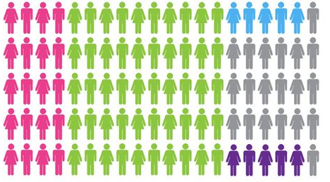
Resident Demographics
This Photo by Unknown Author is licensed under CC BY-SA
Notes:
Trainer’s Note: Allow 10 minutes to go over demographics. Share information about resident demographics for your state’s nursing facilities and residential care communities.
While understanding demographics is important, it is also important to understand that residents aren’t just statistics.
The demographics of long-term care residents have changed over the years. While most residents are white females 85 years and older, it is not unusual for the LTCOP to work with residents who are under 65 years old, or from various cultures, backgrounds, and experiences. With the development of assisted living facilities and other state-licensed homes, the number of residents has increased in RCCs, but has decreased in nursing facilities.
The largest age group living in long-term care at this time is people age 85 years old and over, followed by people who are between the ages of 75 and 84 years old. Individuals who have achieved these ages are likely experiencing some of the physical and psychological aspects of aging. Residents who are 64 years old and younger are increasing in numbers and have been the fastest growing population in long-term care.
While most nursing facilities have this generational overlap of residents, the interests of the younger residents in terms of music, activities, and culture are often quite different than those of the older residents. Facilities may need to expand their activities calendars, rethink their menus, and offer activities that interest younger individuals.
Not all long-term care facilities are nursing facilities. Module 3 provides detailed information about nursing facilities and the different types of residential care communities (RCCs). RCCs vary from state to state. Not all facilities provide the same level of supports and services and some may specialize in certain areas (e.g., memory care). Entrance is determined through a series of assessments and evaluations (discussed in Module 3).

Slide 17
→ Types of Residential Care Communities
Notes:
→ Add state-specific information for residential care communities:
Types of residential care communities.
b. Any specific requirements for providing services such as dementia care, mental health specialty services, developmental disability services, etc.
Trainer’s Note: You don’t need to go into detail – this information will be included in Module 3.

Slide 18
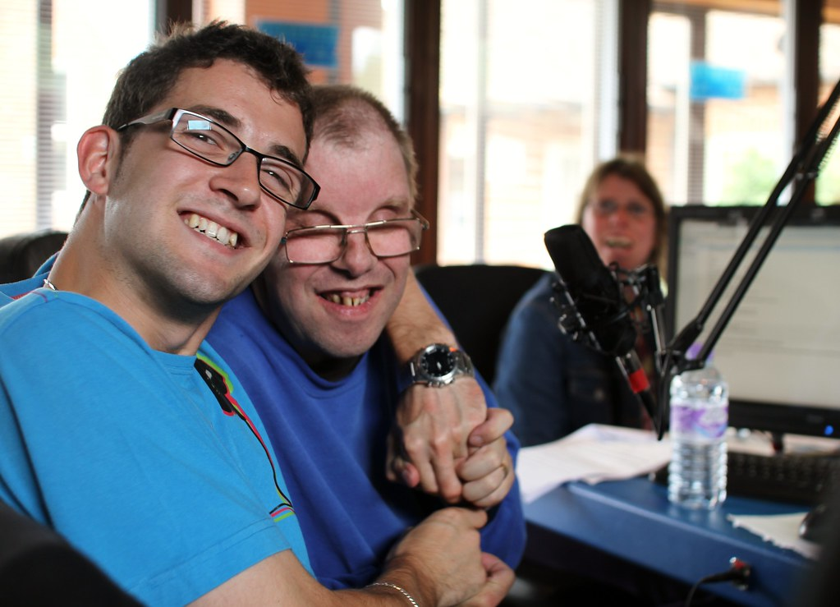
Intellectual and Developmental Disabilities
Problems with:
  Learning
  Problem solving
  Judgment
  Communication
  Independent living skills
This Photo by Unknown Author is licensed under CC BY
Notes:
Trainer’s Note: Allow 5 minutes to discuss individuals with intellectual and developmental disabilities receiving long-term services and supports.
An intellectual disability involves problems with learning, problem solving, judgement as well as communication and independent living skills. According to the Centers for Disease Control (CDC), developmental disabilities are a group of conditions due to an impairment in physical, learning, language or behavior areas. These conditions begin during childhood.

Slide 19
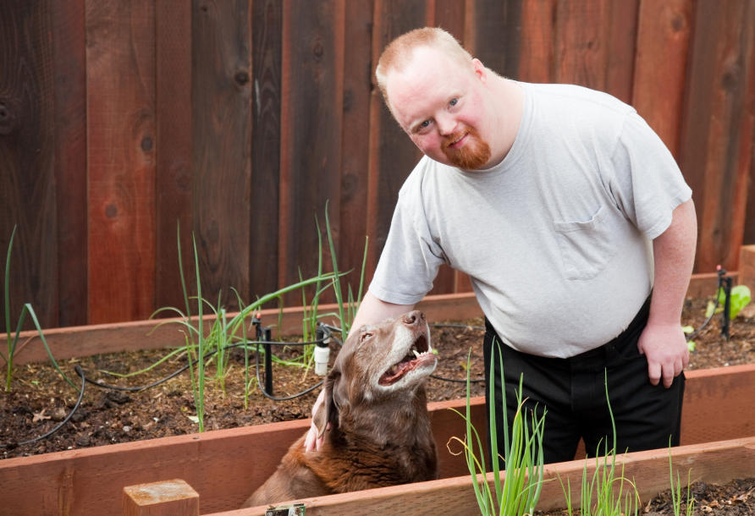
→ Where do persons with disabilities live?
With their families in the community
Group homes
Intermediate Care Facilities for the Intellectually Disabled (ICF/IID)
Residential care communities (RCCs)
Nursing facilities
This Photo by Unknown Author is licensed under CC BY-ND
Notes:
→ Review state-specific information about individuals with intellectual and developmental disabilities and where individuals with such disabilities live (e.g., in the community, Intermediate Care Facilities for Individuals with Intellectual Disabilities [ICF/IID], group homes, and personal care homes).
People with developmental disabilities (DD) may have difficulties with things such as speaking, learning, caring for themselves, moving around, making decisions, living independently, and making and managing money. Their difficulties start before age 22. They continue throughout life and are severe enough that the person needs ongoing supports.
Intellectual disability (ID) begins before age 22. People with ID have trouble learning and solving problems. They also have difficulties with practical skills such as dressing or shopping, social skills such as making and keeping friends and keeping others from hurting them, and with skills such as reading and doing math.
In the United States, about 2.3% of the people have ID/DD. About 7 in 100 children have ID/DD. Some children no longer have significant disabilities by the time they are adults. Fewer than 1 in 100 adults have ID/DD.
Not all Ombudsman programs visit facilities such as Intermediate Care Facilities for Individuals with Intellectual Disabilities (ICF/IID). However, the Ombudsman program assists residents in nursing facilities and residential care communities who may have intellectual or developmental disabilities.
The number of people with ID/DD who receive paid support and do not live with a family member more than doubled between 1987 and 2017. By 2017, most people with ID/DD not living with a family member lived in homes shared by six or fewer people with ID/DD. Not in slides.
Trainer’s Note: Share an example of your program’s experience working with this population and talk about programs and services that support community living rather than institutional care.

Slide 20

Events and Situations
A sudden medical event
The progression of dementia
The progression of a chronic or terminal illness
Notes:
Trainer’s Note: Allow 15 minutes to discuss events and situations. The other 10% not listed in the statistics below are residents who come from psychiatric hospitals, inpatient rehabilitation facilities, LTC hospitals, hospice, etc.
Events and Situations that Lead to the Need for Long-Term Care
Nearly 80% of residents come from an acute care hospital and require some short-term skilled care such as physical therapy, wound care, or IV medication. Only 9.4% of residents enter a nursing facility from the community. There are several reasons individuals enter a nursing facility or a residential care community. Situations that lead to a person living in a nursing facility or a residential care community include but are not limited to: (go over bullet points)

Slide 21



Medical Event Examples
Accidents
Strokes
Falls
Notes:
Sometimes a medical event prompts consideration of a long-term care facility. In some cases, a medical event can lead to an individual suddenly and unexpectedly needing long-term care. Even when the harm is low from a medical event, having that experience may cause a person to become fearful of living alone and that fear may be the driving factor to enter a long-term care facility.
Examples of medical events include accidents, strokes, and falls.
Accidents can lead to paralysis, brain injury, fractures, chronic pain, and more. Some accidents are a result of the progression of dementia (e.g., the individual leaves the stove on and a fire starts).
Strokes are another example of a medical event that could lead to long-term care. Strokes can cause memory loss, paralysis, and/or an inability to verbally communicate.
Falls can also be a signal for individuals and family members that the individual’s health is declining, and more assistance is needed. Falls can cause fractures, brain bleeds, paralysis, traumatic brain injury, internal bleeding, pain, and more.

Slide 22
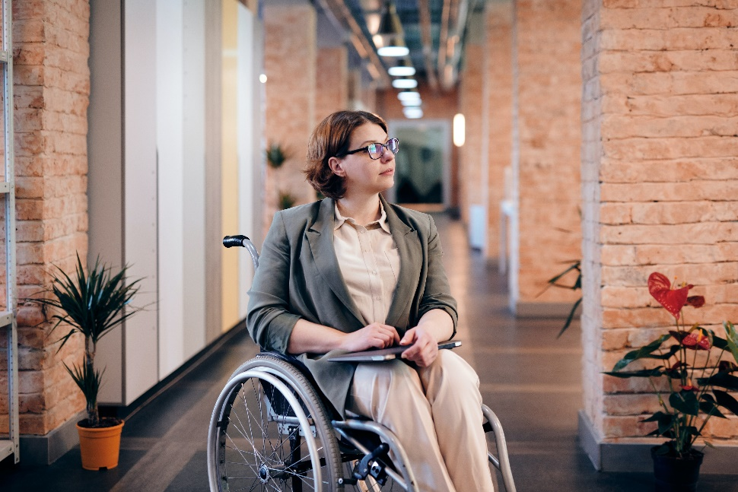
Alison Parker
I am 45 years old and was in a car accident and almost died. I woke up from a coma 2 months later in the hospital and was told I have a traumatic brain injury. I was discharged from the hospital to the nursing facility for physical and speech therapies. I still struggle with my memory and speech and my right side is also affected from the brain injury; but I am working on getting stronger. I rely on others to help me with my activities of daily living, but I’m getting better. I can brush my teeth and feed myself, but I need someone to set everything up for me. I cannot completely wash myself or get dressed on my own. I am working with the facility to help me find a place to live in the community.
Notes:
This is an example of someone who suddenly and unexpectedly found herself in need of long-term care due to devastating injuries from an accident.

Slide 23

Alzheimer's Disease or other Dementias
Memory loss
Disorientation
Confusion
Delusions or hallucinations
Behavior changes
Difficulty eating or swallowing
Difficulty speaking
Weight loss
Wandering
Incontinence
Notes:
The progression of Alzheimer’s disease or other dementias is very overwhelming for individuals and caregivers and often leads to consideration of long-term care. Alzheimer’s disease and other dementias can cause: (Go over the bullet points)
Trainer’s Note: Ask the trainees: “Would anyone like to share their experience of knowing someone who has or had Alzheimer’s disease or dementia?” You do not need to spend a lot of time sharing experiences as the point of this exercise is to engage trainees and help them connect to the material discussed.

Slide 24

Bernie Ford
My father lived at home with his wife until she passed away. After she died, it became clear that his dementia was much worse than I had thought. His wife did everything for him and tried not to worry me with the worsening symptoms of Alzheimer’s. My father moved in with me and after 6 months, I knew I was in over my head. He began wandering in the middle of the night and a couple of times was brought back to my home by the neighbors. At times he would hallucinate and become combative due to fear and confusion. I knew I could no longer manage his care. I found an assisted living facility for him that specializes in memory care.
Notes:
This is an example of a family member’s experience with trying to care for her father at home. Although supports and services may be in place, the progression may become more than caregivers can manage at home.

Slide 25

Chronic or Terminal Illnesses
Cancer
Congestive heart failure
Liver disease
Diabetes
COPD (chronic obstructive pulmonary disease)
ALS (Lou Gehrig’s disease)
MS (multiple sclerosis)
Renal failure
Others
Notes:
The progression of chronic or terminal illnesses can cause symptoms that are unable to be managed without long-term supports and services. Some of these illnesses can lead to severe pain, fatigue, extreme weight loss, and muscle wasting.
Trainer’s Note: ALS stands for: amyotrophic lateral sclerosis

Slide 26

Carolyn Dunn
I moved into the nursing facility because I have COPD and struggle with breathing. One afternoon, I had a terrible coughing episode and passed out in my home. As luck would have it, my son happened to stop by and found me laying on the floor. I went to the hospital and was told my lungs are damaged. I need help and I’m too scared to live alone so I decided to move to a nursing facility. My doctor agreed with my decision, and I know my son feels better now that I’m not alone.
Notes:
Here is an example of an individual with a serious, chronic condition who had a medical event that caused her to reevaluate her current living situation. Recognizing she needed assistance coupled with her fear of living alone aided her decision to go to a nursing home.

Slide 27
Why do People Stay in Long-Term Care?
Nursing facilities:
  The resident’s health did not improve enough to go home
  The resident does not have available supports and services in order to successfully live home alone
  The resident does not have a home to go to
RCCs
  Their needs are being met
  Socialization
  Fills the gap between living independently and living in a nursing home
Notes:
Many, but not all, residents who receive skilled care stay for a short time and are able to return to their home after they have improved. Others may choose to go to a residential care community (RCC) rather than return home. Those who are unable to do either continue to stay in the nursing facility.
Some reasons individuals do not return home include:
The resident’s health declined or did not improve enough to go home, even with home care services.
The resident does not have available supports and services to successfully live at home alone.
The resident has a need for care services and does not have a home to return to. For example, the resident:
Lost their home because of financial hardship
Had to give up their apartment to pay for their nursing care
Was homeless prior to entering the facility
This will be discussed more in Module 4, but even when a resident encounters barriers to returning to their home or a community setting it does not mean they have no other options. Nursing facilities are required to ask all residents if they would like to receive information on how to return to a community setting and, if so, connect the resident to resources that can help them transition out of a nursing facility.
Depending on the state licensure and type of care provided in residential care communities, residents in RCCs may be more independent and physically healthier than those living in a nursing facility. Their reasons for living in an RCC vary and may be different than for those living in a nursing facility.
Some reasons include:
Feelings of loneliness and isolation
The RCC meets the specific needs of the resident
The RCC fills the gap between living independently and living in a nursing facility
The state has increased opportunities for Medicaid to pay for services provided in RCCs through Home and Community-Based Services (HCBS) waiver programs (discussed more in Module 4)

Slide 28
The Resident Experience
Section 3
Notes:
TAKE A BREAK BEFORE SECTION 3
Trainer’s Note: Allow at least 45 minutes for Section 3.
This is a very heavy section, especially the part on grief and loss. Make the next activity about routines and activities as light as possible without taking away from the teaching points. Pay attention to the participants’ reactions during this section and take another break if necessary. You may need to check on some attendees privately to make sure they are doing okay.

Slide 29
Quality is about meaningful interactions and relationships. There is an extraordinary aide, Jan, who worked overnight and regularly came in to awaken me at about 6:15 a.m. She started the one cup coffee maker, reset the thermostat in the room, and smiled as she left the room telling me, “Have a good day.” It is the little things in life that matter – meaningful interactions and relationships. - Terry

Slide 30






This Photo by Unknown Author is licensed under CC BY
Routines and Activities
This Photo by Unknown Author is licensed under CC BY-SA
Notes:
Trainer’s Note: Allow 15 minutes for this activity. The time frame will depend on your class size.
Begin with an activity designed to allow trainees to think about the experience of moving into a long-term care facility. This activity asks them about their own personal routines and daily activities and what they would not want to give up if they had to move to a nursing facility tomorrow.
Step 1 - Tell the trainees to write down their daily routines and activities and give them a few minutes to do so.
Step 2 - Tell the trainees they are going to live in a nursing facility tomorrow, and they must cross off all but one daily routine or activity. That is the routine or activity they get to keep while living in the nursing facility.
If conducting the session virtually, consider the number of trainees and the ability of the trainees to provide verbal responses. If they are unable to respond verbally, they can enter them into the virtual platform (e.g., via a chat box).
Step 3 - Start with your own example then ask each trainee to tell the group which activity they have chosen.
You may choose to keep a running visual list or not.
Once all trainees have answered the first question go to the next slide to continue the activity.

Slide 31
Look at all your daily routines and activities again, and the people involved and consider:
Why are your routines important to you?
Should you have to give up your daily routines?
If you had to modify your routines, what would make the transition easier?
Notes:
Trainer’s Note: Ask the three bulleted questions to the entire class and acknowledge/process their responses. Not everyone needs to respond. Go to the next slide to continue with the activity.

Slide 32


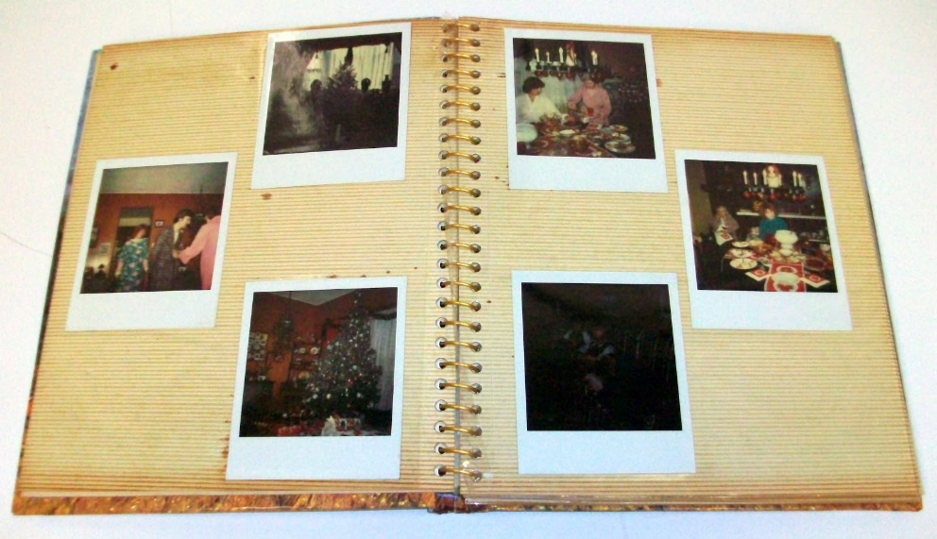


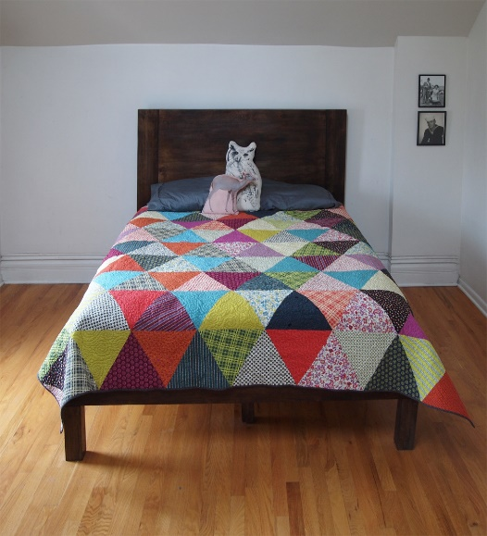
Personal Items
This Photo by Unknown Author is licensed under CC BY-SA
This Photo by Unknown Author is licensed under CC BY-NC
Notes:
Step 5 - Then ask the trainees to picture the personal possessions in their home that are most important to them and ask them to start writing them down. Allow a few minutes to do so.
Step 6 - Tell the trainees to cross off all but three items and those are the possessions they can take with them to the nursing facility.
Step 7 - Again, start with your example then allow for all trainees to share their choices. Once all the trainees have answered the second question go to the next slide to continue the activity.

Slide 33
Picture your personal possessions and consider:
Why are your possessions so important to you?
Should you have to give up all but three of them?
What would help ease you into your new surroundings without your familiar and beloved possessions?
Notes:
Trainer’s Note: Ask the class the second set of three bulleted questions and acknowledge/process their responses. Not everyone needs to respond.
Trainer’s Note: After those that want to respond do, ask “What did it feel like to have to choose only a few of your items and one routine?”
As you work your way through the material in this Module, use the examples given by the trainees to point out the uniqueness of the individuals and the importance our preferences play in the overall quality of life.
Explain to the trainees that the activity was intended to give you an idea of how life-altering moving into a long-term care facility can feel. However, it is important to know that due to federal and/or state requirements long-term care facilities are supposed to provide resident-centered care and honor residents’ rights (e.g., respecting resident choices and preferences for their care and routines). This will be discussed more in Module 3.
Now say: “Consider your thoughts and feelings from the activity. Think about all the changes people make when they move into a long-term care facility and the effect the changes have on them. It’s not surprising that the move into a long-term care facility can be extremely difficult on individuals resulting in heavy feelings of grief and loss.”

Slide 34
Experience of loss
Notes:
Sometimes a discussion of loss and grief can bring up your own personal feelings of past experiences. The training content is not intended to make you feel sad or uncomfortable. However, if something is triggered and you need to step away, please feel free to do so.
Trainer’s Note: If someone does step out, check in with that individual privately, after the session or at the next break.
What do the words loss and grief mean to you?
Trainer’s Note: Give the trainees time to think about and to share what these words mean, even if the room is quiet for a bit. Remind them of the feelings they just expressed during the previous activity. Tell them their reactions are no different than those of people entering long-term care.
Feelings of loss are often associated with life-changing events, such as moving to a nursing facility or other long-term care setting. However, when most people think of loss, they think of death, but death is not the only loss that people need to grieve.
Residents have experienced significant losses in a short period of time which can have damaging effects on their physical and mental wellness.

Slide 35
Experiences of Loss
Loss | New Circumstances | Possible Effects
Health | Coming to terms with managing a new or worsening illness and/or disability | Feeling anxiety, fear, frustration, anger, despair
Home | Removed (voluntarily or involuntarily) from a familiar home or setting to an unknown, unfamiliar place | Having a sense of uneasiness, anxiousness, uncomfortableness, confusion as to whereabouts
Family, Friends, Neighbors | Separated from loved ones with whom you lived or visited often -perhaps the resident’s partner or caregiver passed away. | Feeling sad, lonely, forgotten, isolated, missing loved ones
When you get rid of your house, everything, it is a horrible thing and hard to get adjusted to. They have given me kind words. - Bobby
Notes:
Trainer’s Note: Allow 10 minutes to go over the chart. Go over the Figure 2 chart and connect the “Possible Effects” to the trainees’ responses shared in the activity above. Use the narrative in the trainer’s notes below to guide you through the chart. Give examples from your experience working with residents or use the examples provided in the trainer’s notes featuring a resident named “Jane.”
Let’s take a look at the chart to review some of the major losses people experience when moving into a long-term care facility and the effects it may have on their health and wellness.
Loss of health: Loss of health is often the reason someone enters a long-term care facility. With loss of health, one may struggle with coming to terms with managing a new or worsening illness and/or disability. Loss of health can cause feelings of anxiety, fear, frustration, anger, or despair.
Example: Jane had trouble with her balance while living alone in her apartment. She had a few falls, but the last fall resulted in a broken hip. She is now receiving physical therapy in a nursing facility. She is afraid of being alone and falling again, but at the same time, she is angry at her limited mobility. She has always been very independent and can’t bear to think about not living life as she did prior to breaking her hip.
Loss of home: Every person in a long-term care facility has left their previous home and now may be living in an unknown and unfamiliar setting. Residents can feel a sense of uneasiness, anxiousness, and even confusion about their surroundings. Many may feel uncomfortable in their new home.
Example: Jane has a hard time relaxing in the nursing facility with all the commotion going on in the halls. She doesn’t sleep well because her bed is not as comfortable as her bed at home. When she does fall asleep, she wakes up confused. Jane is at risk of losing her senior housing if she stays in the nursing facility much longer and she has a great deal of anxiety about it.
Loss of family, friends, and neighbors: Most people in long-term care are newly separated from their loved ones. Not just those who lived in the same home, but friends and neighbors as well. Some residents enter a long-term care facility because the person taking care of them passes away. When people lose someone they love, whether through death or separation, it can be devastating and may bring about feelings of sadness, loneliness, isolation, and missing loved ones.
Example: When Jane lived in her apartment, she played cards with four friends from her floor every Tuesday night. Most were single, without a lot of family around, so the five of them became each other’s family. Jane’s friends rely on public transportation and the nursing facility isn’t in a convenient area for them to visit. She misses them terribly.

Slide 36
Experiences of Loss
Loss | New Circumstances | Possible Effects
Freedom | Adjusting to new routines, scheduled activities, and the confines of the facility; understanding a new system with rules and guidelines | Feeling frustrated, angry, hopeless, loss of control over daily life; having no autonomy, feeling like a child again
Privacy | Sharing a room with a stranger, staff walking in and out, people asking personal questions, people washing and dressing you and taking you to the bathroom | Feeling humiliated, embarrassed, loss of dignity, frustration, anger
Personal Property | Loss of personal belongings with special meaning or memories | Feeling disconnected
My greatest loss was not mobility but losing the ability to give and receive affection. - Lee
Notes:
Loss of freedom: Individuals go from making all decisions about their daily life to adjusting to new routines, scheduled and non-scheduled activities, and the confines of living in a facility with new rules and guidelines. No longer living on one’s own can lead individuals to feeling frustrated, angry, hopeless, and/or a loss of control over their daily life. Having no autonomy and being told what to do can make one feel like a child again.
Example: Jane feels very frustrated and angry with her new set daily schedule. She used to sleep in and slowly get out of bed, make her coffee, and have toast with jam. Sometimes she would invite her friends over mid-morning for coffee and cookies. In the evening she liked to eat dinner and watch her shows. At 9:00 p.m. every night, Jane would take a bath, then make herself a bowl of ice cream and eat it in bed while watching the news. Now, staff get her up early to go to physical therapy, then take her to breakfast where she is served too much food. She feels guilty if she doesn’t eat it, but she just wants some toast and coffee and quiet time in her room. Jane only gets showers twice a week at 11:00 a.m. Her roommate’s TV is too loud for Jane to watch her evening shows and since her roommate was there first, Jane is uncomfortable asking her to turn her TV down. Jane feels as though her life is now all on the facility’s schedule and feels a complete loss of control over her own life.
Loss of privacy: Most residents share a room with a stranger. All residents deal with staff walking in and out and asking very personal questions. In addition, some residents have strangers washing and dressing them and taking them to the bathroom. These are very intimate acts and can lead to feeling humiliated, embarrassed, frustrated, angry, and even feeling a loss of dignity.
Example: When Jane lived alone, she was used to taking care of herself. She likes her roommate in the nursing facility and enjoys their conversations, but she feels so humiliated and embarrassed when staff assist her in the shower and in the bathroom, especially when the male aides help her. It makes her feel sick to her stomach every time she needs assistance in the bathroom or shower.
Loss of property: Residents can only bring a few personal items when they move in. Often, personal items or possessions make people feel a sense of belonging or may remind them of special memories. Without those items some people feel disconnected from their former life.
Example: Jane has a special clock that was handed down to her from her grandparents. The clock chimes every hour, and the sound always reminds her of her childhood. She misses her clock and the memories it brought to her.
To manage feelings of loss, individuals must grieve those losses. Feelings of grief and loss can cause some residents to respond in a manner which may be perceived as being “difficult.” When a resident experiences multiple, significant losses in a short period of time, it can impact the resident’s ability or desire to: be involved with decisions related to their care; develop new relationships; accept help; eat; and/or sleep.
Representatives are not social workers or therapists and should not act in such a manner. The purpose of understanding grief and loss is to consider whether a specific loss or the grief process is at the core of an issue which helps weigh options in the problem-solving process. This also offers opportunities for you to promote, and advocate for, facility practices that embody resident-centered care, such as choice in daily routines, rather than residents following routines of the staff and facility.

Slide 37
What’s a good day?
When I wake up and I get my cup of caffeinated coffee. I get hot water for caffeinated coffee, I have instant coffee and that makes my day, my caffeinated coffee. I go to breakfast, a lot of people don’t but I’m able to and if there is some activity going on that I especially like, like cards or bingo, or a nice amusement and then if I have a nice supper and then I usually go to bed early, I watch television, Wheel of Fortune, Jeopardy. - Fran
Um, getting up early, which I’ve had a tough time convincing them that that’s what we need. Um, having breakfast in the morning, that’s good. I have time after breakfast to do some physical therapy if I could find someone to help me. Um, which is about always available most of the time. And then it’s sitting outside with some friends, breathing in the good air or going upstairs and watching TV or reading, all those exciting things. Then it’s lunch and then you go back to, going outside, and if you get tired of that, then you go back upstairs to your room, watch TV and read, come down for dinner and when that’s done, you go outside and you go upstairs, you watch TV or read. - Jessica
Notes:
Trainer’s Note: TAKE A BREAK BEFORE SECTION 4 and leave this slide up for the trainees to read on their own.

Slide 38
Common Health Experiences
Section 4
Notes:
Trainer’s Note: Allow approximately 60 minutes to cover Section 4.

Slide 39
I don't ever want to be in a nursing home, I used to say. I fell and broke bones, went to the nursing home, went home, fell again, went back to the nursing home. I need to be in a nursing facility -I want to be in a nursing home. - Betty

Slide 40
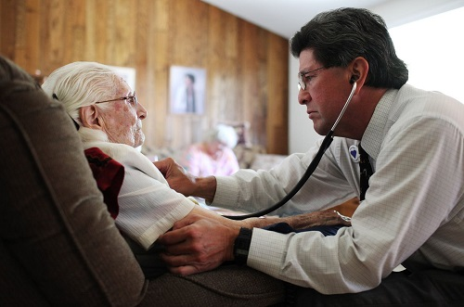
Common Physical Diagnoses and Their Importance to the Ombudsman Program
This Photo by Unknown Author is licensed under CC BY
Notes:
Trainer’s Note: Allow 20 minutes to explain the common diagnoses and their importance to the LTCOP. Data is from the MDS 3.0 Frequency Report during the fourth quarter 2021. (https://www.cms.gov/Research-Statistics-Data-and-Systems/Computer-Data-and-Systems/Minimum-Data-Set-3-0-Public-Reports/Minimum-Data-Set-3-0-Frequency-Report )
Individuals living in long-term care facilities need a variety of supports and services related to their diagnosis or diagnoses. Most people living in long-term care facilities are there not because of the diagnosis, but because they cannot manage their illness or illnesses on their own. Many residents have more than one illness.
Residents who experience chronic illness and/or have a disability have unique needs and ways of living with their condition(s). It is important to see the person, not the disease or disability, and to understand individual needs and preferences in order to provide resident-directed advocacy. In addition to understanding the resident’s individual experiences, needs, and preferences related to their diagnoses and/or disability, it is important to know how they want to be acknowledged. Module 3 will discuss person-first and identity-first language.
According to resident data, some of the most common physical health diagnoses in nursing facilities include hypertension (high blood pressure), hyperlipidemia (high cholesterol), diabetes, heart disease, and arthritis. Although the common physical health diagnosis discussed in this section are based on data from nursing facilities, residents in RCCs often have similar chronic health issues.

Slide 41
Hypertension
Why is this important information for the LTCOP?
  Residents may have concerns related to:
    Medication
    Diet
    Exercise
    Stress
  Residents may want to go against doctor’s orders and ask the LTCOP to advocate on their behalf.
Notes:
Commonly referred to as high blood pressure, hypertension is the most common diagnosis of long-term care residents. High blood pressure can lead to severe health complications, including heart disease, stroke, and even death. High blood pressure can be treated through medication, diet, and exercise as well as stress reduction.
Healthline: Everything You Need to Know About High Blood Pressure (Hypertension) https://www.healthline.com/health/high-blood-pressure-hypertension
High Blood Pressure: Why is this important information for the LTCOP?
Residents may have concerns about their health and whether the facility staff are appropriately providing the medication, diet, exercise, and stress reduction necessary for them to remain as heathy as possible. On the other hand, residents may wish to go against doctor’s orders and ask you to advocate on their behalf to eat whatever they want, to decline their medication, or to not engage in physical activity.
We’ve talked about the role of the LTCOP and taking resident direction, but not focusing on best interest. At times, by following resident direction the LTCOP may advocate for something we think is not best for the resident.
If a resident wants to go against doctor's orders, how would you start that conversation with the nurse?
Trainer’s Note: Start with obtaining permission from the resident to talk to the nurse. Ask the resident if they are comfortable talking with the nurse while you are there and encourage the resident to explain why they want to go against doctor’s orders. If the resident does not want to talk to the nurse with you, relay the resident’s concerns and desired outcomes in their own words. For example, say, “the resident told me the medicine makes him too groggy, and he barely remembers visits with his family.” As opposed to saying, “the resident wants to stop taking his medication.”

Slide 42
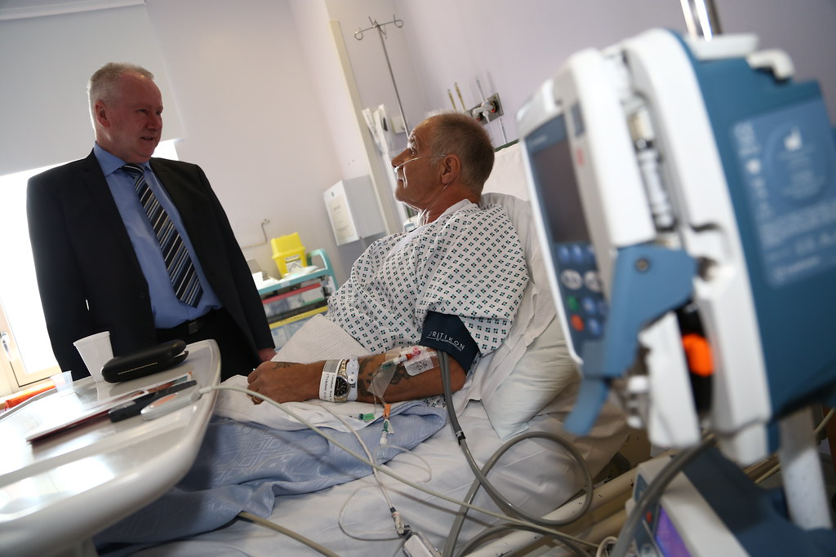
Heart Disease & High Cholesterol
Why is this important information for the LTCOP?
  Residents may have concerns such as:
    Fear
    Anxiety
    Medication distribution
    Diet
This Photo by Unknown Author is licensed under CC BY-NC
Notes:
Heart disease describes a range of conditions affecting the heart that involve narrowing or blocking of blood vessels. Such conditions can lead to heart attack or stroke. Other heart conditions affecting the heart’s muscle, valves, or rhythm are also considered to be forms of heart disease. Heart disease and high cholesterol are significant diagnoses in long-term care residents. Both can be treated through diet, exercise, a healthy lifestyle, and medication.
Often heart disease is viewed only as a physical condition. However, according to the National Institutes of Mental Health, up to 65% of people with heart disease and a history of heart attack experience various forms of depression
Heart disease & high cholesterol: Why is this important information for the LTCOP?
Some residents with a history of heart attack have expressed fear and anxiety. For example, residents may worry they could have a heart attack, and no one will come in time. The LTCOP may advocate for residents to keep their nitroglycerin tablets in their room.
Trainer’s Note: If the question is asked, yes, a resident may be allowed to keep medication in their room if they are able to manage it, but don’t go into details about that issue. It can be addressed during the care plan module. Nitroglycerin is a medication that is often prescribed to help stop chest pain.

Slide 43
Diabetes
Type 1 diabetes occurs when the body does not make insulin.
Type 2 diabetes is more common and occurs when the body does not make or use insulin well.
The term “brittle diabetes” may be used to describe uncontrolled diabetes with drastic swings between too high or too low blood sugar.
Notes:
Diabetes is common, and nationally 35.69% of nursing facility residents have diabetes.
Diabetes is a disease in which the body’s blood sugar (glucose) is too high. Insulin is the hormone that helps blood sugar get into cells. When there is not enough insulin, too much glucose stays in the blood, and, over time, too much glucose can lead to serious health problems affecting one’s eyes, kidneys, and nerves.
People with type 1 diabetes take insulin to control their blood sugar.
Type 2 diabetes is treated through diet, exercise, and sometimes medication and/or insulin.
Some people may refer to their “sugars” when talking about diabetes or their sugar levels.

Slide 44
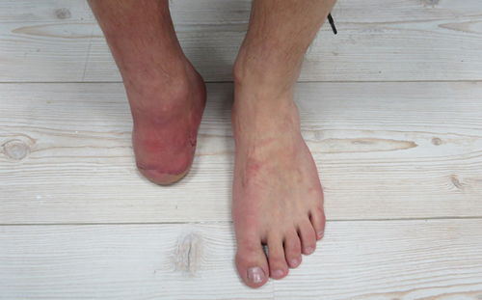
Diabetes
Why is this important information for the LTCOP?
  Residents may have concerns such as:
    Uncontrolled blood sugar levels
    Insulin not being checked per doctor’s order
    A diet served that is not appropriate for people with diabetes
    The facility not allowing the resident’s right to decline dietary restrictions set by the physician or the facility
    Possible amputation
Notes:
The LTCOP often works with residents who have concerns related to the management of their diabetes. Residents often consider not just their health, but their quality of life.

Slide 45
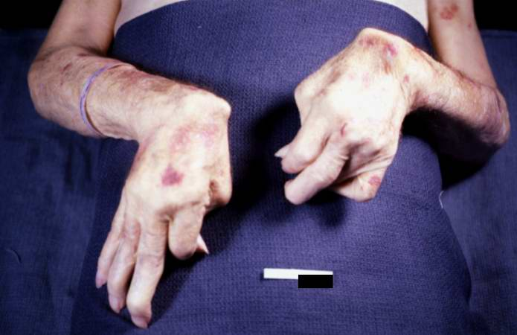
Arthritis
Why is this important information for the LTCOP?
  Residents may have concerns related to:
    Pain
    Quality of life
    Anxiety
    Depression
This Photo by Unknown Author is licensed under CC BY-SA
Notes:
Arthritis is the swelling and tenderness of one’s joints. The main symptoms of arthritis are joint pain and stiffness that can worsen with age. Some residents have severe and painful arthritis that impacts their daily life. Treatments are used to reduce the pain and symptoms and improve quality of life.
Arthritis can be very debilitating, both physically and mentally. The pain and restrictions of arthritis can make it difficult to perform daily tasks. Due to the pain and restrictions related to arthritis some individuals are more susceptible to developing anxiety and depression. Representatives of the Office assist residents who have concerns of pain and quality of life and often advocate for the resident to receive appropriate treatment and care to manage the physical and mental impact of arthritis.
Representatives are not medical experts. While advocating for appropriate treatment and care, representatives should always talk about the concern from the perspective of the resident. For example, instead of saying, “the resident needs more appropriate treatment,” the representative could say “the resident is telling me that her pain medication is not working.”
Trainer’s Note: Instead of giving them the correct answer, you could ask the trainees what they would say to a medical professional instead of saying “the resident needs more appropriate treatment?”

Slide 46
Important:
The Ombudsman program does not serve as a source of medical advice or expertise (even if a representative has such expertise) but serves to represent resident concerns and ensure that the resident has access to medical information and their health care providers.
Notes:
It’s important to remember that the Ombudsman program does not serve as a source of medical advice or expertise (even if a representative has such expertise) but serves to represent resident concerns and ensure that the resident has access to medical information and their health care providers.
While advocating for appropriate treatment and care, talk about the concern from the resident’s perspective. For example, instead of saying, “the resident needs more appropriate treatment,” you could say, “the resident is telling me that her pain medication is not working.”

Slide 47

Cognitive Disorders and Mental Health
Notes:
Trainer’s Note: Allow 20 minutes to explain cognitive disorders, mental health and their importance to the LTCOP.
Cognitive disorders and mental health affect many people.
Some residents have illnesses such as cognitive disorders and mental health disorders. While you can’t see cognitive disorders and mental illness, both can be very debilitating. Some people cannot manage their cognitive disorder or mental health disorder and require the supports and services of long-term care.

Slide 48

Dementia
Decline in memory, reasoning or other thinking skills that interferes with daily life. Affects the ability to:
  Communicate
  Remember
  Reason
  Think
Notes:
Dementia is a general term for a decline in memory, reasoning, or other thinking skills that interferes with daily life. There are many different types of dementia. Over half of residents in nursing facilities have a diagnosis of dementia or Alzheimer’s disease. Dementia is not a normal part of aging.
Dementia is not a single disease. It’s an overall term — like heart disease — that covers a wide range of specific medical conditions, including Alzheimer’s disease. Disorders grouped under the general term “dementia” are caused by abnormal brain changes. These changes trigger a decline in thinking skills, also known as cognitive abilities, severe enough to impair daily life and independent function. They also affect behavior, feelings, and relationships.
Treatment for dementia depends upon the cause of the dementia. There are many conditions that can cause symptoms of dementia and some of those conditions are reversible.
The Ombudsman program works with and takes direction from residents living with dementia to the extent that they can provide direction. Often, others prematurely take charge and make decisions for residents with Alzheimer’s or dementia without the input of the resident. The representative may be the only person who brings the resident’s wishes to the table.

Slide 49
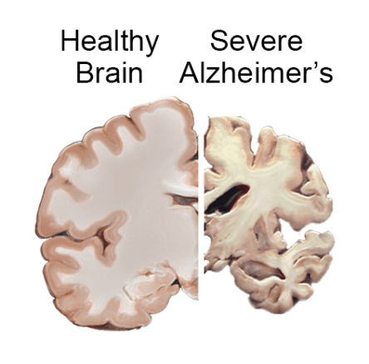
Alzheimer’s Disease
Memory loss
Disorientation
Confusion
Behavior changes
Weight loss
Incontinence
Delusions or hallucinations
Difficulty:
  Speaking
  Eating or swallowing
This Photo by Unknown Author is licensed under CC BY-NC-ND
Notes:
Alzheimer’s disease is the most common cause of dementia, accounting for 60-80% of dementia diagnoses. Alzheimer’s disease is a deteriorating brain disease that is caused by cell damage. It leads to dementia symptoms that gradually worsen over time. The most common early symptom of Alzheimer’s is trouble remembering. As Alzheimer’s advances, symptoms get more severe and could include disorientation, confusion, behavior changes, weight loss, incontinence, delusions, or hallucinations. Eventually, speaking, swallowing, and walking become difficult.
There is no way to prevent, cure, or even slow Alzheimer’s disease. However, there are several treatment options to help manage the symptoms of the disease including medications for memory and treatment for behavior and sleep changes.
The Alzheimer’s Association https://www.alz.org/alzheimers-dementia/difference-between-dementia-and-alzheimer-s

Slide 50
LTC Informational Series Video 7 - Addressing Dementia in Long-Term Care Facilities
Notes:
Trainer’s Note: According to the video, what statements are true about people living with dementia?
The person may not remember who or where they are. TRUE
All individuals living with dementia are alike. FALSE – no two individuals with dementia are alike.
Residents with dementia need advocates. TRUE

Slide 51


Greta
Doris
Greta said she feels scared at night when they turn all the lights off in her room.
Doris complained that someone stole her purse, and she wants help with getting it back.
Notes:
Trainer’s Note: Don’t go into too much detail here with complaint resolution. The point is that you can take direction from each of these residents with these concerns regardless of their memory problem.
Provide your own examples of working with and taking direction from someone with dementia.
Many people have questions about the LTCOP taking direction from someone with Alzheimer’s or dementia. Here are a couple of examples of when the LTCOP took direction from residents who have dementia.
The LTCOP can certainly talk to staff with Greta’s and Doris’ permission in order to resolve their concerns.

Slide 52
Dementia
Why is this information important to the LTCOP?
  Residents may have concerns about:
    Anxiety
    Medication
    Others respecting their rights
    Their care plan
  Facilities and other residents may have concerns about:
    Wandering
    Combativeness
    Anxiety
Notes:
The LTCOP works with and takes direction from residents who have dementia to the extent that they can provide direction. Often, others prematurely take charge and make decisions for residents with Alzheimer’s or dementia without the input of the resident. The representative may be the only person who brings the resident’s wishes to the table.
Representatives may become involved with a resident for whom the facility is having difficulty managing the symptoms of the dementia, such as wandering, combativeness, and anxiety. The key is finding out what the resident’s wishes and preferences are and what resolution looks like to them. The LTCOP can then work with the resident, facility staff, and other members of the resident’s support system to develop a person-directed care plan that includes techniques related to approach, de-escalation and meeting the resident’s needs.
Residents with dementia may have escalated symptoms related to their dementia in response to their environment. They may feel fearful, hurt, confused, or even experience delirium. Behavioral symptoms may be the only way residents are able to communicate their feelings. It is important to remember that behavior is communication.
The key is figuring out the root cause. The LTCOP can work with the resident, facility staff, and other members of the resident’s support system to develop a person-directed care plan to meet the resident’s needs.

Slide 53
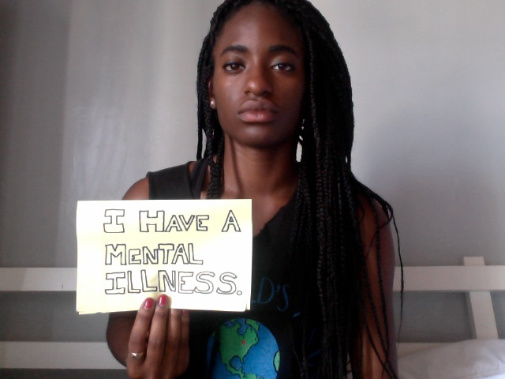
Mental Illness
Notes:
Individuals with mental illness are common not only within the community-at-large, but also in long-term care settings. Mental illnesses vary in degree of severity. As previously mentioned, some residents in long-term care are there because they cannot manage their mental illness.
Serious mental illness is a mental, behavioral, or emotional disorder that significantly interferes with or limits one or more major life activities.

Slide 54
Serious Mental Illness (SMI)
Why is this information important for the LTCOP?
  Working with individuals who have a diagnosis of a serious mental illness may be challenging due to barriers in communication
  Facility staff are often not properly trained
  Residents with SMI are at greater risk for facility-initiated discharge
Notes:
A mental illness that interferes with a person’s life and ability to function is called a serious mental illness (SMI). With the right treatment, people with SMI can live productive and enjoyable lives.
Working with residents who have a diagnosis of a serious mental illness may present a challenge if there are barriers in communication, or if the resident’s concern is not one you can verify or resolve.
Most long-term care staff do not have proper training on SMI. Due to a lack of staff training and the residents’ potential responses, residents with a serious mental illness may be at a greater risk for being discharged from the facility against their wishes.
There are many kinds of serious mental illness. Common types include bipolar disorder, major depressive disorder, and schizophrenia.
Despite common misperceptions, having a serious mental illness is not a choice, a weakness, or a character flaw. It is not something that just “passes” or can be “snapped out of” with willpower. The specific causes are unknown, but various factors can increase someone’s risk for mental illness including, family history, brain chemistry, and significant life events such as experiencing a trauma or death of a loved one.
Trainer’s Note: Discharges are discussed in another module. No need to get into a discussion about discharges at this point in the training.

Slide 55
Bipolar Disorder
Causes dramatic shifts in a person’s:
Mood
Energy
Ability to think clearly
Individuals with this disorder experience extreme high and low moods, known as mania and depression.
Notes:
Bipolar disorder is a brain disorder that causes intense shifts in mood, energy, and activity levels. People have manic episodes in which they feel extremely happy or euphoric, and energized. Usually, they also have depressive episodes in which they feel deeply sad and have low energy.

Slide 56
Major Depressive Disorder (MDD)
One of the most common mental disorders
Symptoms vary, but may include:
  Sadness
  Hopelessness
  Anxiety
  Pessimism
  Irritability
  Worthlessness
  Fatigue
Notes:
Major depressive disorder (MDD) -- one of the most common mental disorders. Symptoms vary from person to person, but may include sadness, hopelessness, anxiety, pessimism, irritability, worthlessness, and fatigue. These symptoms interfere with a person’s ability to work, sleep, eat, and enjoy their life.

Slide 57
Schizophrenia
Interferes with a person’s ability to:
Think clearly
Manage emotions
Make decisions
Relate to others
Maintain touch with reality
Notes:
Two types of serious mental illness common in long-term care are: Schizophrenia and bipolar disorder.
Schizophrenia, as explained by the National Alliance on Mental Illness (NAMI), “interferes with a person’s ability to think clearly, manage emotions, make decisions and relate to others. It also causes people to lose touch with reality, often in the form of hallucinations and delusions.”

Slide 58

Depression
Why is this important information for the LTCOP?
  Residents with depression may not seek assistance from the LTCOP.
  Residents with depression may sleep often or stay in their room.
This Photo by Unknown Author is licensed under CC BY-NC-ND
Notes:
Depression is also called depressive disorder, or clinical depression, and is a mood disorder. Depression is a constant loss of interest or pleasure in normal activities that lasts for at least two weeks and significantly interferes with a person’s daily activities. Unfortunately, over one-half of nursing facility residents are diagnosed with depression. Depression can be treated with medication and various forms of therapy.
Many residents experience a feeling of sadness or grief at one time or another. Clinical depression is more than a feeling of temporary sadness and one cannot simply get better by changing one’s attitude. Residents with a diagnosis of depression may choose not to seek assistance from the LTCOP or may stay in their room or sleep often during LTCOP visits. Such residents may be hard to reach.
It is important to attempt to visit residents who seem withdrawn and tend to stay in their room. It may take multiple visits, but the resident may share their experiences if they believe you are willing to take time to be present with them and listen.
Sometimes just sitting quietly with a resident can be helpful.

Slide 59
Anxiety Disorders
Emotional Symptoms | Physical Symptoms
Feelings of apprehension or dread | Pounding or racing heart and shortness of breath
Feeling tense or jumpy | Sweating, tremors and twitches
Restlessness or irritability | Headaches, fatigue and insomnia
Anticipating the worst and being watchful for signs of danger | Upset stomach, frequent urination or diarrhea
Notes:
People with anxiety disorders experience persistent, excessive fear or worry in situations that are not threatening. There are various types of anxiety disorders, and each has its own specific symptoms and treatments. According to the National Alliance on Mental Health, typical symptoms of anxiety disorder can be broken into two groups - emotional symptoms and physical symptoms (go over chart).

Slide 60

Why is this information important to the LTCO?
  Representatives should be:
    Honest
    Relatable
    Respectful
Notes:
Residents with anxiety disorders often have issues related to trust and may not believe you are able or willing to make a difference. They may be agitated and have a hard time focusing on the issue at hand.
Representatives should be honest, relatable, and respectful to build a trusting relationship.

Slide 61

Other Health Concerns
Falls
Incontinence
Pain
Pressure Ulcers
Notes:
Trainer’s Note: Allow 15 minutes for Other Health Concerns.
Follow the PowerPoint when discussing falls, incontinence, pain, and pressure ulcers. The statistics provided are to give the trainees an idea of the frequency of each concern presented. Make sure you share your experiences with each of these concerns.
There are other health concerns that residents may experience while living in a long-term care facility. Some of those concerns include: (go over bullet points)

Slide 62
Falls
Staff don’t like to have to lift people. - Otis
Common reasons residents fall
  Medical conditions
  Medication side-effects
  Accidents
  Hazards and spills on the floor
While some falls are unavoidable, there are preventive measures facilities can take to lower the likelihood of a fall
Notes:
Falls can have damaging effects on residents from cuts and scrapes, to fractured bones, to brain bleeds, and even death.
Common reasons residents fall include:
Medical conditions (e.g., muscle weakness, dizziness, balance issues)
Medication side-effects (e.g., lightheadedness, groggy)
Accidents while moving residents from one location to another (e.g., dropping residents during a transfer between their wheelchair and the toilet)
Not receiving timely help so the resident attempts to complete the activity on their own (e.g., walk without assistance)
Hazards and spills on the floor
While some falls are unavoidable, there are prevention measures facilities can take to lower the likelihood of a fall, such as:
Conduct fall risk assessments
Train staff on proper transferring techniques and fall prevention techniques
Have adequate staff to meet all resident needs
Ensure equipment used to transfer residents is functioning properly
Ensure there are no environmental hazards that would cause a resident to slip, trip, or fall
Offer exercise programs, physical therapy, stretching, and balancing
Nursing Home Abuse Center retrieved from www.nursinghomeabusecenter.org

Slide 63
Incontinence
Lack of privacy during incontinent care
Residents not changed often enough
Residents being left in their own waste
#1 and #2
Residents not being taken to the bathroom and asked to just go on themselves
Call lights not answered timely which can lead to accidents
Notes:
Trainer’s Note: Share deidentified case examples to show what it is like for residents to be incontinent and have to wait for someone to change and clean them. The slide has quotes from representatives with regard to incontinence.
There’s no easy or comfortable way to talk about going to the bathroom. There are many terms used casually (e.g., going #1 or #2) and more clinical terms (e.g., urinating, defecating, having a bowel movement). “Stool,” “excrement,” and “feces” are other terms used to describe the body’s waste.
Incontinence means the inability to control urination or defecation. Incontinence is a significant concern that impacts more than one-half of nursing facility residents. Problems associated with incontinence are urinary tract infections (UTIs), other infections, risk of pressure ulcers or skin irritation, as well as feelings of embarrassment and humiliation.
Concerns shared with the Ombudsman program about incontinence include:
Residents being left in their own waste
Lack of privacy during incontinence care
Call lights not answered timely which can lead to accidents
Residents’ clothing or bedding not changed often enough
Residents not being taken to the bathroom and told to “go in place/go in their brief”

Slide 64
Pain
Effects
Treatments
Loss of appetite
Loss of interest in activities
Difficulty sleeping
Depression
Stress
Anxiety
Anger
Feeling misunderstood
Aroma therapy
Massage
Music therapy
Heat or cold packs
Over-the-counter medication
Prescription medication
Others
Notes:
Many residents experience pain at one time or another, while some experience chronic pain. With pain comes other factors such as loss of appetite, loss of interest in activities, and difficulty sleeping. Pain assessments should be done on a regular basis and as prescribed in the resident’s care plan. Treatment for pain ranges from non-medical techniques (e.g., aroma therapy, massage, music therapy) to various levels of pain medications (e.g., over-the-counter medication or prescription medication, including the use of opioids).
The National Consumer Voice for Quality Long-Term Care has additional information on opioid use in long-term care.

Slide 65
Pain Concerns Heard by the LTCOP
Residents have reported that they are in so much pain that they have attempted suicide due to their untreated pain. This is very disturbing.
Residents who have used opioid pain medications for years have suddenly been told they can no longer use opioids and must switch to non-opioid pain medications that don't effectively manage their pain.
Another resident reported she has to go through so many hoops just to get relief from her pain. For example, she has to go to the doctor weekly or every two weeks just to get a scrip for her chronic pain.” She is in her 90's.
There have been residents who complain that they don't feel they are getting their pain addressed or getting their pain medicine that helps with their pain.
Notes:
Trainer’s Note: The quotes on this slide came from a questionnaire that NORC, CV, and the National Center on Elder Abuse developed and sent to the LTCOPs for a project titled “The Effects of the Opioid Crisis on Residents: Points of Advocacy.” Read the quotes.
A second questionnaire was used to conduct face-to-face interviews with residents on the topic of opioid use. The quotes from the next slide are from the same project.

Slide 66
Resident Quotes on Pain
...meds were not always ordered on time from the pharmacy so may have to go one or more days without treatment. - Michael
The pain is always there… it will never go away completely. - Joe
…only thing that works is the opioids, but it doesn’t always help. Sometimes it takes 1 hour to kick in. - Charlie
Sometimes medication isn’t effective for entire window of time. - Lewis
One resident said she has to be assertive to get her meds –says she “rounds up” staff to get them. - Ezra
Was an instance of a nurse diverting fentanyl patches for herself. - Pat
Notes:
While many nursing facility residents are in persistent pain, the pain is often under-treated, and alternatives are not widely available or used. Residents report not being involved or informed of changes of their pain medication. Residents also report delays in getting their pain medication or even missing doses. The most common opioid related complaints are drug diversion (e.g., theft or misuse of resident medication by facility staff) and medication unaccounted for. Residents express a great deal of concern about pain management and a lack of knowledge about their own treatment and other treatments.
Trainer’s Note: Fentanyl is an opioid pain medication. The quote on diverting fentanyl patches is referring to a staff member stealing the patch to either sell or to use. The result is that the resident who was prescribed the patch would not receive their pain medication for at least 3 days (or as prescribed).

Slide 67
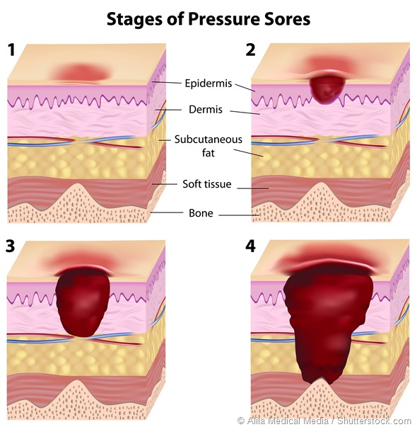
Pressure Ulcers
Risk factors include:
  Lying in the same spot
  Incontinence
  Spinal cord injuries, neurological disorders, etc.
  Poor nutrition and hydration
  Medical conditions affecting blood flow
Notes:
Trainer’s Note: The MDS 4th Quarter Report indicates that while 86.07% of residents are at risk of developing a pressure ulcer, only 7.26% of residents have one or more unhealed pressure ulcer. Many residents have the risk factors to develop a pressure ulcer. You don’t need to go over the graphic. It is just an illustration to show the damage each stage can do to a person.
Pressure ulcers, often referred to as pressure sores, decubitus ulcers, or bed sores, are caused by pressure to areas of the skin when resting in one position for too long, thereby restricting blood flow. According to Mayoclinic.org, “the degree of skin and tissue damage ranges from red, unbroken skin to a deep injury involving muscle and bone.” Pressure ulcers are serious and can lead to infections which may result in death if not properly treated.
Many residents have risk factors to develop a pressure ulcer including:
Immobility
Incontinence
Spinal cord injuries, neurological disorders, etc.
Poor nutrition and hydration
Medical conditions affecting blood flow
Mayo Clinic retrieved from: https://www.mayoclinic.org/diseases-conditions/bed-sores/symptoms-causes/syc-20355893

Slide 68



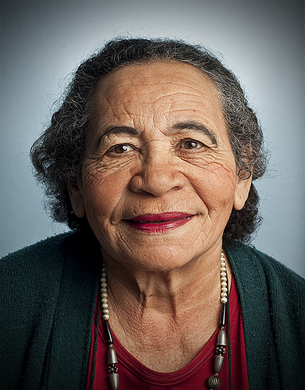

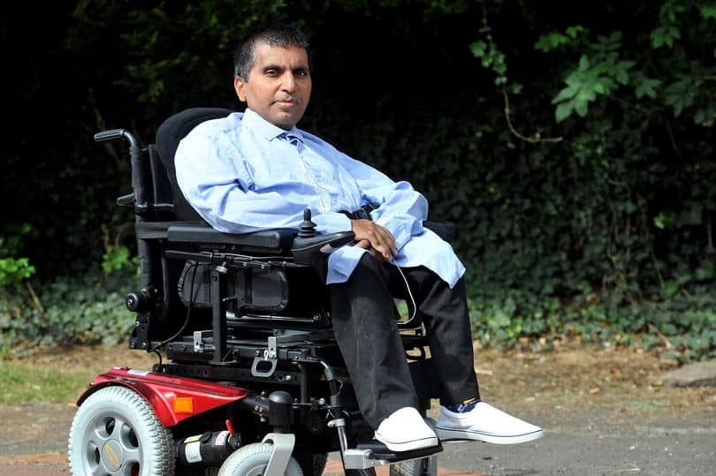
“If you’ve talked to one resident, you’ve talked to one resident.”
This Photo by Unknown Author is licensed under CC BY-NC
Notes:
There’s a saying within the Ombudsman program, “If you’ve talked to one resident, you’ve talked to one resident.” Each resident has their own unique background and experience. The key point to take away from this Module is to approach each resident with dignity, respect, and an open mind. While it is important to understand resident demographics, common health experiences, and reasons why individuals receive long-term care services and supports, remember that the resident comes first. Residents are more than their diagnoses and ensuring they receive resident-centered, quality care is your primary goal as a representative.

Slide 69
Conclusion
Section 5
Notes:
Trainer’s Note: Allow approximately 15 minutes for this section.

Slide 70
Residents need to feel needed. So many times, one sits in the long-term care facility day after day with nothing to do. Life becomes mundane and boring. When asked to help or do something new, whether it be large or small, it is a boon to our spirits. Once again, we begin to feel life is not as bad after all; that we and our opinions are of value to others. What a wonderful feeling that is as it spreads from that resident to others---a whole change taking place with all. -Jan

Slide 71
Module 2 Questions
1. Select the statements that are true about individuals who live in long-term care facilities. Residents
  a. May be of any ethnicity
  b. Are not under the age of 65 years
  c. Are primarily men
  d. Are primarily white
  e. Are primarily over 85 years of age
Notes:
Trainer’s Note: Ask the following questions and make sure the correct answer is discussed.
Answers: The correct answers are: a, d, and e.
The incorrect answers are b some residents are under 65; c most residents are female.

Slide 72
2. Name some reasons people enter long-term care facilities.
3. Name some of the losses that residents may experience when they enter a long-term care facility and how those losses affect residents?
4. Name some of the common diagnoses and other health concerns of residents.
5. Why is it important for representatives to understand resident experiences?
Notes:
2. Name some reasons people enter long-term care facilities.
Answers: A medical event, the progression of Alzheimer’s disease or other dementias, the progression of chronic or terminal diseases, loneliness and isolation, the need for supports and services not accessible within the community.
3. Name some of the losses that residents may experience when they enter a long-term care facility and how those losses affect residents.
Answers: Health, home, family, friends, neighbors, freedom, privacy, personal property, dignity. Effects include - feelings of anxiety, fear, frustration, anger, despair, sadness, hopelessness, humiliation, embarrassment and/or sense of uneasiness, anxiousness, confusion on whereabouts, uncomfortableness, loneliness, loss of control over daily life, being forgotten, feeling isolated, missing loved ones, feeling like a child.
4. Name some of the common diagnoses and other health concerns of residents.
Answers: Hypertension, Alzheimer’s disease or other dementias, depression, heart disease, diabetes, arthritis, bipolar disorder, schizophrenia, anxiety disorder, falls, pressure ulcers, pain, incontinence.
5. Why is it important for representatives to understand resident experiences?
Answers may include: to empathize with the resident’s situation, to clarify any myths or preconceived notions, to be prepared for what representatives may encounter.

Slide 73
Questions?

Slide 74
Additional resources
Refer to your trainee manual for other sources of information related to topics discussed in this module.
Notes:
Trainer’s Note: If you have specific information or resources that you feel trainees need to follow-up on, use this opportunity to direct their attention to those in the trainee manual.

Slide 75
Contact Information
INSERT PRESENTER CONTACT INFORMATION

Slide 76




Connect with us!
ltcombudsman.org
ombudcenter@theconsumervoice.org
The National LTC Ombudsman Resource Center
@LTCombudcenter
This project was supported by the Administration for Community Living (ACL), U.S. Department of Health and Human Services (HHS) as part of a financial assistance award totaling $516,407 with 100 percent funding by ACL/HHS. The contents are those of the author(s) and do not necessarily represent the official views of, nor an endorsement, by ACL/HHS or the U.S. Government.

