Slide 1
INITIAL CERTIFICATION TRAINING CURRICULUM FOR LONG-TERM CARE OMBUDSMAN PROGRAMS
Module 5: Access & Communication
January 2025

Slide 2
Welcome and Introduction
Section 1
Notes:
Trainer’s Note: Allow at least 15 minutes to go over Section 1

Slide 3

Welcome
Your name
Where you are from
One thing you learned from Module 4
What you hope to learn since the last module
Notes:
Begin the session by welcoming the trainees to the training session and thanking them for their continued interest in the program. Make sure everyone introduces themselves – even if they come late.
To begin please share:
Your name
Where you are from
One thing you learned from Module 4 - something that really stuck with you or surprised you
What you hope to learn since the last module
After introductions, thank the trainees for their information and explain any housekeeping items that need to be addressed including the time frame of the training day, breaks, location of restrooms, refreshments, etc. Ask the trainees to speak up if they have any questions throughout the training.

Slide 4

Notes:
Trainer’s Note: If this is the first-time meeting, ask if there are any questions at this point; or, if this is not the first meeting, ask if any questions have come up for them since the last session.
If everyone has gone through Module 4, ask them what they learned about in the previous session.
Responses may include:
• The different types of long-term care settings, including home and community-based services
• The various staffing positions in nursing facilities and residential care communities (RCCs)
• Residents’ rights in long-term care facilities and how the Ombudsman program can help when those rights are violated
• Residents’ rights in residential care communities
• The regulatory process for both nursing facilities and RCCs

Slide 5
Today’s Agenda
Section 1: Welcome and Introduction (15 minutes)
Section 2: Access (45 minutes)
-----------------BREAK------------------------ (5-10 minutes)
Section 3: Confidentiality & Disclosure of Ombudsman Program Information (30 minutes)
-----------------BREAK------------------------ (5-10 minutes)
Section 4: Communication Strategies (45 minutes)
Section 5: Conclusion (15 minutes)
Notes:
Trainer’s Note: Go over the agenda with the trainees and refer them to the table of contents in their manual.
Section 1 – 15 mins
Section 2 – 45 mins
Section 3 – 30 mins
Section 4 – 45 mins
Section 5 – 15 mins
Trainer’s Note: The timeframes for each section are approximate. Allow at least 3 hours for this session.

Slide 6
Module 5 Learning Objectives
Ombudsman program authority to access:
  Long-term care facilities
  Residents
  Records
What to do when access is denied
What information you can and cannot disclose
Communication strategies
Notes:
Trainer’s Note: Go over the Module 5 objectives saying “by the end of this Module you will be able to understand”:
Ombudsman program authority to access
long-term care facilities
residents
records
What to do when access is denied
What information you can and cannot disclose
Communication strategies

Slide 7
Access
Section 2
Notes:
Trainer’s Note: Allow about 45 minutes for this section.

Slide 8
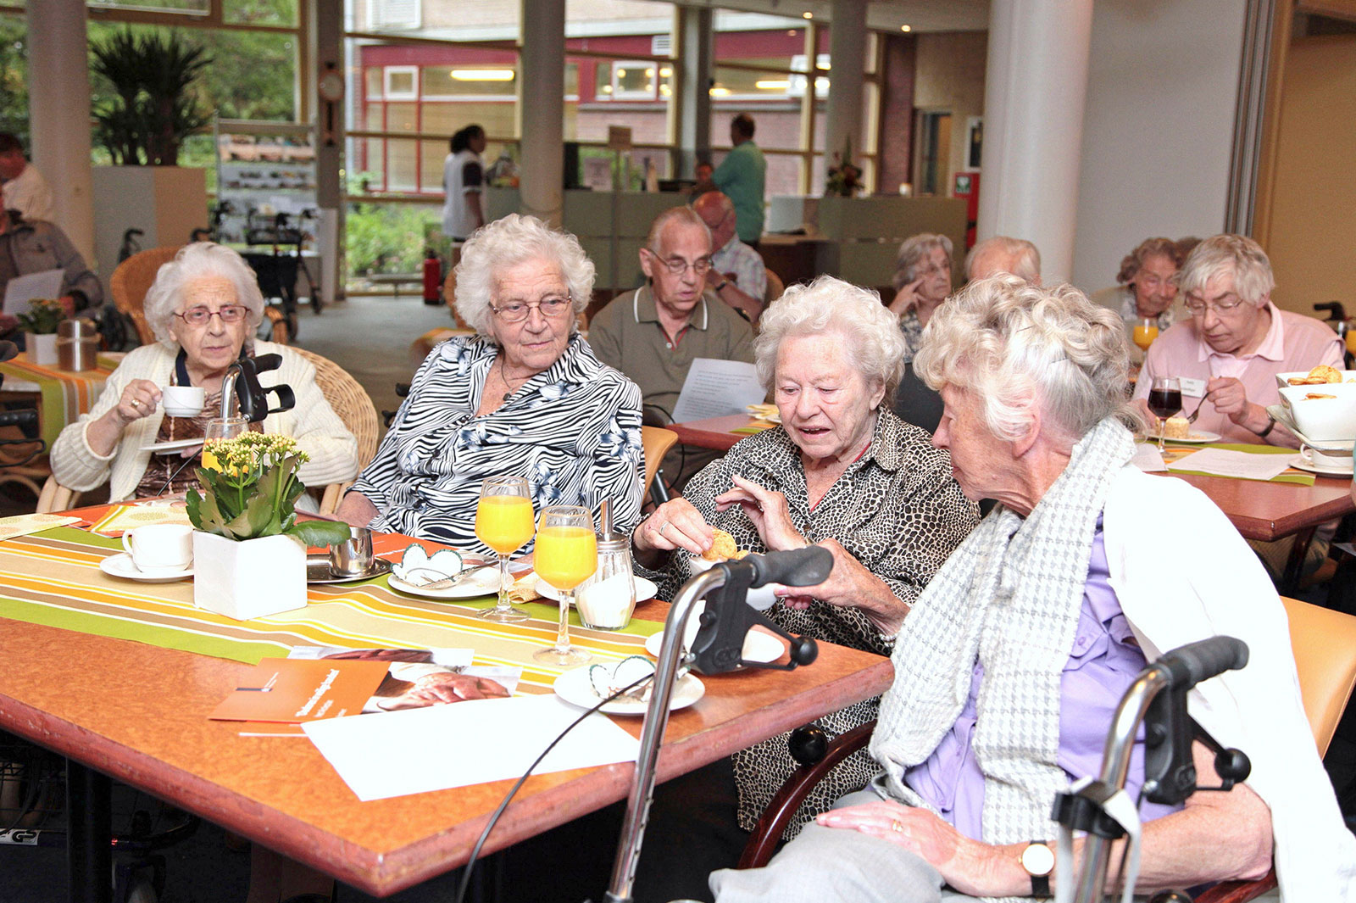
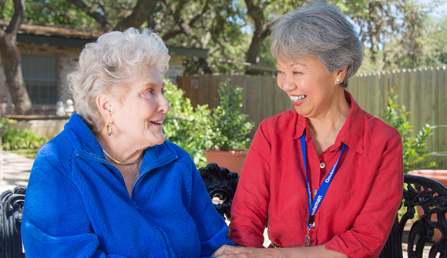
Resident
(Right)
Ombudsman program
(Authority)
ACCESS
Notes:
Trainer’s Note: Clarify that access refers to the resident’s access to the Ombudsman program and the LTCOP’s access to residents, facilities, and records. Residents have the right to access. LTCOP has the authority to access.
In this section, access is described in two different manners. Access applies to both the residents’ rights to contact the Long-Term Care Ombudsman program (LTCOP) and speak in-person with a representative of the Office (representative) during a facility visit, and it applies to the Ombudsman program’s authority to access residents, facilities, and records.
Access is crucial when conducting the functions and duties of the Ombudsman program, such as complaint investigation and resolution, as discussed in Module 1 and determined in the LTCOP Rule. Access allows representatives to hear from residents about their experiences, to provide information and assistance, and to let residents know they have an advocate if or when needed.
Access may be difficult when the facility lacks communication devices such as cell phones, computers, or other electronic devices to assist residents in communicating with the LTCOP, as well as family and friends.

Slide 9
→ State-Specific Regulations for Residents to Access the Ombudsman Program
Notes:
→ Share state-specific regulations regarding residents of nursing facilities and/or residential care communities right to access the Long-Term Care Ombudsman program (LTCOP).
State laws and regulations ensure that residents in nursing facilities and other residential care communities have access to the Ombudsman program.

Slide 10
Nursing Facilities Must
Provide immediate access
Allow the LTCOP to examine resident records
Not prohibit or discourage residents from communicating with the LTCOP
Notes:
Nursing facility residents’ rights to access the LTCOP are addressed in the federal nursing home regulations.
Facilities must:
· Provide immediate access to any resident by a representative of the Office of the State Long-Term Care Ombudsman (the Office)
· Allow representatives of the Office to examine a resident’s medical, social, and administrative records
· Not prohibit or discourage a resident from communicating with a representative of the Office
Trainer’s Note: Denial of access and interference is discussed later in this Module.

Slide 11
Facilities
Residents
Contact information for resident representatives
Records
LTCOP
ACCESS
Notes:
Authority of the Ombudsman Program to Access Long-Term Care Facilities, Residents, and Records
The authority of the Ombudsman program to access long-term care facilities, residents, and records is defined in the Older Americans Act (OAA) and the LTCOP Rule. Federal and/or state laws and regulations also ensure the LTCOP has access to residents in long-term care facilities. The OAA states that access to residents and facilities shall be private and unimpeded, provides conditions when access to records is appropriate, and instructs states to have procedures related to access.
The LTCOP Rule expands upon the OAA and states that representatives of the Office have authority to:
Enter nursing facilities and residential care communities at any time during a facility’s regular business hours or regular visiting hours, and at any other time when access may be required by the circumstances to be investigated
Trainer’s Note: Reinforce that representatives cannot be denied access to the facility or residents outside of visiting hours (just like any other visitor).
Access all residents
Access the name and contact information of the resident representative, if any, where needed to perform the Ombudsman representatives’ functions and duties
Review medical, social, administrative, and other records relating to the resident when specific factors apply
Access long-term care facility administrative records, policies, and documents, to which the residents or the public have access
The State Ombudsman has authority to access, and, upon request, obtain copies of all licensing and certification records maintained by the State with respect to long-term care facilities.

Slide 12

The Health Insurance Portability and Accountability Act
Ombudsman program = health oversight agency
The facility, upon request, may share with the Ombudsman
  Resident’s medical, social, other records
  List of resident names & room numbers
  The name and contact information of resident representatives
Notes:
The Health Insurance Portability and Accountability Act (HIPAA) – sometimes referred to as the Privacy Rule - is a federal law that sets rules and limits on who can look at and receive an individual’s health information. Under HIPAA, the Ombudsman program is considered a “health oversight agency.” As such, nursing facilities and other long-term care facilities may, in response to appropriate Ombudsman program requests, share other information without fear of violating the Privacy Rule. Such information includes, but is not limited to, residents’ medical, social, or other records; a list of resident names and room numbers; and the name and contact information of resident representatives. As noted above, access to records must be consistent with the LTCOP policies and procedures in accordance with the OAA and the LTCOP Rule.

Slide 13

When does the Ombudsman Program Review Resident Records?
Informed consent is obtained
Consent is documented
Access to records is necessary
Notes:
It is not always necessary to review resident records during an investigation. Representatives use other investigatory tools (e.g., interviews and observation) and often find it is not necessary to review records. If you do access resident records, make sure to document the reason (e.g., a care complaint that requires review of the care plan), use your program’s consent form (if applicable) and be prepared to share that information with your supervisor and the Ombudsman.
The Ombudsman program only accesses records when necessary to investigate a complaint. According to the OAA, representatives must have access to resident records if:
The representative of the Office has permission of the resident or the resident representative, or
The resident is unable to communicate consent to the review and has no resident representative, and the representative of the
Office obtains the approval of the Ombudsman; or
Access is necessary to investigate a complaint and: the resident representative refuses permission to consent to the access; a representative of the Office has reasonable cause to believe that the resident representative is not acting in the best interests of the resident; and the representative of the Office obtains the approval of the State Ombudsman.

Slide 14
Informed consent must…
Come from a resident or resident representative AND
Consent is documented…
At the time the consent is given AND
Access to records is necessary to investigate the complaint and the resident is unable to communicate informed consent and…
The resident representative refuses to consent AND
The resident representative is not acting in the best interest of the resident AND
Approval is obtained from the State Ombudsman
Access to records is necessary to investigate the complaint and...
the resident is unable to communicate informed consent and has no resident representative then follow your program's policies and procedures.
Per LTCOP policies (e.g., form or case notes)
Be given in writing, orally, visually, or through auxiliary aids and services.
In the LTCOP resident's case file
Notes:
Trainer’s Note: Access is discussed in more detail during Module 6. Use the information in Figure 1 as an introduction to the topic to explain when/why resident records would be accessed. How to review them is discussed in Module 6. The paragraph below explains the process to obtain informed consent to review a resident’s record.
According to the LTCOP Rule, the resident or resident representative communicates informed consent, and the consent is given in writing, verbally or using auxiliary aids and services (i.e., accommodations that assist with communication) and when verbal or by other means, consent is documented at the time or shortly after consent is given; and access is necessary to investigate a complaint, the resident’s representative refuses to consent to the access, and the LTCOP has reasonable cause to believe the resident representative is not acting in the best interests of the resident, and the representative of the Office obtains approval from the State Ombudsman.
If there is no resident representative and the resident cannot communicate informed consent, follow program policies and procedures for accessing records.

Slide 15
→ Include your program’s policies and procedures on accessing records when a resident is unable to communicate informed consent and has no resident representative.
Notes:
→ Include state-specific policies and procedures on access to review residents’ medical, social, administrative, and other records, including the requirements and steps to obtain consent to access resident records, and when a resident is unable to communicate informed consent and has no resident representative.

Slide 16

If access to resident records is necessary to investigate a complaint and the resident cannot communicate informed consent – What do you do?
  Obtain consent from the resident representative
What if the resident representative says no?
  If the LTCOP believes the resident representative is not acting in the resident’s best interest and you have permission from the State Ombudsman
    You may access the resident’s records
Notes:
Trainer’s Note: Click to pull up each bullet point as you read the statement below.
If access is necessary to investigate a complaint and the resident cannot communicate informed consent - what do you do?
Obtain consent from the resident representative
What if the resident representative says no?
If the LTCOP has reasonable cause to believe the resident’s representative is not acting in the best interests of the resident, and the representative of the Office obtains approval from the Ombudsman – then you may access the resident’s records.
If there is no resident representative and the resident cannot communicate informed consent, seek approval from the Ombudsman before attempting to access records and follow program policies and procedures for doing so.
In summary, you must have informed consent from the resident, or the resident representative when the resident is unable to communicate informed consent, or the approval from the State Ombudsman to access residents’ records. If there is no resident representative and the resident cannot communicate informed consent, the program may access the records in accordance with the program policies and procedures. In all circumstances, follow your state program’s policies and procedures.

Slide 17

Consent not required to view:
Activity calendar
Current state survey/inspection results
Facility admission contract
Facility policies, especially those related to residents’ rights
Menus
Number of staff per shift
Lists of resident names and room numbers
Notes:
Consent is not required to view: (Go over information on the slide.)
Lists of resident names and room numbers are confidential documents that the LTCOP has authority to access. Because they contain resident-identifying information they cannot be shared outside of the Ombudsman program. Follow program policies and procedures for keeping resident information confidential.

Slide 18
→ State-Specific Policies and Procedures to Access
Notes:
State Ombudsman Program Policies and Procedures to Access
As per the LTCOP Rule, State Ombudsmen are required to develop policies and procedures that include timeframes for access to facilities, residents, and appropriate records.
Trainer’s Note:
→ Include state-specific policies and procedures regarding access to the facility after regular visiting hours and any other time when access may be required by the circumstances to be investigated.
→ Include state-specific policies and procedures regarding access to residents.
→ Include state-specific policies and procedures about access to facility records, including administrative records, policies, and documents, to which the residents and public have access.

Slide 19

Is the Ombudsman Program Entitled to all Facility Information?
Incident reports
Personnel information on facility staff
Non-public financial information
Notes:
During an Ombudsman program investigation, the representative seeks information from various sources. However, the LTCOP does not (Click to show the word “No” when you say the word “not”) have access to all records and documentation maintained by the facility. Information the facility does not have to share with the LTCOP includes but is not limited to: (Click to go over each bullet points.)
Trainer’s Note: Share program examples of when the LTCOP requested information that the facility is not required to provide. An incident report is a document that records details when an unexpected event occurs, such as an accident, injury to a resident or staff, or potential abuse.

Slide 20

Interference with the Ombudsman Program
Notes:
There are several ways in which facility staff may attempt to restrict the Ombudsman program’s access to residents and residents’ records. Some actions are subtle, and some actions are more obvious.
Staff might:
• Come in and out of the room during a visit
• Linger outside of the room during a visit
• Frequently suggest walking around the facility with you and/or ask who you are visiting
• Tell residents not to share information with you
• Purposefully schedule conflicts to prevent a resident from visiting with you
• Agree to give you the requested records or information, but never do
• Give you only part of the requested records
During your visit, if you notice a facility staff member following you around. What would you say to the staff member?
Responses may include:
Ask if the staff member has a question or concern.
Explain the authority of the LTCOP to unimpeded access to residents.
Politely ask them not to follow you on your visits.
If the staff member protests, don’t argue. Talk to the person in charge. After the visit, inform your supervisor of the occurrence.

Slide 21
→ State-Specific Policies and Procedures: Access Interference
Notes:
→ Include state-specific policies and procedures on what to do when access is impeded or denied.
→ Add state laws, regulations, or policies pertaining to willful interference and any other penalty information.

Slide 22

Not reasonable
A family member denies access
Staff denies visits because the guardian said so
The provider does not answer the door or phone
Staff says residents get “worked up” over learning their rights
Reasonable
Infectious disease outbreak
Resident is receiving personal care
Resident is out of the building
Resident is in therapy
Why?
Notes:
When access to the facility or to a resident is denied, at the time of denial, ask the person for the reasoning behind the decision. There may be a reasonable cause for the denial.
Trainer’s Note: Click to bring up the text box.
For example, during an infectious disease outbreak, the LTCOP may be asked to temporarily refrain from visiting the building. When such situations arise, follow your program’s policies and procedures.
If you are denied a visit with a resident because the resident is receiving care, or the resident is bathing, these are reasonable explanations. Plan to come back at a more convenient time for the resident. Be respectful of the resident’s schedule and privacy and do not interfere with resident activities or care.
Trainer’s Note: Click again to bring up the 2nd text box.
There are times, however, when access to a facility or a resident is denied, and the restriction is not reasonable and is a violation of residents’ rights and the Ombudsman program authority.
Examples include but are not limited to:
A family member denies access to a resident who wants to visit with a representative
Staff denies access at the direction of the resident’s guardian, or staff believe that because the resident has a guardian, that access is limited
The provider does not answer the door or the phone
Staff denies access to the building saying the residents get “too worked up” when the representative visits and explains residents’ rights

Slide 23

Role Play
Notes:
Trainer’s Note: Refer to the Trainer Guide for more instructions. Conduct as a role play considering the questions below:
Provide multiple opportunities or different groups of two to demonstrate the situation. OR
Conduct as a large group discussion.
Please use your own examples and share the outcomes of the denial of access with the trainee.

Slide 24
What would you say to the staff person on the phone?
Who else might you talk to at the facility?
At what point do you visit the facility?
It’s Brian. I’m being evicted in three days! Please call me back on the nursing home phone before coming to see me!
Notes:
Trainer’s Note: Conduct as a role-play, considering the questions below – provide multiple opportunities or different groups of 2 to demonstrate the situation. Or conduct as a large group discussion.
Please use your own examples and share the outcomes of the denial of access with the trainees.
The Ombudsman program receives a phone message from a resident named Brian saying he is being evicted in three days. Brian asks that someone call him back on the facility phone before coming to see him. When the representative tries to contact Brian, the staff refuse to take the phone to him. (Click to add the “Access Denied” sign.)
(Click again to add the questions to the slide.)
What would you say to the staff person on the phone?
Who else might you speak to at the facility?
At what point do you visit the facility?
Trainer’s Note: Responses may include:
Why isn’t the resident able to come to the phone? Is there a problem? Please transfer me to your supervisor.
The charge nurse, Director of Nursing (DON), or the Administrator, perhaps the Social Services Director.
Speak with your supervisor about the facility’s actions, develop a plan of action, then visit the facility. Once at the facility, visit the resident when no staff are around, talk to the resident about the failed attempts to call and if there is an alternate way to communicate in the future.

Slide 25
How would you respond?
Who else might you speak to at the facility?
How do you respond to residents?
At what point do you leave?
What do you do next?
Please leave. You’re riling up the residents by explaining their rights!
Notes:
Sonya, the Social Services Director, asks the representative to leave the facility because they are “riling up residents” by explaining their rights.
(Click to add the “Access Denied” sign.)
(Click again to add the questions to the slide.)
How would you respond to Sonya?
Who else might you speak to at the facility?
How do you respond to residents?
At what point do you leave?
What do you do next?
Trainer’s Note: Make sure you tell the trainees to follow the policies and procedures when access to residents is being denied. Responses may include:
Maintain a calm and professional demeanor. Do not argue. Inform Sonya about residents’ rights and the authority of the Ombudsman program to access residents. Give her a program brochure that includes information about residents’ rights and the LTCOP. Offer to send additional information on residents’ rights and the Ombudsman program. Let her know if she still has concerns, you could go with her to talk with the Administrator.
The Administrator. May consider calling your supervisor or State Ombudsman for direction.
Explain to the residents that there is some confusion, and you will work it out with the facility. Reassure residents and let them know that you will be back or will stay to address their questions and concerns.
Leave if/when feeling threatened, if your presence is having a negative effect on residents, or when told to leave by your supervisor.
Immediately notify your supervisor, document the occurrence, and follow all requirements in the program’s policies and procedures for when access is denied.

Slide 26
Confidentiality & Disclosure of Ombudsman Program Information
Section 3
Notes:
Trainer’s Note: Allow at least 30 minutes for Section 3. Documentation is discussed in detail during Module 9.

Slide 27

Confidentiality
Don’t identify residents or complainants without their consent.
Don’t disclose any information about a resident or a complainant.
Do explain your program’s confidentiality& disclosure requirements.
Notes:
Access allows you to gather information through observations, interviews, and record reviews. It is important to have a system to document your initial findings. Most representatives take notes during their visit or phone calls via pen and paper or an electronic device. Others take notes immediately after. The notes taken will be entered into an electronic-based system managed by the Office. Requirements for documentation are discussed in more detail during Module 10.
The OAA and the LTCOP Rule have strict parameters for protecting the confidentiality of the identity of residents and complainants, resident records, program records, and other information.
As a representative, you must maintain confidentiality: (Go over the bullet points on the slide.)
All records and information obtained by the LTCOP during conversations with residents and complainants must be held in confidence. It is important to explain to residents and complainants that the information they share with the program is confidential, meaning the information will not be shared (disclosed) with anyone outside of the Ombudsman program without their permission. In addition to federal requirements, always follow the program policies and procedures for confidentiality and disclosure of program information.

Slide 28
→ State-Specific Policies and Procedures: Confidentiality
Notes:
→ Include state-specific policies and procedures related to confidentiality.

Slide 29
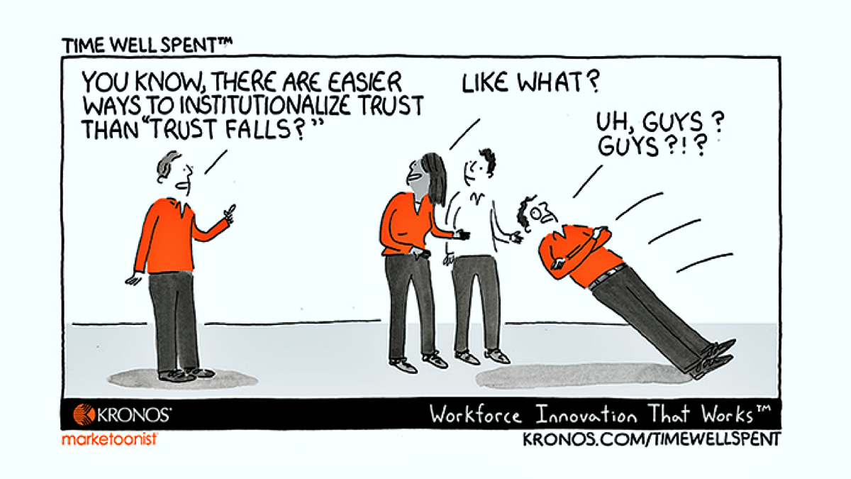
Why is Confidentiality Important?
Level of comfort
Encourages individuals to be open
Builds a trusting relationship
Assures services are resident-directed
This Photo by Unknown Author is licensed under CC BY-NC-ND
Notes:
Confidential conversations with the LTCOP allow residents and complainants a level of comfort when discussing concerns. When the resident and complainant understand that the information cannot be shared with anyone without their approval, it encourages them to be open about details of their complaints. Maintaining confidentiality is the best way for the Ombudsman program to earn and keep the trust of residents and ensure that actions are resident-directed.

Slide 30

When the Complainant is Not the Resident
Cannot disclose the identity of the complainant without their permission
Must have the resident’s permission to report back to the complainant
Required to honor both the resident’s and the complainant’s confidentiality
Notes:
When a complainant is not the resident, the Ombudsman program: (Go over the information on the slide.)

Slide 31
Do
Resident = Client
Reveal information without permission
Follow the direction of the resident
Don’t
Maintain confidentiality
Tell staff who you are visiting
Allow staff to follow you
Notes:
Confidentiality applies to all records and communications such as: verbal, non-verbal (includes sign language), observations, and written (e.g., letters, emails, texts, etc.).
Do
Respect the resident as the “client” and take direction from them regardless of who files the complaint.
Follow the direction of the resident representative when the resident cannot communicate informed consent and is acting in the resident’s best interest or if the resident gives you permission to follow the direction of their representative.
Keep the identity of the complainant confidential.
Keep the identity of the resident confidential.
Don’t
Reveal information to anyone without permission from the resident.
Tell facility staff who you are visiting.
Read a resident’s chart that is offered to you by a facility staff member without the resident’s consent or attempt to access a resident’s chart without the consent of the resident or the resident representative.
Reveal the identity of the complainant without permission.
Show program records to anyone outside of the LTCOP.
Allow staff to follow you on your visits.

Slide 32
Disclosure Rules
When Information can be Disclosed
Files, records, and information maintained by the LTCOP
Identifying information of any resident or complainant with respect to whom the LTCOP maintains files, records, or information
As determined by the State Ombudsman
Permission from the resident
Permission from the complainant
A court order
Notes:
Disclosure of information simply means the releasing of information either verbally or in writing. Details of when and why to disclose resident or complainant identifying information will be explored further in the complaint-handling Modules. Quite often some kind of disclosure of resident information is required to resolve a complaint.
Regardless of where the Ombudsman program is located, all files, records, and information maintained by representatives of the Office pertaining to program activities and complaints are the property of the Office of the State Long-Term Care Ombudsman. Such information is not the property of the individual representatives nor the local Ombudsman entity (LOE).
Disclosure of such information, including identifying information about a resident or a complainant may only occur under the following circumstances and as determined by the State Ombudsman in their program’s policies and procedures:
Permission from the resident (or a resident’s representative when applicable)
Permission from the complainant
An order from the court
Otherwise, disclosure of files, records, and information maintained by the LTCOP pertaining to program activities and complaints is prohibited.
Trainer’s Note: A directive issued by a court, or a judge requiring a person to do or not do something. Instruct trainees to contact the State Ombudsman and follow program policies and procedures if they receive a court order and explain relevant policies and procedures.
When might the Ombudsman program disclose resident or complainant identifying information, and for what purpose?
Some common reasons for disclosure include:
To resolve a complaint with facility staff
To refer a complaint to an outside agency
To discuss resident concerns with their representative or other family or friends
Disclosure will be further reviewed in Module 10 during the complaint processing sections.

Slide 33
→ State-Specific Policies and Procedures: Disclosure
Notes:
Trainer’s Note: Clarify your program’s policies and procedures on disclosure and let the trainees know when and how they are required to notify the Office when they receive a request to disclose information or records.
→ Include state-specific policies and procedures on disclosure of resident information and program records, including required steps to disclose the information and records.
→ Include state-specific policies and procedures for when a resident is unable to communicate informed consent to disclose information and the representative believes that an action, inaction, or decision may adversely affect the health, safety, welfare, or rights of the resident. Include steps when the resident has a representative, when the representative is not acting in the best interest of the resident, and when the resident does not have a resident representative.

Slide 34

What Would You Do?
A local law enforcement officer calls the Ombudsman program and asks if the representative knows anything about a resident named Daniel Johnson. Kari, the representative, knows Daniel well. They have had conversations about his family’s management of his money, but he has not asked Kari to act on his concerns. Relieved the police are investigating, Kari tells the Officer about her concerns and offers to send her case notes to him.
Lisa goes to Mrs. Jones’s room to follow up on a complaint, but she is not there. Lisa asks the social worker where to find Mrs. Jones because her daughter called the Office with a concern.
Notes:
Lisa, a representative of the Office, goes to Mrs. Jones’s room to follow up on a complaint, but she is not there. Lisa then asks the social worker where to find Mrs. Jones because her daughter called the Office with a concern.
Ask the trainees the following 2 questions:
Did Lisa breach confidentiality?
If so, how should Lisa have handled the situation?
Trainer’s Note: Yes, Lisa breached confidentiality. Lisa should visit with other residents, then go back to Mrs. Jones’s room. If she still isn’t there, casually ask her roommate if she knows the whereabouts of Mrs. Jones. Do not tell staff or anyone that you are responding to a complaint. You may have to go back to the facility at another time. Follow up with the resident’s daughter to see if there is a better time to attempt a visit.
Click to remove the first situation and to bring up the second situation.
2. A local law enforcement officer calls the Ombudsman program and asks if the representative knows anything about a resident named Daniel Johnson. Kari, the representative, knows Daniel well. They have had conversations about his family’s management of his money, but he has not asked Kari to take action. Relieved the police are investigating, Kari tells the Officer about her concerns and offers to send her case notes to him.
Ask the trainees the following questions:
Does Kari follow program requirements for disclosure of information?
If not, what should she have done?
Trainer’s Note: No, Kari did not follow the requirements. She did not have permission to disclose information from the resident or from the State Ombudsman. Instead, Kari could have asked the officer for his contact information and told him she could not indicate whether she was aware of Daniel Johnson or the concerns surrounding the information shared by the officer. Kari could then say that someone from the program will follow-up with him after they speak with the resident. Then Kari would contact the resident and follow program policies and procedures regarding consent and disclosure of information.

Slide 35
What Would You Do?
Jane is a representative of the Office. A law firm serves her with a subpoena at her home. The subpoena asks for the dates of visits to “Caring Touch” personal care home, the names of the residents and staff that she spoke to and for her impressions of the home.
Notes:
Jane is a representative of the Office. A law firm serves her with a subpoena at her home. The subpoena asks for the dates of visits to “Caring Touch” personal care home, the names of the residents and staff that she spoke to and for her impressions of the home. What would you do?
Trainer’s Note: For Ombudsman program purposes, a subpoena issued by someone other than a judge, such as a court clerk or an attorney in a case, is different from a court order.
You should contact your supervisor and give them the subpoena. Do not share or acknowledge that you visited “Caring Touch.” Your supervisor should review all activity and alert the State Ombudsman for follow-up.

Slide 36
Questions?
Notes:
Ask for any questions so far and then take a break.

Slide 37
Communication Strategies
Section 4
Notes:
Trainer’s Note: Allow for 45 minutes for Section 4.

Slide 38
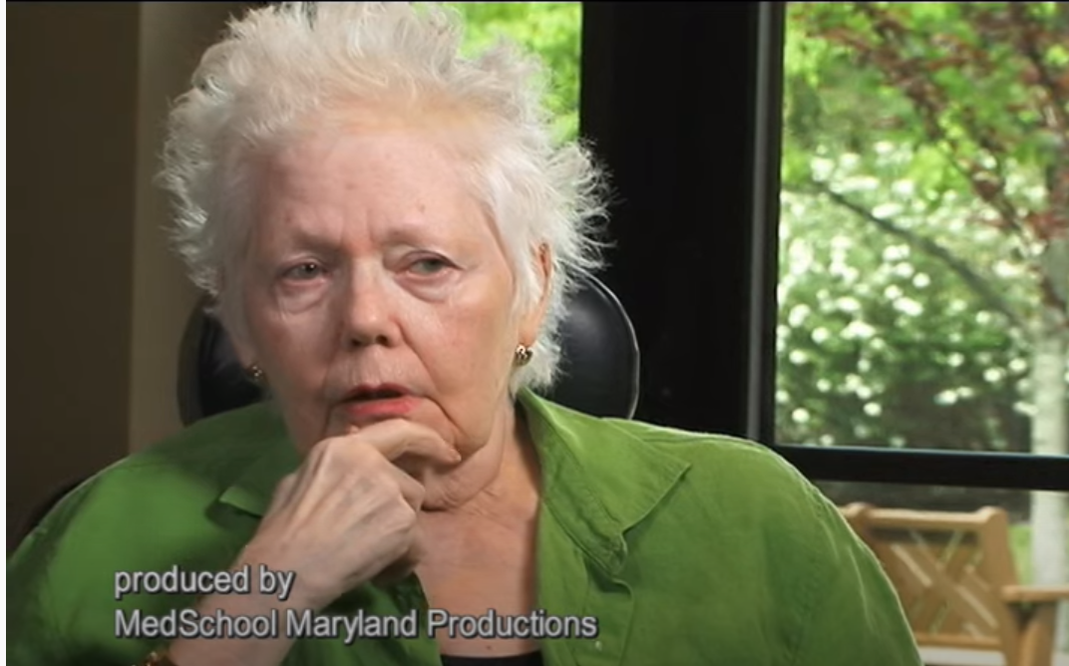
Residents Speak Out: Resident's Rights
Notes:
Communication is the act of exchanging ideas, knowledge, information, and sharing personal experiences. Regular and timely access to long-term care facilities and residents is essential for Ombudsman program communication with residents, resident representatives, family members, visitors, and facility staff. The way you speak to and listen to an individual builds trust and meaningful connection, which is an important part of complaint intake and investigation, specifically discussed in Module 6.
Trainer’s Note: Show the video Residents Speak Out: Resident's Rights to begin a discussion about communication from the resident’s perspective.
Ask the trainees:
What are your thoughts on the video?
What were some common themes related to communication?
Responses may include: Residents express wanting to be engaged and spoken to as a person, not just a “room number,” and residents indicate wanting someone to pay attention to them and value them. Tell the trainees to keep the video in mind as this section on communication is discussed.
Tell the trainees to keep the video in mind as this section on communication is discussed.

Slide 39

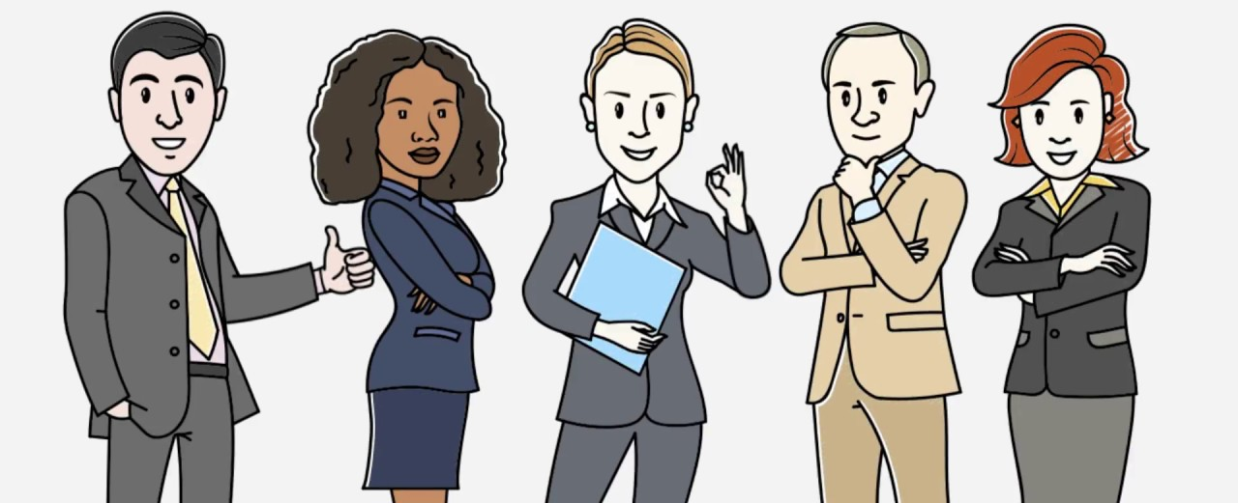

Words or Speech
Body Language
Tone of Voice
Notes:
Effective communication is a two-way process of how information is provided and received. Both verbal and non-verbal communication contributes to how one interprets information. Word choice, tone of voice, and body language all contribute to successful communication.
Trainer’s Note: Ask trainees from a total of 100%, what percentage of communication is through: Words or Speech, Tone of Voice, Body Language. The answers are below.
10% is communication through words or speech
40% is communication through tone of voice
50% is communication through body language.
Actions really do speak louder than words!

Slide 40
Words or Speech
Suggested Responses
The resident - your mother- is our client and we’re going to do the best we can for her.
Responses to Avoid
I work for the resident, not the family.
I am a resident advocate. I am here for your mother and what she needs, and hopefully we can all work together on this.
I can’t tell you anything about my visit with the resident.
Notes:
The words you choose and how you say them set the stage for building relationships. It is common for family members to contact you because someone has told them, “The Ombudsman program can help.” Most have no idea about LTCOP responsibilities and what representatives can and cannot do, so it is critical to provide them with a clear understanding of your role right from the very beginning. Family members may expect you to share all information gathered and may request your follow-up on their concerns. Take particular care to explain that the resident is your client, not them.
Trainer’s Note: Go over the responses on the slide.
Another common situation you may encounter is when the complainant tells you the resident has dementia so there is no point in speaking with them.
Here are some responses you can use:
Trainer’s Note: Meeting face to face or in-person visits may not be possible in all circumstances. Communication with the resident may take different forms. If this is the case in your area, please indicate as such.
“Please understand that I am required to meet with the resident face to face.”
“I will go and see the resident and talk with them about this. Then, we can see where we’ll go from there.”
“I understand what you are saying, but my obligation is to go and speak with the resident first. It’s important that I see for myself.”
As opposed to saying:
“Regardless of what you say, I have to talk to the resident.”
“Thanks for the information, but I need to find out for myself.”

Slide 41
I didn’t say that.
Notes:
Your tone of voice impacts how a message is heard. Emphasizing a specific word in a sentence can result in different interpretations of the intent of your message.
Trainer’s Note: Ask trainees to volunteer to read the sentence and emphasize one word in the sentence. Make sure all words in the sentence have been individually emphasized. Ask the trainees the intent of the varying messages. The trainer should then very loudly and angrily read the sentence. Ask the trainees the intent of the sentence now.

Slide 42

Do I Look Like I’m Listening?
This Photo by Unknown Author is licensed under CC BY
Position yourself at the resident’s eye level
Lean forward when listening
Face the person
Nod your head
Act natural
Use positive facial expressions
Wait for pauses
Listen without interrupting
Notes:
Body language speaks volumes. Be aware of the impact your non-verbal cues have on those with whom you are speaking. There are many ways to effectively communicate without using words, such as:
Positioning yourself at the resident’s eye level
Leaning forward when listening
Facing the person
Nodding your head
Relaxing and acting natural
Using positive facial expressions (e.g., smiling as opposed to frowning)
Waiting through pauses
Listening without interrupting

Slide 43

Body Language
Try not to:
Cross your arms in front of your body
Check your phone or divide your attention
Tap your foot or drum your fingers
Use negative facial expressions
Notes:
Trainer’s Notes: (Go over slide.) Ask the trainees for examples of how they show others they are interested in what is being said and are listening to the individual.
The examples can be verbal or nonverbal such as:
Making sure I’m eye level with the person
Tilting my head
Looking directly at the person and not looking around as they are talking
“What you are saying is important to me”
“I’d like to hear more about…”

Slide 44
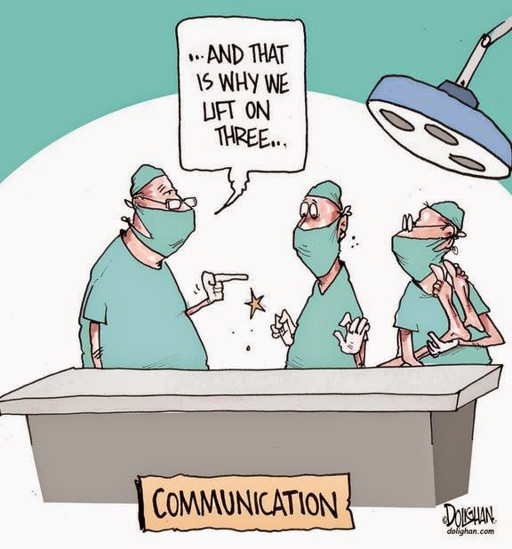
Conveying Your Message
This Photo by Unknown Author is licensed under CC BY
Notes:
Effective communication is more than just relaying your ideas, knowledge, and experience. There are other factors involved that influence how information is received and understood. In addition, you may use different communication approaches depending on the individual receiving the message (e.g., a resident, family member, staff person, etc.).
Whether you are communicating verbally, in writing, or using another means, there are several elements to consider when communicating your message.
To avoid confusion and misunderstandings, don’t:
Use technical terms, acronyms, vague words, and slang
Relay conflicting messages
Use a language that is not understood by the recipient
Include too much information
To maximize the chance for successful communication, consider the following:
Is your message clear? Use simple and easy-to-understand language.
Is your message factually correct? Ensure information is not vague, subject to interpretation, or false.
Is your message complete? Include all relevant information, particularly if it is the basis for decision-making.
Is your message precise? Provide straightforward and concise information to avoid incorrect interpretations of the message.
Are you professional and respectful in your message? Deliver the message in a manner that is considerate of the person and sensitive to the topic at hand.
How do you ensure your message is received? Consider with whom you are communicating. What is their role, knowledge of the subject, ability to understand, what mode of communication works best, and what language does the receiver understand?

Slide 45

Words Matter
This Photo by Unknown Author is licensed under CC BY-SA-NC
Rose
Notes:
Trainer’s Note: Tell the trainees to close their manuals then read the example to them. Ask if the following scenario considers all elements just discussed when talking to Jane.
Ask if the following scenario considers all elements just discussed when talking to Rose. (Read the following.)
Rose recently came to the facility with chronic pain and some minor memory loss. Rose tells you she has been in terrible pain and doesn’t know if she gets her pain medication like she did when she was in the hospital. Rose gives you permission to review her chart and speak with anyone in the facility who could help.
You go back to Rose and say:
“I checked your care plan and talked to the care plan coordinator who told me that you should be getting your pain meds every four hours. However, when looking at the med chart, I saw that the pain meds are being distributed PRN. The federal requirements indicate you have a right to be included in the care planning process and in your health decisions. Do you want your medication PRN or every four hours? And who do you want me to talk to about it?”
Ask: Were the elements of effective communication used when talking to Rose?
The answer is no. The information provided does not take into consideration Rose’s ability to understand acronyms and terms used in long-term care. The message delivered was accurate, but not concise and not delivered in a manner to allow Rose to make a good decision. PRN means “as needed.”
Ask: How would you deliver this message? Allow time for trainees to give examples.
Make sure the following response is discussed: “I checked on your concern about your pain medication and found out you are supposed to get your pain medication every four hours. The facility had the wrong information and thought you were only supposed to get your pain medication when you asked for it. I talked to the nurse, Michael, and straightened it all out. He said he will come by within the hour to talk to you and set up a schedule. I’ll follow up with Michael and will stop by again in a few days to see how you are doing.”

Slide 46
Do I Sound Like I’m Listening?
I’m happy to listen
I see
Demonstrate Interest
Use minimal responses
Encourage additional information
Active Listening
Paraphrasing
Asking open-ended questions
Oh
Sounds like…
How? Why? Tell me about..
Notes:
There are techniques to use when verbally communicating with someone to indicate you are listening. Those methods include demonstrating interest, active listening, affirmation, and validation.
Trainer’s Note: When talking to residents, be careful not to nod or shake your head when asking a question. This can lead the resident into giving a response meant to please you instead of giving a response that reflects their true thoughts or wishes.
Demonstrate Interest
Use minimal responses such as, “oh,” “so,” and “I see.”
Encourage additional information such as, “Is there more you would like to share…” and, “I’m happy to listen…”
Active Listening
Paraphrase what is heard. For example, the resident says that he keeps telling the Certified Nursing Assistant (CNA) not to put his clothes on the floor; she just doesn’t listen. You paraphrase by saying, “Sounds like you are not feeling heard by the CNA regarding your clothing.”
Ask open-ended questions for more details instead of closed-ended questions. Open-ended questions are questions that cannot be answered with just a “yes” or “no” response. To allow for more detailed responses, open-ended questions often start with “how,” “tell me about…,” and “why.” Closed-ended questions lead to answers of just, “Yes,” “No,” or a brief piece of specific information.
Trainer’s Note: This topic goes onto the next slide.

Slide 47
Affirmation
Validation
There is nothing wrong with being angry right now about…
I hear you saying…
It sounds like…
It appears as though…
It’s okay to feel sad…
Notes:
Trainer’s Note: Click to bring up the first set of speech bubbles and then say: “Restate what is heard in sentence form.”
Click again to bring up the next set of speech bubbles and say, “Acknowledge the resident’s feelings.”
Affirmation
Restate what is heard in sentence form, such as:
“I hear you saying…”
“It sounds like…”
“It appears as though…”
Validation
Acknowledge the resident’s feelings, such as:
“It’s okay to feel sad…”
“There is nothing wrong with being angry right now about…”

Slide 48

Observation: Pay Attention
Facial expressions
Eye contact
Posture
Gestures
Notes:
Look for non-verbal forms of communication such as: (Go over bullet points.)
Ask: Based on your observation, what is going on in the picture? Does the medical person look as though she is paying attention or listening to the individual? What would you do in this situation if you were this individual’s advocate?
Trainer’s Note: Allow the trainees to respond and acknowledge their answers. Let them know that as representatives, not only will they have to make sure they are hearing the resident’s message, but they will also make sure that others are hearing the resident’s message.

Slide 49
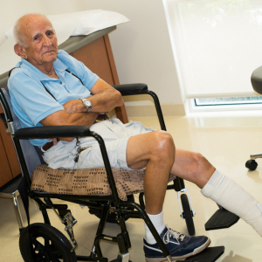
Barry
Treated well?
How’s the food?
Activities?
“Everything is wonderful…"
Notes:
(Read the following.) During a visit with a resident named Barry, you ask him if staff treat him well. Barry tells you that most staff are nice to him. You ask him how the food is, and Barry says it’s okay if you eat it in the dining room. You then ask Barry about the activities, and he replies, “What activities?” and then laughs. A CNA walks into the room and Barry immediately says to you that everything is wonderful and thanks you for stopping by. You continue asking Barry about life in the facility.
Trainer’s Note: Ask if effective communication skills for receiving information were used in the case study about Barry. Tell the trainees to close their manuals for the next part of the activity.
This activity can be conducted as a role-play or a large group discussion. If conducting as a role-play, read the first situation then have trainees role-play how to handle the conversation differently.
Ask: Did the representative listen to Barry?
The answer is no, the representative did not listen to what Barry was saying and did not ask any follow-up questions to clarify his comments. The representative did not pay attention to the change in Barry when the CNA came into the room.
Ask or conduct the role-play: How would you have handled the conversation differently? Allow for trainees to give examples.
Make sure the following revised situation is discussed:
During a visit with a resident named Barry, you ask him if staff treat him well. Barry tells you most staff are nice to him. You ask Barry, “Most staff? Tell me more about the staff who aren’t nice.”
You ask Barry how the food is, and he says, “It’s okay if you eat in the dining room.” You ask Barry, “Where do you prefer to eat? What do you mean, ‘if you eat in the dining room’?”
You ask Barry about the activities, and he replies, “What activities?” and then laughs. You say, “Yes, I noticed there are just a few activities on the calendar. How do you like to spend your time (or, what are your interests)? Are there activities that you would like to see happen in the facility?”
A CNA walks into the room and Barry immediately says to you that everything is wonderful and thanks you for stopping by. Take the cue from Barry and let him know you appreciate talking to him and end the visit. Revisit Barry at another time to address the concerns brought up during your conversation and ask Barry about his response when the CNA entered the room. Make sure there are no staff around when you meet with him the second time.
If they want your assistance, remind them how you will support them and the next steps. If they do not want to pursue the complaint immediately, reassure them that they have your support, and you will follow-up with them. Before leaving any resident that shared concerns, continue the conversation for a few more minutes that way the conversation didn’t end on a negative note potentially adding to their sense of helplessness or stress.

Slide 50

Communication Tips
This Photo by Unknown Author is licensed under CC BY-NC
Notes:
Many of the communication tips below apply to communicating with anyone, particularly residents. However, certain tips are even more helpful when communicating with residents who have a disability or a diagnosis that may affect their ability to provide and receive information. To effectively communicate, consider the best way to communicate with each individual resident.

Slide 51

Individuals Who have Memory Loss
Approach from the front and identify yourself
Speak to the resident and not about the resident
Talk to the resident face-to-face in a quiet space with minimal distractions
Look at the resident and speak slowly and clearly
Notes:
Some residents have a disability or a diagnosis that may impact their ability to provide and receive information. To effectively communicate, consider the best way to communicate with each individual resident.
Memory loss does not always affect one’s ability to communicate. Therefore, it is important not to make assumptions based on a diagnosis related to dementia or memory loss.
• Approach the resident from the front and identify yourself
• Speak to the resident and not about the resident when others are in the room
• Talk to the resident face-to-face in a quiet space with minimal distractions
• Look at the resident and speak slowly and clearly
Trainer’s Note: The list continues onto the next slide.

Slide 52

Ask one question at a time
Ask yes or no questions
Give the resident ample time to respond to your questions
Consider the feelings behind words or sounds
Be respectful
Notes:
• Ask one question at a time
• Ask yes or no questions
• Give the resident ample time to respond to your questions
• Consider the feelings behind words or sounds
• Be respectful

Slide 53

“Sweetie”
Do you remember me?
“Are you pulling my leg?”
Notes:
There are also specific communication actions to avoid when talking to individuals who have memory loss.
Trainer’s Note: Click to bring up the speech bubble.
• Don’t ask the resident if they remember you
• Don’t argue or try to convince
• Don’t explain reality or try to reason
• Don’t be too physically close to the resident, invading their personal space
Trainer’s Note: Click to bring up the next picture
• Don’t raise your voice, frown, or scold.
Trainer’s Note: Click to bring up the next speech bubbles
• Don’t use confusing language, language that could be misinterpreted as romantic (e.g., sweetie, honey), or idioms (e.g., “it’s raining cats and dogs”, or “are you pulling my leg?”) as residents may take the words in literal form.
• Don’t take it personally if the resident doesn’t remember you, doesn’t want to talk, or uses offensive language.

Slide 54
Individuals Who are Blind or Visually Impaired
Speak to the resident when you approach them.
Identify who you are and introduce anyone else with you.
Be descriptive about what you are doing.
Don’t touch or distract their service animal.
If documents must be read or signed, ask the resident what would be most helpful for them to see better (e.g., increased lighting, magnification, etc.)
Ask in what format they would like to receive information (e.g.; Braille, large print, audio, etc.)
Notes:
Trainer’s Note: Use the PowerPoint slide with small font. Act as though the trainees can see what is on the screen and continue to train the material. If no one mentions they cannot see, ask why they did not mention it. Either way, ask the trainees how the small font affected their ability to pay attention to the trainer.
• Speak to the resident when you approach them
• Identify who you are and introduce anyone else with you
• Be descriptive about what you are doing
• Don’t touch or distract their service animal
• If documents must be read or signed, ask the resident what would be most helpful for them to see better (e.g., increased lighting, magnification, etc.)
• Ask in what format they would like to receive information (e.g.; Braille, large print, audio, etc.)

Slide 55
Individuals Who are Blind or Visually Impaired
Speak to the resident when you approach them
Identify who you are and introduce anyone else with you
Be descriptive about what you are doing
Don’t touch or distract their service animal (if applicable)
If documents must be read or signed, ask the resident what would be most helpful for them to see better (e.g., increased lighting, magnification, etc.)
Ask in what format they would like to receive information (e.g., Braille, large print, audio, etc.)
Notes:
This is what the previous slide said.
Speak to the resident when you approach them
Face and address the resident directly
Identify who you are and introduce anyone else with you
Be descriptive about what you are doing
Speak in a normal volume and natural tone
It is okay to use words such as “blind”, “visually impaired”, “seeing”, “looking” and “watching” when speaking with someone who is visually impaired
Don’t touch or distract their service animal (if applicable)
If documents must be read or signed, ask the resident what would be most helpful for them to see better (e.g., increased lighting, magnification, etc.)
Ask in what format they would like to receive information (e.g., Braille, large print, audio, etc.)
Let the resident know when you enter and leave the area and/or room

Slide 56
Individuals with Speech Impairments
Concentrate on what the resident is saying
Be patient
Don’t speak for the resident
Ask questions which require only short answers or a nod
Ask the resident to repeat what was said
Don’t pretend to understand
Consider writing or another means of communicating
Notes:
Concentrate on what the resident is saying
Be patient. Take as much time as necessary
Don’t speak for the resident or attempt to finish their sentence
Ask questions which require only short answers or a nod. Consider using yes or no questions
If you don’t understand what the resident has said, ask them to repeat themselves, or repeat back what you heard to confirm it is correct
Don’t pretend to understand when you don’t
If you have difficulty understanding the resident, consider writing or another means of communicating, but first ask the resident if this is acceptable

Slide 57
Individuals Who are Deaf or Hard of Hearing
Gain the resident’s attention
Look directly at the resident, face the light, speak clearly, in a normal tone of voice, and keep your hands away from your face
Use short, simple sentences
Avoid eating or chewing gum
Speak directly to the resident, not the interpreter
Notes:
Trainer’s Note: If presenting the training in-person, do not look at the trainees and talk quietly; act distracted and rustle papers while going over the bullets below. Ask the trainees how your actions affected their experience when trying to learn something new.
If presenting the training virtually, take a piece of paper and crumple it up near the microphone (but away from the camera). Ask the trainees how the noise affected their experience when trying to learn something new.
• Gain the resident’s attention before starting a conversation
• Look directly at the individual, face the light, speak clearly, in a normal tone of voice, and keep your hands away from your face
• Use short, simple sentences
• Avoid smoking, eating, or chewing gum
• If the resident uses a sign language interpreter, speak directly to the resident, not the interpreter
Trainer’s Note: The list continues onto the next slide.

Slide 58
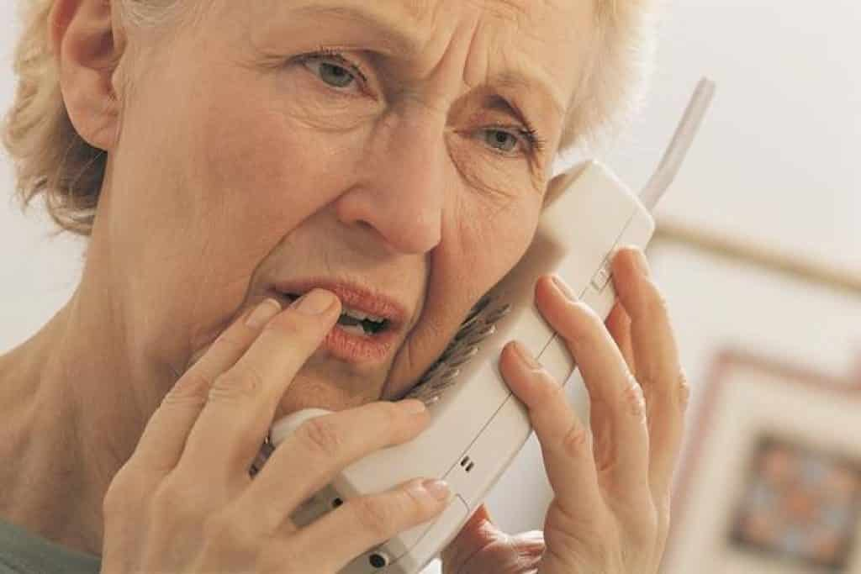
Text Telephone (TTY), dial 711
Is it okay to communicate in writing?
What is your preferred method to communicate?
Notes:
• If you are talking to a resident by phone, speak clearly and be prepared to repeat your questions and comments
• If you do not have access to Text Telephone (TTY), dial 711 to reach the national telecommunications relay service, which facilitates the call between you and an individual who uses a TTY
• If you are having difficulty communicating with the resident – whether in their presence or not - ask the resident if it is acceptable to communicate via written word
• Ask the resident the best way in which they would like to further communicate (texting, email, etc.)

Slide 59

Individuals who Speak Another Language
Have program information available in other languages
When using gestures and nonverbal cues, be sensitive to the resident’s reaction
Use a communication board or a free application on your phone
This Photo by Unknown Author is licensed under CC BY-SA-NC
Notes:
Trainer’s Note: Tell the trainees that on your first visit and periodically, it is preferable to ask facility staff if there are residents who are unable to communicate in English and identify the resources staff use to communicate with such resident(s).
Have program information available in other languages to provide to residents
When using gestures and nonverbal cues to help the person understand, be sensitive to their reaction. Some American mannerisms – such as pointing directly at a person – may be interpreted differently in other cultures
Use a communication board or a free application on your phone

Slide 60
Ask the resident if there is someone they trust to interpreter
Ask the facility how they communicate with the resident
Know your local resources
Use an interpreter
This Photo by Unknown Author is licensed under CC BY-SA-NC
Notes:
Ask the resident if there is someone they trust to interpret
Following your program policies and procedures, ask the facility how they communicate with the resident
Ask if the facility has a handheld translation device, and request to use it
Know your local resources for in-person and telephone language services
If other options are not sufficient, use an interpreter

Slide 61
→ Add State Specific Information on Use of Interpreters and auxiliary aids
When using an interpreter:
  Explain confidentiality
  Explain the need to translate word for word
  Ask them to be neutral
  Direct questions to the resident
  Look at the resident, not the interpreter, when talking
Notes:
Trainer’s Note: Go over the bullet points on the slide and then discuss the use of an interpreter (below).
When using an interpreter:
Explain LTCOP rules of confidentiality
Explain the need to translate word for word (ask them not to put statements into their own words)
Ask them to be neutral
Direct questions to the resident
Look at the resident not the interpreter when talking
Insert state-specific policies and resources related to use of interpreters and auxiliary aids.
Trainer’s Note: Provide resources available in your area and how to access those services. Discuss the pros and cons of having a family member act as an interpreter. One benefit to having a family member could be that they are familiar with the resident’s concerns and wishes. However, a family member might reinterpret words to suit their own perspective, the resident may not want the family member to know about the concern, etc.
Every resident is unique and may have different ways in which they communicate with others. As a representative, the key to successful communication with residents, family members, facility staff, and others is the ability to actively listen, identify the best way to connect with the individual, and clearly convey your message in a way the individual understands.

Slide 62
Conclusion
Section 5
Notes:
Trainer’s Note: Allow at least 15 minutes for the Module 5 questions.

Slide 63
Module 5 Questions
1. What information does the Ombudsman program require be kept confidential (unless given permission by the resident or complainant)?
2. Name something federal law authorizes the Ombudsman program to access.
3. Describe what you would do if you were denied access to a resident.
4. True or False? The representative may show their notes to a nurse if they promise not to share the information with anyone.
False
Notes:
Trainer’s Note: Ask the following questions and make sure the correct answer is discussed. (Click to go to the next question.)
1. What information does the LTCOP require be kept confidential (unless given permission by the resident or complainant)?
Answer: Federal and state laws mandate that the Long-Term Care Ombudsman program keep all identifying information about a resident and a complainant private.
2. Name something federal law requires the nursing facility to give the LTCOP access to.
Answer(s): Residents, facilities, and medical, social, and administrative records.
3. Describe what you would do if you were denied access to a resident.
Answer: Ask why you cannot visit with the resident. Determine if the reason is valid (e.g., resident receiving care) or not valid (e.g., staff say the resident has dementia and cannot hold a conversation). Explain the authority of the Ombudsman program. Describe the rights of residents to meet with a representative. Move up the “chain of command” within the facility. Call your supervisor or the State Ombudsman. Follow program policies and procedures.
4. True or False? The representative may show their notes to the nurse if they promise not to share the information with anyone.
Answer: False. In addition to strict federal requirements regarding disclosure of information, the Ombudsman program has specific policies and procedures about disclosure of files, records, and information maintained by the Ombudsman program.

Slide 64
5. When a representative receives a complaint from a family member which of the following statement(s) are true?
The representative:
Must have the complainant’s permission to be identified, whether it is identified to the resident or a staff member or someone else
Must have the resident’s permission to report back to the complainant
Is required to honor both the resident’s and the complainant’s confidentiality
All are True
Notes:
Trainer’s Note: Click to show the answer.

Slide 65
6. How do you show someone you are listening to them?
7. Name tips to use when talking to an individual with a speech impairment.
Notes:
Trainer’s Note: Click to go to the next question. The answers are not on this slide.
6. How do you show someone you are listening to them?
Answer(s): Nodding your head; using minimal responses such as “oh,” “so,” and, “I see;” paraphrasing what you heard; asking open-ended questions by beginning with words such as: who, what, when, where, why, how; restating what you heard in sentence form:
“I hear you saying…”
“It sounds like…”
“It appears as though…”
7. Name tips to use when talking to an individual with a speech impairment.
Answer(s):
Concentrate on what the resident is saying.
Be patient. Take as much time as necessary.
Don’t speak for the resident or attempt to finish their sentence.
Try and ask questions which require only short answers or a nod. Consider using yes or no questions.
Ask the resident to repeat what was said if you do not understand, then repeat it back; don’t pretend to understand.
If you have difficulty understanding the resident, consider writing or another means of communicating, but first ask the resident if this is acceptable.

Slide 66
Questions?

Slide 67
Additional resources
Refer to your trainee manual for other sources of information related to topics discussed in this module.
Notes:
Trainer’s Note: If you have specific information or resources that you feel trainees need to follow-up on, use this opportunity to direct their attention to those in the trainee manual.

Slide 68
Contact Information
INSERT PRESENTER CONTACT INFORMATION

Slide 69




Connect with us!
ltcombudsman.org
ombudcenter@theconsumervoice.org
The National LTC Ombudsman Resource Center
@LTCombudcenter
This project was supported by the Administration for Community Living (ACL), U.S. Department of Health and Human Services (HHS) as part of a financial assistance award totaling $516,407 with 100 percent funding by ACL/HHS. The contents are those of the author(s) and do not necessarily represent the official views of, nor an endorsement, by ACL/HHS or the U.S. Government.

